Slide 1
AUTOMATION SCENARIOS - ARCHIVING LOGS -> How do I archive all the matching logs and move the achieved files to the backup directory
Darsh asawa
500061595

Slide 2
Log file ..??
Log files are set of records that Linux maintains for the administrators to keep track of important events.
They contain messages(records) about the server, including the kernel, services and applications running on it.
Linux provides a centralized repository of log files that can be located under the /var/log directory.

Slide 3
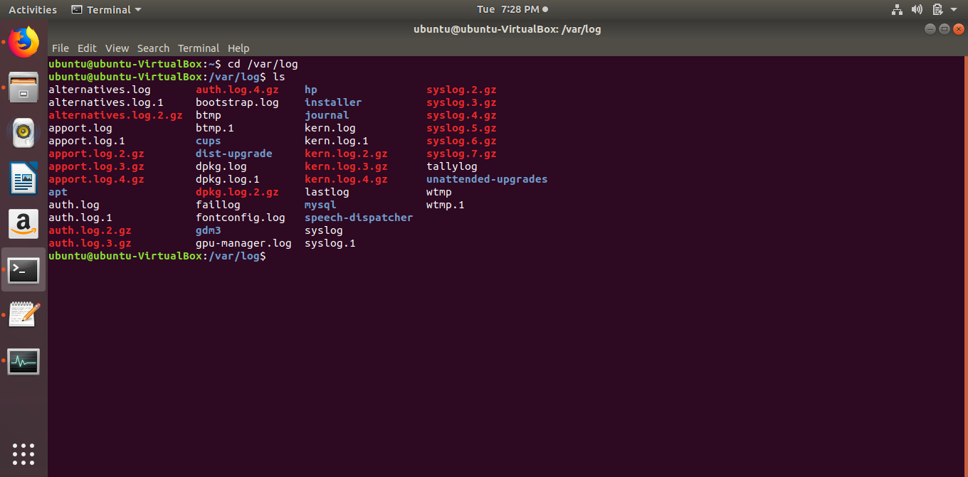
/var/log Directory

Slide 4
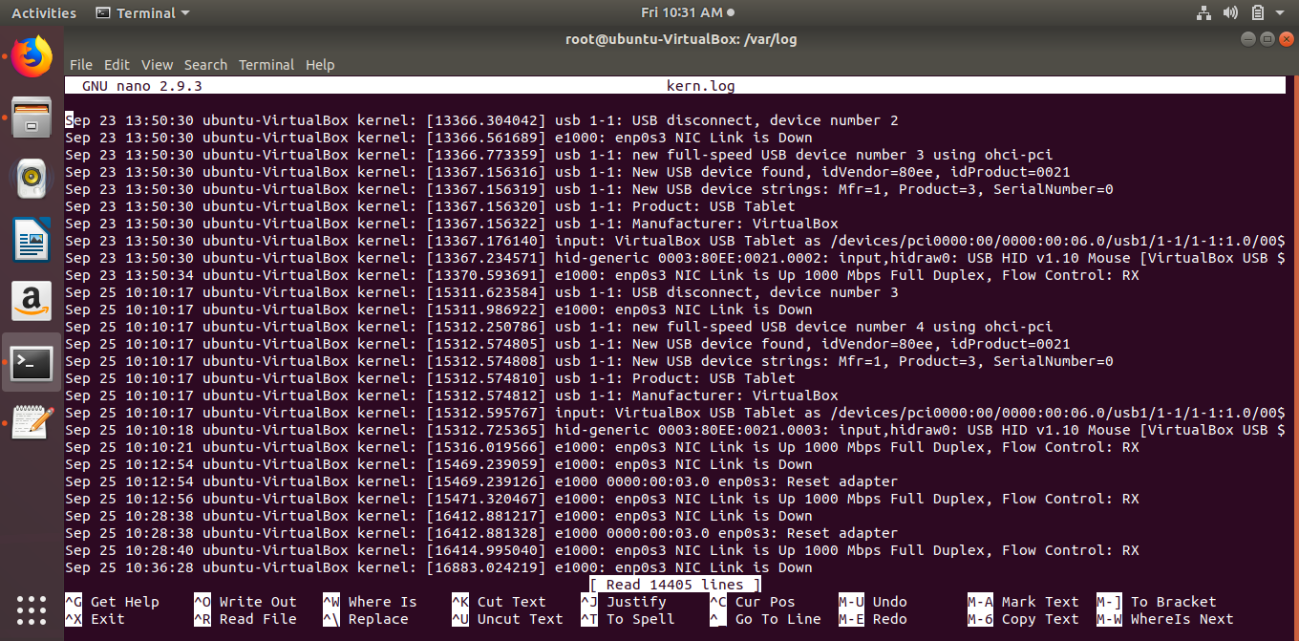
EXAMPLE OF A LOG FILE :

Slide 5
Scenario: Archive all the matching logs and move the archived files to the backup directory.
(PSEUDO CODE): For archiving the log files and backing them up,
Firstly, we should know where the log files actually exist, and the extension of log files.
Location of the backup directory.
In order to make archives, a lot of compression tools like tar,zip,7zip,unzip,etc . These tools helps us compress these big log files to occupy much lesser space.
Once these archives files are made, move them to backup location.
In case , those log files are required, you can retrieve them from these archives.

Slide 6
As we know the log files are present in /var/log directory.
Lets try and make a shell script for the scenario…

Slide 7
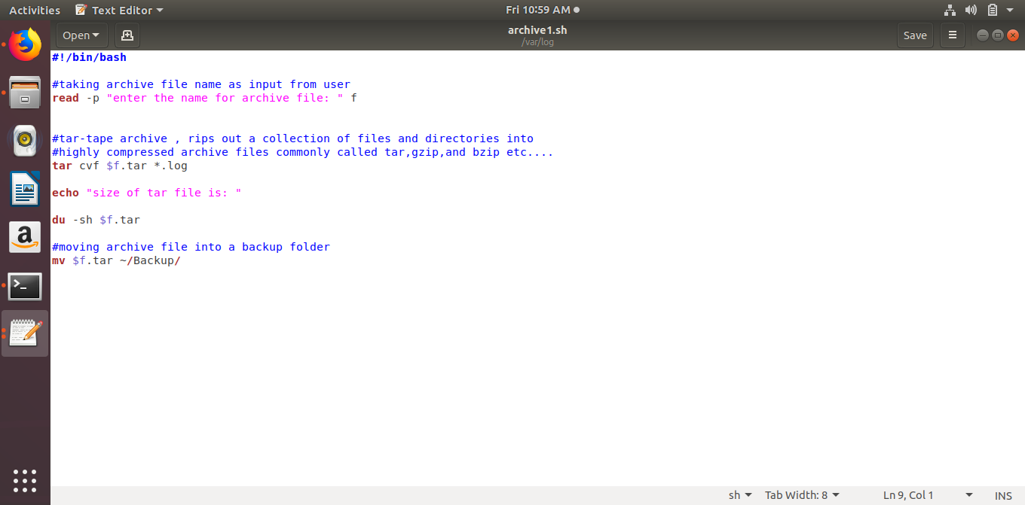
Archive1.sh
du :disk usage

Slide 8
And when you run it :

Slide 9
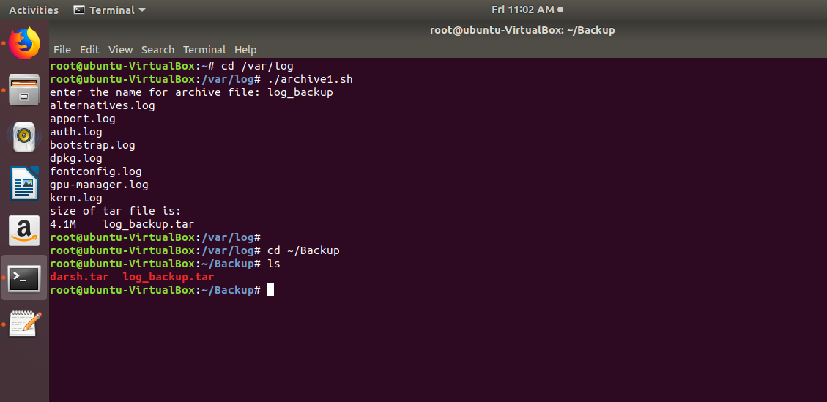

Slide 10
THANK YOU!!

