Slide 1
SCENARIO 6 USER COMMAND VALIDATION
By Vanshika-
059

Slide 2
WHY USER COMMAND VALIDATION IS REQUIRED??
Because not all the people will have the same level of permissions in an organization.
The people in the senior role will have the maximum permissions that a new beginner obviously to avoid any fatal mistake.

Slide 3
Think what would happen if a fresher unkowingly
Deletes all the core files of a production server .
So , We need to monitor and decide whether to allow the user’s command to execute or not

Slide 4
Here we have made a group and add user into it

Slide 5
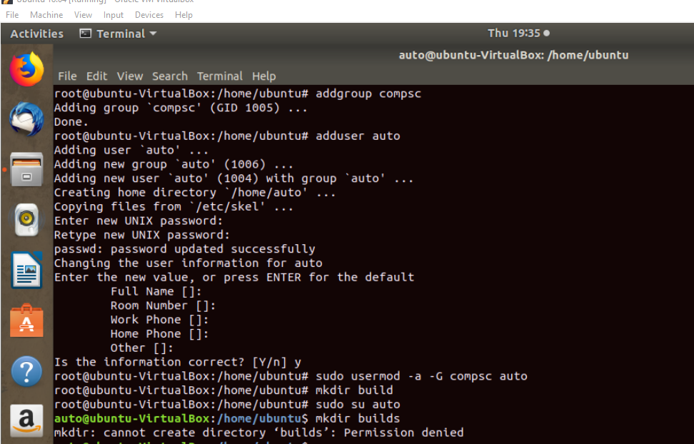

Slide 6
There are certain control attributes that may be set on a file or directory in order to allow data to be appended, to prevent it from being changed or deleted, etc.
There are two commands lsattr and chattr that are used for attribute management.

Slide 7
chattr is the command in the Linux operating system that allows a user to set certain attributes of a file
lsattr is the command that displays the attributes of a file.

Slide 8
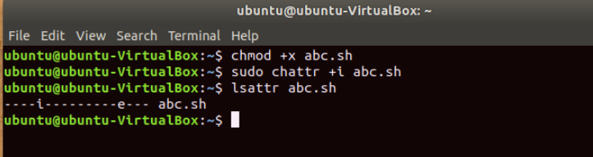

Slide 9
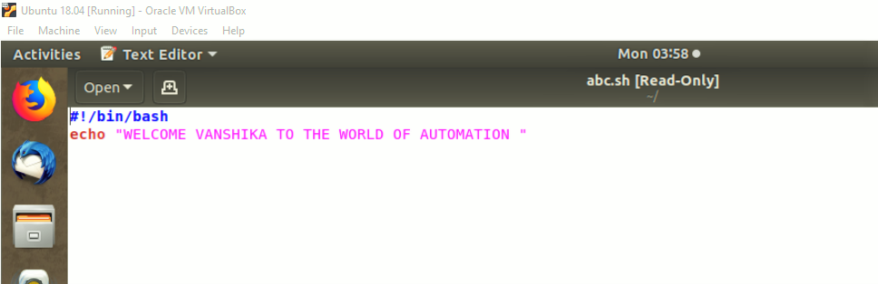

Slide 10
What is Bashrc file??
BASHRC files are executed automatically when a user creates a new shell that is a non-interactive login shell. In other words, BASHRC files run for every Bash command that executes after the terminal has been created. This can be useful for initializing the same settings for embedded shell scripts. BASHRC files differ from .BASH_PROFILE files, which execute for interactive login shells (when a user enters login credentials or opens a new terminal).
NOTE: BASHRC files are hidden and do not contain a filename prefix. They always have the filename .bashrc and are located in the user's home directory.

Slide 11
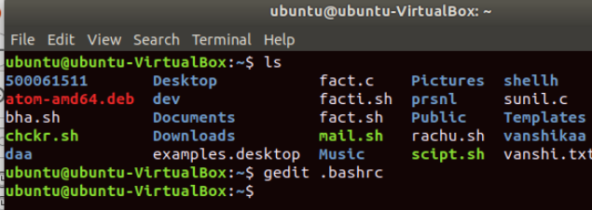
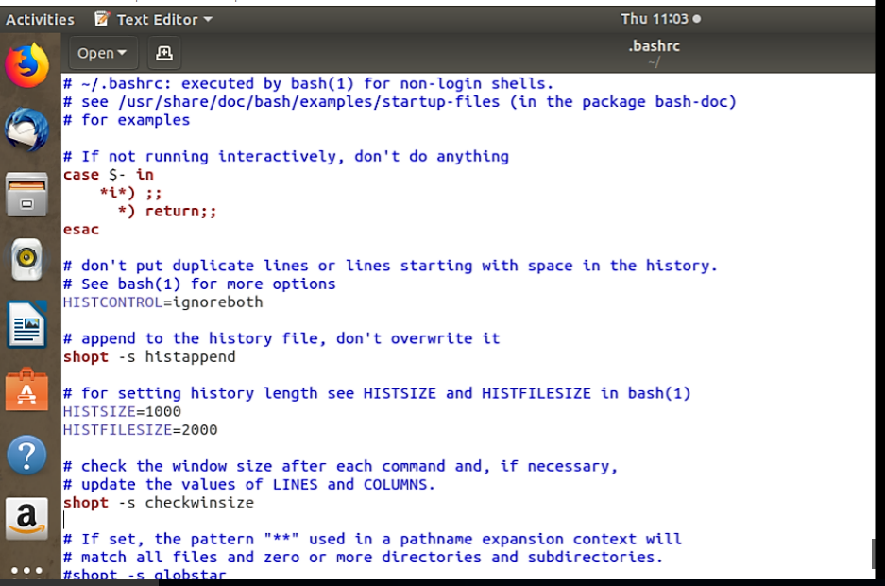

Slide 12
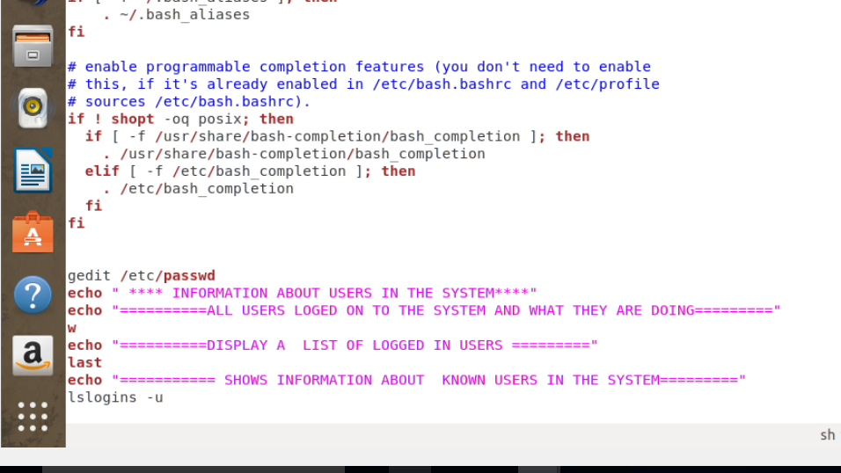

Slide 13
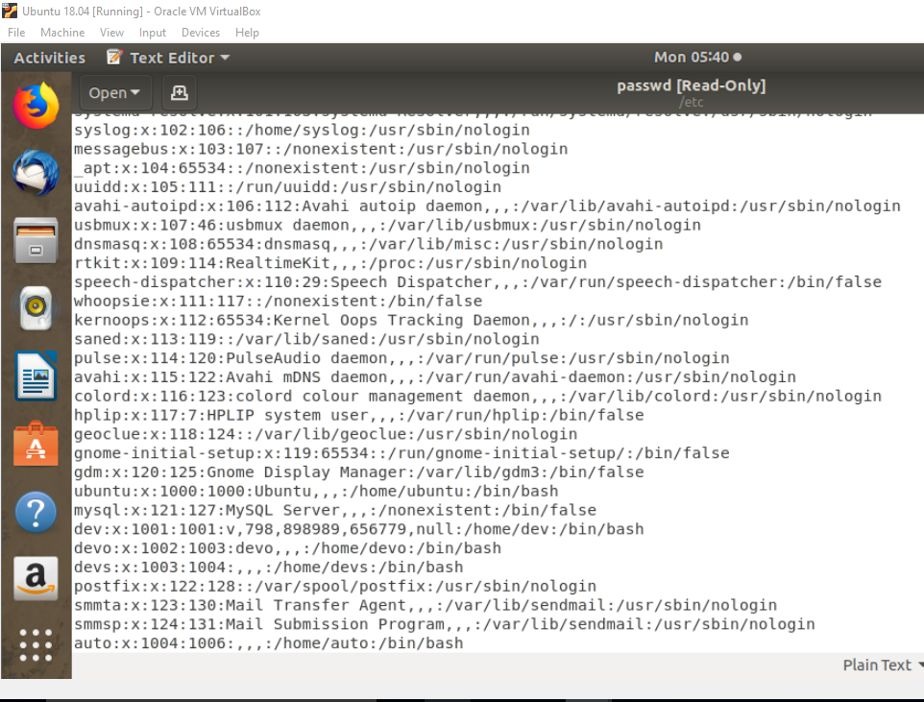

Slide 14
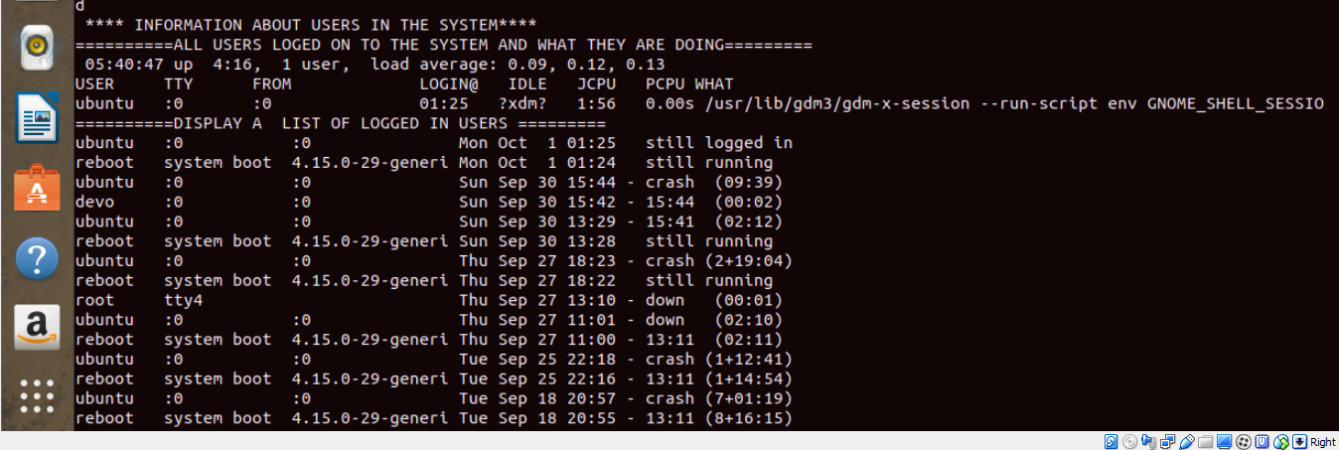

Slide 15
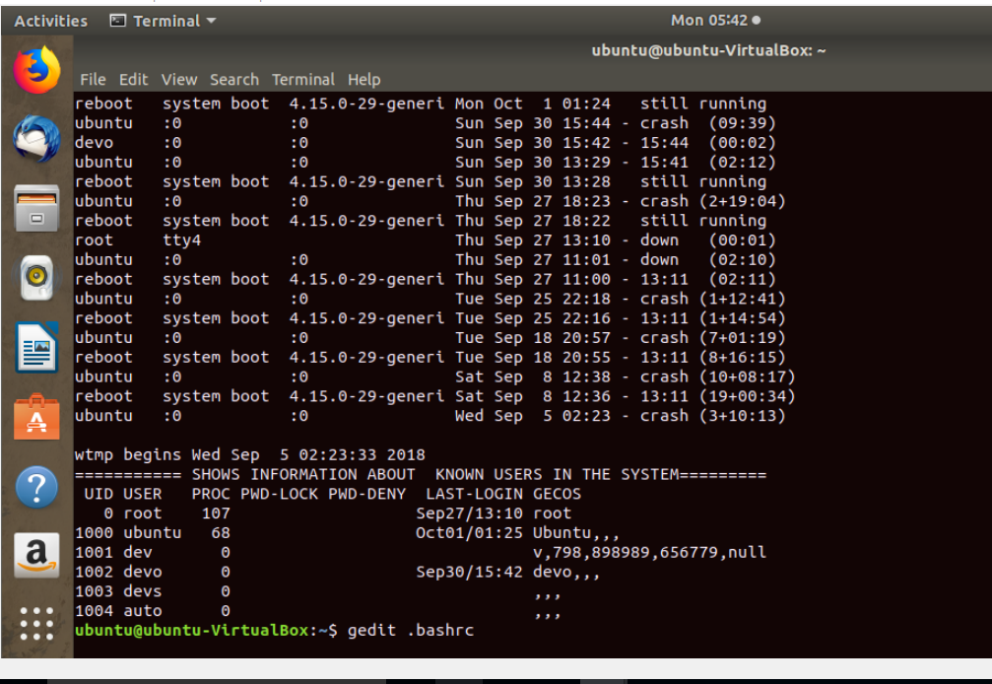

Slide 16
THANK YOU

