Slide 1
Topic :Understanding Linux File System
- Mohit Kumar

Slide 2
Everything is File
Bash scripts
File directories
Scanners and Printers
Kernel parameters
Documents

Slide 3
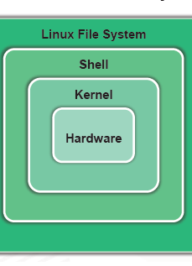
Overview of Linux System
The Linux File System(LFS)
Organize Data in a Systematic way
2. SHELL:
Provides user interface to run command
3. KERNEL:
The core program that manage system hardware device

Slide 4
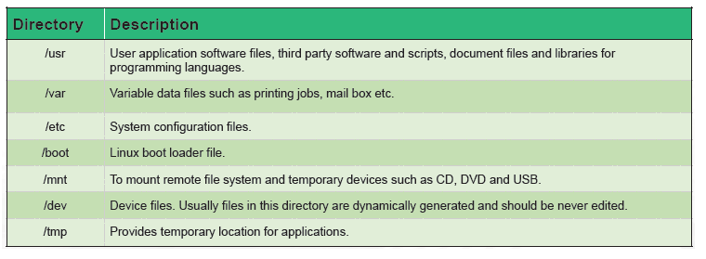
Root Directory(/)
/usr
/var
/etc
/boot
/mnt
/dev
/tmp
/home

Slide 5
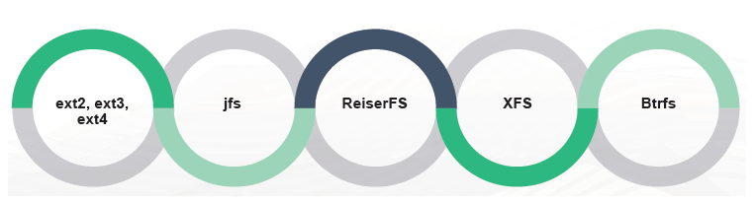
Types of Linux file system
Ext2,ext3,ext4 – extended file system (MINUX)
JFS - Journaled file system (IBM)
ReiserFS – Alternative of ext3
XFS – High speed JFS, NASA USE THIS FILE SYSTEM FOR 300+ TB STORAGE
Btrfs - B-Tree File System

Slide 6
thank you

