Slide 1

AUTOMATED PROVISIONING
BY -ANMOL AHUJA (500061317)

Slide 2
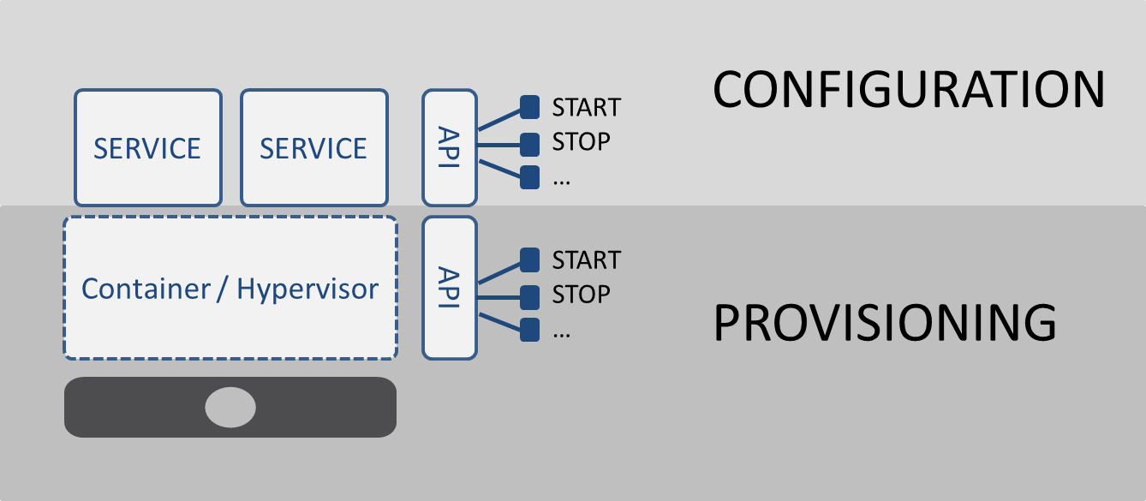
WHAT IS PROVISIONING ?
In general, provisioning means "providing" or making something available. In case of devops this means that, we should not only build, test and deploy application code, but also the underlying application environment.
This leads to the question, what are the elements that constitute an environment that we need to deploy along with the application code. An environment consists of infrastructure, configuration and dependencies. Infrastructure defines where the application will run, configuration dictates both how the application behaves in a given infrastructure and how the infrastructure behaves in relation to the underlying application and dependencies are all the different modules or systems an application depends on, from libraries to services or other applications.

Slide 3
AUTOMATED PROVISIONING
Automated provisioning is defined as the fully automated delivery and maintenance of application environment components. Rather than provisioning and managing environment components, like an Application server manually, DevOps teams must be able to acquire new environment components on demand, fully automated. No manual setup, installation, configuration, and maintenance should be required.
Application environment components are the deployment target containers of the application. In a DevOps organization, automated provisioning can be the responsibility of DevOps Platform teams.
The goals of automated provisioning are; a) consistency across application environments, b) standardization of the platforms and reduction of the number of variations, c) control, traceability of system changes, no change is applied manually, and there is a single, central source of truth, d) new environments are delivered within minutes/hours instead of weeks/months, hence, great speed,
e) defect reduction.

Slide 4
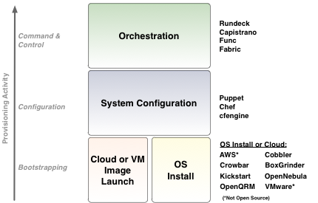
TOOLS REQUIRED
The different layers of automated provisioning are as follows:
1. Automated OS install or Image Launch: Any specific version of the operating system has to be automatically installed across multiple machines, which involve physical or virtual machines (local or cloud-based). Cloud infrastructure allows to configurable virtual machine images that can be copied and these machines can be spun up as and when needed.
2. System Configuration: Once the OS is installed, we need to make sure that all the OS, network and security settings are in place. The correct version of the libraries and packages also have to be configured. This layer of automation enables us to automatically identify and correct and configuration drift. The common tools of configuration management are given above.
3. Orchestration: Orchestration refers to the coordination of actions that needs to be there across multiple tiers, such as web application, database, etc. and multiple servers have to effectively start, update and manage the integrated system. Similar to the configuration layer, the orchestration layer also needs to be specification-driven. The facilities needed to speed up ad hoc management and emergency troubleshooting are also provided by the orchestration layer.

Slide 5
