Slide 1
RAPID APPLICATION DEVELOPMENT
Rachit chauhan
49

Slide 2
What is Rapid Application Development??
It is a model that represents one method as to how software can be developed in short span of time.
Compare to traditional life cycle it is Faster development with higher quality systems.
RAD is a people-centered and incremental development approach.

Slide 3
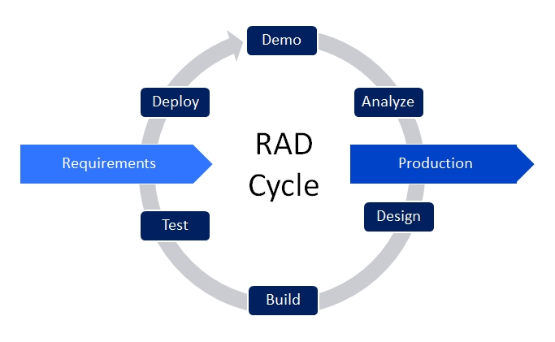

Slide 4
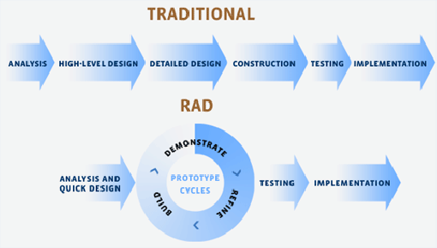

Slide 5
People involved in RAD
RAD Facilitator- who plans and manages the project
The information specialist who translate the end user’s need
The scribe, who document the process
The Developers

Slide 6
Phases of RAD
There are three phases of RAD:
Requirements planning
RAD design workshop
Implementation

Slide 7
Requirements Planning Phase
Users and analysts meet to identify objectives of the application or system.
Oriented toward solving business problems.

Slide 8
RAD Design Workshop
Design and refine phase
Use group decision support systems to help users agree on designs
Programmers and analysts can build and show visual representations of the designs and workflow to users
Users respond to actual working prototypes
Analysts refine designed modules based on user responses

Slide 9
Implementation Phase
As the systems are built and refined, the new systems or partial systems are tested and introduced to the organization
When creating new systems, there is no need to run old systems in parallel

Slide 10
Advantages
It reduces development time as compared to other models.
It encourages customer feedback
Flexible and adaptable to changes

Slide 11
Disadvantages of RAD
It requires highly skilled developers.
High dependency on modelling skills.
Inapplicable to cheaper projects because cost of modelling is very high.

Slide 12
When to Use RAD ??
RAD is used when
Reasonably well-known requirements.
User involved throughout the life cycle
Project can be time based
The team includes programmers and analysts who are experienced with it
There are pressing reasons for speeding up application development
The project involves a novel ecommerce application and needs quick results

