Slide 1
Deployment Automation
Prakhar Agarwal
B.Tech CSE DevOps
Roll no:R171217045

Slide 2
Automated deployment
First of all , What is deployment?
Deployment is the process of deploying the software build on the target server(s) which includes installing, updating, un-installing, configuring resources, configuring the installed application where applicable.
While build automation systems produce executable code, deployment automation systems deploy that executable code to an environment.

Slide 3
Need of automation in deployment
Deployment is the phase where two world meet. i.e., Dev and Ops.

Slide 4
Developers are typically concerned with
Understanding requested features
Designing components
Writing code
Writing test cases
Compiling code
Testing code

Slide 5
OPS are typically concerned with
Installing server hardware and Operating Software (OS)
Configuring servers, network, and storage
Monitoring servers
Responding to outages
Appling security measures
Maintaining disaster recovery protocols

Slide 6
The common issues associated with manual application deployment are
Inconsistency
Slow deployment
Not repeatable or reliable
Affects collaboration between teams

Slide 7
Benefits of Automated Deployment
Activities reusable over and over again: Cost effective
Full deployments with a press of a button: Fast
Tested and proven deployments: Reliable
One standardized central point of access :Maintainable Deployments
Reuse of deployment patterns

Slide 8
With automated deployment tools, engineers can focus more on developing the software, than spending their valuable time in performing and validating a manual deployment.
The time taken to initiate a fully automated deployment is almost negligible.
Automated deployment does not require any technical knowhow, since anyone with basic knowledge can initiate the process at the click of a button.

Slide 9
Tools used
Jenkins
One of the leading Continuous Delivery (CD) and Continuous Integration (CI) tools on the market.
Travis CI
Travis CI can be synced to your GitHub account and allows for automated testing and deployment. Travis CI is free for open-source projects.

Slide 10
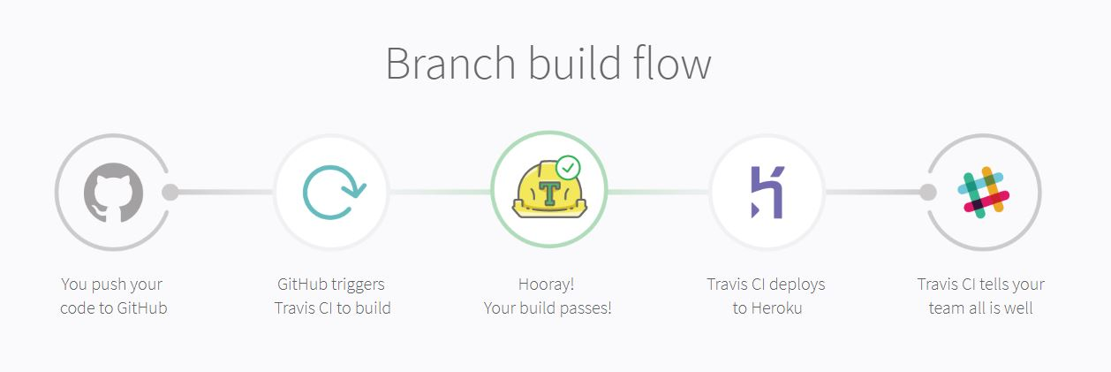
**)Heroku is a platform as a service (PaaS) that enables developers to build, run, and operate applications entirely in the cloud.

Slide 11
Thankyou

