Slide 1
Devops Automation
Aishwarya Sharma
B.Tech CSE DevOps
Roll no. 05

Slide 2
Automation test in automation of software delivery process
Automation testing is an Automatic technique where the tester writes scripts by own and uses suitable software to test the software.
Thus Optimization of software validation is done using automated tests.

Slide 3
CASE STUDY
THE COMPANY:This client is a leading supplier of Enterprise solutions, desktop software etc
THE CHALLENGE:With over 1500 manual test cases – quality assurance process – challenging to maintain
Belatrix Quality Assurance team proposed to automate testing process.

Slide 4
End-to-end tests v/s Unit tests
End to end tests | Unit tests
Tests the flow of the process and makes sure that functional requirements are met resulting in happy scenarios. | Tests the functionality, the edge cases, boundaries, and exceptions.
End-to-end tests inform you when the code is failing. | Unit test inform you where the code is failing.

Slide 5
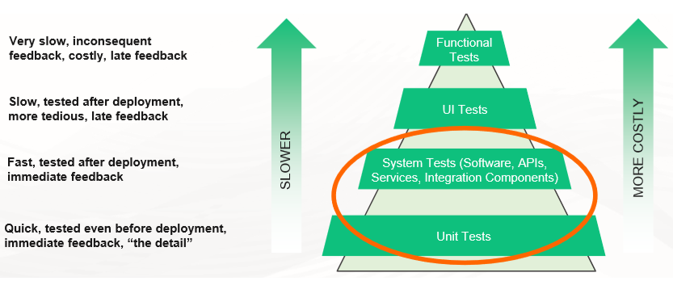
A reverse pyramid is an anti – pattern, also when you automate the higher level tests, it results in a very costly anti-pattern.

Slide 6
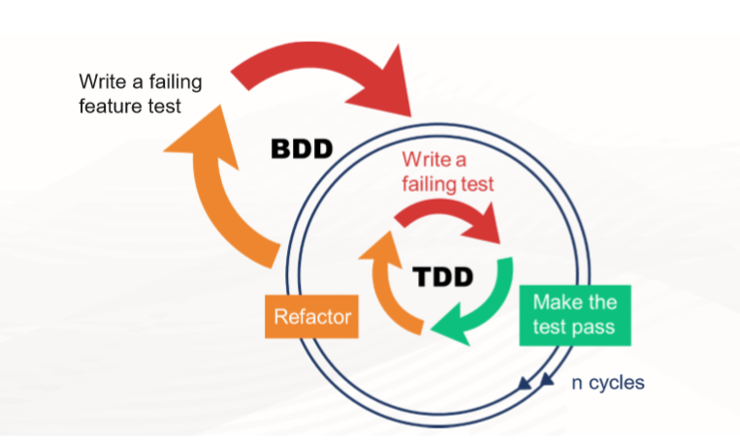
Behavior-driven development (BDD) is a software development methodology in which an application is specified and designed by describing how its behavior should appear to an outside observer. | Test-driven development (TDD) is an iterative development process. Requirements are turned into very specific test cases, then the software is improved to pass the new tests, only.

Slide 7
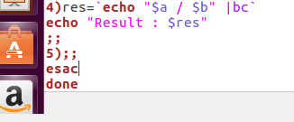
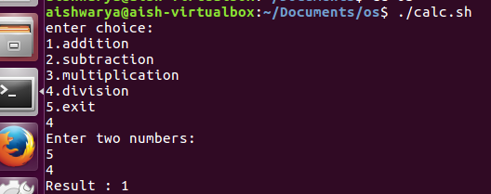
TDD

Slide 8
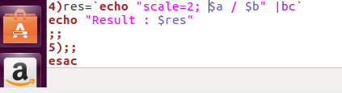
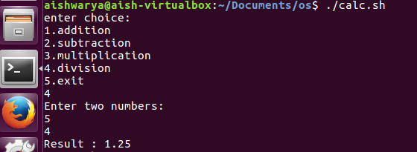

Slide 9
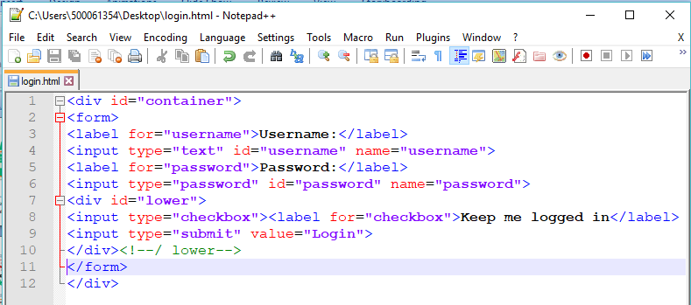
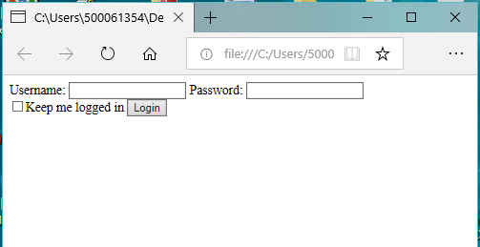
BDD

Slide 10
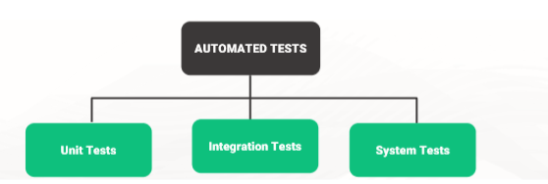
Types of Automated Tests

Slide 11
Unit Tests
Unit tests are run first by developers, in some cases even before they add their changes to the repository.
Unit tests are generally test individual classes or functions.
Integration Tests
Integration tests make sure that the modules that comprise an application work properly with each other.
System Tests
Tests the entire system in an environment as close as possible to the real production environment.

Slide 12
THANKYOU

