Slide 1
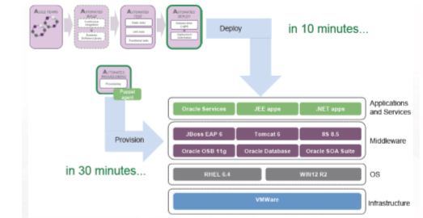
AUTOMATED PROVISIONING IN AUTOMATION OF SOFTWARE DELIVERY PROCESS BY- PRATYUSH PANDEY

Slide 2
INTRODUCTION –
Rather than provisioning and managing environment components, like an Application server manually, DevOps teams must be able to acquire new environment components on demand, fully automated.
No manual setup, installation, configuration, and maintenance should be required.
Automated provisioning is defined as the fully automated delivery and maintenance of application environment components.
Application environment components are the deployment target containers of the application. For example, a Database server or Application Runtime server.
In a DevOps organization, automated provisioning can be the responsibility of DevOps Platform teams.
Ideally, these teams deliver platform products, which are used autonomously by DevOps Business System teams. In other words, the Business System DevOps teams can use the platform products via fully automated self services. There is a clear separation of responsibilities.

Slide 3
Goals of automated provisioning:
1) Consistency across application environments
2) Standardization of the platforms and reduction of the number of variations
3) Control, traceability of system changes, no change is applied manually, and there is a single,
central source of truth
4) New environments are delivered within minutes/hours instead of weeks/months, great speed.
5) Defect reduction

Slide 4
Continuous Delivery for Automated Provisioning -
Automated provisioning requires a development rather than an operations perspective, because changes to infrastructure must be provisioned in a controlled manner, including extensive verification of these infrastructure changes. Infrastructure changes must be viewed as code (Infrastructure as Code) rather than change instructions bound to a change ticket. This new perspective implies that software delivery process based on the Continuous Delivery can be applied to manage infrastructure changes (for example, the platform products). This approach requires profound standardization of the platform product characteristics.

Slide 5
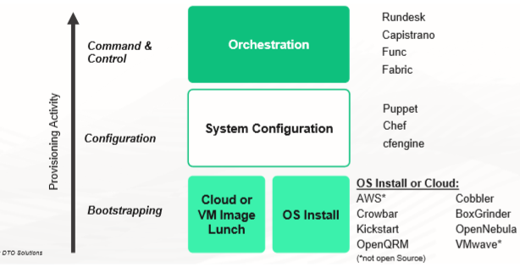
Tools for Fully Automated Provisioning

Slide 6
The different layers of automated provisioning are as follows:
1. Automated OS install or Image Launch: Any specific version of the operating system has to be automatically installed across multiple machines, which involve physical or virtual machines (local or cloud-based). Cloud infrastructure allows to configurable virtual machine images that can be copied and these machines can be spun up as and when needed.
2. System Configuration: Once the OS is installed, we need to make sure that all the 08, network and security settings are in place. The correct version of the libraries and packages also have to be configured. This layer of automation enables us to automatically identify and correct and configuration drift. The common tools of configuration management are given above.
3. Orchestration: Orchestration refers to the coordination of actions that needs to be there across multiple tiers, such as web application, database, etc. and multiple servers have to effectively start, update and manage the integrated system. Similar to the configuration layer, the orchestration layer also needs to be specification-driven. The facilities needed to speed up ad hoc management and emergency troubleshooting are also provided by the orchestration layer.

Slide 7
THANK YOU

