Slide 1
DEVOPS AUTOMATION
Made by-Ashish Rajbhar

Slide 2
Model Driven Architecture(MDA)
THE ARCHITECTURE OF CHOICE FOR A CHANGING WORLD

Slide 3
Introduction
-Model Driven Architecture® (MDA®) is an approach to software design, development and implementation spearheaded by the OMG. MDA provides guidelines for structuring software specifications that are expressed as models.
- Note that the term "architecture in MDA does not refer to the architecture of the system being modeled but rather to the architecture of the various standards and model forms that serve as the basis for MDA.

Slide 4
The MDA approach is aimed at separating design from architecture
Design: Addresses the functional requirements (use cases) of the application.
Architecture: Infrastructure for non-functional requirements like scalability, reliability and performance.

Slide 5
The advantages of MDA are as follows.
Portability: The migration of existing functionalities to new environments and platforms, as per the business requirements, can be rapidly done. Productivity and Time-to-Market: Many of the tasks are automated and the development team can concentrate on the core logic. Thus productivity is increased and time to reach market becomes shorter. Quality: The consistency and reliability of the components built, contributes to the overall quality of the system. Integration: The MDA greatly facilitates the production of integration bridges with legacy and/or external system. Maintenance: Since the design is available in a machine-readable form, analysts, developers and testers can directly access the specification of the system and thus maintenance process is simplified.

Slide 6
UML-Unified Modeling Language
-UML diagram is a diagram based one UML with the purpose of visually representing a system along with its main actor, roles, actions, artifacts or classes, in order to better understand, alter, maintain, or document information about the system.
-UML is a modern approach to modeling and documenting software.
-It is based on diagrammatic representations of software components.

Slide 7
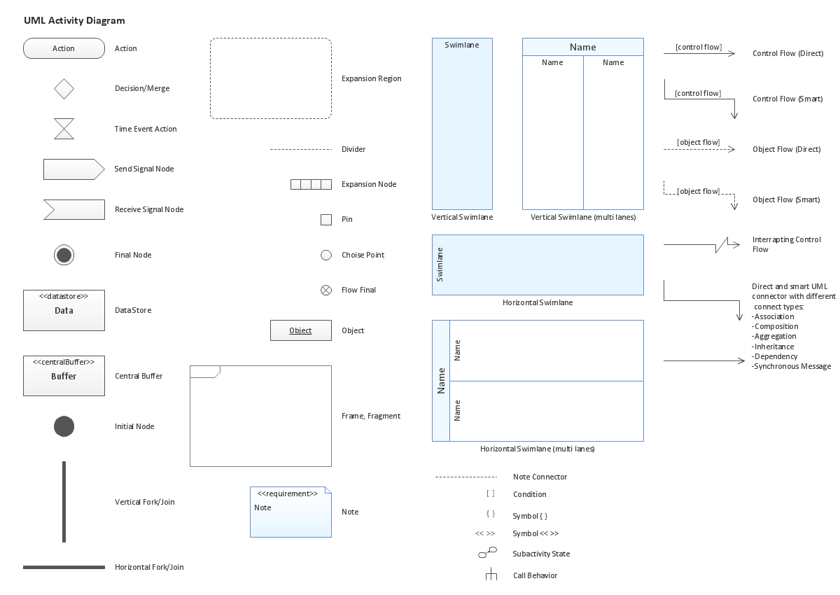

Slide 8
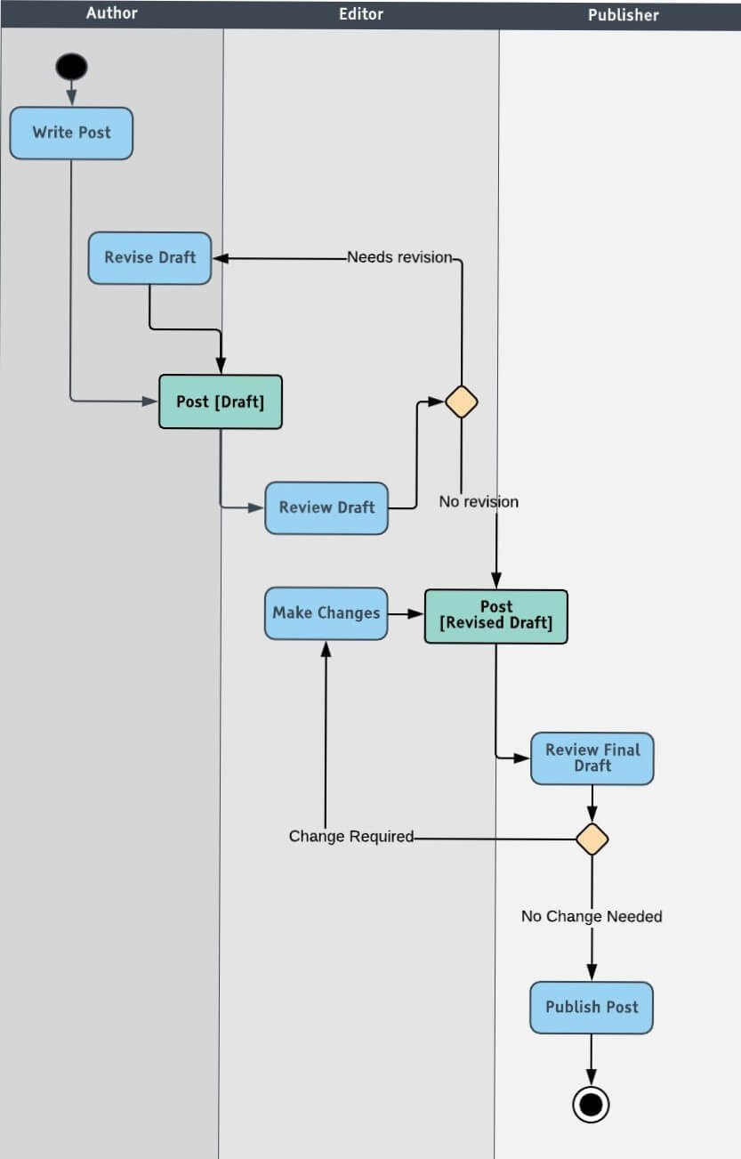
Example of
UML Diagram

Slide 9
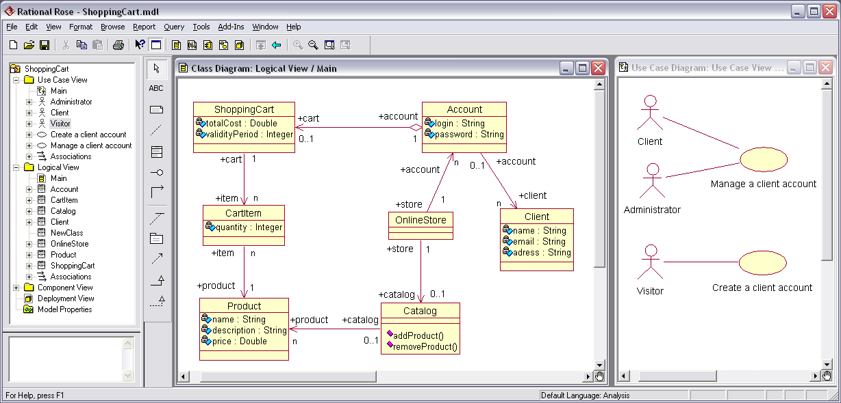
Rational Software Architect
It is a modeling and development environment that uses the Unified Modeling Language for designing architecture for C++ applications and web services. It enables model management for parallel development and architectural re-factoring e.g.- split, combine, compare and merge.

Slide 10
Thank You

