Slide 1
MODEL-DRIVEN ARCHITECTURE
SAJAL SOOD
51
B.Tech-DEVOPS-B2

Slide 2
POINTS---
OMG LAUNCHED SOFTWARE DESIGN APPROACH
IN 2001
OMG’s purpose:--Creating a standard architecture for distributed objects (also known as "components") in networks.
The MDA approach is aimed at separating design from architecture.
Design: Addresses the functional requirements (use cases) of the application.
Architecture: Infrastructure for non-functional requirements like scalability, reliability and performance.

Slide 3
CONTINUED--
The overall process of MDA is documented in a document produced and regularly maintained by
the OMG and called the MDA Guide.
The principles of MDA can also be applied to other areas like business process modelling where the architecture and technology neutral PIM is mapped onto either system or manual processes.
Translations between PIM and PSMs done using automated tools, like model transformation tools.

Slide 4
MDA-CONCEPTS---
The important concepts associated with MDA are:
1 System
2 Model
3 Model-driven
4 Architecture
5 Viewpoint
6 Platform
7 Platform Independence
8 Platform Model
9 Model Transformation
10 Implementation

Slide 5
MDA ADVANTAGES---
Portability
Productivity and Time-to-Market
Quality
Integration
Maintenance
Testing and Simulation
Return on Investment

Slide 6
MDA MODELS---
The three major models of MDA based on three MDA-Viewpoints are:
1. Computation Independent Model (CIM): It is termed business or domain model because it
uses a vocabulary familiar to the subject matter experts. Provides exact specifications as to what
the system must do but hides all the IT specifications. This is to ensure the model remains
independent of how the system will be implemented. The role of CIM is significant in bridging the
gap that exists between the subject matter experts and IT people who implement the system.
2. Platform Independent Model (PIM): This model exhibits its degree of independence so that it
could be mapped to one or more platforms. To make this happen, a set of services is first defined
in a way, that abstracts out technical details. Other models then specify a realization of these
services in a platform-specific manner.
3. Platform Specific Model (PSM): A combination of specifications mentioned in PIM and additional
details, which elaborates how a system uses a particular platform. A PSM is considered abstract,
if it does not include details of implementing the platform. In these cases, it relies on other explicit or implicit models that contain these details.

Slide 7
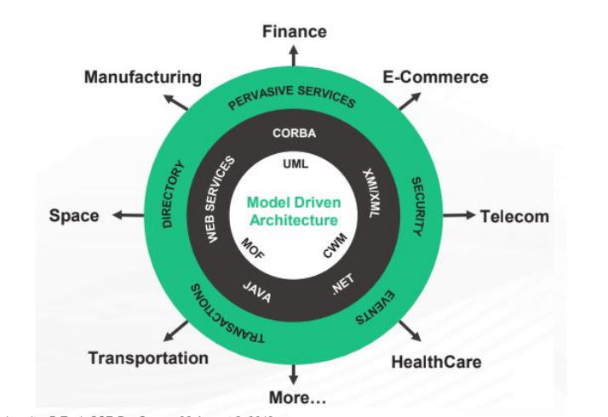
BRIEF DIAGRAM OF MDA---

Slide 8
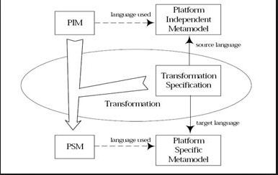
CONVERSION MODEL DIAGRAM---

Slide 9
Disadvantages of MDA---
1. MDA actually introduces a lot of rigidity.
2. Models are only flexible where flexibility has been designed.
3. The modeling environment doesn’t always support version control.
4. The modeling tool/approach is "almost" finished at project start The famous word "almost" is pitifully used a lot when talking about how far the model-driven software factory is finished at the start of a project.

