Slide 1
DEVELOPMENT AUTOMATION
CH.SRI SAI VALLI
58
500060228
B.Tech CS- DEVOPS-II

Slide 2
AUTOMATION SCENARIOS
EMAIL WEB SERVER SUMMARY
+
RUNNING

Slide 3
WHAT IS A SERVER?
A server is a computer, a device or a program that is dedicated to managing network resources.
Servers are often referred to as dedicated because they carry out hardly any other tasks apart from their server tasks.

Slide 4
WHAT ARE THE TYPES OF SERVERS?
FTP Server [ FILE TRANSFER PROTOCOL ]
Groupware Server
IRC Server [ INTERNET RELAY CHAT ]
List Server
Mail Server
News Server
Proxy Server
Virtual Servers
Web Server

Slide 5
WHAT IS A WEB SERVER?
A web server is nothing but a software that continuously listens for the request from a user through the client known as browsers.
Some commonly used browsers are Chrome ,Firefox,Safari,Opera, Internet Explorer ,etc.
Some of the most famaliar web servers are Apache, Tomcat, Nginx, etc.

Slide 6





TYPES OF WEB SERVERS
APACHE HTTP SERVER
IIS [ Internet Information Services ]
NGINX
GWS [ Google Web Server ]
SUN JAVA SYSTEM

Slide 7
SCENARIO--
HOW TO EMAIL THE SUMMARY OF THE WEB SERVER
REQUESTS EVERYDAY ?
SHOULD THE SUMMARY HAVE THE RESPONSE COUNTS OF
ALL THE HTTP STATUS CODES ?

Slide 8
PSEUDOCODE-
READ ARGUMENT- Location of Web Server's log files.
Filter the logs that are generated within the last 24 hours.
Iterate through the lines in the log and have a counter to track the account of each response code.
Finally,print the above summary and pipe it to the mail function so that the summary can be emailed.If mail returns a non-zero exit code ,then exit the script and write the error message to the logs.
CHECK- The script is scheduled in the cron.If not, add the script to cron such that it gets executed every 24 hours.

Slide 9
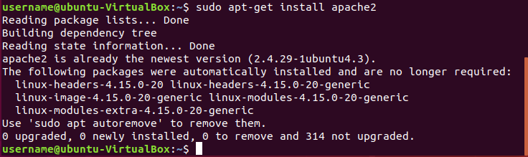
INSTALL THE WEB SERVER -

Slide 10
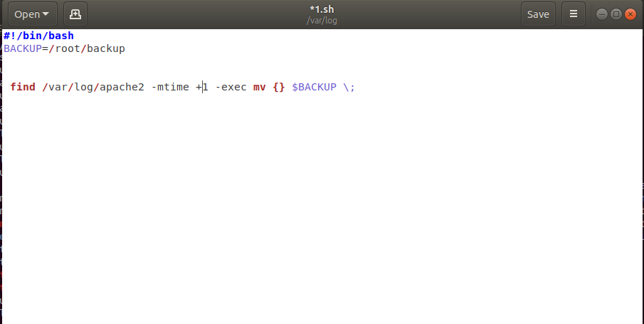
AFTER FINDING THE LOCATION USING “GREP”
SHELL SCRIPT TO FILTER LOG FILES-

Slide 11
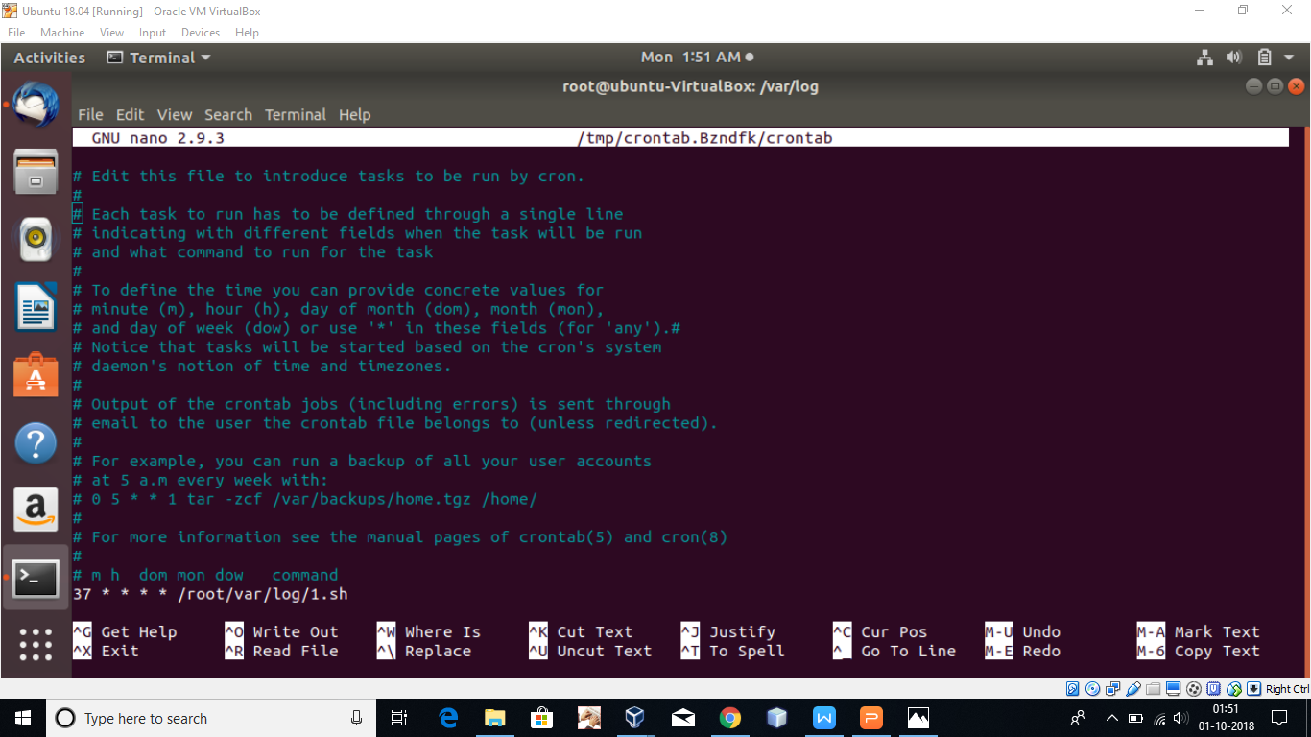
SCHEDULING USING CRONTAB

Slide 12
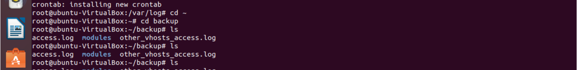
FILTERED LOG FILES OF LAST 24 HOURS

Slide 13
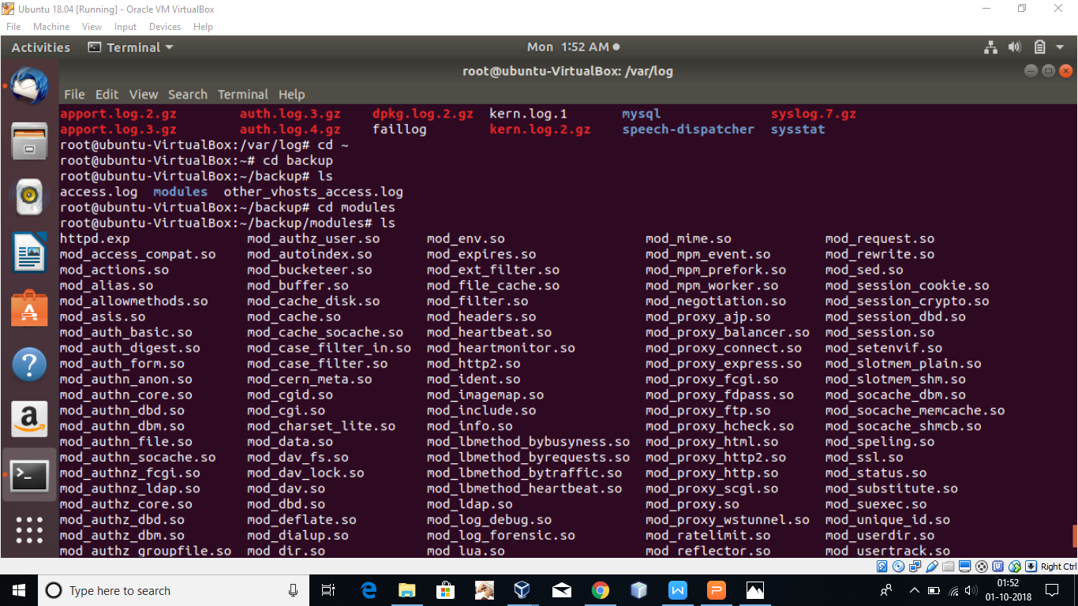

Slide 14
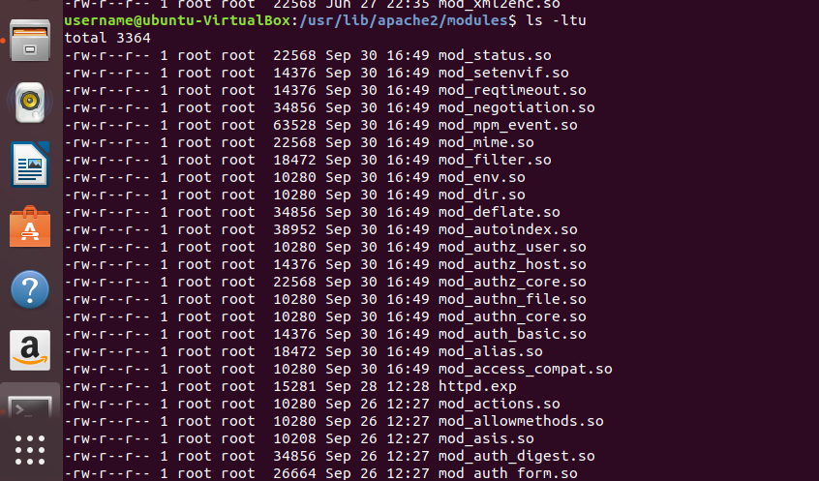
ANOTHER OPTION TO VIEW YOUR LAST FILES-

Slide 15
SCENARIO-- (RUNNING)
SHOULD WE CONTINUOUSLY MONITOR AND RESTART THE WEB SERVER IF IT IS NOT RUNNING?
HOW?

Slide 16
PSEUDOCODE- (RUNNING)
READ ARGUMENT: Web server's listing port
RUN: 'netstat' command to find all the listing ports of the server.
Filter the above list with the webserver's list port.
If the filtered list is empty, then write the timestamp to log and restart the web server.
CHECK: The script is scheduled in the cron.
FALSE: Add the script to cron such that it gets executed every minute.

Slide 17
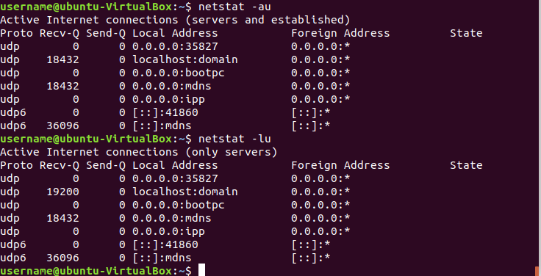
NETSTAT COMMAND TO VIEW THE PORTS

Slide 18
WHAT IS “ TIMESTAMP” ?
Simply the Unix timestamp is the number of seconds between the particular date and the Unix Epoch.
A timestamp is the current time of an event that is recorded by a computer.
Timestamps are also routinely used to provide information about files, including when they were created and last accessed or modified.
The -t option allows you to set the date and time stamp of the file. To set the time stamp to a specific time:
$ touch -t 03201600 myfile
This sets the file, myfile's, time stamp to 4 p.m., March 20th (03 20 1600).

Slide 19
THANK YOU

