Slide 1
Development Delivery Pipeline Overview
Abhinav Sharma
500061181

Slide 2
Today's Scenario...
In today's world, clients expect a constant flow of updates. Moreover, they expect them to be seamlessly deployed.
Thus, we need something that optimizes time and keeps the flow of updates continuous and error free. This is achieved with the help of a pipeline in DevOps .
The two main processes in a pipeline are Continuous Integration (CI) and Continuous Delivery (CD).

Slide 3
Case Study: Why is there a need for a delivery pipeline?
Consider a scenario in a project where the client suddenly tells the development team to build a new functionality in a very less amount of time. If the team, keeps the as-usual process ongoing then, first it would go to dev team where the functionality would be coded, then it would move to testing team, then QA Team, then the user acceptance test and then finally to operations team for final deployment. The process of moving from one phase to another would also require time, moreover there are chances of errors too in any of the phases. So to reduce the errors and time that is being wasted, we use delivery pipelines where build, test, and deploy are done in a repeatable way with minimal human intervention. In a pipeline, sequences of stages retrieve input and run jobs, such as builds, tests, and deployments.

Slide 4
Before we begin...
Continuous Integration (CI) and Continuous Delivery (CD) are two of the most crucial parts in a DevOps development life cycle.
Thus, we need to have a good understanding about them.

Slide 5
What is Continuous Integration (CI)?
It is a development practice where the developers integrate their codes in a shared repository several times a day.
Moreover, each update goes through an automated build, to ensure an error free development.

Slide 6
What is Continuous Delivery (CD)?
It is a software strategy that enables organizations to deliver new features to their users/clients as fast as possible.
Delivering constant flow of changes into production can be achieved via an Automated Development Delivery Pipeline.

Slide 7
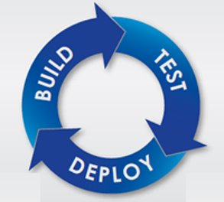
Stages involved in a Delivery Pipeline.
The delivery pipeline might differ for different softwares depending on the requirements. But the common processes involved in an development delivery pipeline are :
1) Build
2) Test
3) Release/Deploy

Slide 8
Build Stage
During the build stage, actual code for the software is written, compiled and archived. Once the code is compiled, unit tests take place that ensure that the code that is written is error free.
In case of an error, the code is again reviewed and fixed by the developers and is brought back to working.
Usually, the source code is collected in a shared repository (similar to a database) so that all the developers can work on a common platform. Here, we use Version Control Systems (VCS). Some of the examples are Git, Mercurial etc. In the end, all the builds are packaged into a single unit.

Slide 9
Test Stage
In this stage, the packaged unit that has been built and has passed unit testing is deployed to the Staging Environment.
Staging Environment: It refers to an environment that allows the testing of built software/applications under almost real conditions.
Functional tests (slice of functionality in a system) and integration tests are done to verify functionalities of the application.
Finally, performance tests are done to ensure whether the application will run successfully under expected workload.

Slide 10
Release Stage
This stage involved the deploying or releasing of the software or application in the production environment.
Sometimes, tests might also occur in the production environment to ensure error free client side experience.

Slide 11
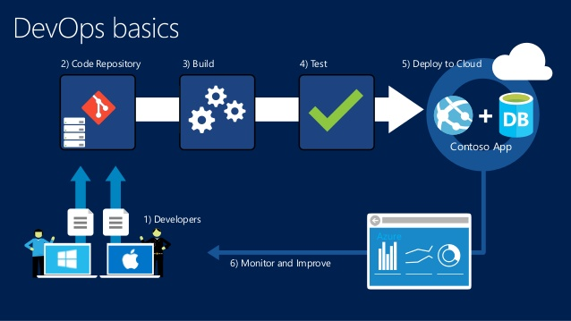

Slide 12
Then, what's the problem?
Sometimes, there are chances that manual testing, deployment might have some errors and can lead to discrepancies and slowing down of the delivery process. This is where continuous delivery pipeline comes into picture.
Continuous delivery ensures that the all the processes at each stage in a delivery pipeline are automated by using various tools. This way, errors reduce and efficiency increases, thus leading to even more faster updates.

Slide 13
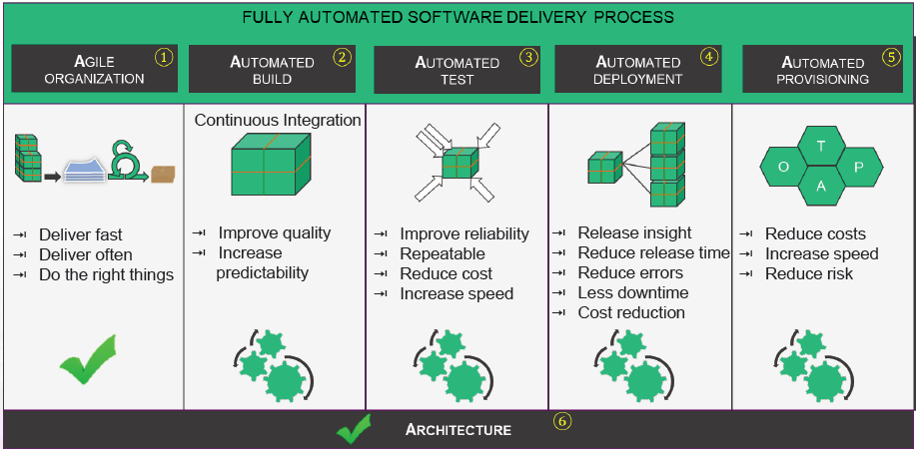
Thus, now we automate the build, test and deployment process to a full extent.
Source: Xebia: Module 1 – Introduction to Automation

Slide 14
Thus, the continuous delivery pipeline can be majorly divided into following stages:
1) Automated Build: It is the process in which the parts of code written by developers are combined together and unit tests are conducted to ensure each part of code is working. There is generally a continuous integration process where software developers check-in their changes, and if anyone breaks the build, it needs to be addressed. Tools like Apache ANT, Maven, Gradle, MSBuild etc are used to automate this process.
2) Automated Testing: This involves the testing of the software that passes the build stage. Tests such as functional test, static code quality analysis etc take place. Tools used are Selenium, Jenkins, Bamboo, Vagrant etc are used.

Slide 15
3) Automated Deployment: This is the stage in which the package is ready to be released or deployed into real production. In layman language it is the process of updating your code to the server. It is in this stage, where we integrate our release management software with our actual code releases. Tools like uDeploy, Jenkins are used to schedule deployments on servers.
4) Automated Provisioning: They are primarily used for the provisioning and ongoing configuration management of servers. They apply changes to infrastructure using an infrastructure as code approach where the desired state of infrastructure is stored in a repository—usually a source control system. Tools used are Chef, Puppet, Salt.

Slide 16
THANK YOU!

