Slide 1
AUTOMATION TESTING
PRAJJAWAL BANATI
R171217044
DEVOPS(B2)
IN SOFTWARE DELIEVERY PROCESS

Slide 2
Going to Study
What is Automation Testing ?
Why Automation Testing ?
How is it different from Manual Testing ?
Types Of Automation Testing.
What are the tools for Automation Testing ?
How these Tools Work and reduce manual workload ?

Slide 3
Pre-Requisites:
What is meaning of Automation ?
Overview of Software delivery pipeline.
Overview of the Continuous delivery pipeline.
Know about Build Automation And Continuous Integration.
Overview of Automated Software Delivery Process.

Slide 4






SCENARIO FOR UNDERSTANDING TESTING
Lets us suppose that a bank is hiring a group to develop a online bank application.

Slide 5

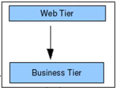



FUNCTIONAL SPECIFICATION
Here the architecture , database and operating environment design is finalised.
Will be handled by the ops one.
Three-Tier System Architecture:
Web Tier : The Web tier manages communication between a person's Web browser and a Web server. Your browser, for instance, may contain client-side JavaScript that runs locally in the browser.
Business Tier : Business services tier would contain the code that contains the logic needed to enforce your organization's business and data rules.
Data Tier : Probably need a data repository to hold information if your business’s website manages data. This repository could be a database or some other data storage mechanism. The code in the data tier has a single function: manage the data

Slide 6
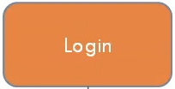
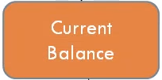
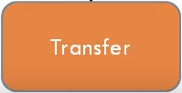
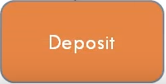
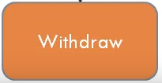
High level Design
The application is broken down in modules and programs. Like the app is gonna work in which workflow.

Slide 7

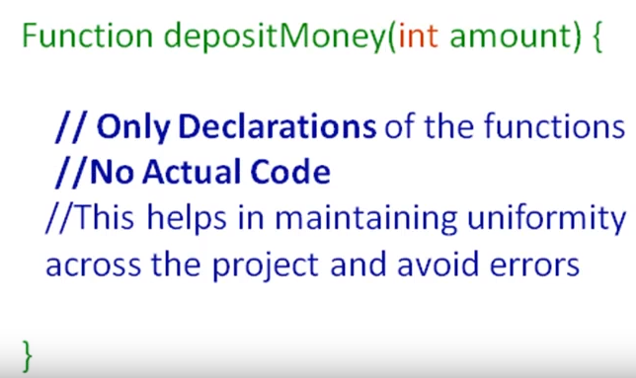
Detailed Design
In detailed design we write the pseudo-code of each functionality.

Slide 8
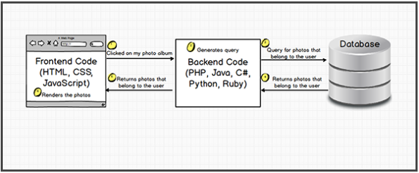
CODING : (THE MAIN PART)
FRONT-END Coding
Front end development manages everything that users visually see first in their browser or application. Front end developers are responsible for the look and feel of a site
Sites created by front end developers won’t interact with information stored on a database in order to be functional.
HTML5, JAVASCRIPT, CSS etc.
Back-End Coding
Back end development refers to the server side of an application and everything that communicates between the database and the browser.
Back end developers are most focused on a site’s
responsiveness and speed. Code written by back end developers is what communicates the database information to the browser.
Java, Ruby on Rails, Python, .NET framework

Slide 9




SCM TOOLS :
These tools will help in managing the source code , like it will be keeping a log of commits or changes we done in the source code , and will save every version of the source code in the server so that we can later access it.

Slide 10





BUILD STAGE :
the process by which source code is converted into a stand-alone form that can be run on a computer or to the form itself.
So let us take an instance of “gulp”. Gulp is an automated build tool. Gulp with one command can do a lot of things like :
It could concatenate(join) all the java script files and make help in building a package.
Can compile your .js code.

Slide 11

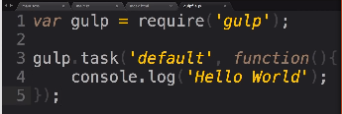
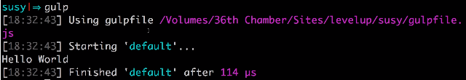
UNDERSTANDING AUTOMATED BUILD :

Slide 12
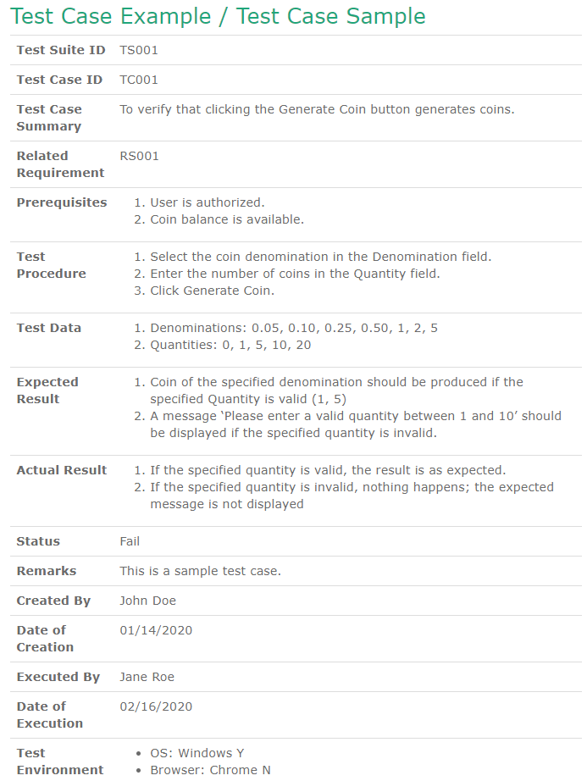
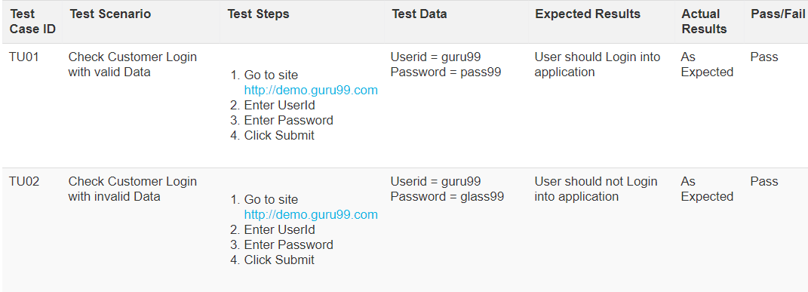
What Is a “TEST CASE” ?
A test case is a set of conditions and pre-required variables on which a tester will determine that the application is working correctly or not.

Slide 13
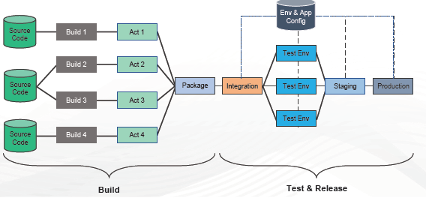
How Testing was different before Automation ?
During test stage the production environment and staging environments are created.
So in this stage, artefacts are installed in this staging environment.
Functional and integrated tests are performed in this stage.
Also regression Test will be performed.
BUT IT WILL BE MANUALLY !!!!!!

Slide 14
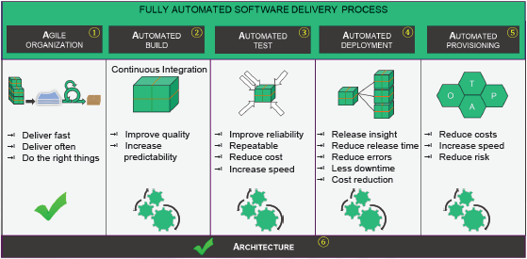
FULLY AUTOMATED SOFTWARE DELIEVERY PROCESS
So here we use different tools to automate testing and deploying.
It increases the efficiency and generates atomic test cases.
TOOLS WE USE:
  BUILD TOOLS
  TEST TOOLS
  INTEGRATION TOOLS
  DEPLOYMENT TOOLS

Slide 15
WHAT IS AUTOMATION TESTING ?
In this method we use tools for testing.
These tools enter test data into the system and compare the actual and expected test reports or cases.
Goal of Automation Testing is to reduce number of test cases to be run manually and not eliminate manual test cases all together.

Slide 16
WHY AUTOMATION TESTING ?
Manual testing of all workflows , all fields , all negative scenarios is time consuming and cost consuming.
Can run automated test over night, no human intervention is required.
Increases speed of test execution and test coverage.

Slide 17
TYPES OF AUTOMATED TESTING :
UNIT TEST
FUNCTIONAL TEST
INTEGRATION TEST
SYSTEM TEST
CONFIGURATION TEST
REGRESSION TEST

Slide 18
WHICH TEST CASES NEEDED TO BE AUTOMATED ?
SOME TEST CASES ARE OUGHT TO BE DONE MANUALLY.THE TEST CASES WHICH SHOULD BE SELECTED FOR AUTOMATION ARE :
Test Cases that are executed repeatedly.
Test Cases that are very tedious or difficult to perform manually.
Test Cases which are time consuming.
Test Case which may have large number of possibilities.

Slide 19
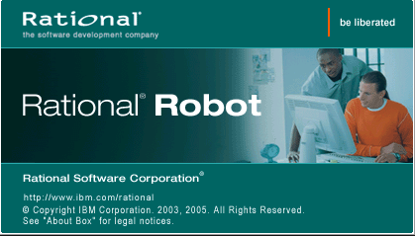


TOOLS FOR AUTOMATION TESTING :
The most popular automation testing tools are :
QTP: Functional Testing tool.
RATIONAL ROBOT: Used to automate Regression , Functional and Configuration test.
SELENIUM: An open Source Web Automation tool.
AND MANY MORE………….

Slide 20
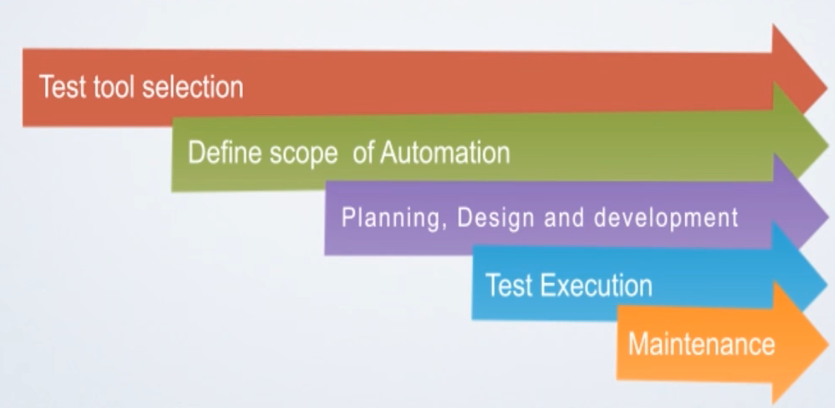
AUTOMATION PROCESS :
Following steps are followed in an Automation Process.

Slide 21
TEST TOOL SELECTION :
->Test Tool Selection largely depends on the technology the Application under Test is built on.
DEFINE SCOPE OF AUTOMATION :
->Scope of Automation is the area of your application under Test which will be automated.
PLANNING, DESIGN AND DEVELOPMENT :
->During this phase you create Automation Strategy and Plan.
TEST EXECUTION :
->Automation Scripts are executed during this phase.
MAINTAINENCE :
->As new functionalities are added to the System Under Test with successive cycles,
Automation Scripts need to be added,reviewed and maintained for each release cycle.

Slide 22
THANK YOU ……..
KEEP AUTOMATING……....

