Slide 1
AUTOMATION BUILD IN AUTOMATION OF SOFTWARE DELIVERY PROCESS
NAME:SAILESH PILLA
SAP ID:500061963
ROLL NO:R171217043

Slide 2
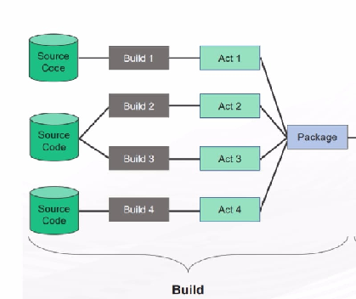
THE BUILD PROCESS
BUILD CAN BE DEFINED AS THE PROCESS WHERE THE APPLICATION IS CREATED FOR THE SOFTWARE RELEASE BY COLLECTING ALL THE RELAVENT SOURCE CODE FILES,COMPILING THEM AND CREATING AN EXECUTABLE PROGRAM.

Slide 3
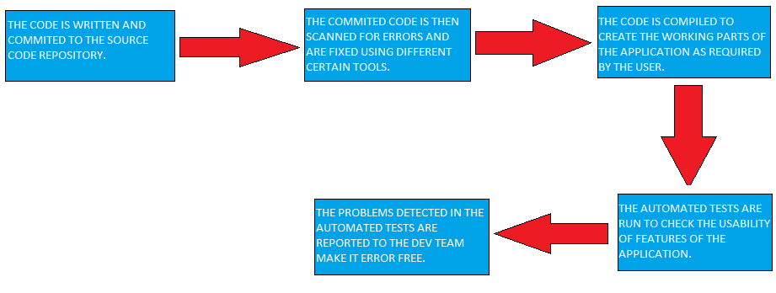
THE FOLLOWING STEPS ARE DONE DURING THE BUILD PROCESS:

Slide 4
AUTOMATED BUILD SYSTEM
AN AUTOMATED BUILD SYSTEM MAINLY CONSISTS OF THE FOLLOWING COMPONENTS:
SOURCE VERSION CONTROL SYSTEM
CONTINUOUS INTEGRATION SERVER
CODE QUALITY ANALYSIS AND REPORTING
ARTIFACT REPOSITORY
BUILD TOOLS
STATIC ANALYSIS
UNIT TESTS AND TEST RUNNER FRAMEWORKS

Slide 5


SOURCE VERSION CONTROL SYSTEM
SMALL PARTS OF CODE BY DIFFERENT CONTRIBUTORS ARE COMMITED TO THE VERSION CONTROL REPOSITORY.
VERSION CONTROL KEEPS THE TRACK OF ALL THE CHANGES DONE BY DIFFERENT CONTRIBUTORS.
IT HELPS THE DEVELOPENT TEAM TO MANAGE THE CHANGES DONE TO THE SOURCE CODE.
EXAMPLES OF VERSION CONTROL SYSTEMS ARE: GIT , MERCURIAL ETC.

Slide 6



CONTINUOUS INTEGRATION SERVER
THE FUNCTION OF CONTINUOUS INTEGRATION SERVER IS TO INTEGRATE THE CODE COMMITED IN THE VERSION CONTROL REPOSITORY
BY INTEGRATING REGULARLY YOU CAN DETECT ERRORS QUICKLY.
CONTINUOUS INTEGRATION REDUCES TIME TO FIND BUGS AND ENABLES FASTER FEEDBACK WHILE OTHER TASKS ARE CARRIED OUT MANUALLY.
TOOLS OF CONTINUOUS INTEGRATION SERVER ARE JENKINS,TRAVIS CI,BAMBOO ETC.

Slide 7


CODE QUALITY AND ANALYSIS
IN THIS PROCESS THE INTEGRATED CODE IS CHECKED FOR SYNTAX ERRORS AND MERGE CONFLICTS WHICH ARE RESOLVED.
THIS ANALYSIS EXPOSES THE AREA OF CODE WHERE QUALITY CAN BE IMPROVED.
TOOLS USED FOR CODE QUALITY AND ANALYSIS ARE SONARQUBE,BLACK DUCK ETC.

Slide 8


ARTIFACT REPOSITORY
AFTER CODE QUALITY AND ANALYSIS THE CODE (ARTIFACT) IS STORE IN THE ARTIFACT REPOSITORY.
MANY ARTIFACT REPOSITORIES ARE CREATED AND ARTIFACTS ARE STORED IN THEM FOR EVERY FEATURE OF THE APPLICATION.
NEXUS AND ARTIFACTORY ARE SOME OF THE EXAMPLES OF ARTIFACTORY REPOSITORY.

Slide 9



BUILD TOOLS
BUILD TOOLS ARE PROGRAMS WHICH AUTOMATE THE SOURCE CODE TO EXECUTABLE PROGRAMS
BUILDING INCOPERATES COMPILING ,LINKING AND PACKAGING THE CODE INTO A USABLE OR EXECUTABLE FORM.
EXAMPLES FOR BUILD TOOLS ARE MAVEN,GRADLE ANT ETC

Slide 10



STATIC ANALYSIS
STATIC ANALYSIS, ALSO KNOWN AS STATIC CODE ANALYSIS, IS A METHOD OF COMPUTER PROGRAM DEBUGGING WHICH IS DONE BY EXAMINING THE CODE WITHOUT EXECUTING THE PROGRAM.
THIS PROCESS PROVIDES AN UNDERSTANDING OF THE CODE STRUCTURE,AND CAN HELP TO ENSURE THAT THE CODE REACHES THE INDUSTRY STANDARDS.
TOOLS FOR STATIC ANALYSIS ARE FINDBUGS,CHECKSTYLE,PMD ETC.

Slide 11


UNIT TESTS AND TEST RUNNER FRAMEWORKS
UNIT TEST IS A LEVEL OF TESTING WHERE SMALLEST INDIVIDUAL PART IS TESTED WHETHER THEY ARE FIT FOR USE OR NOT.
THE UNIT TEST CASES ARE EXECUTED USING TEST RUNNERS.
JUNIT AND KARMA ARE EXAMPLES OF TEST RUNNERS.

Slide 12
ADVANTAGES OF BUILD AUTOMATION
VARIATIONS ARE ELIMINATED,THUS DEFECTS CAN BE AVOIDED.
MISTAKES THAT OCCUR IN MANUAL BUILD DUE TO MULTITUDE STEPS,CAN BE AVOIDED IN AUTOMATED BUILD.
PRODUCT QUALITY IS IMPROVED.
REDUDANT TASKS ARE ELIMINATED.
CODE COMPILATION AND LINK PROCESSING ARE ACCELERATED.

Slide 13
DISADVANTAGES OF BUILD AUTOMATION
TRIGGERING SOME OF THE BUILD OPTIONS WITHIN THE DEVELOPMENT ENVIRONMENT(IDE) MAY NOT BE SUFFICIENT.
SOME OF THE BUILD OPERATIONS ARE NOT SUPPORTED WITHIN THE IDE,SO IT MUST BE POSSIBLE TO PERFORM A BUILD OPERATION OUTSIDE THE IDE.
IN CASES WHERE BUILD PROCESS TAKES MORE THAN 10 MINUTES,ACHIEVING CONTINUOUS INTEGRATION WILL BECOME DIFFICULT.

Slide 14
THANK YOU

