Slide 1
Development AUtomation
Shraddha Saini
R171217055
Devops II Batch 2
500062194

Slide 2
Automation Scenario- Auto Discard Old Archives
How to delete archive files that are older than “x” time automatically?
Why to discard old archives?
Why automation?
How to do so
Advantages
Let’s take some day to day cases where we need to auto discard automatically.

Slide 3
1.Why to discard Old Archive files?
To optimally utilize the space.

Slide 4

Why automation?
To avoid human errors.

Slide 5
There are two ways to do so…
DIRECT IN CRONTAB
We use a command which directly auto discards in crontab
USING SHELL SCRIPT
We make a shell script whuch delets the old archive files and then execute it using cron

Slide 6
CASE: Auto Discard old screenshots in Pictures directory.

Slide 7
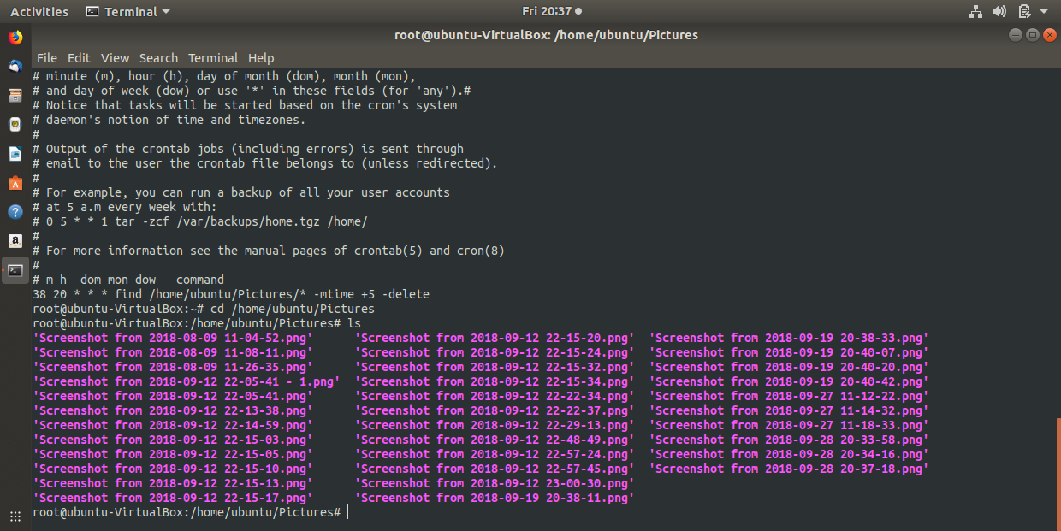
In the Pictures Directory
There were screenshots that were older than 5 days and some were not.

Slide 8
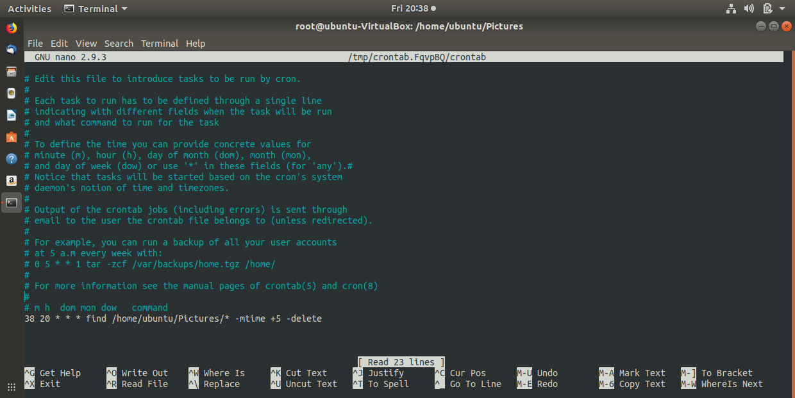
Crontab -e
30 20 * * * find /home/ubuntu/Pictures/* -mtime +5 -delete

Slide 9
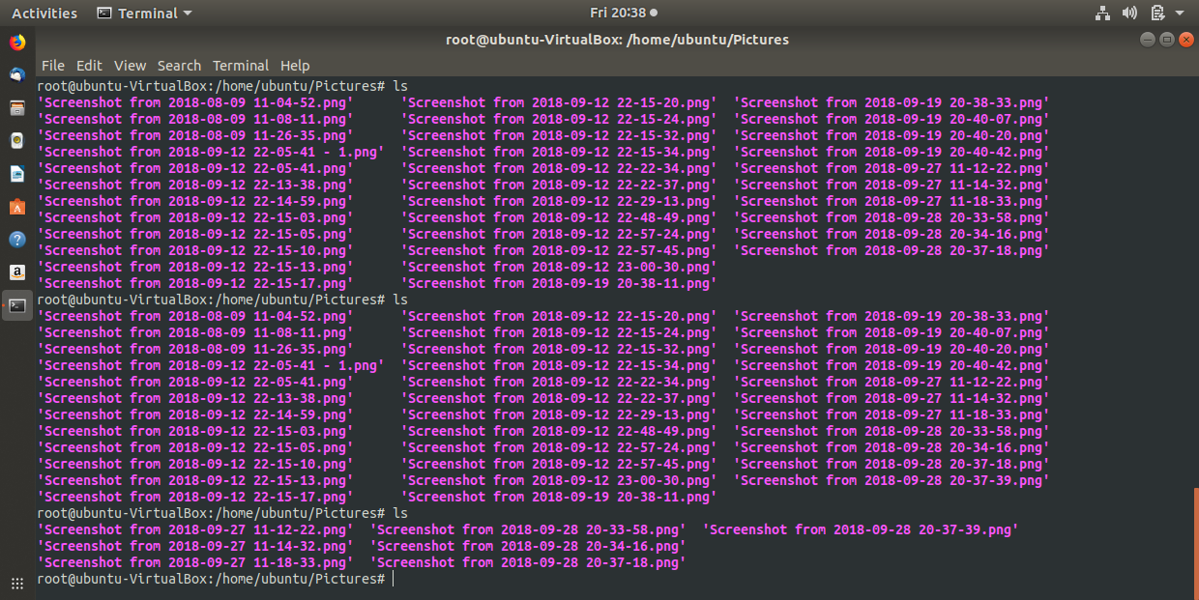
Files are discarded automatically.

Slide 10
Using Shell Script
The program needs to know the location of the directory containing the archives. And it needs the date and time beyond which the files will be considered as old and marked for deletion.
Then let the program get all the files in the given directory and filter the files that are older than the given timestamp. Once it has the list, it can delete all the files in the list.
To continue the same process everyday, just add it to the task scheduler named ‘cron’ in Linux that would just execute the program for you exactly at time you specify it.

Slide 11
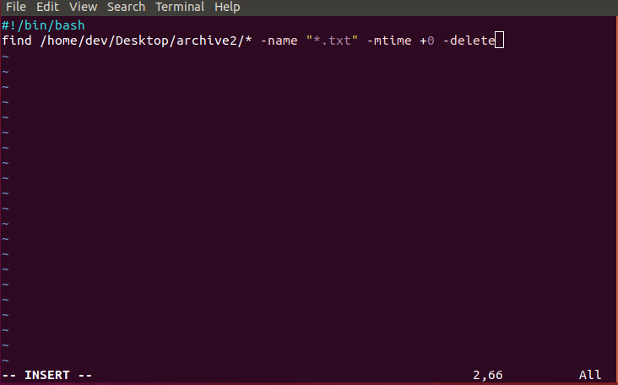

Slide 12
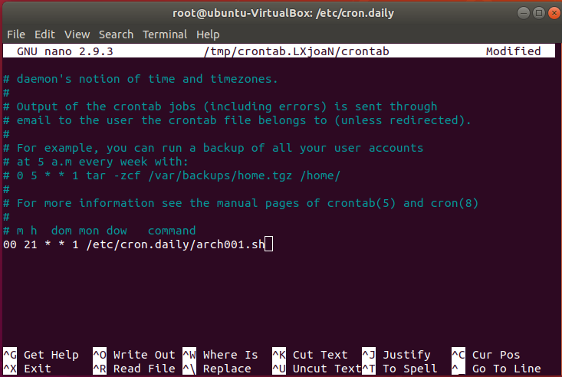

Slide 13
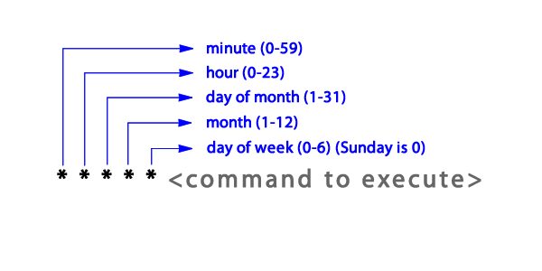
Understanding the wildcards

Slide 14
Advantages
It saves cost
It saves time
It saves efforts
it provides a very high reliability.

Slide 15

Thank you

