Slide 1
Creating Users and groups
By Mudit Garg
R171217036

Slide 2
What You Will learn
What is the need of creating users and group?
How to manage user and group?
Where user and group information lives?
How to add and delete users and group?

Slide 3
User and Group
NEED OF USER
User account is important because it helps to maintain identification (who is using system)
To maintain system log files
To maintain security of data:
User can set access permissions on their files
System administrator uses ‘root’ account for managing users
NEED OF GROUP
Groups helps to organize users in logical manner and share data among them .
Providing permissions to them collectively.

Slide 4

User account consists of:
Username( or login ID),UID (user ID) unique number, Default group ,Comments, Shell, Home directory location
All this information is stored in /etc/passwd file
Username:password:UID:GID:comments:home dir:shell
For root:
root:x:0:0:root:/root:/bin/bash
x – encrypted password, can be access through /etc/shadow file

Slide 5
Steps to create User
Step 1: Switch to root user : sudo su
Step2: adduser username
Step3: usermod –aG sudo username
(Usermod is used to add new user to sudo group)
Step 4: su – username
For deleting user:
Deluser username

Slide 6
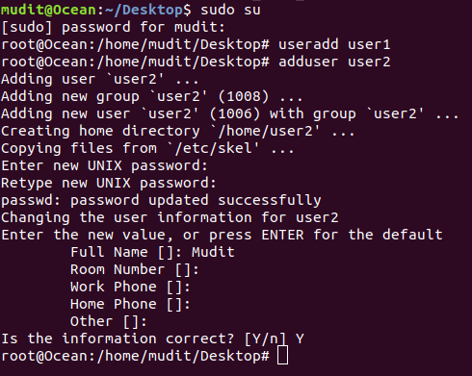

Slide 7
Difference b/t adduser & useradd
useradd: add user with his name only ( if you want to add a temp user with only a name, other info not required)
Basically it creates a temporary user , can we provide permissions to it, to access data.
adduser: add user with full profile and info
( You can check the details in screenshot of slide 6)
The difference is clearly reflected in slide 6 screenshot b/w both.
It is recommended to use adduser instead of useradd.

Slide 8
Steps to create Group
All this information is stored in /etc/group file
Groupname:password:gid:members
Addgroup groupname
Usermod –a –G groupname username
(To add user to group)
-a: tells usermod we are appending
-G: tells usermod we are appending to the group that follows the option.
To delete group: delgroup groupname

Slide 9
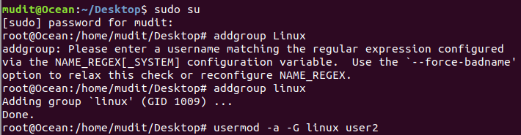

cat /etc/group

Slide 10
THANK YOU!!

