Slide 1
Automation scenarios: auto discard old archives.
By:
Garishma Virk
Roll no.17

Slide 2
What is autmation?
Automation is the technology by which a process or procedure is performed without human assistance.
WHAT IS SCENARIO?
a postulated sequence or development of events.

Slide 3
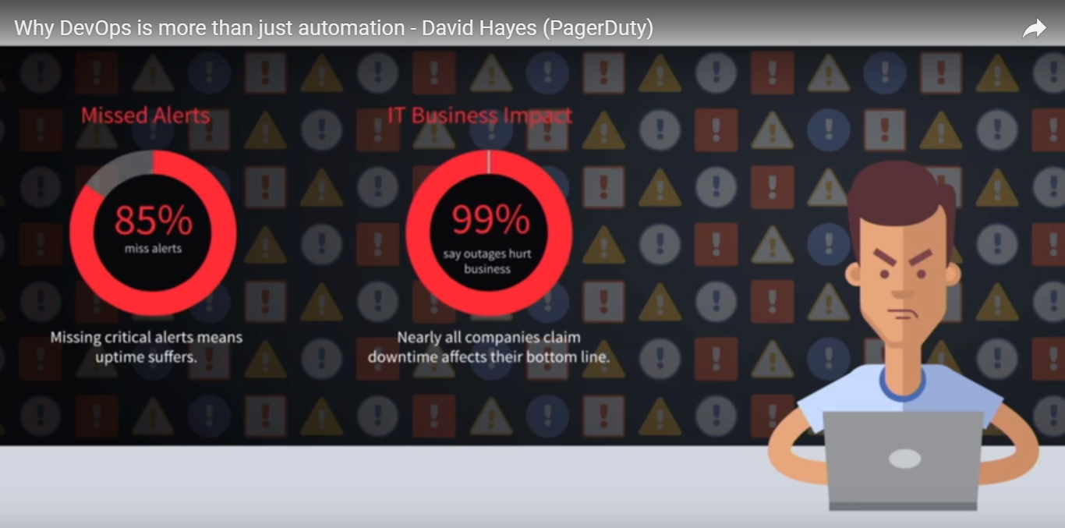
Why automation???

Slide 4
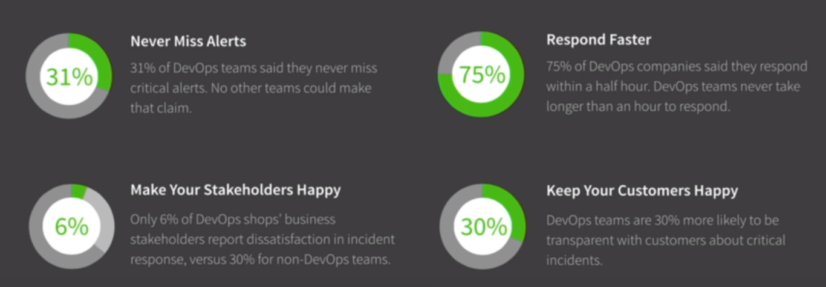
Some surveys:

Slide 5
Storage problem??????
No longer an issue.
Storage providers like AWS S3 , JFROG etc gives unlimited storage space on cloud.

Slide 6
What is the real problem??
What about managing the old artifacts that are no longer required……

Slide 7
Example :
Consider:
A file of 100 MB
20 commits per day,
Storage cost around 2 GB
After build deployment,,no longer we’ll need build of 1 to 15th commit.
Delete data and optimize cost

Slide 8
let us understand what an artifactory is and how can we speed up the deployment process using such artifactories with CI/CD tools?
Artifactories are used to store the artifacts (build packages) onto a storage service.

Slide 9
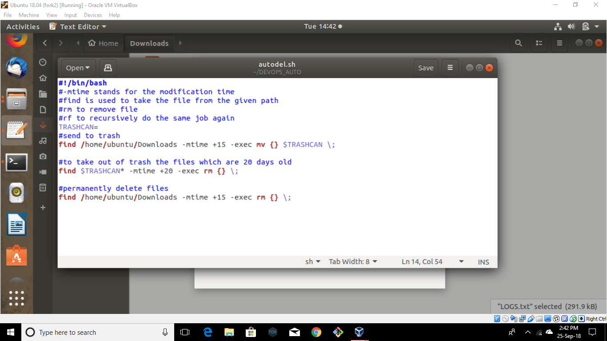
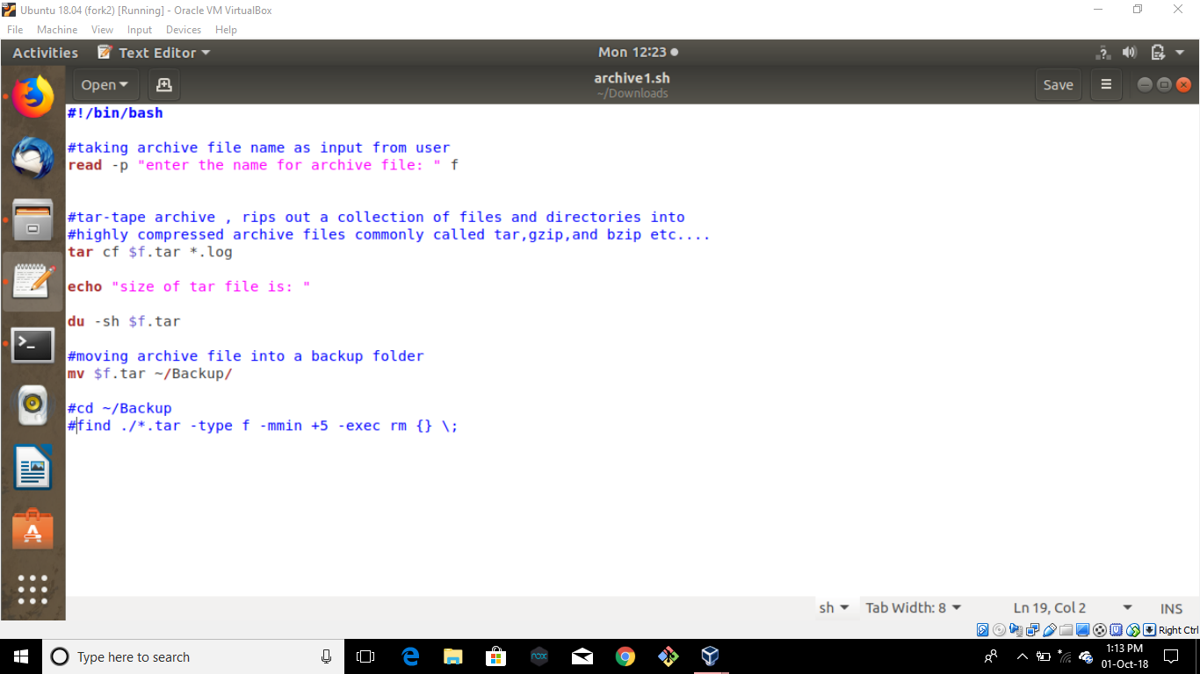
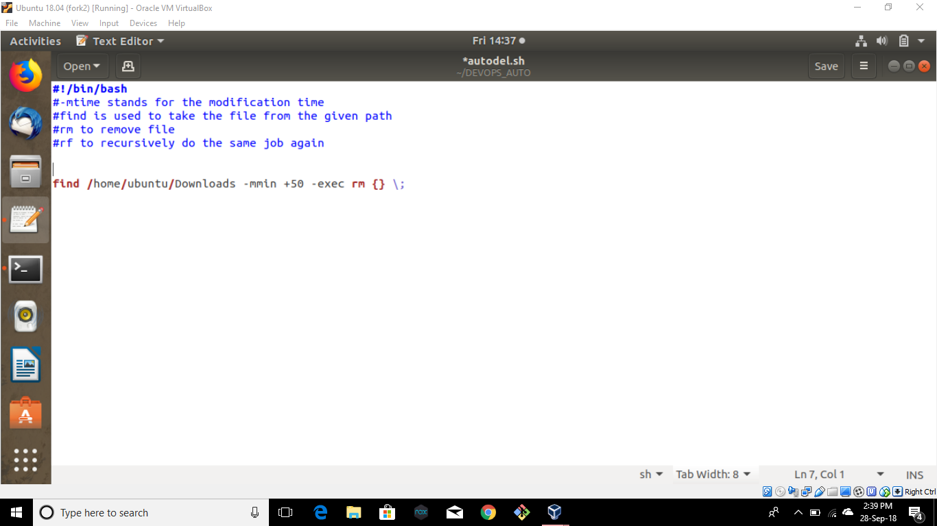

Slide 10
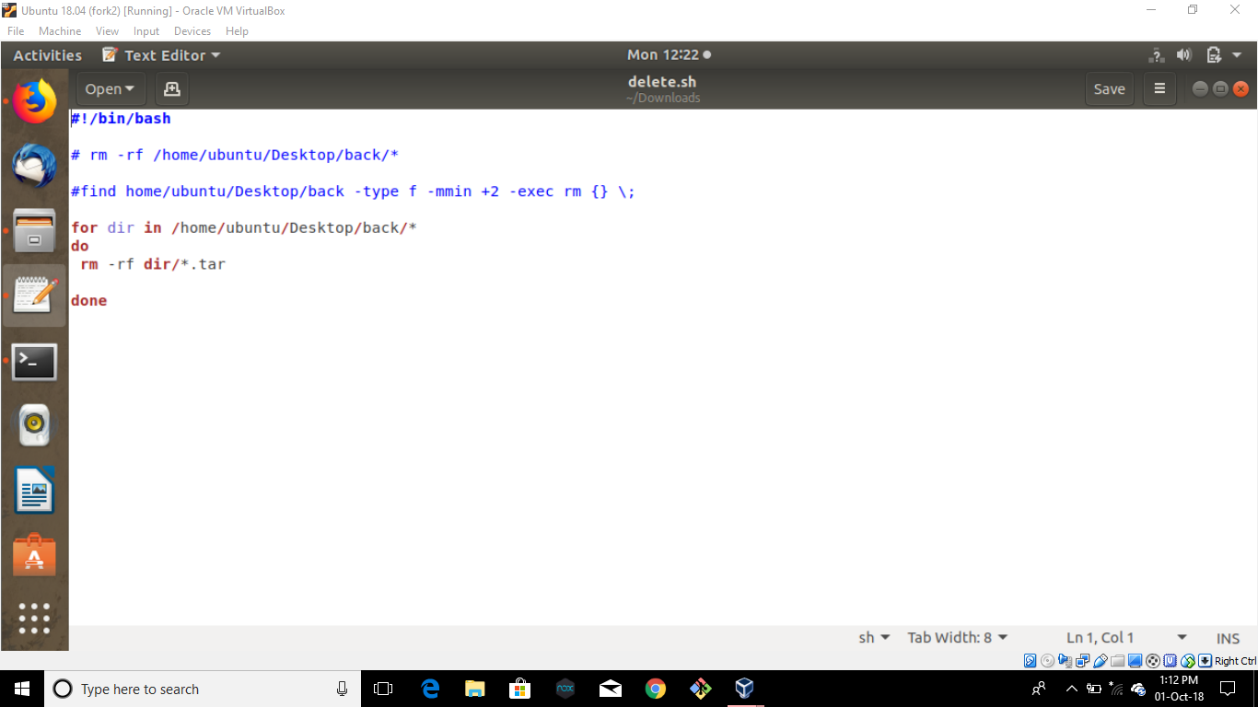

Slide 11
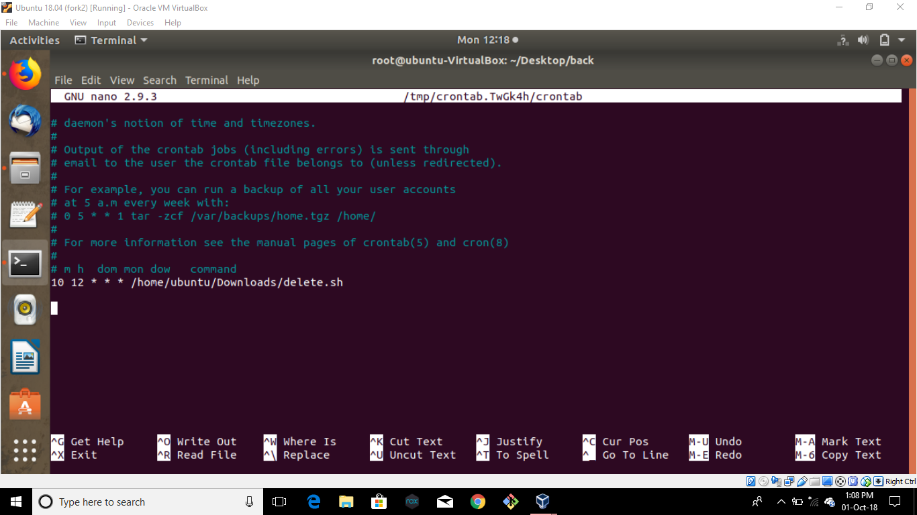

Slide 12
Problems of using cli:
Some cron scripts are used
If these scripts fail, then it will increase the storage cost.
On deleting particular folders using CLI, it deletes the files but leaves the folders empty. This way, it becomes difficult to identify the folders whose files have been deleted.

Slide 13
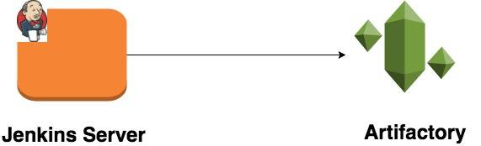
Now, integrate jenkins with artifactory???

Slide 14
JENKINS:
Jenkins provides an option to manage the older artifacts.
Discard Old Build Plugin

Slide 15
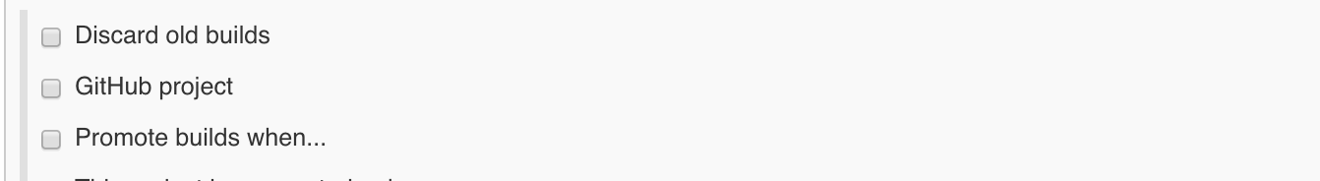
This plugin functionality can be extended to manage the artifacts. after installing the plugin, you will get the option as shown below to manage the build data of your Jenkins job:

Slide 16
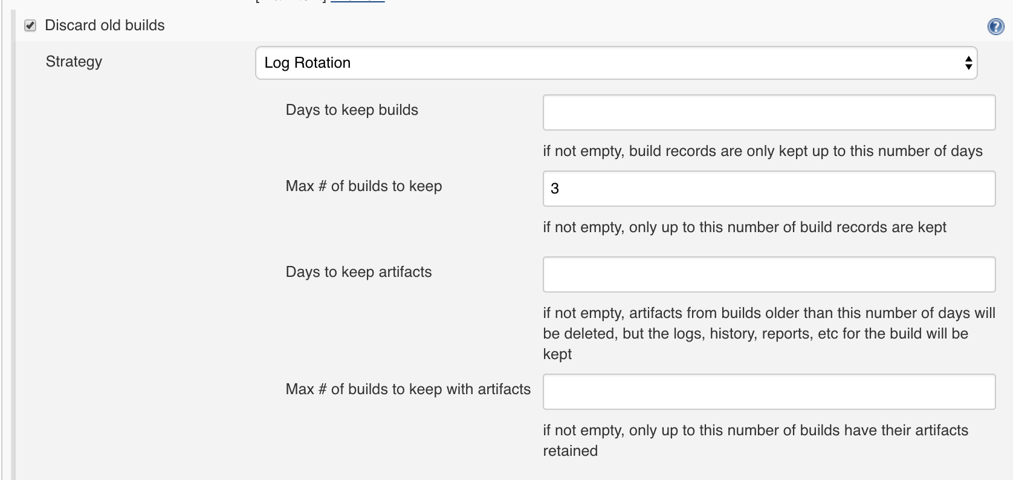
One can handle the build data depending upon the last number of builds or number of days.

Slide 17
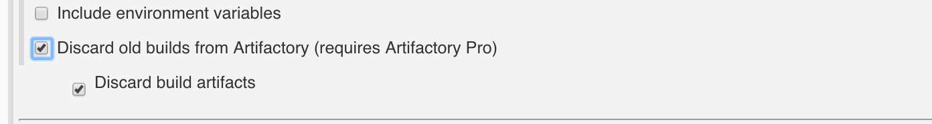
After defining the above options, it is also desired to manage the artifacts generated through the execution of Jenkins job. This can be managed through the Artifactory configuration as shown below:

Slide 18
And….
No need to install the artifactory CLI and setting up automation scripts to manage the older artifacts and job details.

Slide 19
THANK YOU !

