Slide 1
File Permissions in Linux
NAMAN VATS
Devops Batch-1
500061496
171217038

Slide 2
Topics covered:-
Ownership of Linux files
Permissions
A program in detail
Access rights
Changing file/directory permissions with 'chmod' command
Absolute mode
Symbolic mode
Summary
New terms

Slide 3
Ownership of Linux files
Ownership of
Linux files
User
A user is the owner of the file. By default, the person who created a file becomes its owner. Hence, a user is also sometimes called an owner.
Group
A user- group can contain multiple users. All users belonging to a group will have the same access permissions to the file.
Other
Any other user who has access to a file. This person has neither created the file, nor he belongs to a user group who could own the file. Practically, it means everybody else.

Slide 4
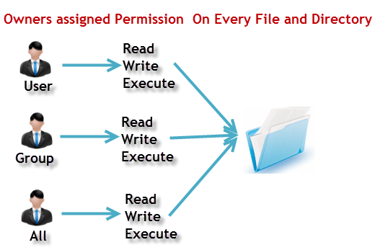
Permissions
Read:
This permission give you the authority to open and read a file. Read permission on a directory gives you the ability to lists its content.
Write:
The write permission gives you the authority to modify the contents of a file. The write permission on a directory gives you the authority to add, remove and rename files stored in the directory.
Execute:
An executable is a file that contains a program - that is, a particular kind of file that is capable of being executed or run as a program in the computer.

Slide 5
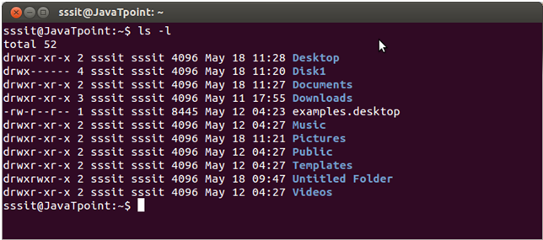
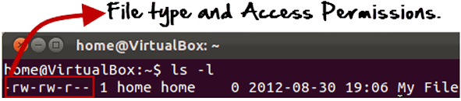
A program in detail:-
ls - l on terminal gives
------------- -- ------ ------ -- -------------- -------- ----------
| | | | | | | |
| | | | | | | +------ File Name
| | | | | | +---- Modification time
| | | | | +--- Modification Date
| | | | |
| | | | +------------- Size (in bytes)
| | | |
| | | +----------------------- Group
| | |
| | +-------------------------------- Owner
| |
| +-------------------------------------- “link count”
|
+---------------------------------------------- File Permissions

Slide 6
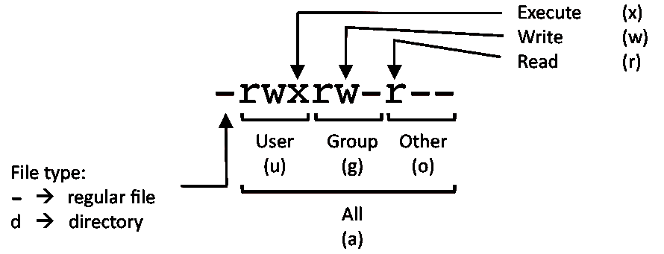
Access rights:-
Files are owned by a user and a group (ownership)
Files have permissions for the user, the group, and other
“other” permission is often referred to as “world”
The permissions are Read, Write and Execute (R, W, X)
The user who owns a file is always allowed to change its permissions
Two critical points:
The permissions of a directory affect whether someone can see its contents or add or remove files in it.
The permissions on a file determine what a user can do to the data in the file.
Example:
If you don't have write permission for a directory, then you can't delete a file in the directory. If you have write access to the file you can update the data in the file.

Slide 7
Changing file/directory permissions with 'chmod' command
There are 2 ways to use the command -
Absolute mode
Symbolic mode
Say you do not want your colleague to see your personal images. This can be achieved by changing file permissions.
We can use the 'chmod' command which stands for 'change mode’.
Using the command, we can set permissions (read, write, execute) on a file/directory for the owner, group and the world.
Syntax:
chmod permissions filename

Slide 8
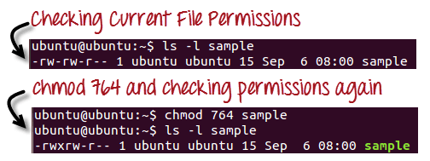
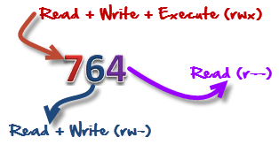
Absolute mode
In this mode, file permissions are not represented as characters but a three-digit octal number.
The table below gives numbers for all for permissions types.
Number | Permission Type | Symbol
0 | No Permission | ---
1 | Execute | --x
2 | Write | -w-
3 | Execute + Write | -wx
4 | Read | r--
5 | Read + Execute | r-x
6 | Read +Write | rw-
7 | Read + Write +Execute | rwx

Slide 9
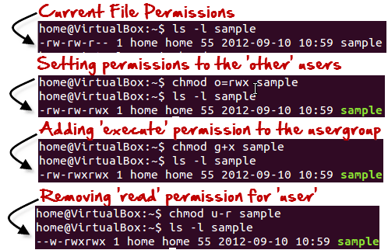
Symbolic mode
In the Absolute mode, you change permissions for all 3 owners. In the symbolic mode, you can modify permissions of a specific owner. It makes use of mathematical symbols to modify the file permissions.
Operator | Description
+ | Adds a permission to a file or directory
- | Removes the permission
The various owners are represented as -
User Denotations
u | user/owner
g | group
o | other
a | all

Slide 10
New terms:-
link count :-Unix file systems keep track of a "link count" to all objects in the file system. This "link count" value is the number of different directory entries that all point to the inode associated with the object.

Slide 11
Summary:
Linux being a multi-user system uses permissions and ownership for security.
There are three user types on a Linux system viz. User, Group and Other
Linux divides the file permissions into read, write and execute denoted by r,w, and x
The permissions on a file can be changed by 'chmod' command which can be further divided into Absolute and Symbolic mode
The 'chgrp' command can change the group ownership chrgrp group filename
What does x - eXecuting a directory mean? A: Being allowed to "enter" a dir and gain possible access to sub-dirs.

Slide 12
THANK YOU

