Slide 1
AUTOMATION Scenarios
Ishita Singhal
R171217025

Slide 2
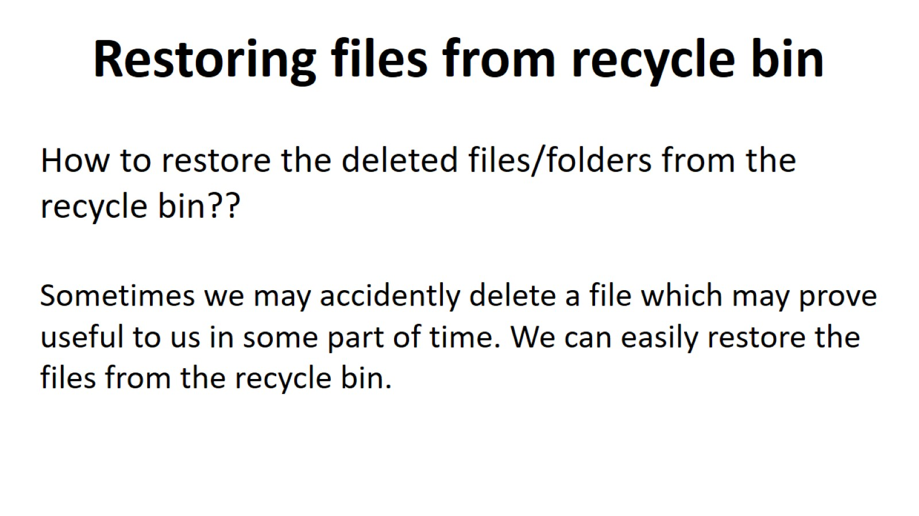

Slide 3
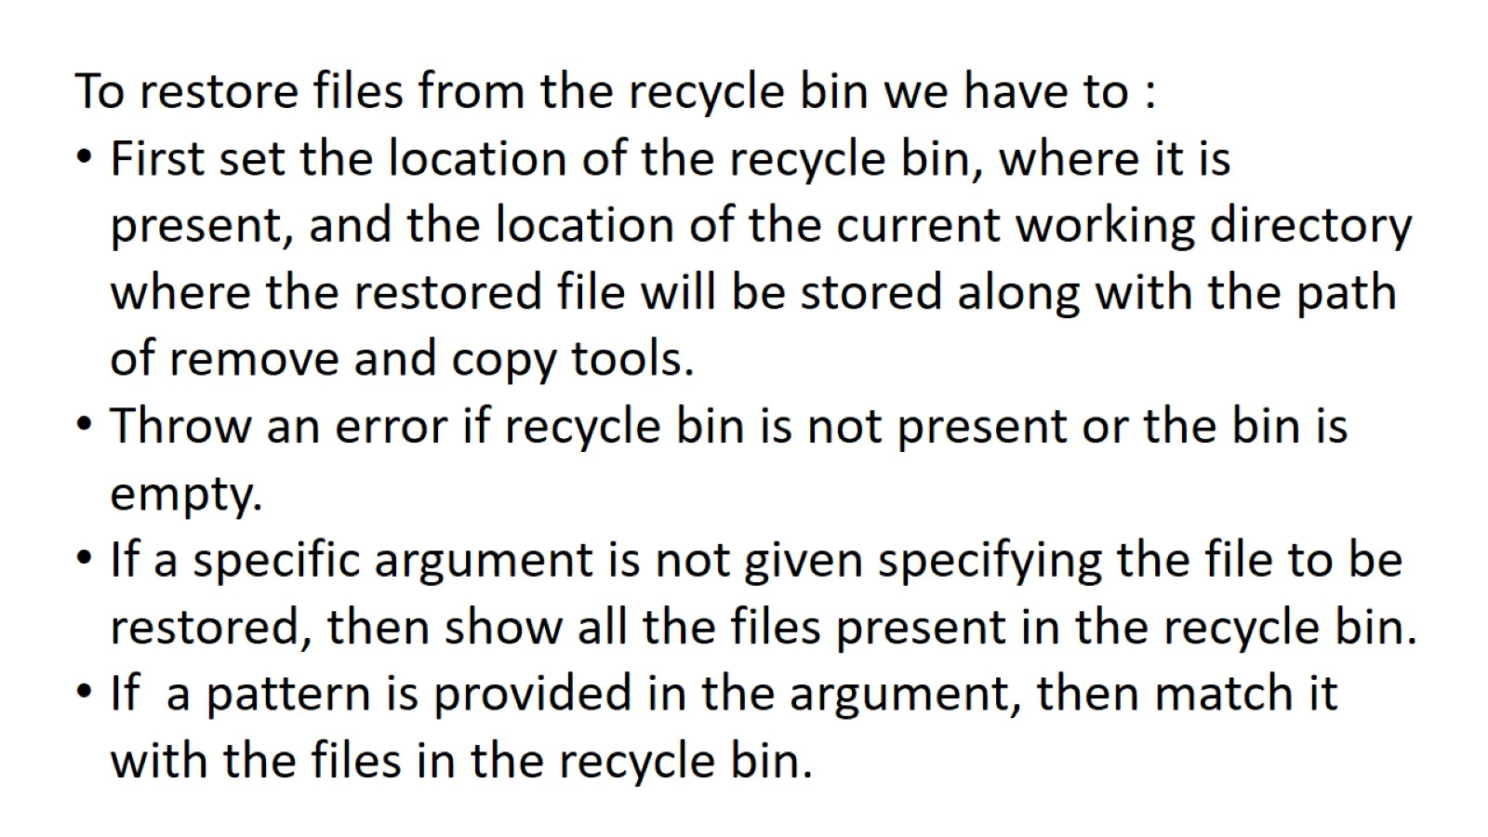

Slide 4
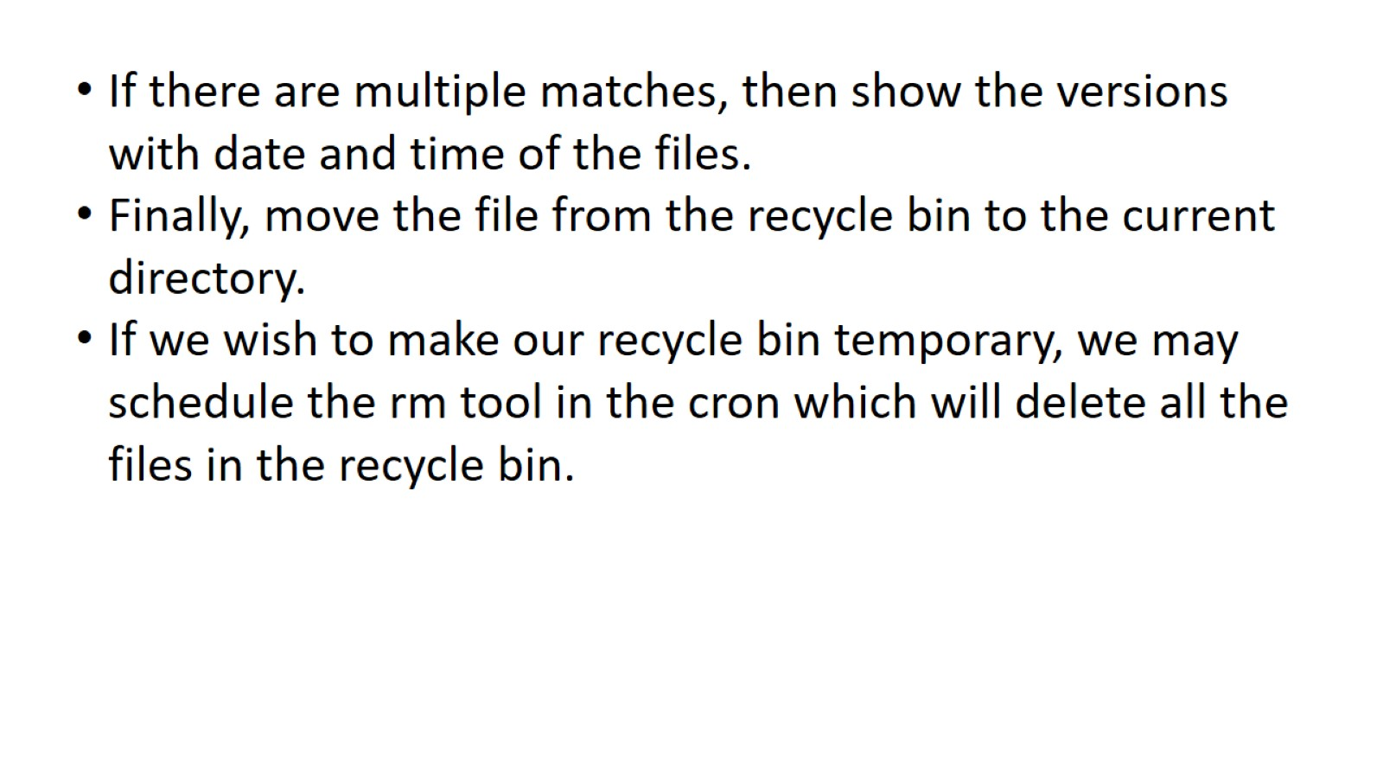

Slide 5
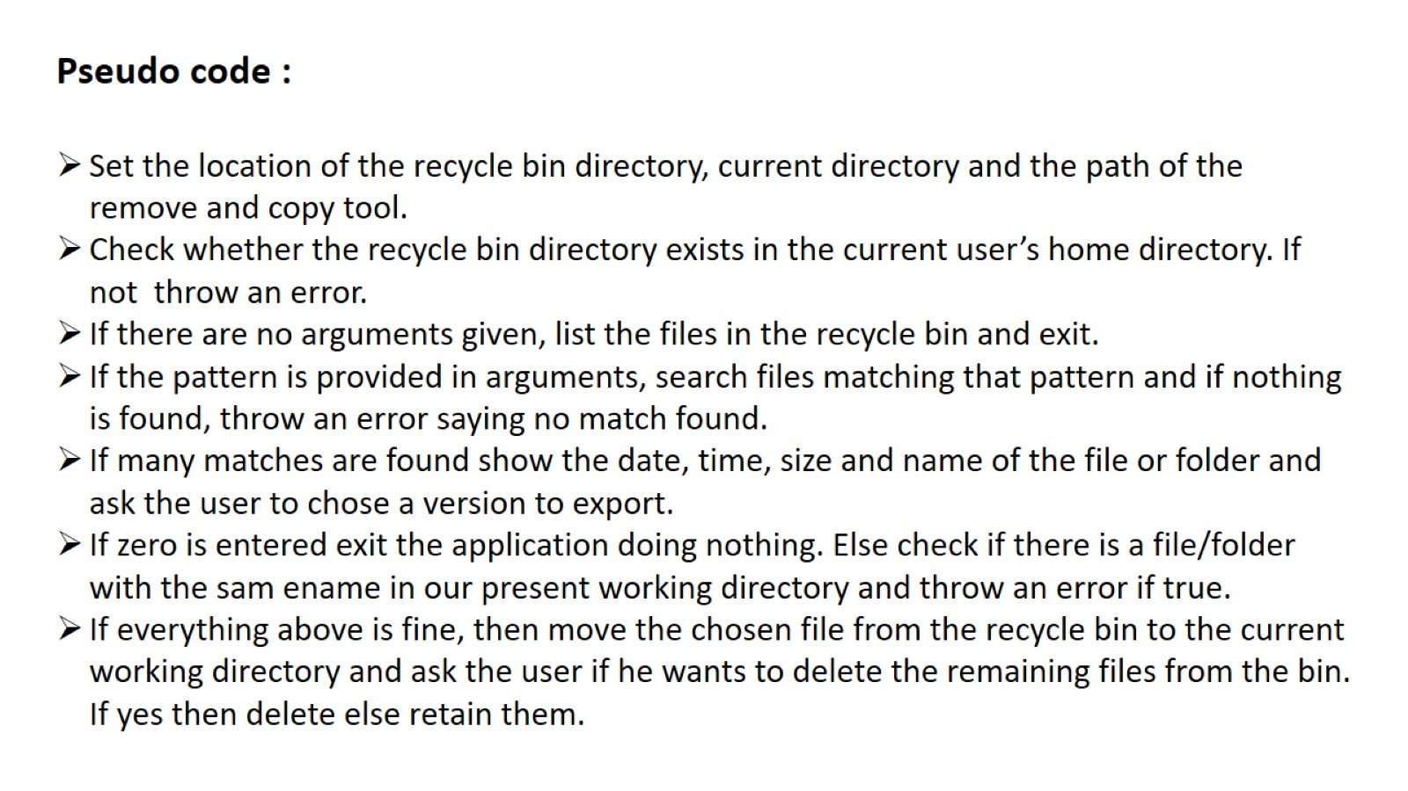

Slide 6
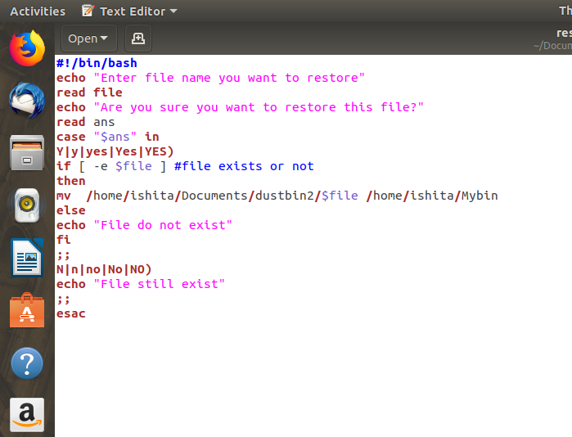

Slide 7
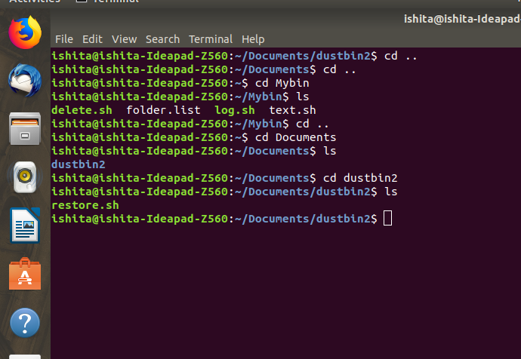

Slide 8
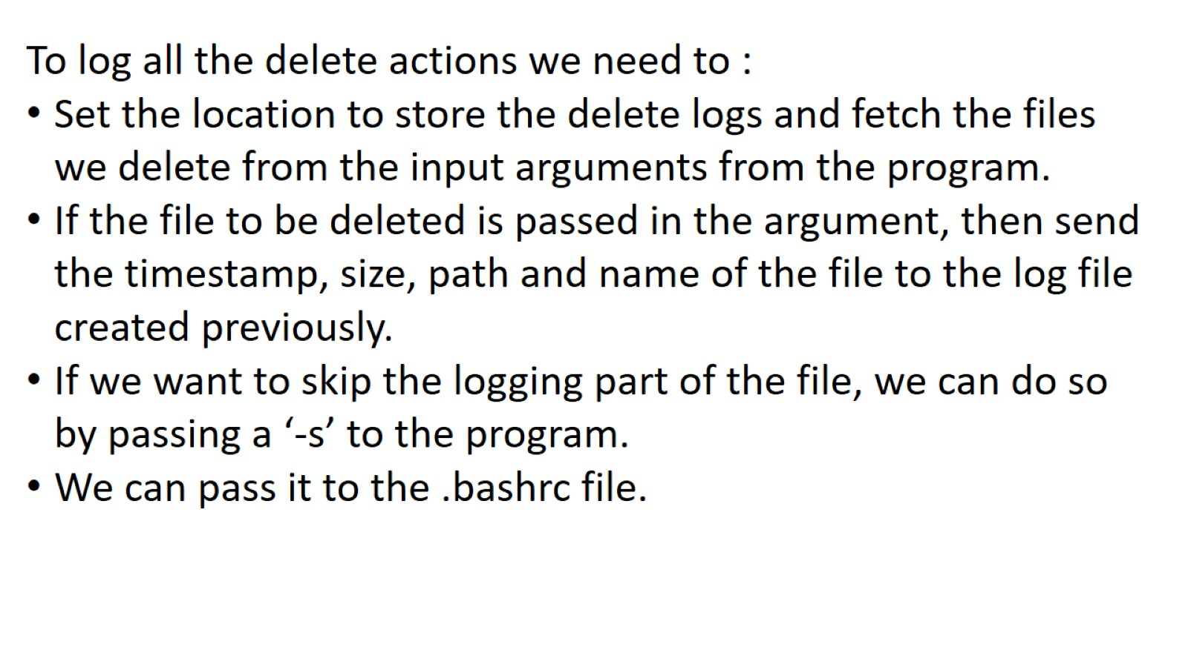

Slide 9
Logging Delete Actions
We can make logs of all the delete actions we perform on a file.
Logs are created to keep a check on what actions have been performed with a file.

Slide 10
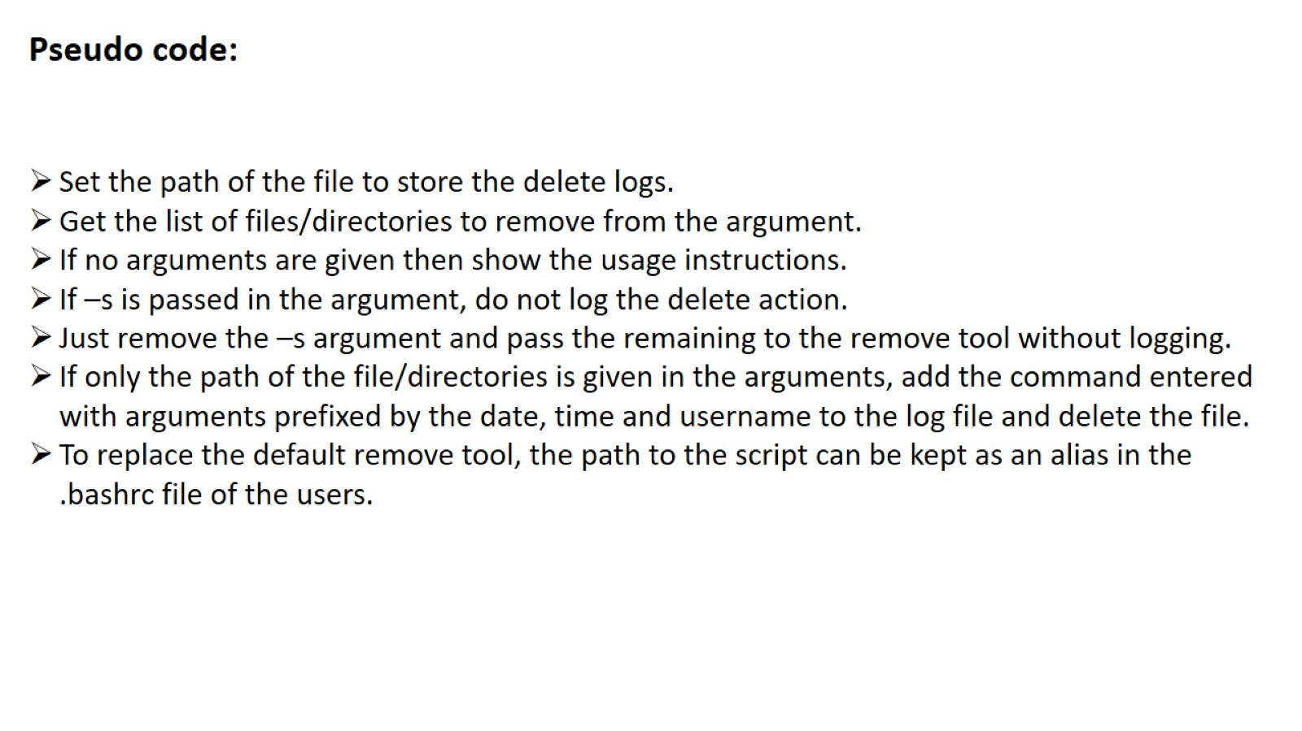

Slide 11
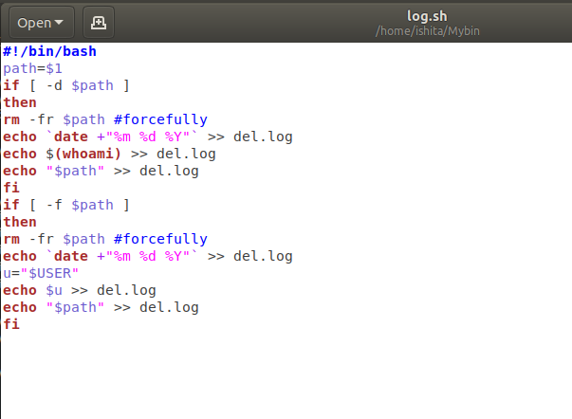

Slide 12
