Slide 1
DevOps Automation

Slide 2
Scenario-13
Decrypting Files::
Linux File Decryption Using GPG.

Slide 3
Why would we use GPG for file encryption?
Advantages::
It is usually installed by default on just about any Linux distribution.
The interface is all CLI based, you can easily integrate gpg inside your CI system. So you can make sure that Jenkins or other build tools send encrypted emails.

Slide 4
Disadvantages::
It doesn't hide file size.
It also doesn't work on directories on its own, requiring another utility called tar, though this is also installed by default on just about every distribution.

Slide 5
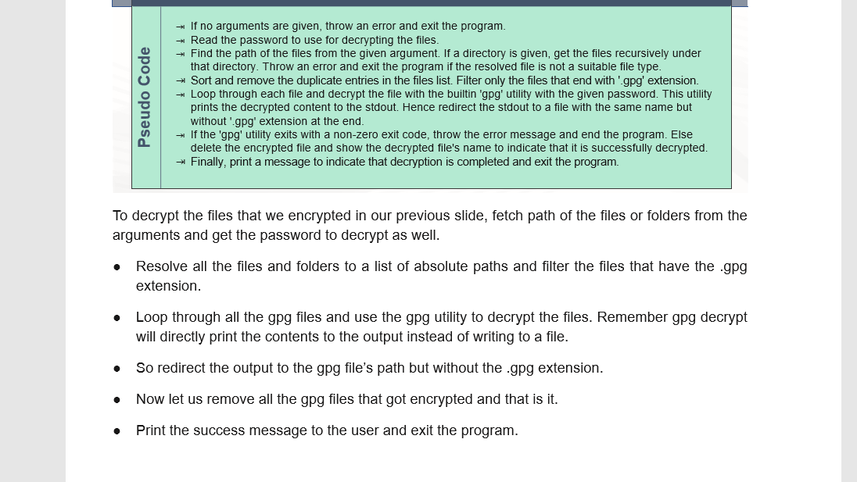

Slide 6
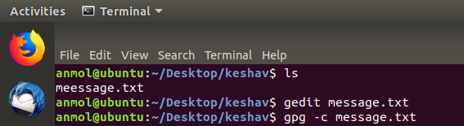

Slide 7
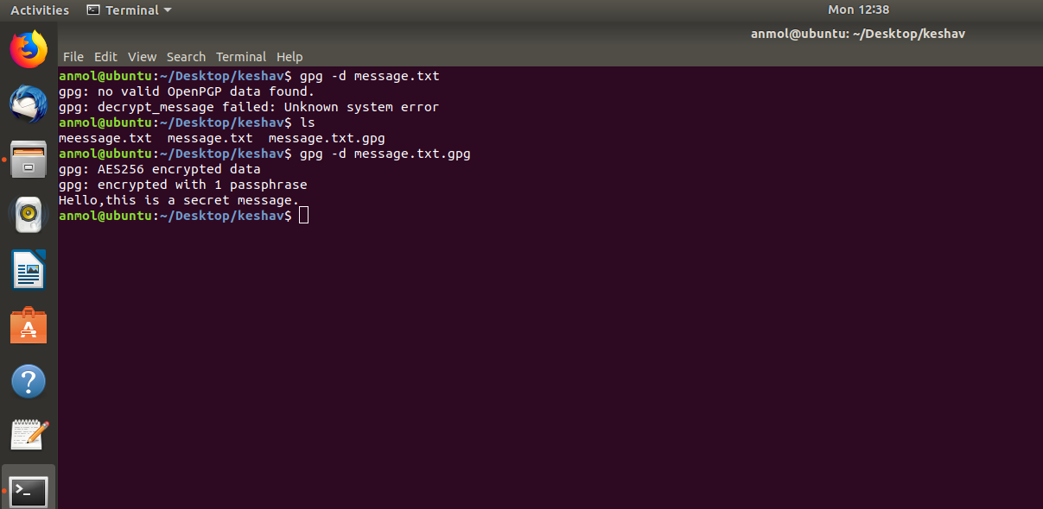

Slide 8
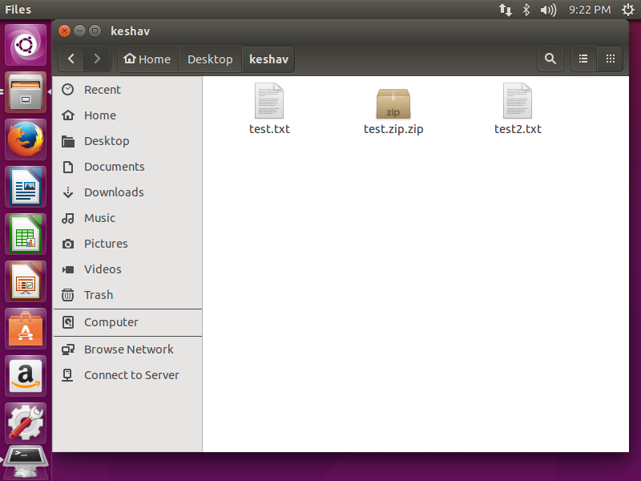

Slide 9
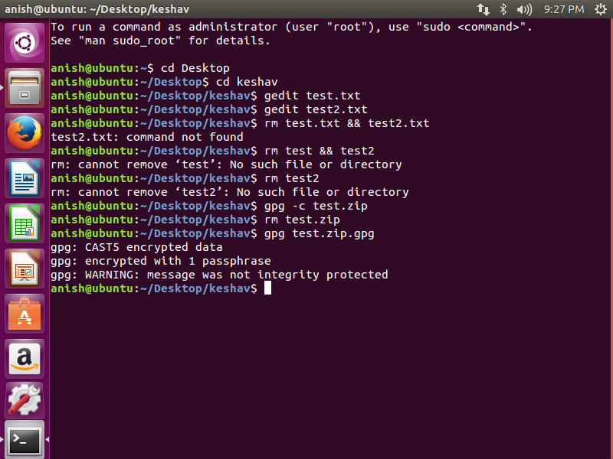

Slide 10
