Slide 1
DEVELOPMENT AUTOMATION
- Vedansh Singhal
R171217060

Slide 2
Disk usage alarm
Scenario 1-
How to monitor the disk usage and alert if it is beyond the given limit?

Slide 3
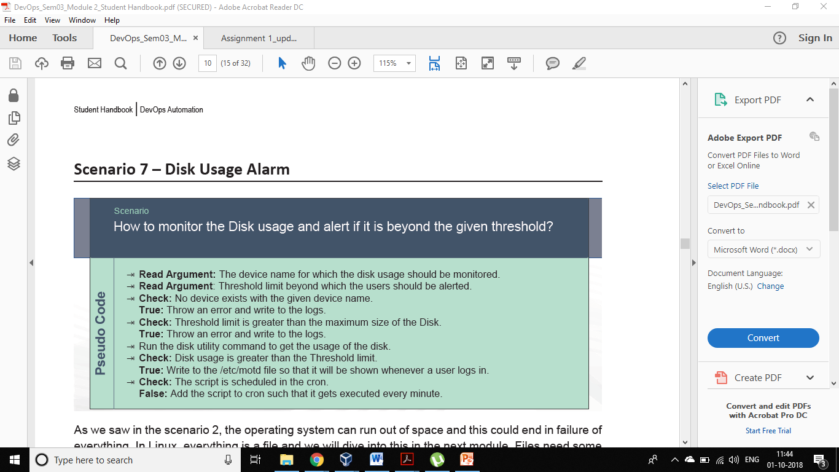
Pseudocode

Slide 4
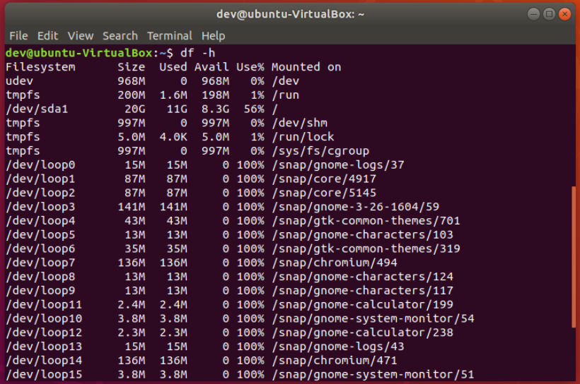

Slide 5
procedure
So firstly we need to know which hard disk or storage device should be monitored and also check if the device is crossing the threshold limit or not.
To make it more robust check whether the given storage exists or not.
Then if the threshold limit is crossing we can either send email or just write the log file.
To do this regularly we can schedule a cron job which will check for the same after every minute.

Slide 6
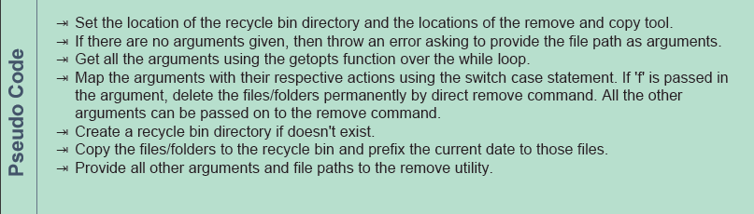
Sending files to recycle bin
Scenario 2- how to move the deleted files/folders to the recycle bin?

Slide 7
procedure
Frist set the temporary directory for the deleted files
Check whether the inputs given are correct or not
Use the script to move the file to recycle bin and rm tool to permanently delete the file

Slide 8
Pseudo code
Ask the user whether the file is there in any directory or it is present in home directory only.
Press “e or E” if it is in home directory.
Enter the name of the directory where the file is present
Enter name of the file which is to be deleted.
Ask the user whether he is sure or not to delete the file.
Move the file to the desired directory.
Use the tar command if you want to compress the file which will eventually reduce the size of the file

Slide 9
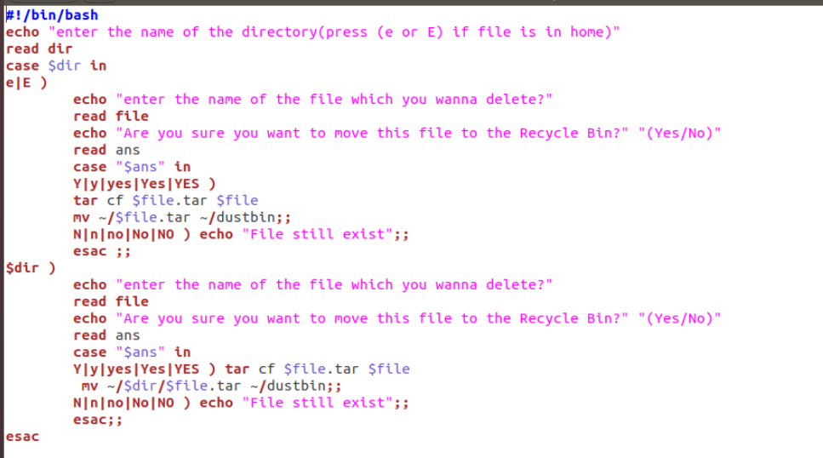

Slide 10
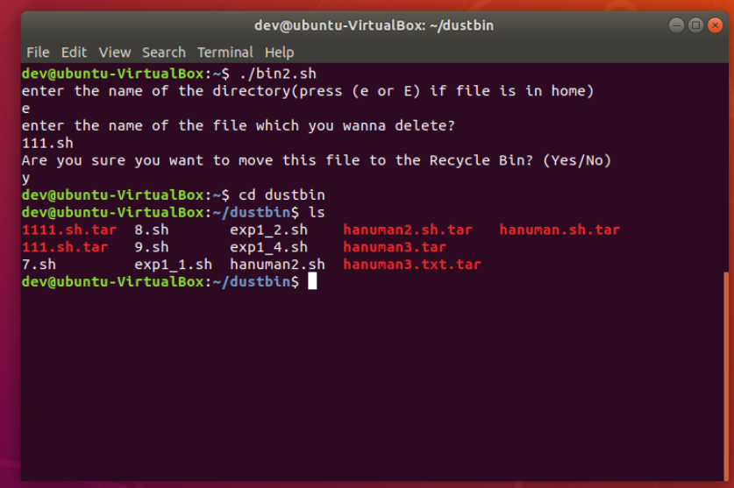

Slide 11
THANK YOU

