Slide 1
100 days code challenge
Day 2
NAME : SHUBHRA BHATTACHARYA
REG_NO : 22MCA10069

Slide 2
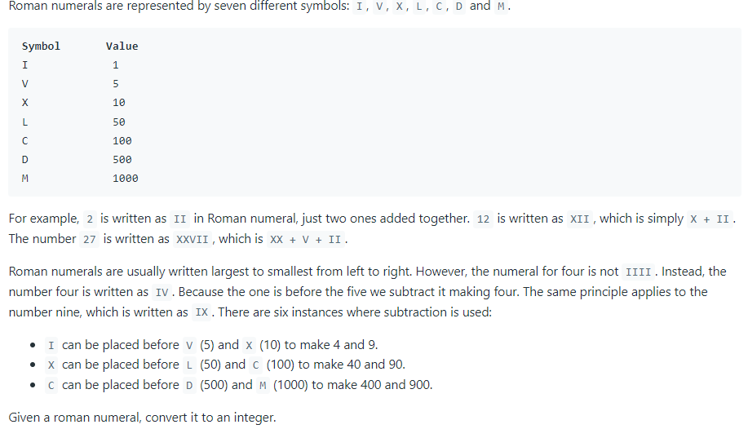
PROBLEM :
Question Link : https://leetcode.com/problems/roman-to-integer/

Slide 3
Solution :
class Solution {
public int romanToInt(String s) {
int len = s.length();
int a = 0;
for (int i = 0; i < len; i++) {
char ch = s.charAt(i);
int b = getValue(ch);
if (i < len - 1 && b < getValue(s.charAt(i + 1))) {
a -= b;
} else {
a += b;
}
}
return a;
}
private int getValue(char ch) {
int a = 0;
switch (ch) {
case 'I':
a = 1;
break;
case 'V':
a = 5;
break;
case 'X':
a = 10;
break;
case 'L':
a = 50;
break;
case 'C':
a = 100;
break;
case 'D':
a = 500;
break;
case 'M':
a = 1000;
break;
default:
break;
}
return a;
}
}

Slide 4
LEARNING :
In this program I learnt how to use String functions.
The array.length string function the total number of characters present in it.
In this program we also used Java Switch Case statement.
The Java switch statement executes one statement from multiple conditions.
The switch statement tests the equality of a variable against multiple values.

Slide 5
Interview related questions on length() AND SWITCH _CASE STATEMENT :
1. How can you explain arr.length string function?
The length() method gives the total number of characters present in the string; therefore, one can also
check whether the given string is empty or not.
Is it necessary to use break statement after last case e.g. default, in switch case block?
No, technically, using break after in default case is not necessary and this is optional. However, it is good to
use break in default to maintain consistency. Meaning, use break, for all cases in switch. It avoids the
accidental mistake.
What if I remove all breaks from switch case block?
If you remove all breaks, compiler will match the case and starting from the matching case, all the cases
below it will execute.

