Slide 1
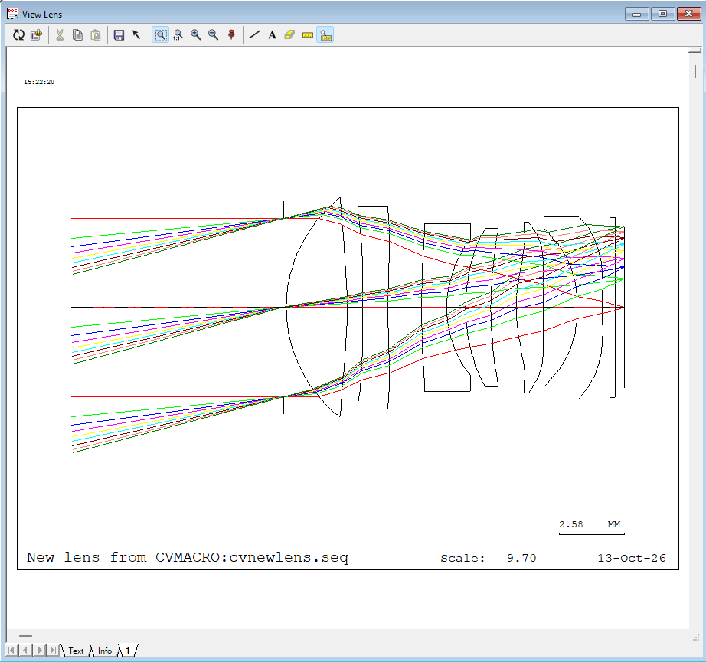
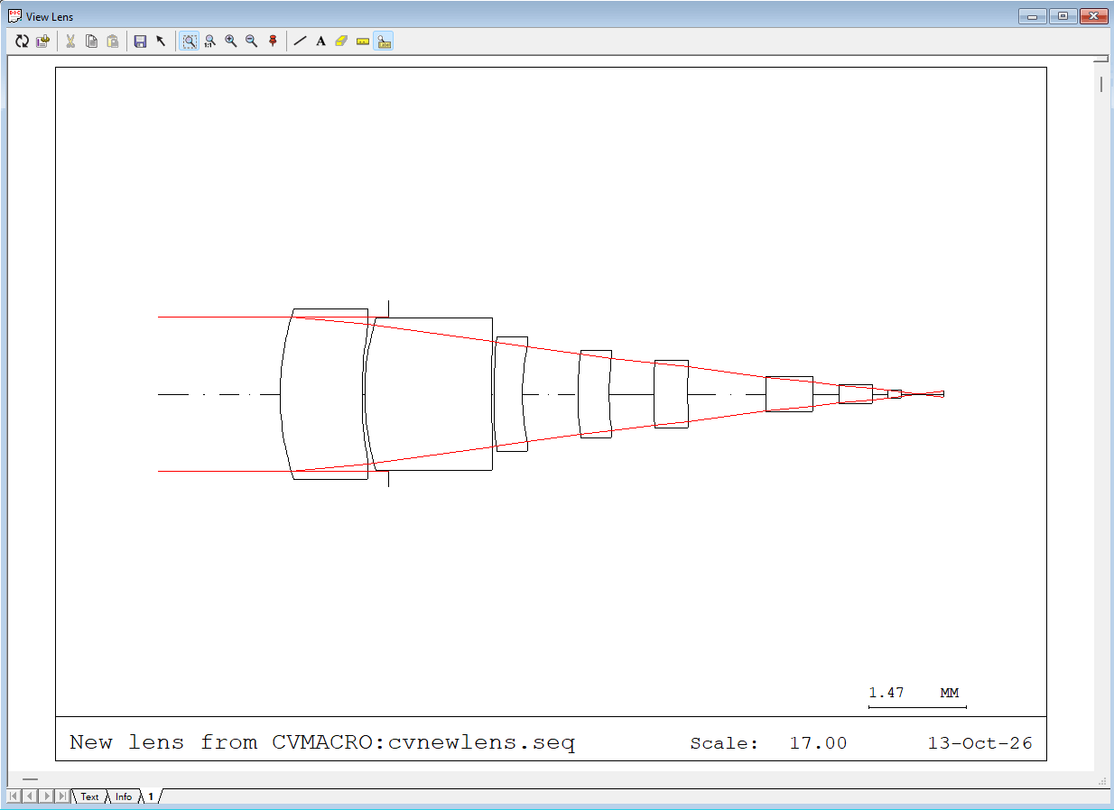
What if we no longer remember how it was obtained?
A historical best design
Initial structure
F# | 1.7
EFL | 12 mm
TTL | 13.5 mm
Max. field | 3.21 mm
Distortion | < 0.16%
MTF | = 0.4 @ 300 lp/mm
Strehl ratio | = 0.59 @ Max. field
Relative illumination | > 0.85
1. Is there a way to ‘fully record’ the process that leads to a good design?
2. Can we review and analyze historical optimization processes to obtain a better design than before?

Slide 2
KABBALAH — infrastructure for quantitative analysis of the optical design process
Reconstruct the complete real optimization history, including all failed/unsaved/rolled-back branches
Automatically save lens data after every optimization run
Automatically organize the history into a tree structure
Merge across files/logs/sessions over time
Translate low-level operations into natural language and add structured annotations to key operations (run optimization/view MTF...); users can freely edit/add annotations
Visual HTML files make human–AI interaction more efficient
......

Slide 3
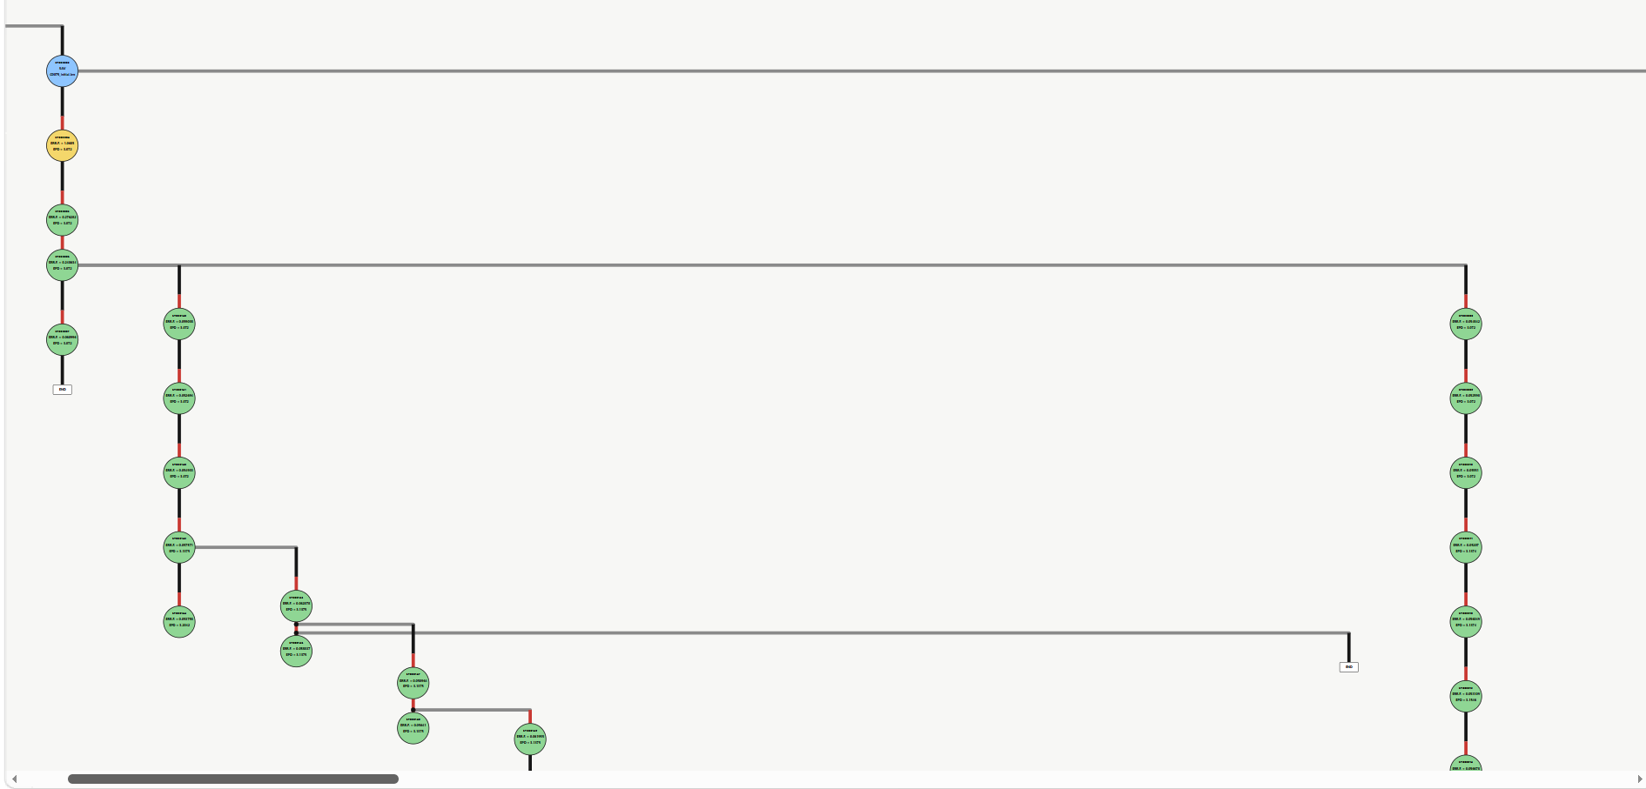
Two different branches derived from the same state
Unsaved rolled-back// failed operation branch

Slide 4
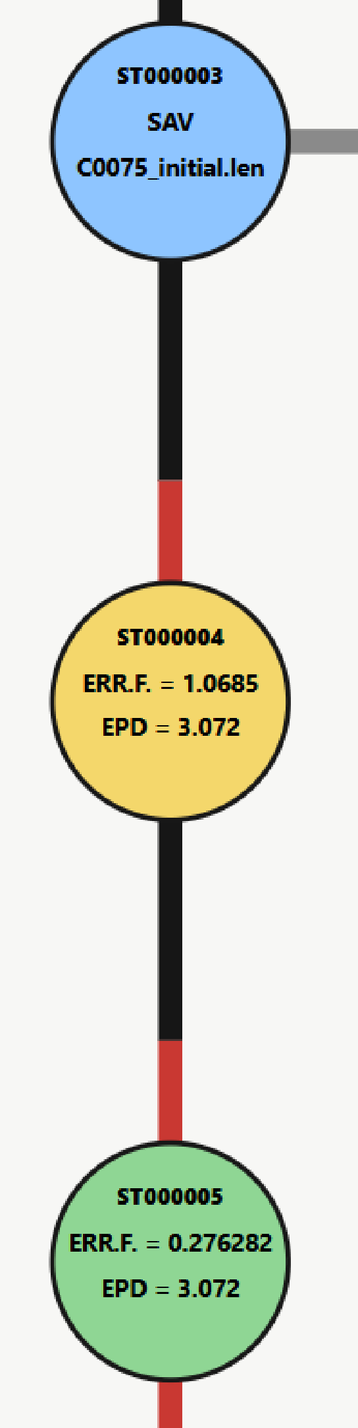
SAVED state
ERR.F >100
1< ERR.F <100
ERR.F <1
HUMAN operation
set and run optimization

Slide 5
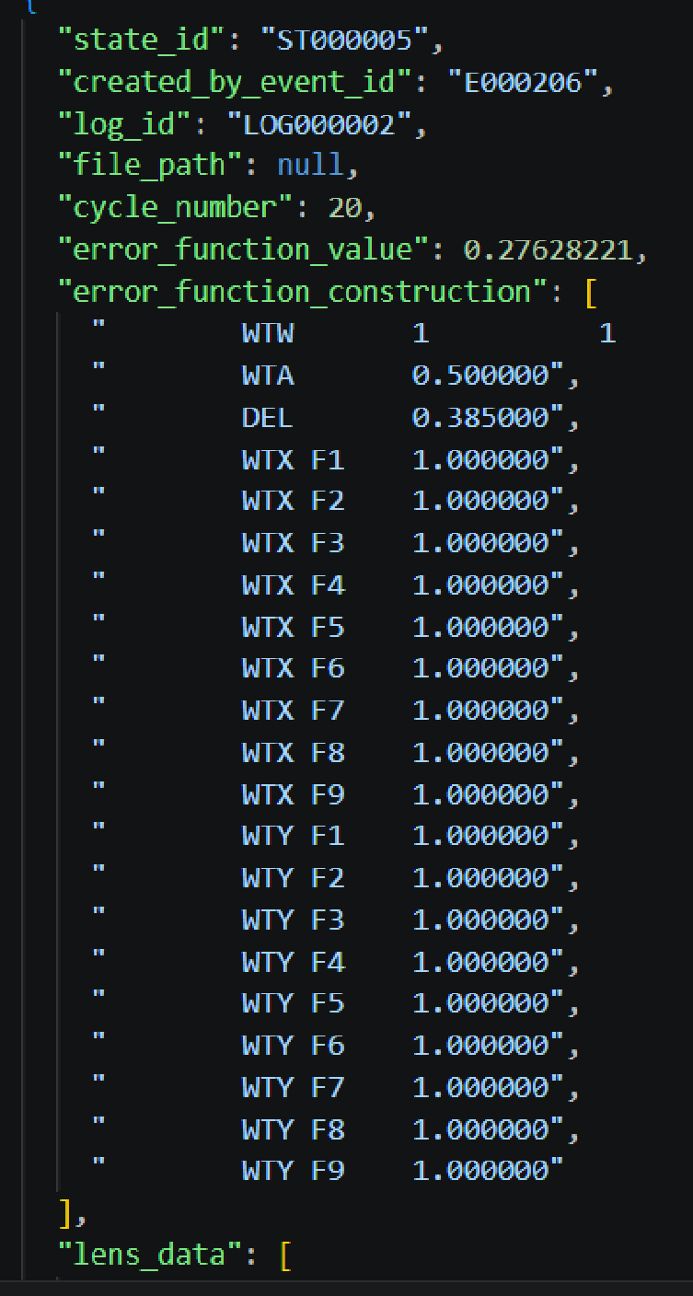
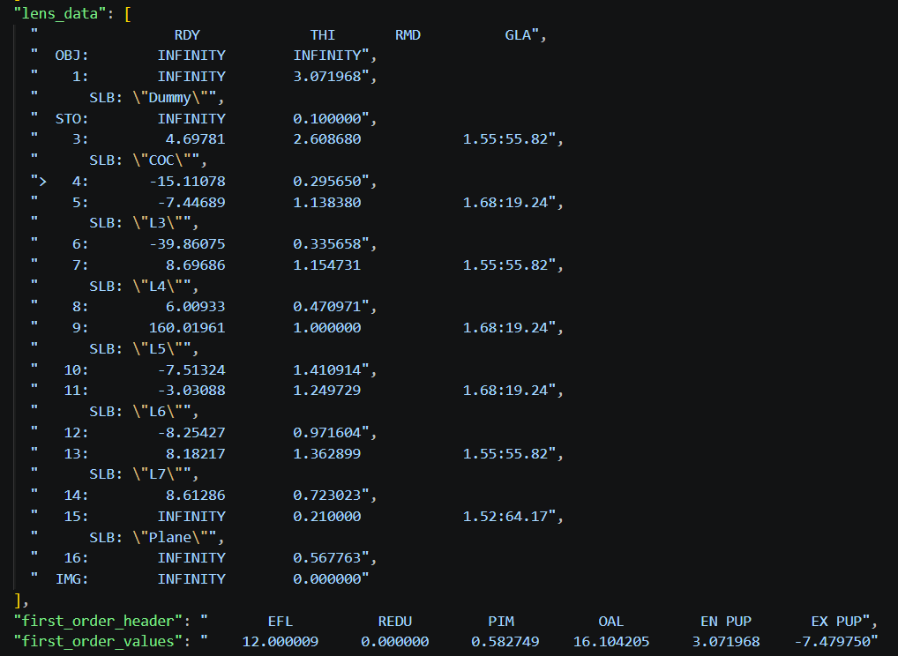
Lens data are stored in the ‘state library’ (except the blue SAV state, whose corresponding local files already exist by default)

Slide 6
What can this be used for?
Case 1: Analyze the direct effect of different distortion-constraint strategies on lens thickness
Case 2: Review an unsuccessful optimization route, identify the key operation step, and obtain a better design
Case 3: Analyze the evolution of L3L4 in the optimization history and quantify the mechanism behind the glass-material swap

Slide 7
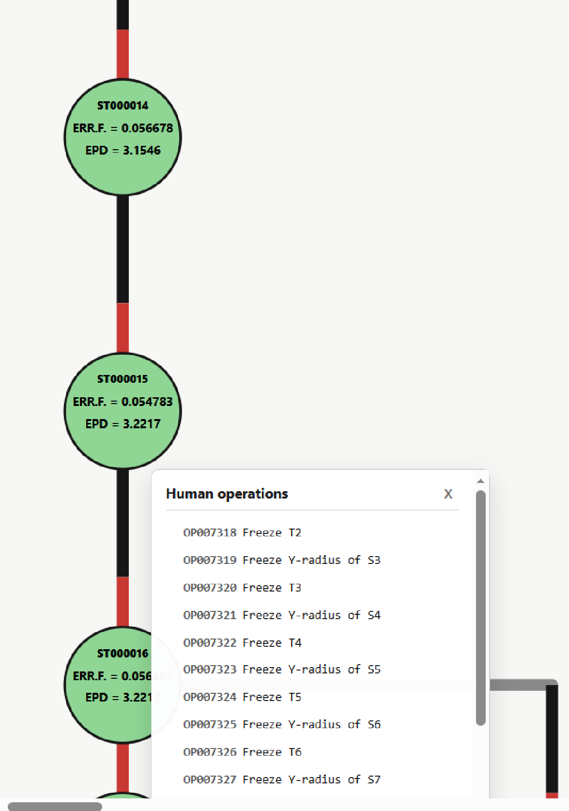
Case 1: Effect of distortion-constraint strategy on lens thickness
1. During trajectory review, GPT identified a clear change in designer behavior
ST000006 (initial spherical structure of this route)
Convert all lens surfaces to Qcon aspheres
Reduce F# and run automatic optimization
. . .
From F3.4,ST000015 onward, freeze all variables except the last lens L6, and reduce the center-thickness constraint from 2.4 to 1.8

Slide 8
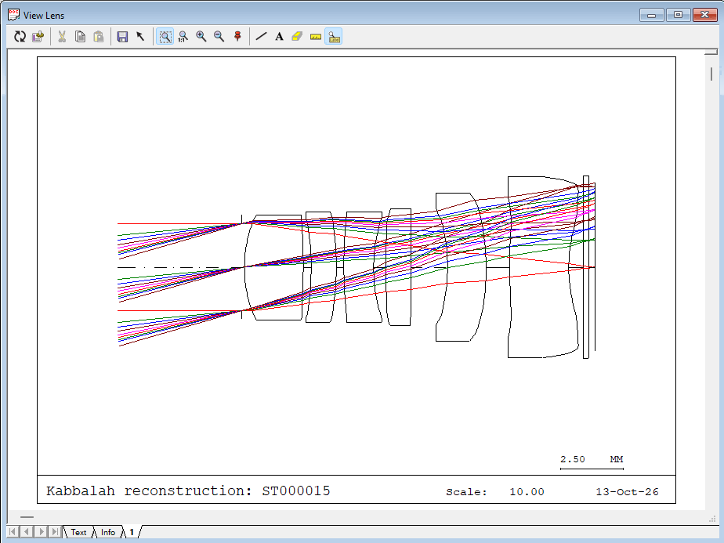
Case 1: Effect of distortion-constraint strategy on lens thickness
Inspect ST000015: the last lens is extremely thick

Slide 9
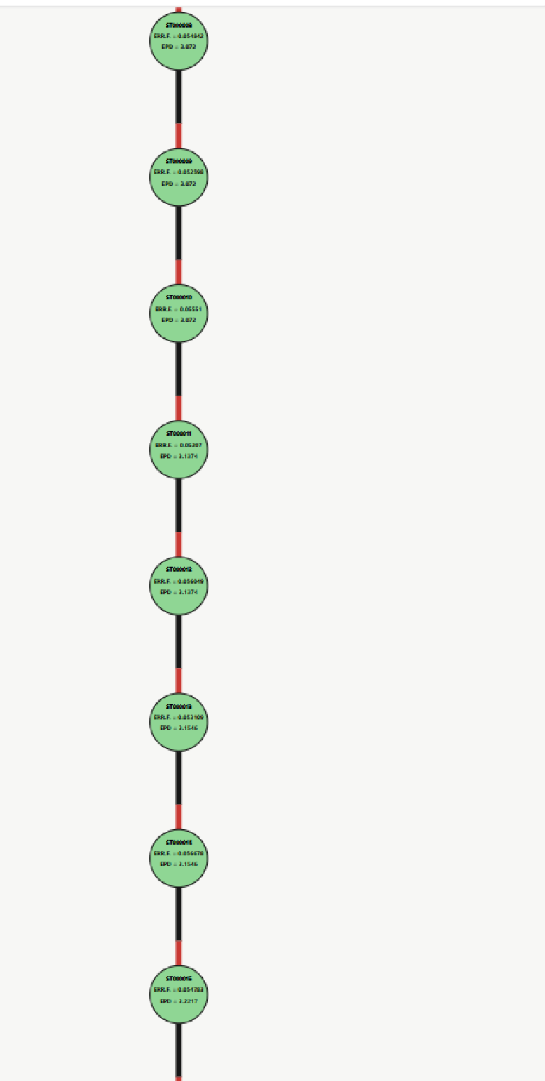
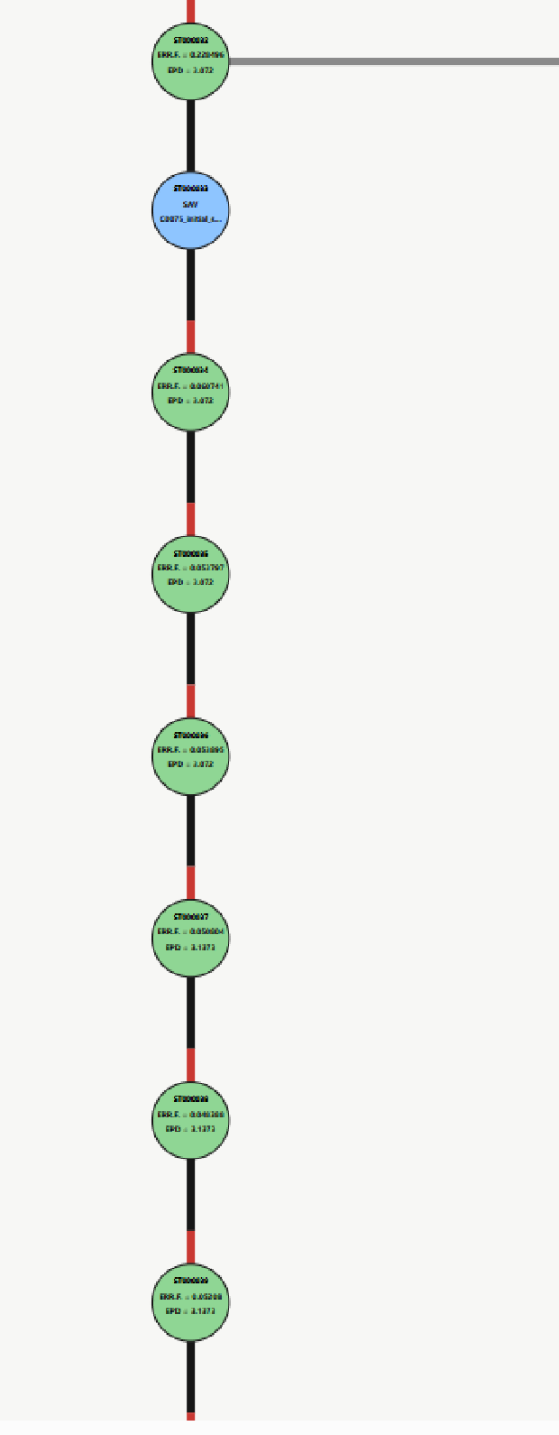
Case 1: Effect of distortion-constraint strategy on lens thickness
2. Compare the distortion-constraint strategies of two routes
Route 1
Route 2
 | Route 1(initial distortion=0.07) |  | Route 2(initial distortion=0.12)
F# | DST constraint | L6_CT/TTL | DST constraint | L6_CT/TTL
4 | <0.05 | 12.18% | <0.12 | 7.41%
3.8 | <0.03 | 13.55% | <0.11 | 7.52%
3.6 | <0.01 | 15.33% | <0.10 | 8.05%
3.4 | <0.008 | 16.85% | <0.09 | 8.62%
<3.4 | Manual thickness repair begins |  | Normal optimization
3.0 |  |  | <0.06 | 10.76%
1.7 |  |  | <0.005 | 7.41%
Problem: the initial states are different

Slide 10
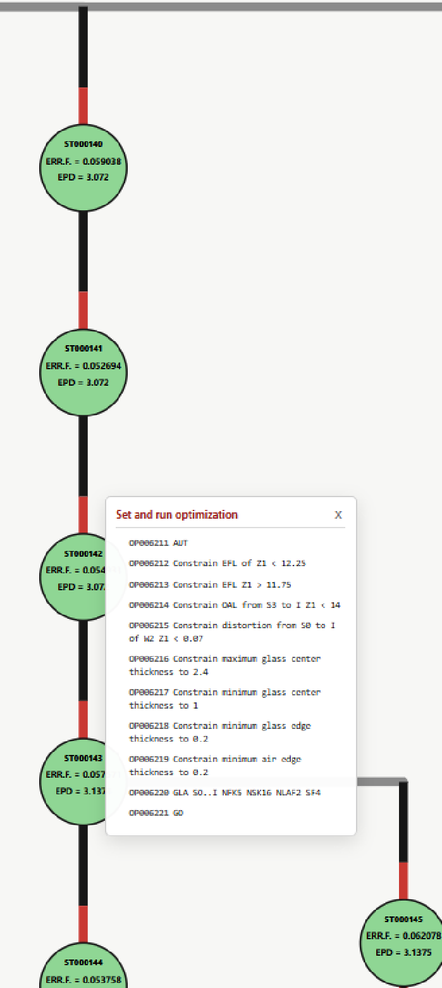
Case 1: Effect of distortion-constraint strategy on lens thickness
3. Actively design a controlled experiment
Route 1
Control route
 | Route 1(initial distortion=0.07) |  | Control route(same initial structure)
F# | DST constraint | L6_CT/TTL | DST constraint | L6_CT/TTL
4 | <0.05 | 12.18% | <0.07 | 11.69%
3.8 | <0.03 | 13.55% | <0.07 | 12.39%
3.6 | <0.01 | 15.33% | <0.07 | 13.36%
3.4 | <0.008 | 16.85% | <0.06 | 14.12%
<3.4 | Manual thickness repair begins |  | Normal optimization
3.0 |  |  | <0.06 | 15.26%
2.4 |  |  | <0.06 | 15.76%
<2.4 |  |  | Manual thickness repair begins

Slide 11
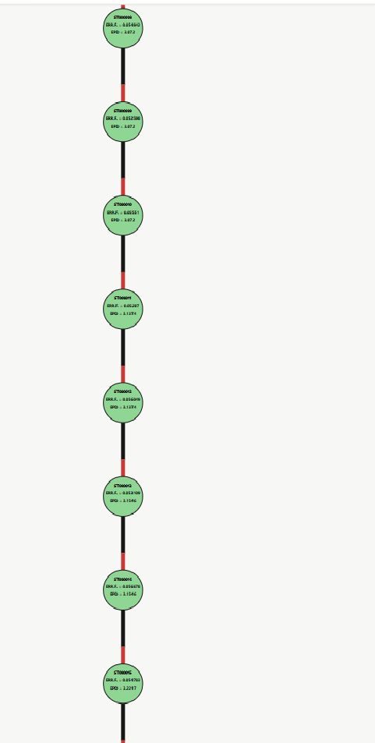
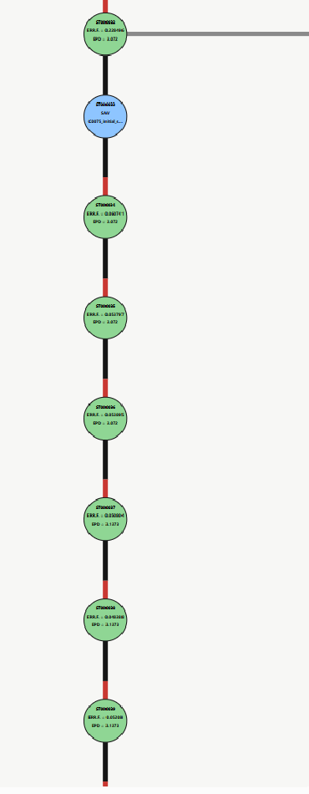
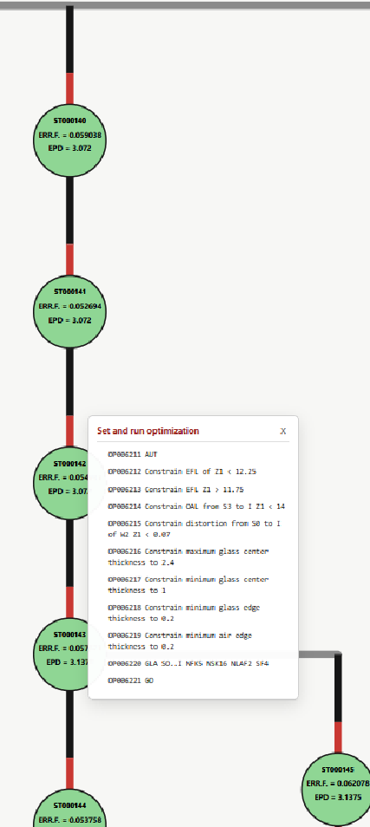
Case 1: Effect of distortion-constraint strategy on lens thickness
Hypothesis: Tightening the distortion constraint too early can cause the last lens to thicken prematurely if the structure already has this tendency.
step1: During review, GPTidentified a clear change in the designer’s operation logic, revealing that the last lens was rapidly thickening during optimization.
step2: Ask GPTto compare two historical optimization routes and identify different distortion-constraint strategies.
step3：Design a controlled-route experiment to test the idea and formulate a data-supported hypothesis that can later be supported/rejected/refined.
Route 1
Route 2
Control route

Slide 12
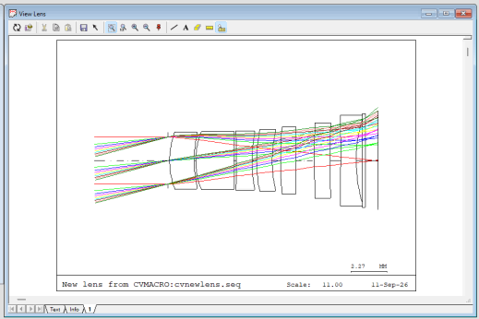
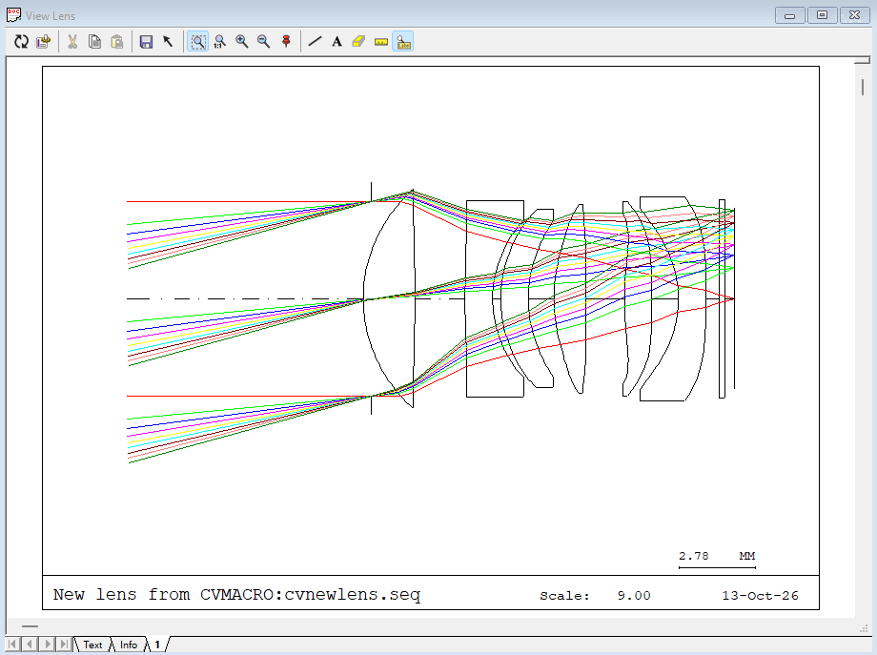
Case 2: Recover a forgotten optimization process and obtain a better design
F# | 1.7
EFL | 12 mm
TTL | 13.5 mm
Max. field | 3.21 mm
Distortion | < 0.16%
MTF | = 0.4 @ 300 lp/mm
Strehl ratio | = 0.59 @ Max. field
Relative illumination | > 0.85
A historical best design
STOP = 0.1
Initial spherical structure
F# | 1.7
EFL | 12 mm
TTL | 13.5 mm
Max. field | 3.21 mm
Distortion | < 2.5%
MTF | = 0.48 @ 300 lp/mm
Strehl ratio | = 0.72 @ Max. field
Relative illumination | > 0.95
A ‘nearly successful’ route
STOP = - 0.3

Slide 13
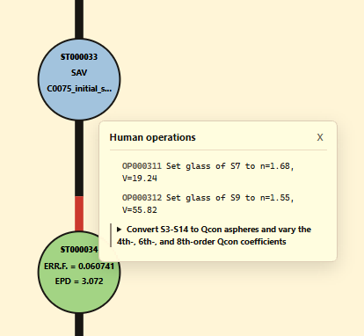
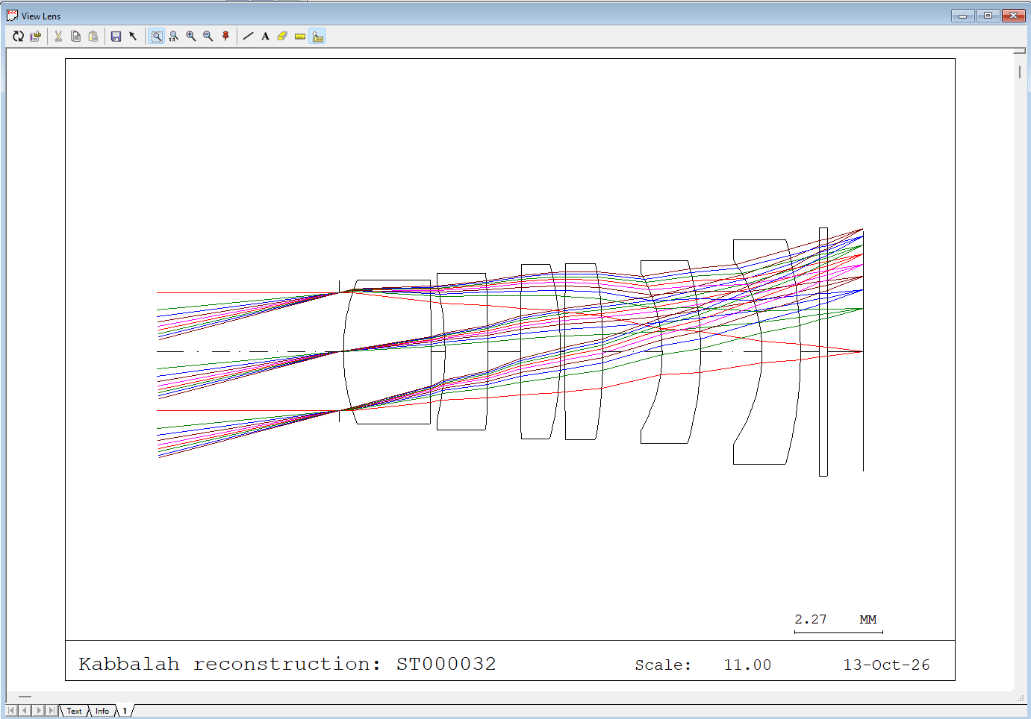
Case 2: Recover a forgotten optimization process through trajectory review
Identify the key operation order: glass swap → convert sphere to Qcon → optimize
After L1L2 lens merge: spherical structure
S7
↓
S9
↓
Before swap: S7 n=1.55, v=55.82; S9 n=1.68, v=19.24
After swap: S7 n=1.68, v=19.24; S9 n=1.55, v=55.82

Slide 14
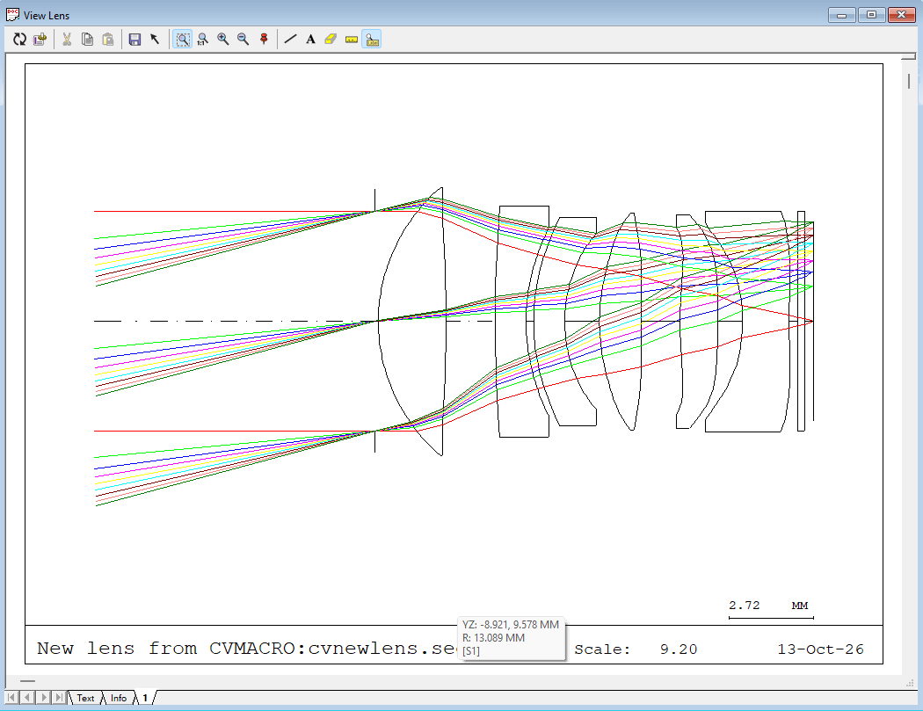
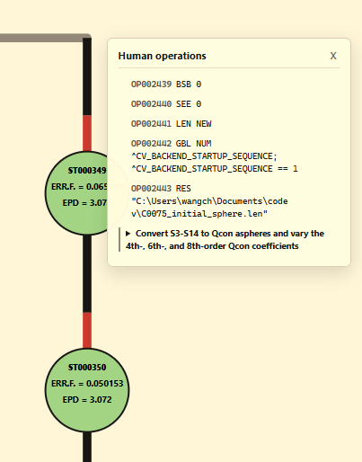
Case 2: Recover a forgotten optimization process through trajectory review
Change the operation order: convert sphere to Qcon → optimize → glass swap → optimize
Final successful route
STOP = 0.1
F# | 1.7
EFL | 12 mm
TTL | 14 mm
Max. field | 3.21 mm
Distortion | < 0.2%
MTF | = 0.48 @ 300 lp/mm
Strehl ratio | = 0.74 @ Max. field
Relative illumination | > 0.89

Slide 15
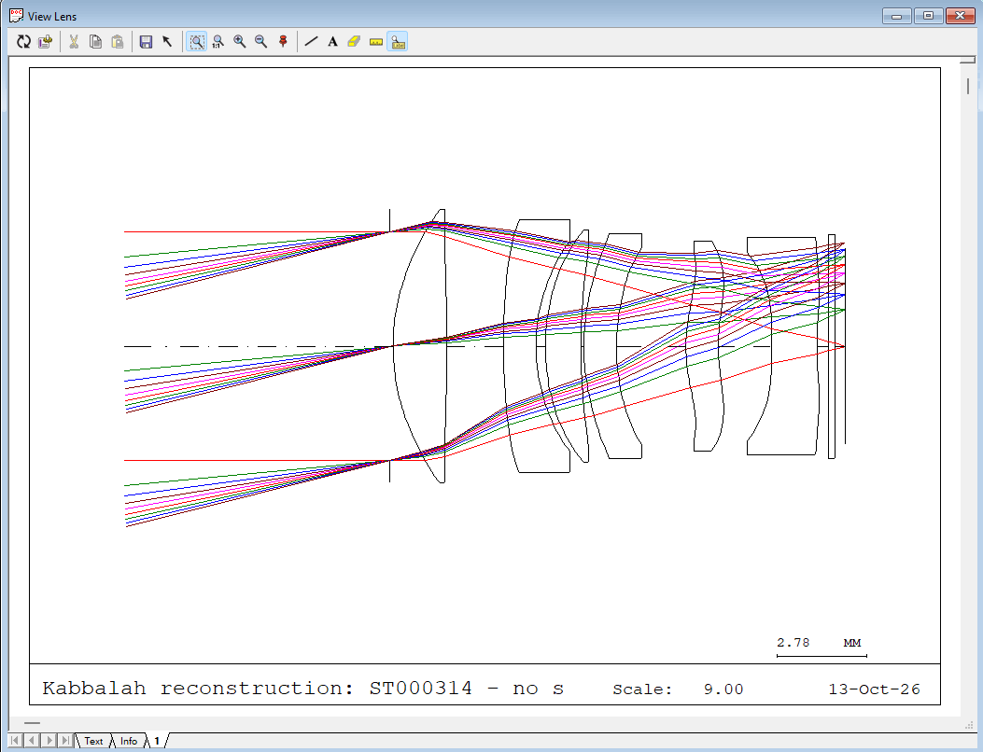
Case 3: Analyze the mechanism behind the glass swap
F# | 1.7
EFL | 12 mm
TTL | 14 mm
Max. field | 3.21 mm
Distortion | < 0.2%
MTF | = 0.48 @ 300 lp/mm
Strehl ratio | = 0.74 @ Max. field
Relative illumination | > 0.89
Final successful route
glass swap
L3
A failed route
L4
F# | 1.7
EFL | 12 mm
TTL | 13.5 mm
Max. field | 3.21 mm
Distortion | < 6%
MTF | = 0.25 @ 300 lp/mm
Strehl ratio | = 0.48 @ Max. field
Relative illumination | > 0.6
No swap

Slide 16
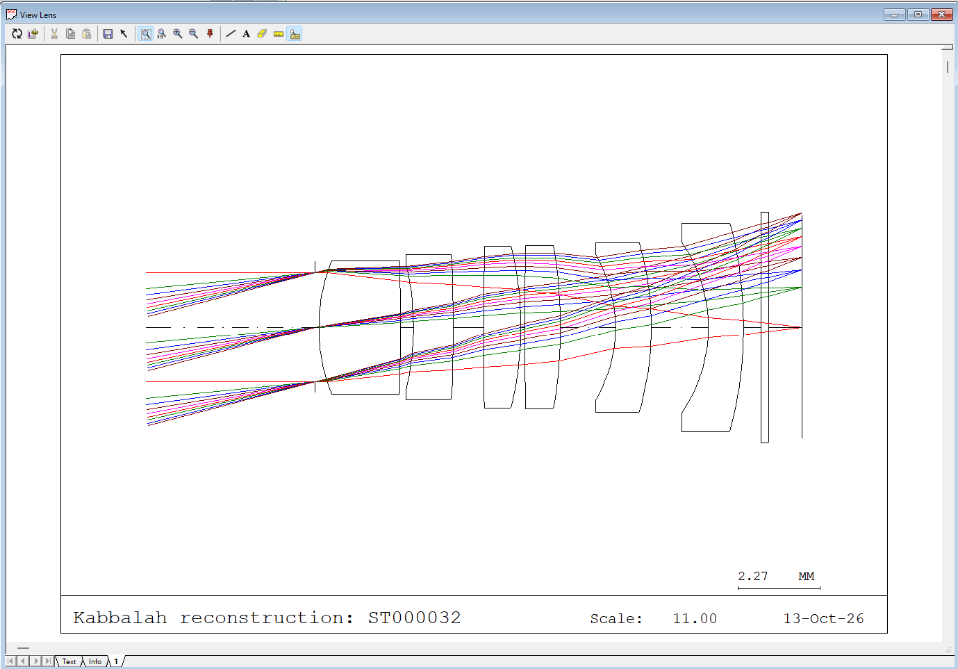
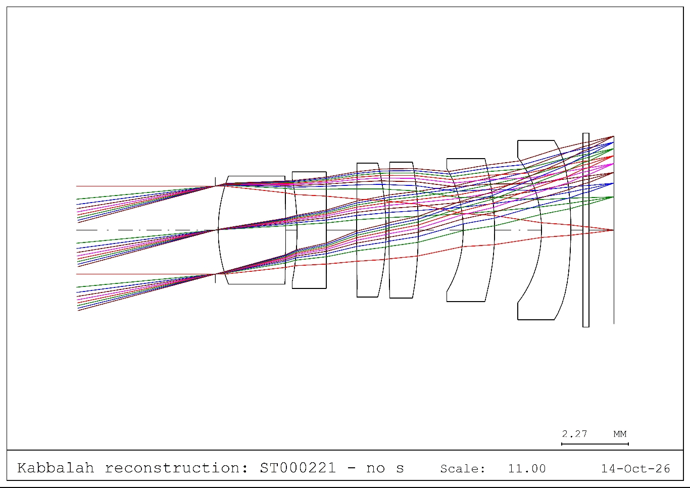
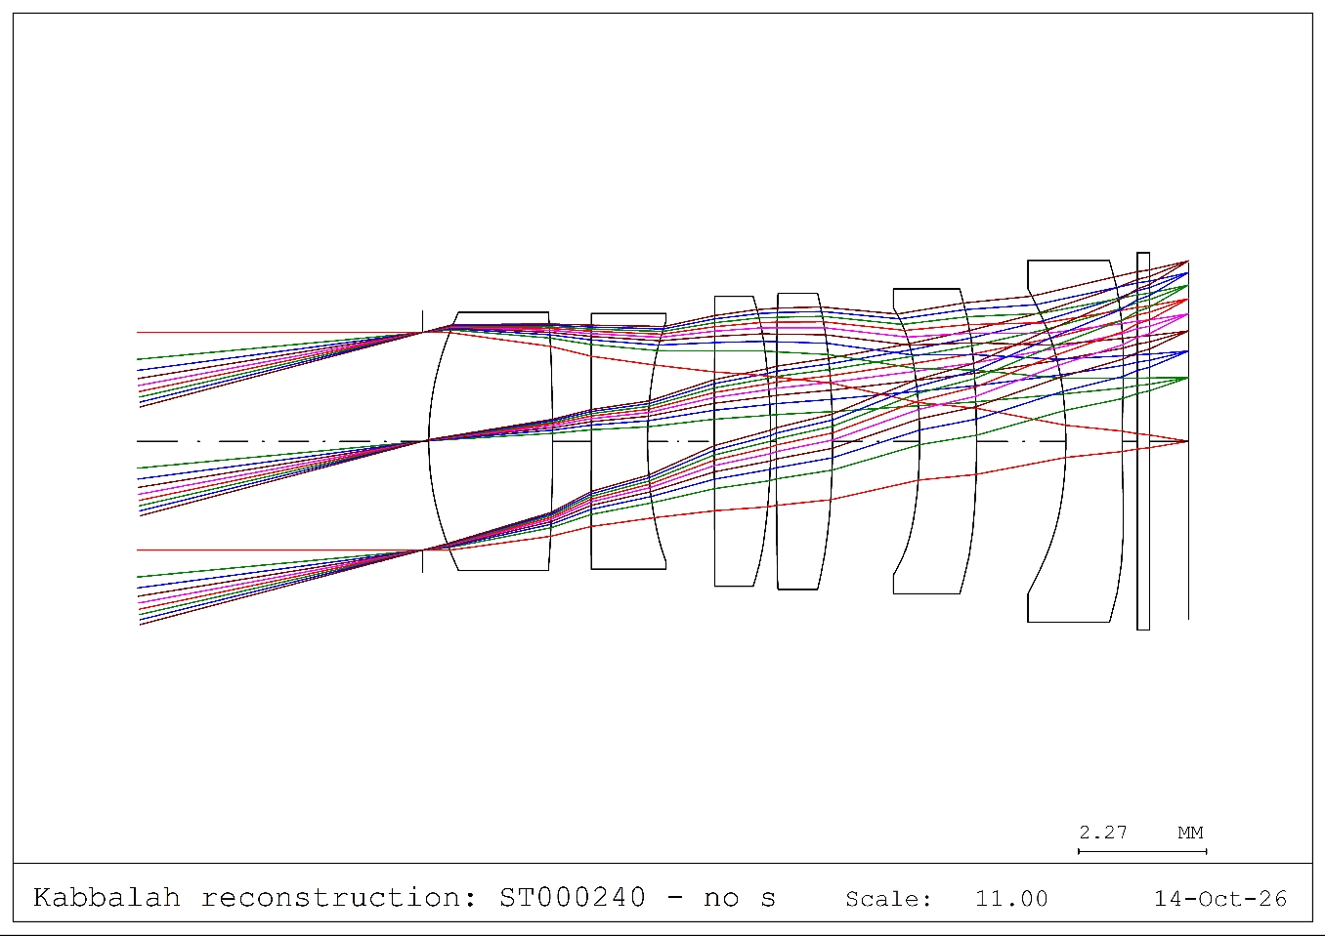
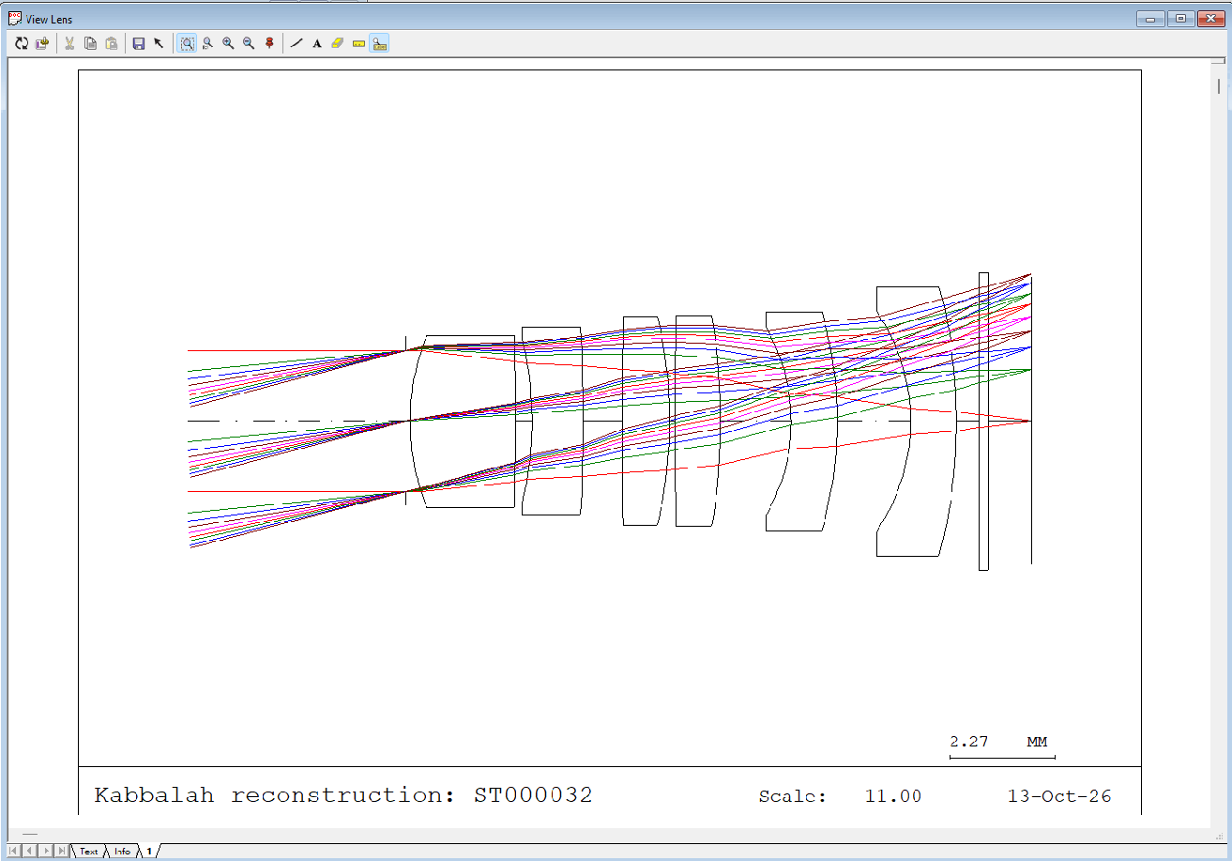
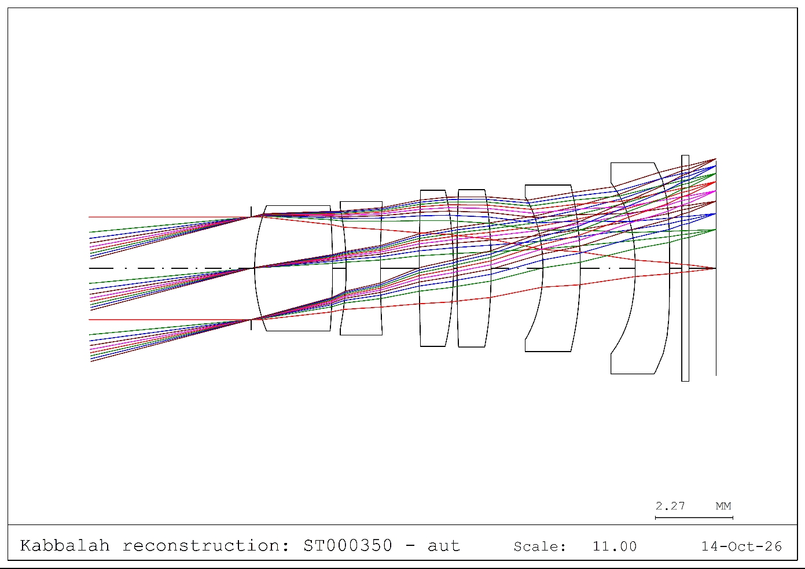
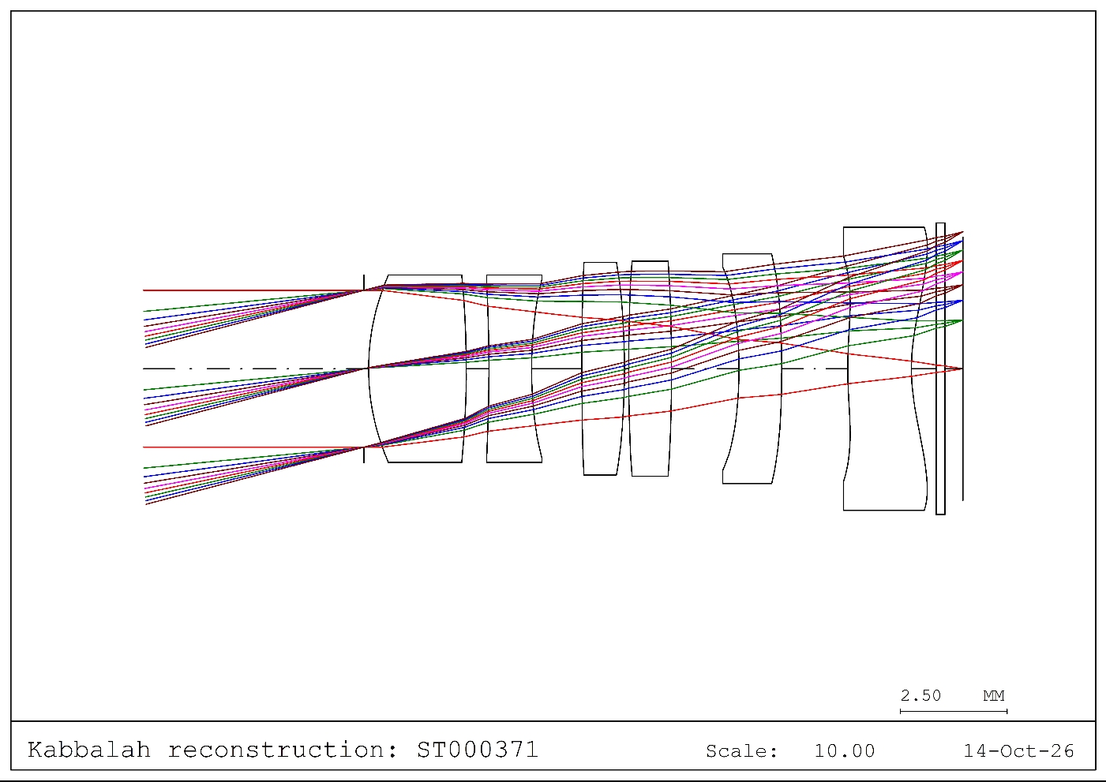
after opening Qcon, F/4.0
F/3.2
same initial structure
No swap
after opening Qcon, F/4.0
F/3.2
same initial structure
Glass swap

Slide 17
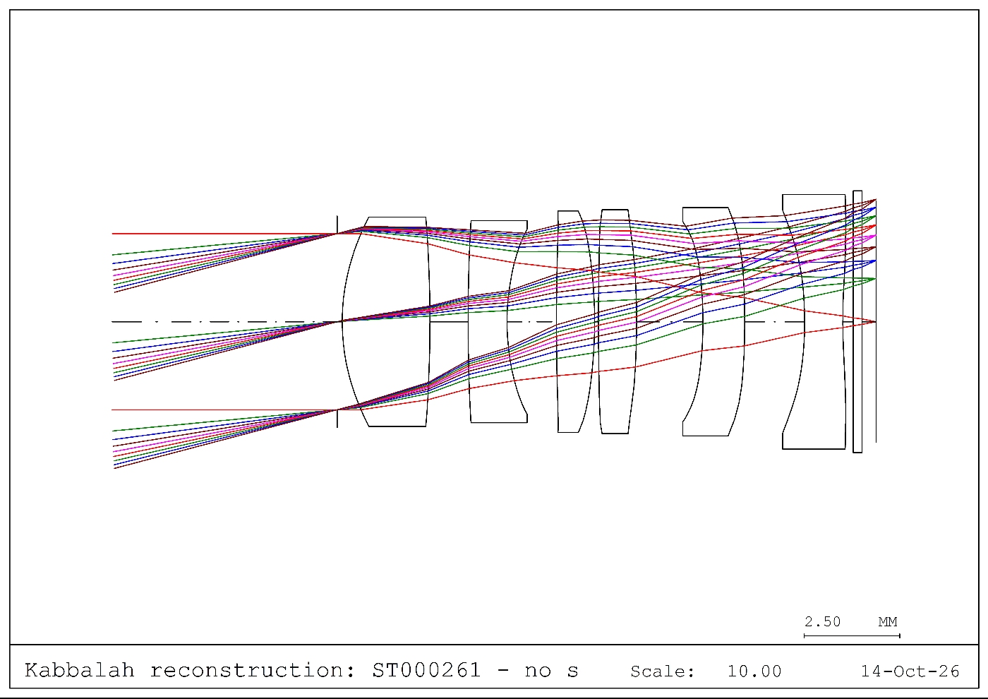
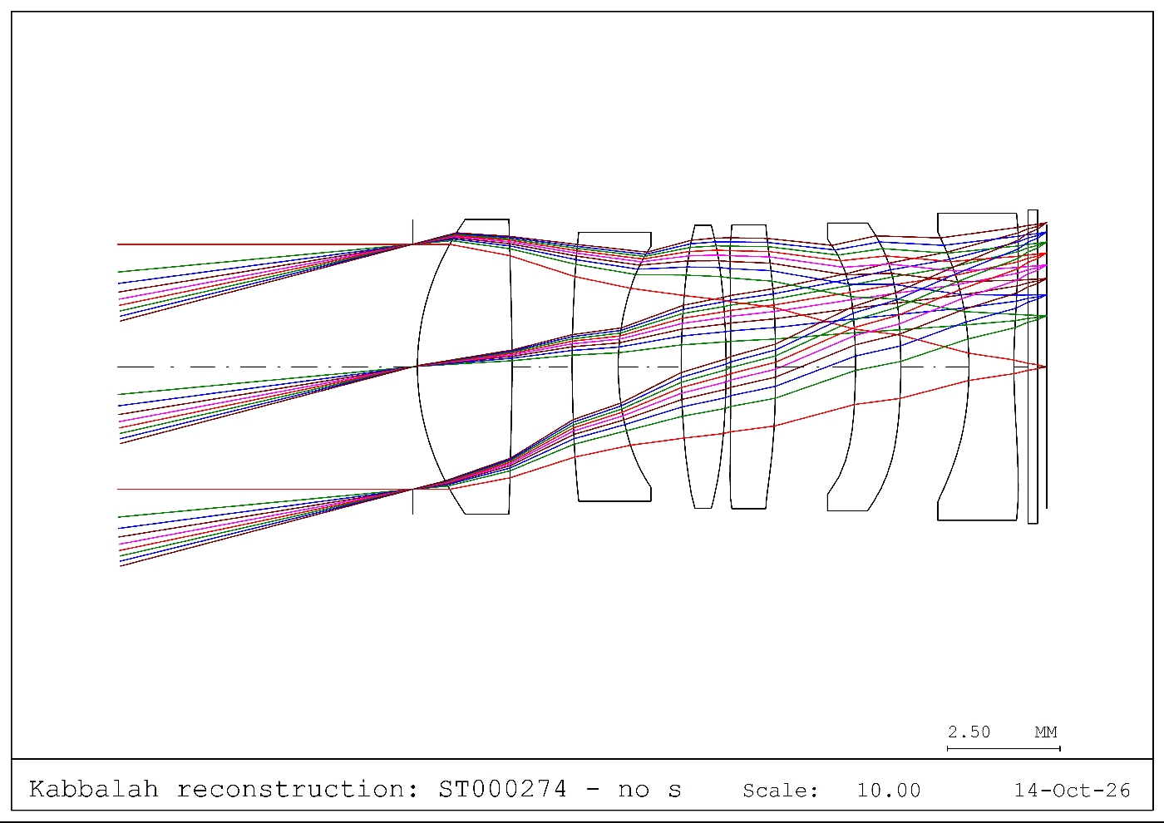
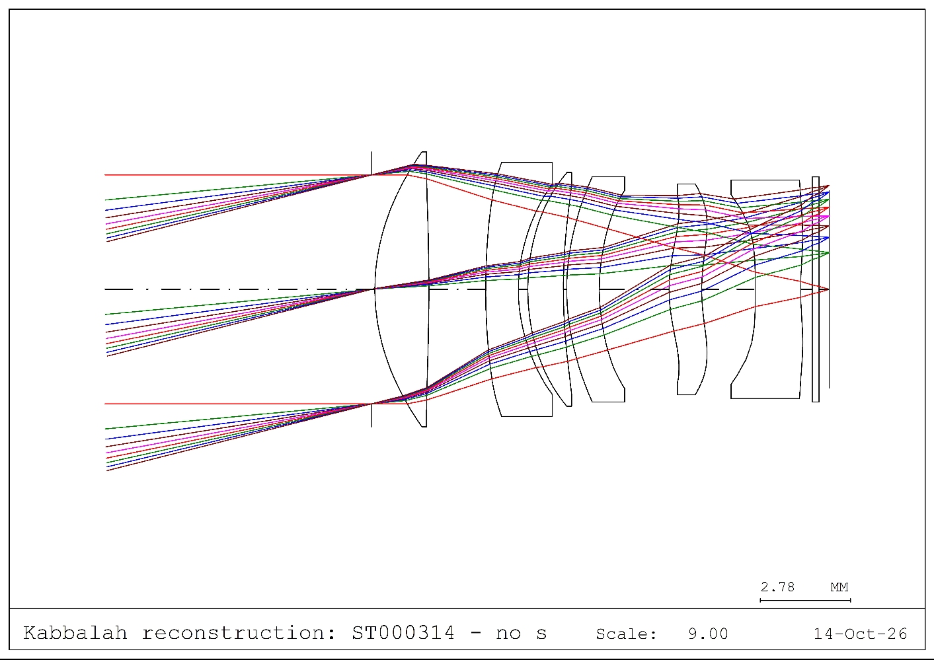

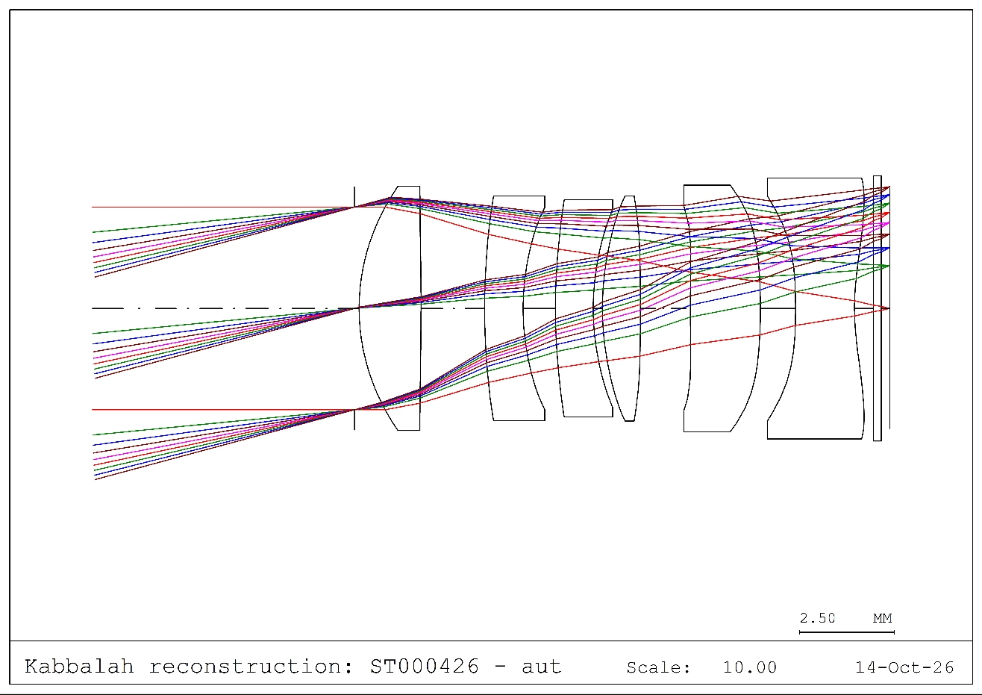
F/2.6
F/2.2
Final F/1.7
No swap
Final F/1.7
F/2.6
F/2.2
Glass swap

Slide 18
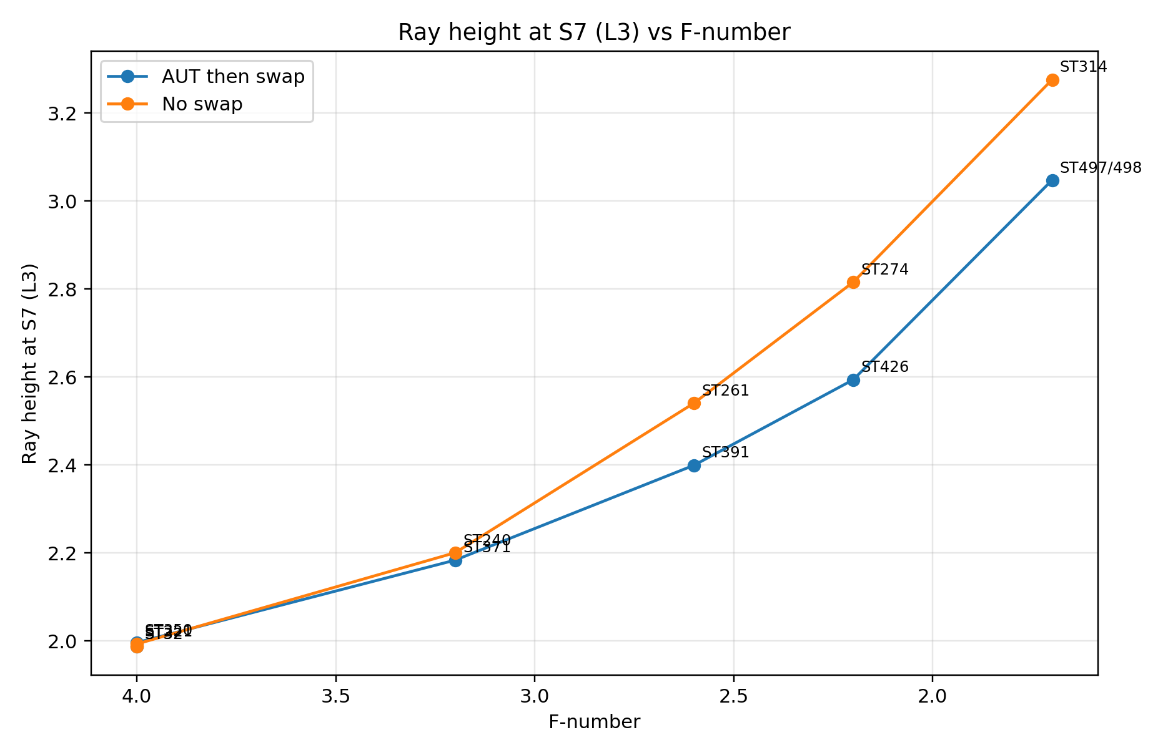

Slide 19
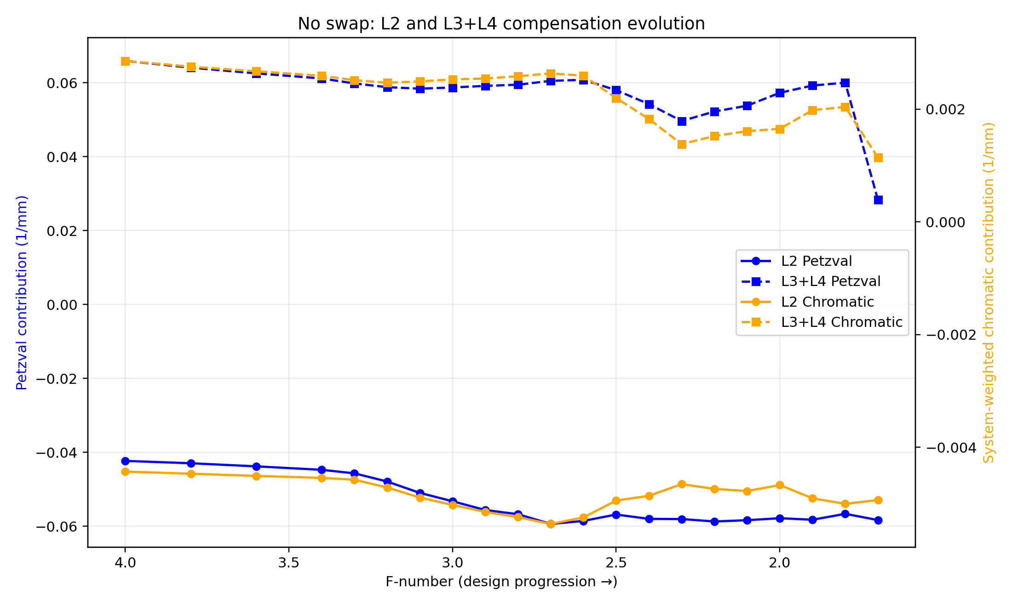
No-swap optimization route

Slide 20
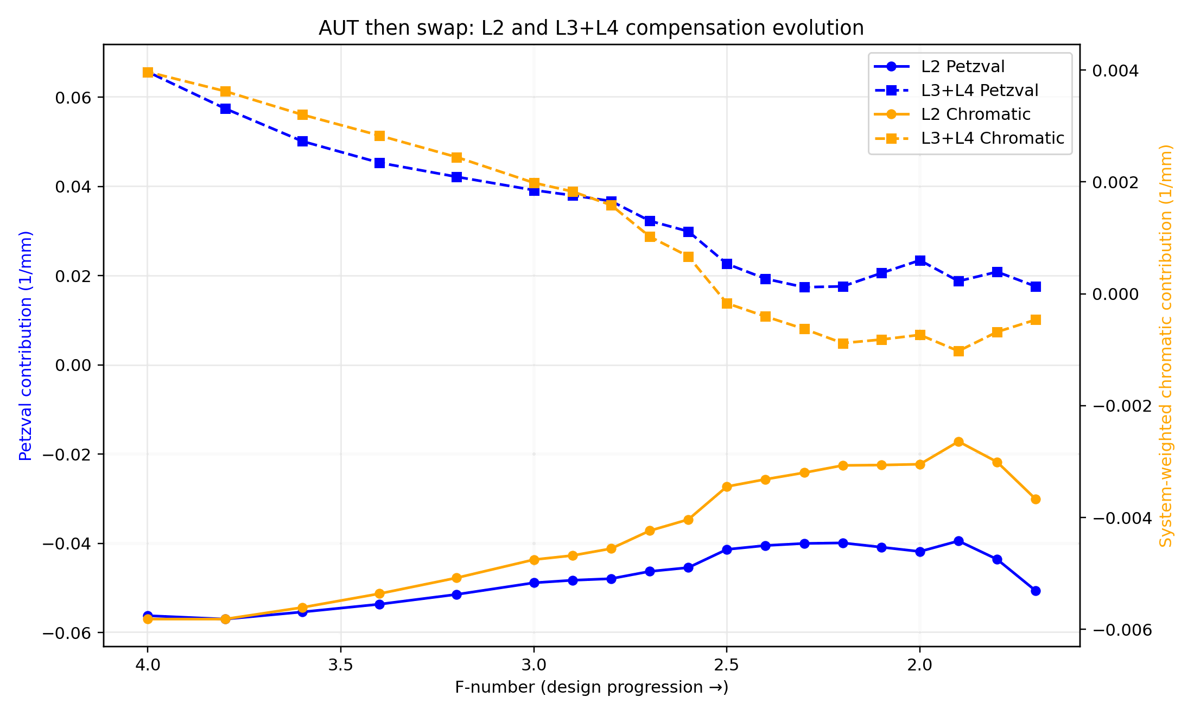
Glass-swap optimization route

Slide 21
Achromat-like shape is dominant
n=1.68, v=19.24
n=1.55, v=55.82
A local achromat-like structure may provide greater “effective structural freedom.” More precisely, this does not increase the number of variables; rather, under global chromatic-aberration and field-curvature constraints, it allows the local group to access a broader set of Petzval–Chromat feasible combinations. The local group does not need to satisfy C=0 or P=0; it only needs to carry a non-zero task assigned by the system (P,C). When two lenses can generate opposing chromatic contribution internally, shape/power can be redistributed without immediately paying a large global chromatic-aberration penalty, thereby enlarging the feasible space of structural evolution.
easy
hard
easy

Slide 22
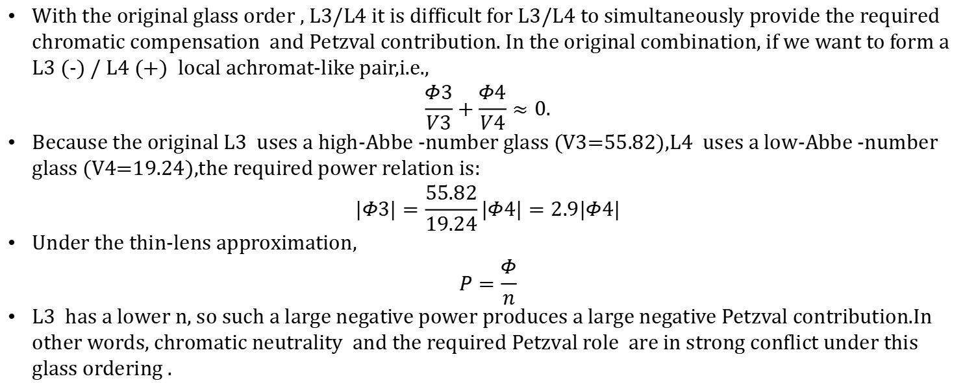
Achromat-like shape is dominant
n=1.68, v=19.24
n=1.55, v=55.82
With the original glass order , L3/L4 it is difficult for L3/L4 to simultaneously provide the required chromatic compensation and Petzval contribution. In the original combination, if we want to form a L3 (-) / L4 (+) local achromat-like pair,i.e.,
$$\frac{Φ3}{V3}+\frac{Φ4}{V4}≈0.$$
Because the original L3 uses a high-Abbe -number glass (V3=55.82),L4 uses a low-Abbe -number glass (V4=19.24),the required power relation is:
$$|Φ3|=\frac{55.82}{19.24}|Φ4|=2.9|Φ4|$$
Under the thin-lens approximation,
$$P=\frac{Φ}{n}$$
L3 has a lower n, so such a large negative power produces a large negative Petzval contribution.In other words, chromatic neutrality and the required Petzval role are in strong conflict under this glass ordering .

Slide 23
achromat-like shape is dominant
n=1.68, v=19.24
n=1.55, v=55.82
easy
hard
easy
No swap initially
Swap

Slide 24
Achromat-like shape is dominant
n=1.68, v=19.24
n=1.55, v=55.82
L2
L3
L4
When L3/L4 cannot economically carry the local chromatic task , more of the compensation responsibility shifts to L2. A stronger negative L2 power makes the marginal ray leaving L2 more divergent; after propagating across the L2–L3 separation, this increases the L3/L4 ray height .
F/# decreases further, this structure is more likely to encounter a marginal-ray ray-trace problem; To restore a traceable state, additional downstream positive power is required, causing a larger Petzval / field-curvature penalty.
L2
L3
L4

Slide 25
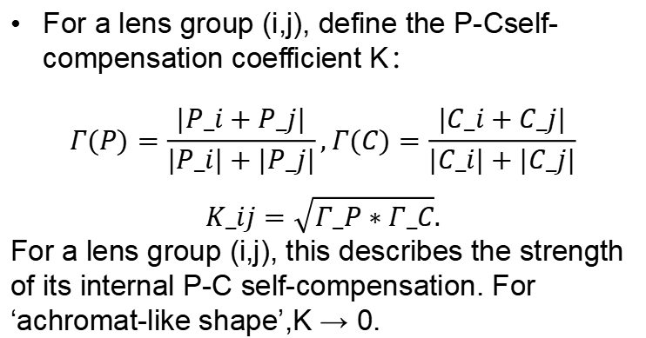
How can designer language be converted into a quantitative description?
i
j
For a lens group (i,j), define the P-Cself-compensation coefficient K：
$$Γ(P)=\frac{|P_i+P_j|}{|P_i|+|P_j|},Γ(C)=\frac{|C_i+C_j|}{|C_i|+|C_j|}$$
$$K_ij=\sqrt{Γ_P∗Γ_C}.$$
For a lens group (i,j), this describes the strength of its internal P-C self-compensation. For ‘achromat-like shape’,K → 0.
What exactly is ‘achromat-like shape’?
How do we describe ‘finding a stable compensation path’?

Slide 26
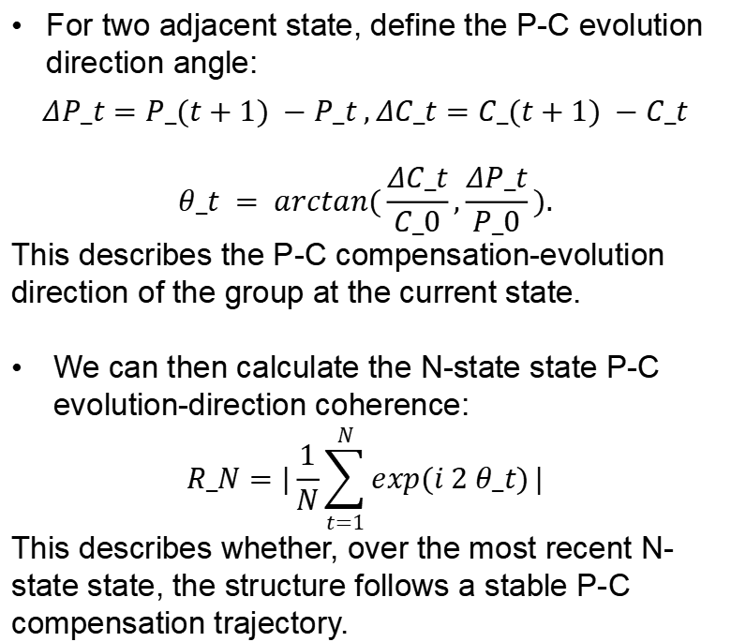
How can designer language be converted into a quantitative description?
For two adjacent state, define the P-C evolution direction angle:
$$ΔP_t=P_(t+1) −P_t ,ΔC_t=C_(t+1) −C_t$$
$$θ_t = arctan(\frac{ΔC_t}{C_0},\frac{ΔP_t}{P_0}).$$
This describes the P-C compensation-evolution direction of the group at the current state.
We can then calculate the N-state state P-C evolution-direction coherence:
$$R_N=|\frac{1}{N}\sum_{t=1}^{N}{exp(i 2 θ_t)}|$$
This describes whether, over the most recent N-state state, the structure follows a stable P-C compensation trajectory.
S_t
S_t+1

Slide 27
How can designer language be converted into a quantitative description?
 | self-compensation coefficient K | Directional coherence R | Structural state
A | Low | High | Internal P–C compensation is strong, with coherent recent evolution
B | High | High | Internal P–C compensation is weak, but recent evolution remains coherent
C | High | Low | Internal P–C compensation is weak, with dispersed or frequently changing recent evolution
D | Low | Low | Internal P–C compensation is strong, while local functional roles are being redistributed

Slide 28
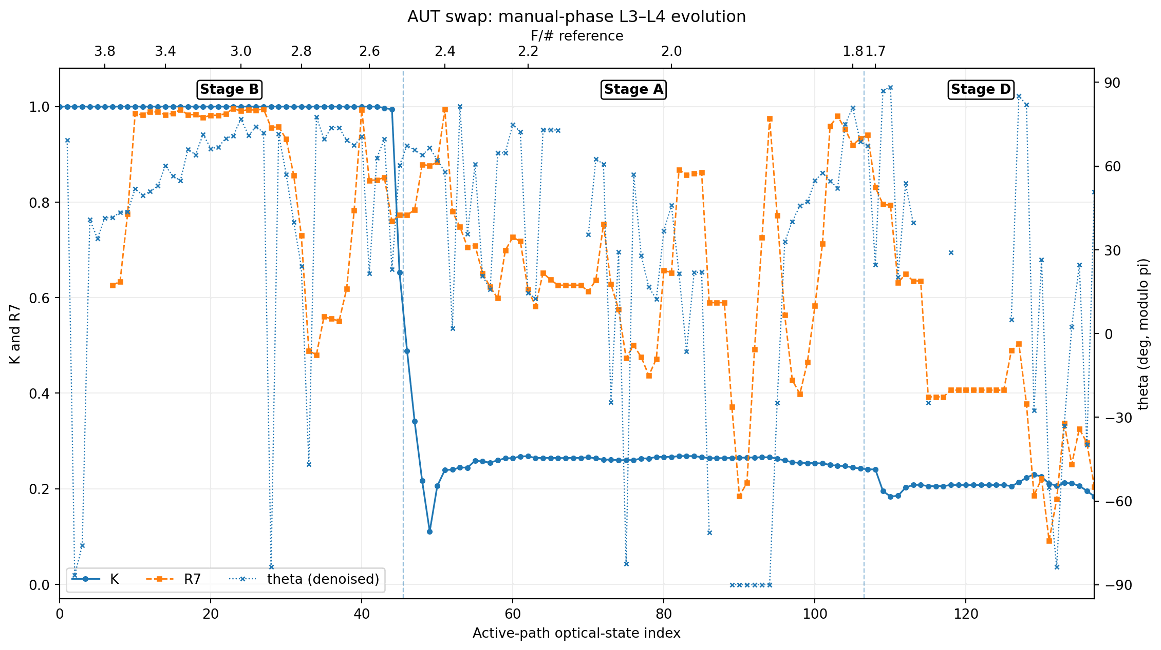
Glass-swap route: L3L4 group: K,R7
Internal P–C compensation is weak, but recent evolution remains coherent
Internal P–C compensation is strong, with coherent recent evolution
Internal P–C compensation is strong, while local functional roles are being redistributed

Slide 29
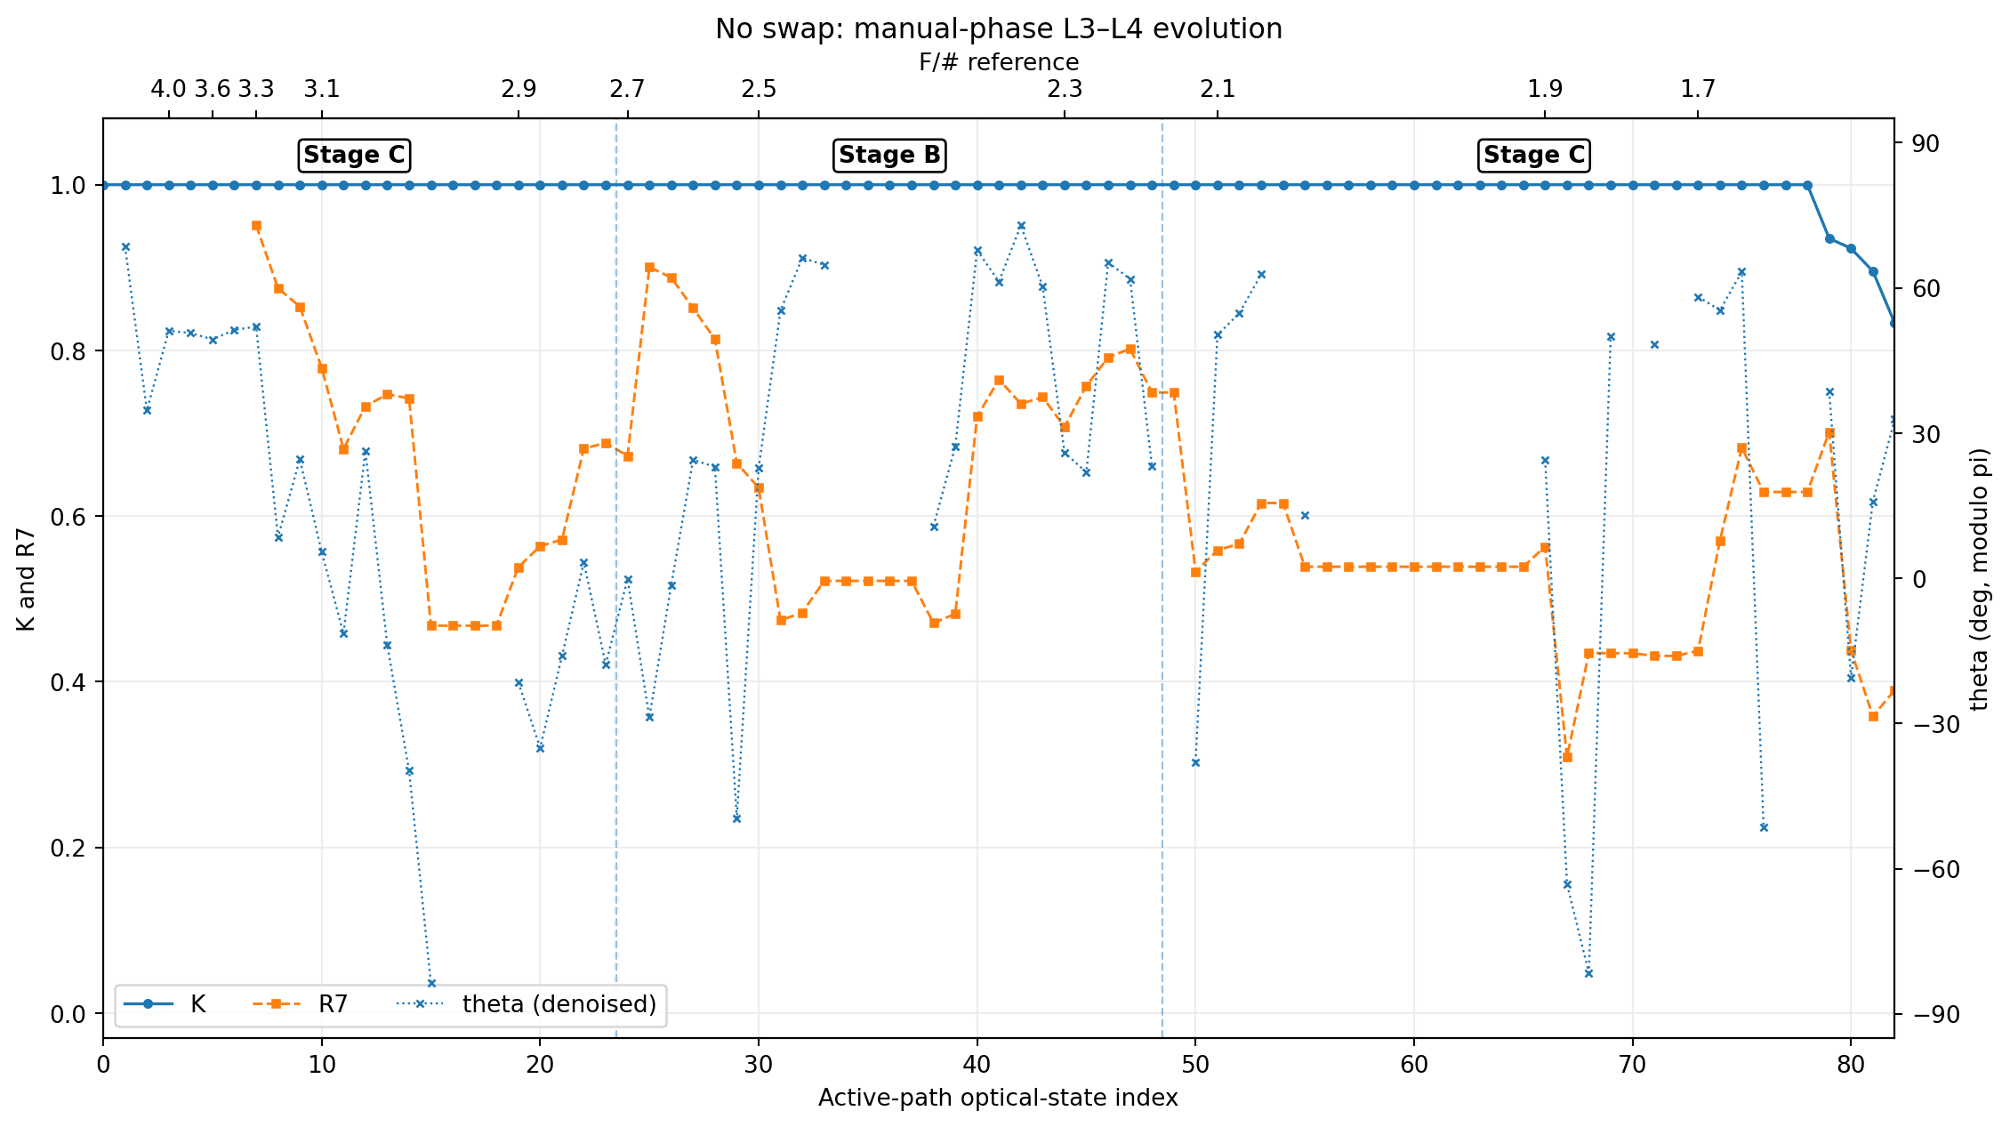
No-swap route: L3L4 group: K,R7
Internal P–C compensation is weak, with dispersed or frequently changing recent evolution
Internal P–C compensation is weak, but recent evolution remains coherent
Internal P–C compensation is weak, with dispersed or frequently changing recent evolution

Slide 30
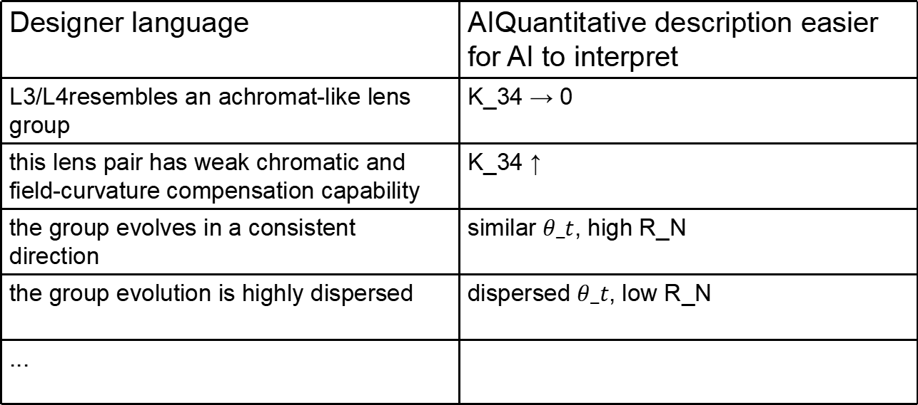
Designer language | AIQuantitative description easier for AI to interpret
L3/L4resembles an achromat-like lens group | K_34 → 0
this lens pair has weak chromatic and field-curvature compensation capability | K_34 ↑
the group evolves in a consistent direction | similar $θ_t$, high R_N
the group evolution is highly dispersed | dispersed $θ_t$, low R_N
...

Slide 31
What did KABBALAH change?
How questions are discovered: designer experience summaries → questions emerging naturally from optimization history
How problems are analyzed: horizontal comparison of multiple structures → longitudinal comparison along optimization trajectories
How hypotheses are formulated/tested: wait for the next design → quantitative comparison of multiple historical routes and actively designed control experiments during review
How optical design is communicated with AI: mainly text descriptions → AI retrieves and quantifies information directly from real design history

Slide 32
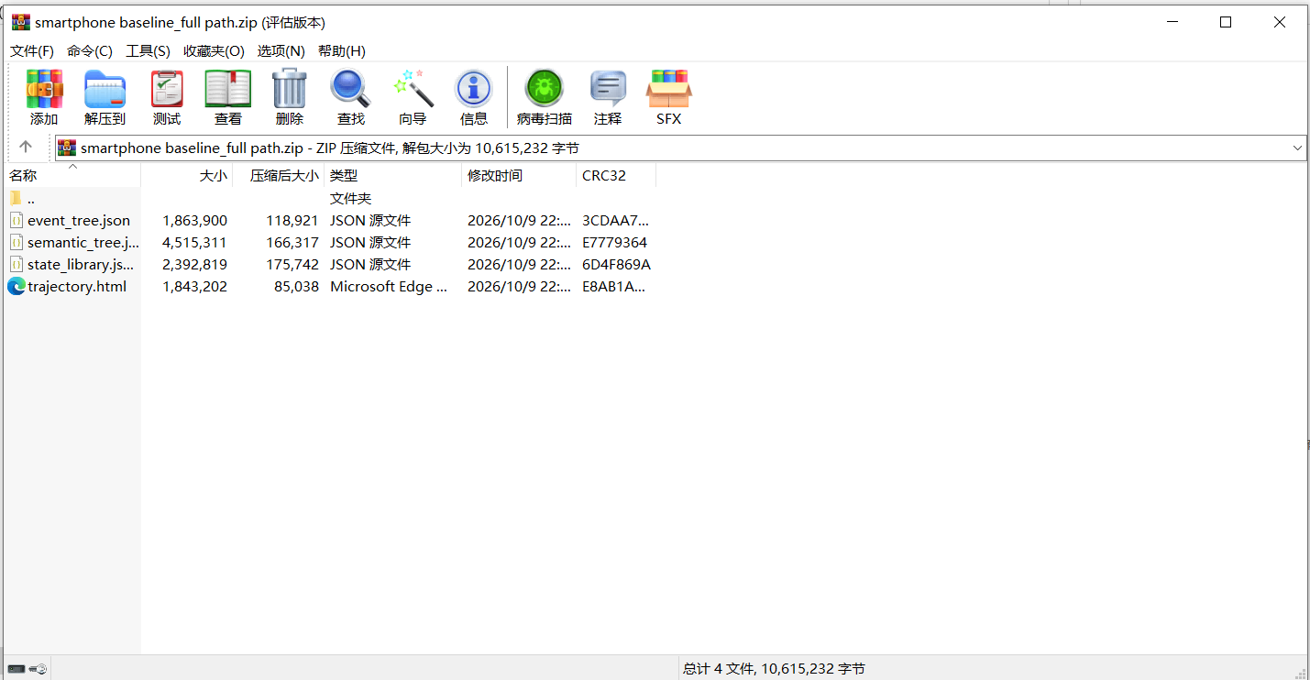
Four files, compressed size: 533KB
140,000-line log compilation time = 5s
Only 6 manually saved initial/final results

