Slide 1
OpenVLA-OFT:
Fine-Tuning Vision-Language-Action Models: Optimizing Speed and Success
Zheng Licheng
Shi Haokun
Chen Ruanhe

Slide 2
Content
Background
Literature Review
Methodology
Experiment Results
Disscusion & Future Works

Slide 3
Background
Vision-Language-Action Models (VLA)
  Build upon large VLM models, and finetune them with robotic datasets
  Take in both images and language commands, and output control actions
  Enables language-conditioned control, semantic generalization and zero-shot reasoning
Challenge: Good on tasks seen during training but struggle to adapt to new robots or unseen tasks.
  We usually need to finetune it.
RQ: How can we fine-tune VLAs more effectively, to achieve both high performance and real-time inference speed?

Slide 4
Related Works
RT-2, OpenVLA, and π0
  Autoregressive Action Generation - High Latency
OpenVLA-mini: Vector Quantization (VQ)
FAST: Discrete cosine transforms for compact action chunks
  Latency between chunks
Diffusion-based VLAs (e.g. RDT-1B and π0):
  Multiple denoising steps
This paper, therefore, conducts a systematic empirical study to identify which design decisions truly matter for efficient, high-performance fine-tuning.

Slide 5
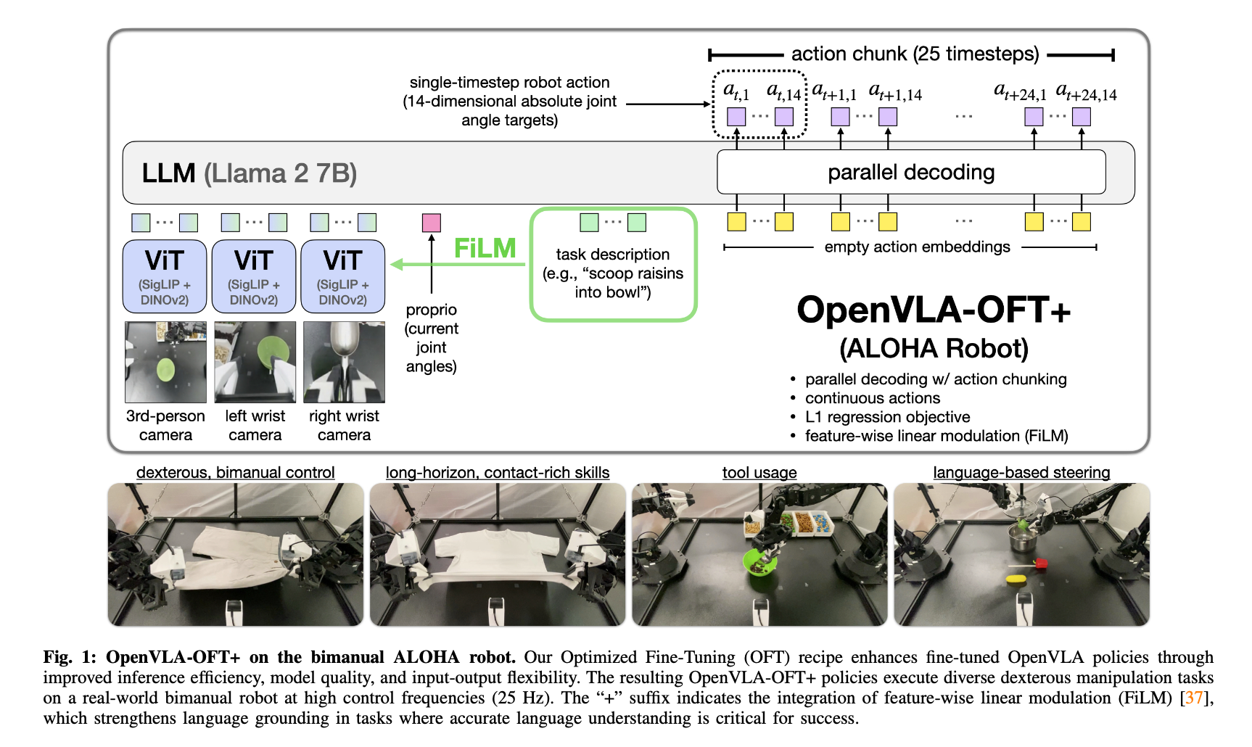
Method
The authors carefully study three key design decisions during fine-tuning:
How actions are generated
  Parallel Decoding instead of AR
How actions are represented
  Continuous instead of Discrete
What learning objective to use.
  L1 objective instead of Diffusion
Enhance Language Understanding
  FiLM (New to OpenVLA Model)

Slide 6
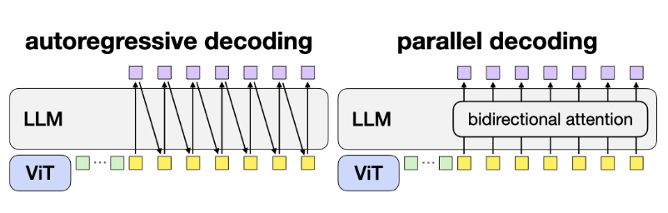
Parallel Action Decoding
Original OpenVLA: Actions are generated autoregressively: Model predicts one action token at a time, each depending on the previous one.
  Extremely SLOW! (3-5Hz)
OpenVLA-OFT: Parallel Decoding, predicts all actions at once, in a single forward pass.
  bidirectional attention, allowing the decoder to see all positions simultaneously.
Action chunking: predicts a chunk of K future actions — for example, 8 or 25 timesteps — all at once

Slide 7
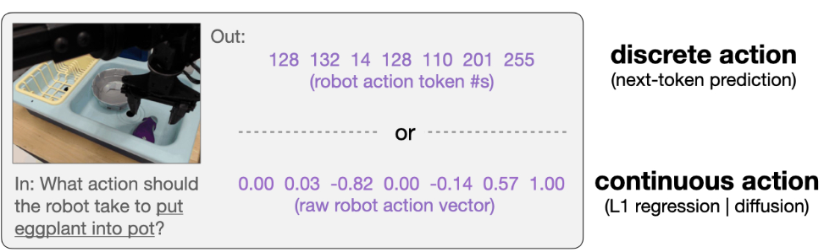
Continuous Action Representation
Original OpenVLA: Discrete tokens (e.g. dividing each joint angle into 256 bins)
OpenVLA-OFT: Add a small MLP head to the model: Directly outputs continuous normalized values for each action dimension.
Smoother, more accurate motor control, especially for dexterous or contact-rich tasks.

Slide 8
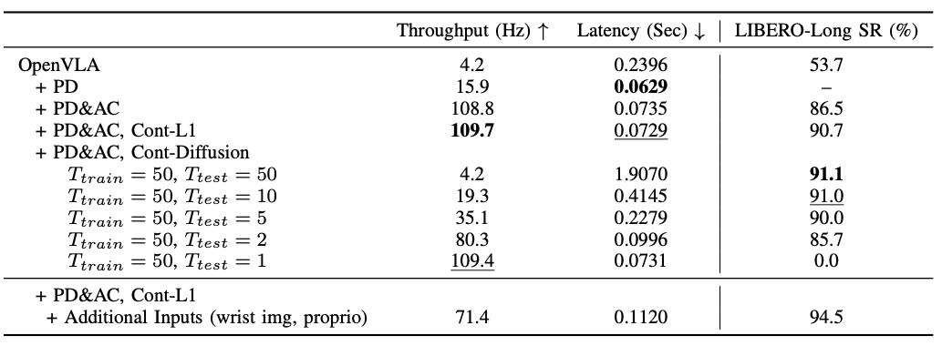
Learning Objective Choice
Next-token prediction, which is the classic cross-entropy loss for discrete tokens.
Diffusion modeling, where the model learns to denoise actions gradually, capturing multiple possible solutions.
Simple L1 regression, which directly minimizes the difference between the predicted and ground-truth continuous actions. simple, fast, and converges quickly.

Slide 9
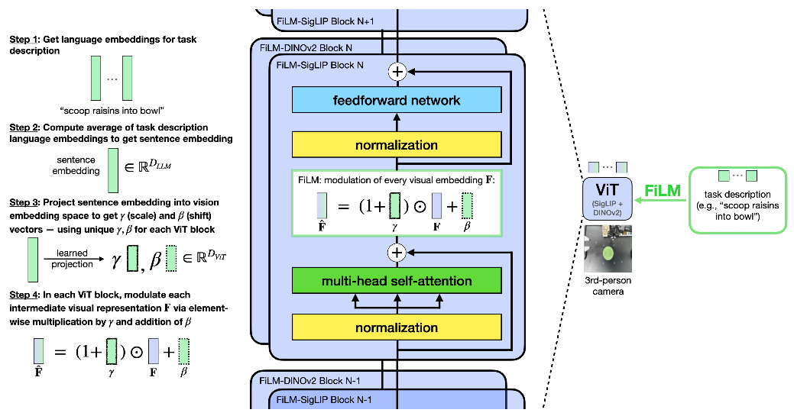
Enhancing Language Understanding
Models sometimes ignore the language command, focusing too much on visual cues.
  Feature-wise Linear Modulation (FiLM).

Slide 10
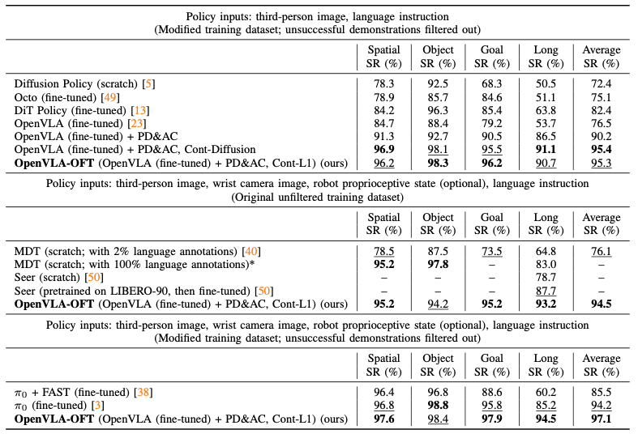
Experiments: LIBERO
PD: Parallel Decoding
AC: Action Chunking
Cont-L1: Continuous – L1
Throughput: ~109Hz

Slide 11
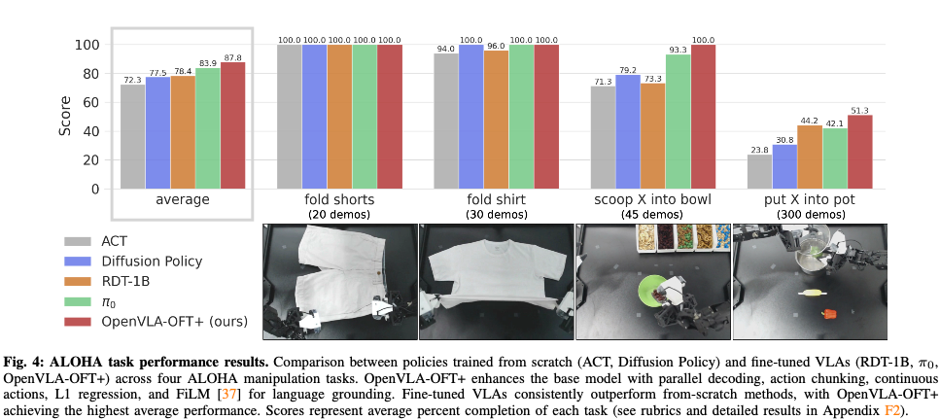
Experiments: ALOHA

Slide 12
Discussions
By combining parallel decoding, action chunking, continuous action representations, and a simple L1 regression loss, OpenVLA-OFT achieves:
Up to 97% task success rate on simulation benchmarks
Up to 43× faster inference speed
Strong real-world dexterous control
Robust language following with FiLM
The key takeaway is that architecture simplicity and fine-tuning strategy can matter more than model scale or complex generative methods.

Slide 13
Thanks
Zheng Licheng
Shi Haokun
Chen Ruanhe

