Slide 1

DIGIBOOKS

Slide 2
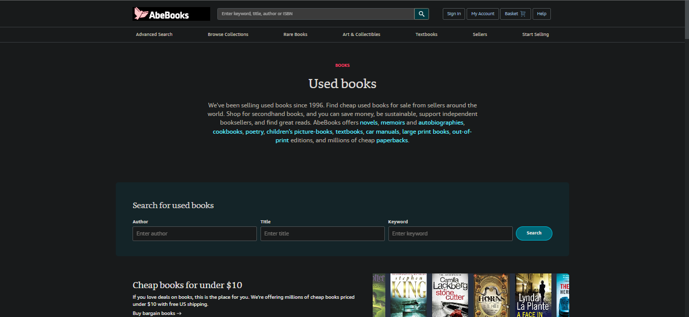
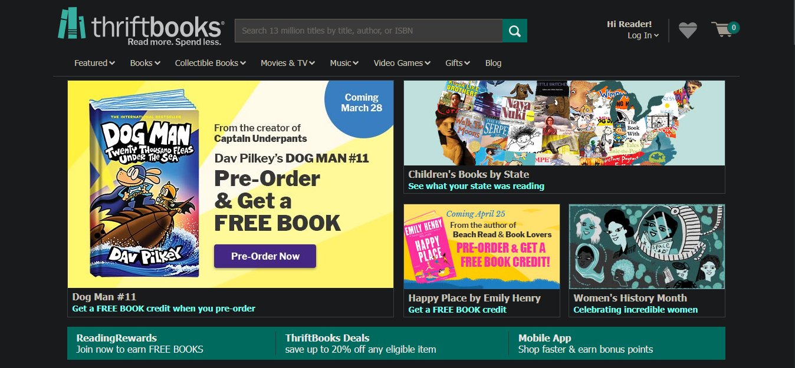
The sites we researched
ABE BOOKS
THRIFT BOOKS

Slide 3
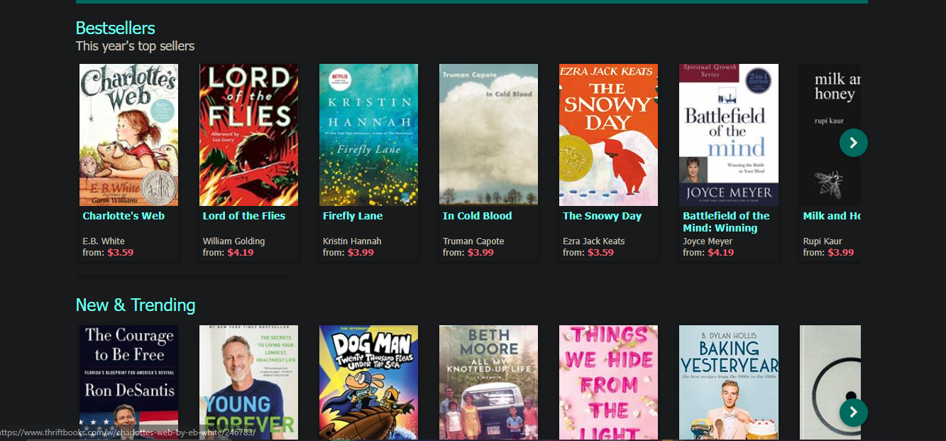
What we like about thrift books
It is a very eye-catching website with good placement and ease of use
According to some users the user experience is unmatched
The website is responsive

Slide 4
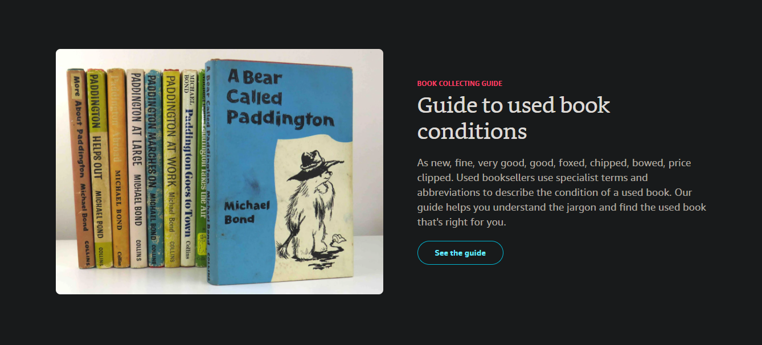
WHAT WE LIKE ABOUT ABE BOOKS
Great for finding first edition copies of books
Wide selection of books
High possibility of finding rare books
Books are sold for cheap
Quick customer support.

Slide 5
Thrift book weaknesses
According to reviews their customer service is lacking and many have claimed that they have yet to receive refunds.
Some customers have complained about the poor product quality of the books they receive such as some books having mold
Their prompt response is unreliable since one user claimed that the site failed to inform them that the book they wanted was available before they made the purchase. Fortunately they were credited.
Some books took longer to arrive and some books were sent that the user didn’t even order.
Shipping rates to other countries makes the price of shipping more expensive than the books.

Slide 6
ABE BOOKS WEAKNESSES
Poor customer service
Refunds don’t include return shipping
Used books get sold as new by sellers so they have an issue with fraud.
Some sellers tend to scam customers
Sometimes the wrong book gets shipped.

Slide 7
What we took from them
Their welcoming design
How minimal Abe books was
Abe books search features
Thrift Books Search features
Abe books had a less cluttered User Interface

Slide 8

Our MOCK UPS

Slide 9
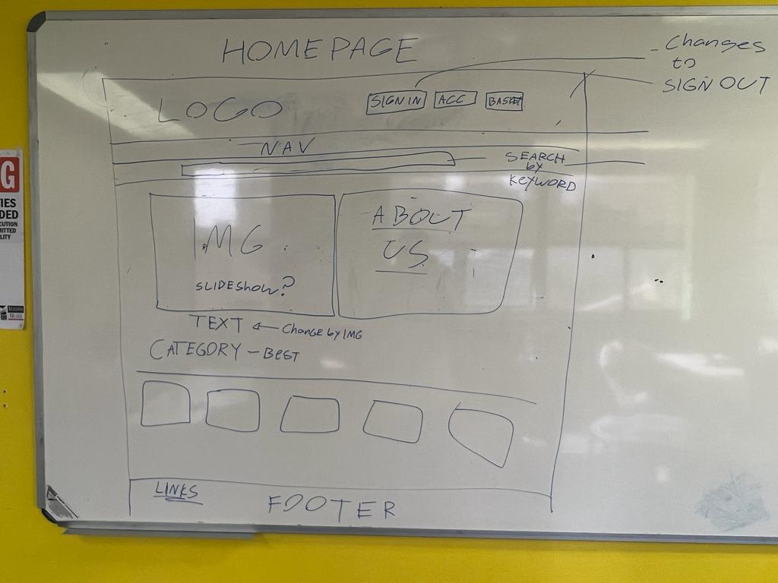

Slide 10
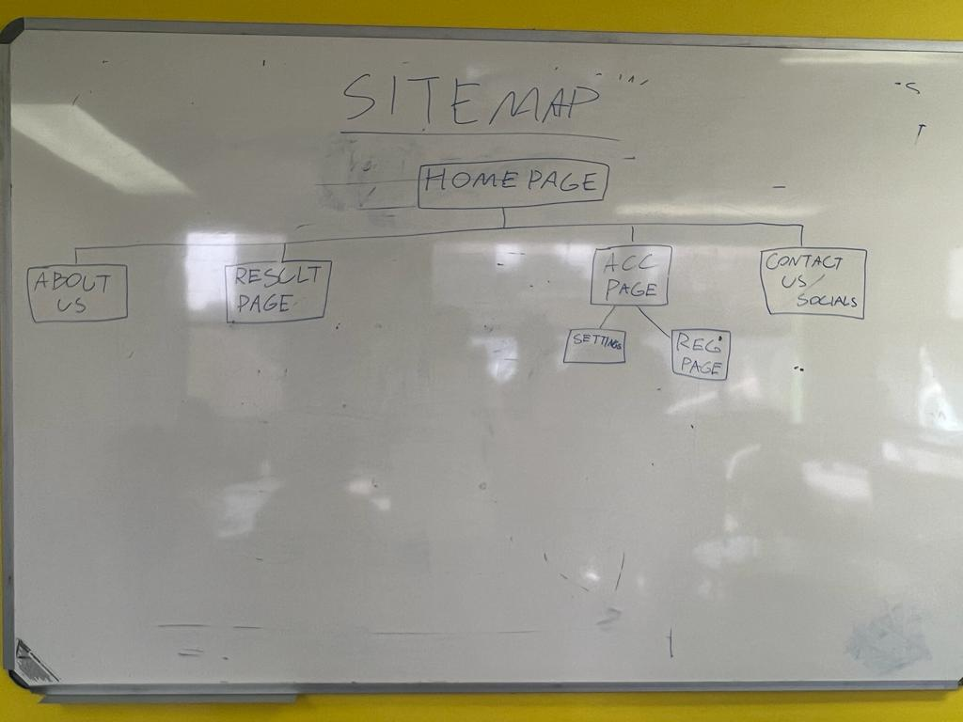

Slide 11
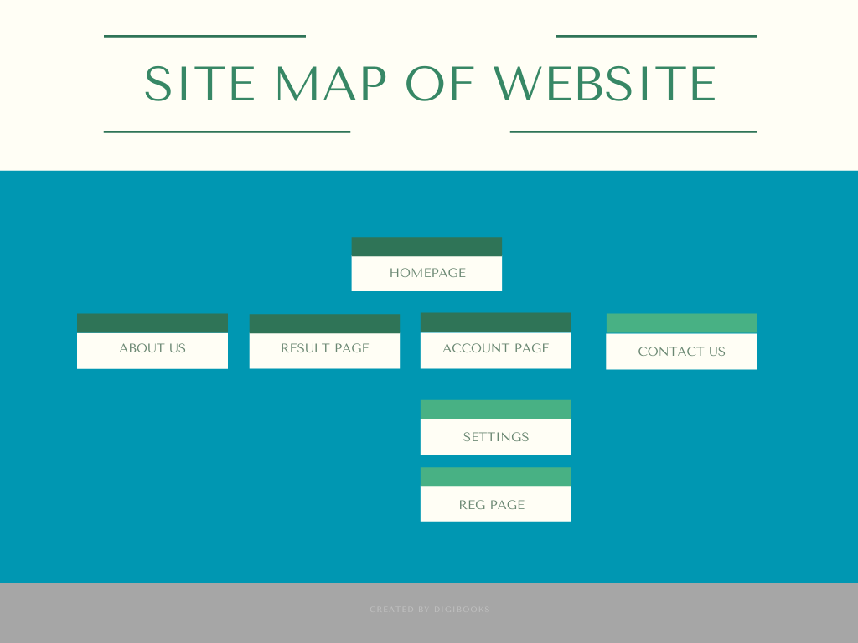

Slide 12
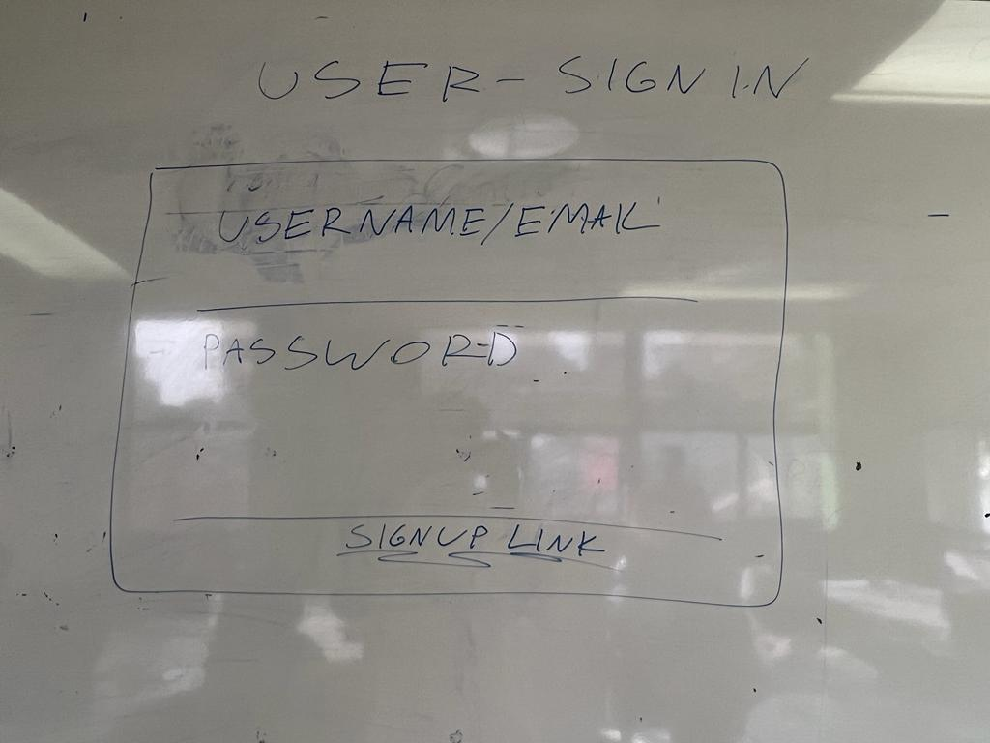

Slide 13
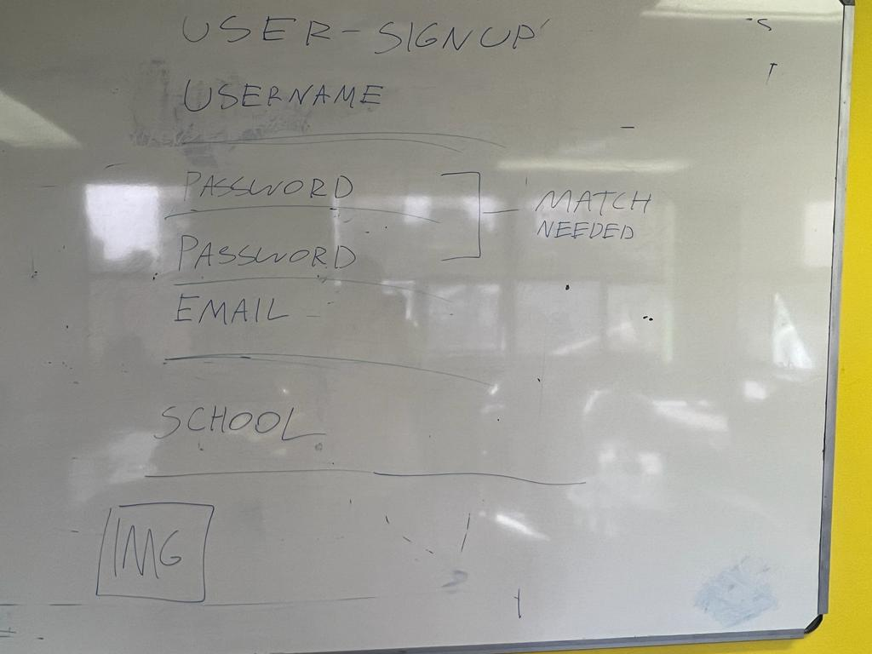

Slide 14
IN CONCLUSION
Our aim is to make a user friendly site that’s sleek
Easy to use for both buyers and seller
Allow for user to user messaging and reviews of books
Come with useful tips

