Slide 1



Carbon emissions prediction

Slide 2

Learning Objectives
Understand CO₂ emission patterns over time.
Apply data preprocessing and cleaning techniques.
Use regression models for time series forecasting.
Evaluate model performance using metrics like MAE, RMSE.
GOAL
Source :
www.freepik.com/

Slide 3
Tools and Technology used
To predict future CO₂ emission levels using historical data and machine learning techniques, enabling better environmental planning and policy-making.
Python, Pandas, NumPy, Matplotlib, Seaborn
Scikit-learn for machine learning
Jupyter Notebooks
joblib for saving models

Slide 4
Methodology
Data Cleaning & Feature Engineering (handled in data_cleaned.csv)
Model selection and training (likely Linear Regression or Random Forest)
Forecasting emissions using the trained model
Evaluation using metrics (MAE, RMSE)

Slide 5
Problem Statement:
The increasing levels of CO₂ emissions pose a threat to the environment. Forecasting these emissions can help in taking proactive environmental actions and tracking sustainable goals.

Slide 6
Solution:
To address the challenge of forecasting CO₂ emissions, we implemented a machine learning-based solution structured around the following steps:
Data Collection & Cleaning:
Historical CO₂ emission data was gathered and cleaned to remove inconsistencies, missing values, and irrelevant features. This ensured data quality for accurate model training.
Feature Engineering:
Relevant features influencing CO₂ emissions were selected and transformed as needed (e.g., normalization, encoding, date-based features).
Model Selection and Training:
Multiple regression algorithms were tested (e.g., Linear Regression, Random Forest, etc.). The best-performing model was selected based on evaluation metrics such as MAE and RMSE.
Model Evaluation:
The model’s performance was validated using a test set. Visualizations such as actual vs predicted CO₂ values helped assess reliability.
git link: https://github.com/SHXZ7/aicte-internship

Slide 7
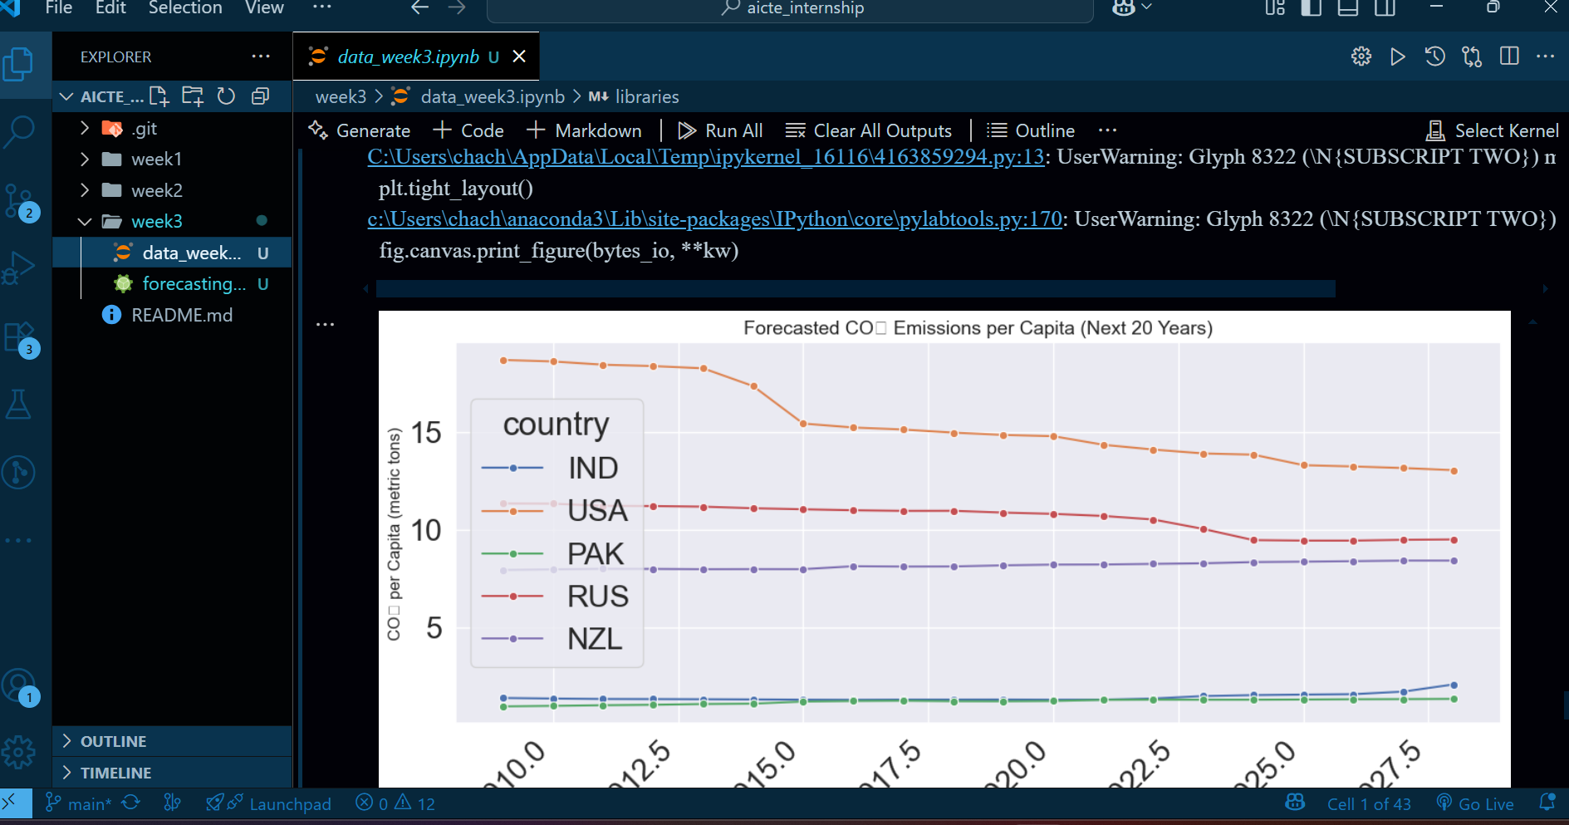
Screenshot of Output:

Slide 8
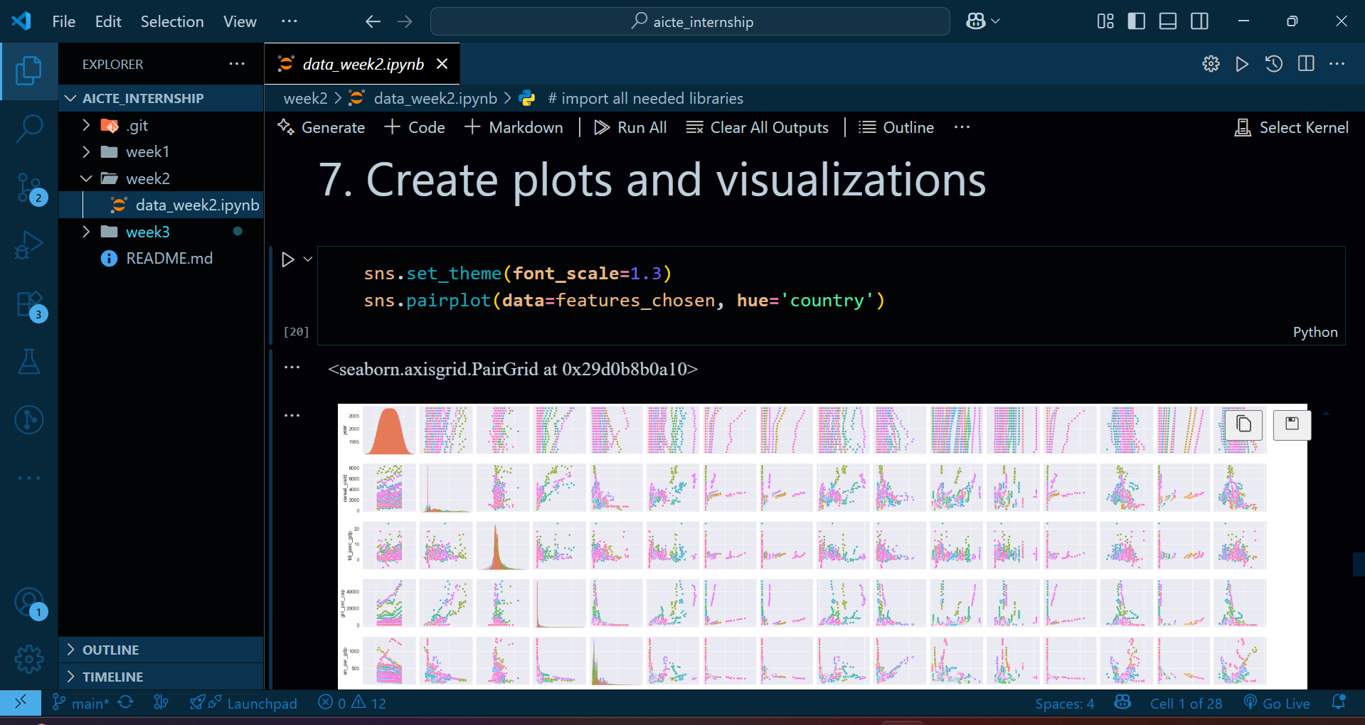
Screenshot of Output:

Slide 9
Conclusion:
Built and evaluated a predictive model for CO₂ emissions.
Achieved good accuracy using regression.
Model is saved and ready for deployment or further use.
Can be integrated into dashboards or environmental monitoring systems.

