Slide 1
SHYAM SUNDAR K N
813821104094
CSE B

Slide 2
House price prediction
House price prediction is a task in which machine learning algorithms are used to estimate the selling price or value of residential properties based on various factors such as location, size, features, and market conditions. This prediction is valuable for both buyers and sellers in making informed decisions regarding real estate transactions.
Advantages of House Price Prediction:
Informed Decision-Making: Buyers can make informed decisions about purchasing properties within their budget and desired location, considering various factors affecting property value.
Optimized Pricing Strategy: Sellers can set competitive and realistic prices for their properties based on market conditions, maximizing profitability and minimizing time on the market.
Risk Management: Investors and lenders can assess the risk associated with real estate investments by accurately predicting future property values and potential returns.
Market Insights: Real estate professionals and policymakers gain valuable insights into market trends, housing affordability, and urban development patterns, aiding in strategic planning and policy formulation.

Slide 3


AGENDA
1. Introduction to House Price Prediction
2. Key Factors Influencing House Prices
3. Data Collection and Preprocessing
4. Exploratory Data Analysis (EDA)
5. Model Selection and Evaluation
6. Training and Fine-Tuning the Model
7. Predicting House Prices
8. Advantages and Applications of House Price Prediction
3/21/2024 Annual Review

Slide 4

PROBLEM STATEMENT
Develop a machine learning model to predict house prices based on various features such as location, property characteristics, and market trends. The model should accurately estimate the selling price or value of residential properties to assist buyers, sellers, investors, and real estate professionals in making informed decisions. The goal is to create a robust and reliable prediction system that enhances efficiency, transparency, and profitability in the real estate market.

Slide 5

PROJECT OVERVIEW
1. Objective:
Develop a machine learning model to predict house prices accurately based on multiple features.
2. Scope:
- Collect and preprocess real estate data, including property characteristics, location information, and market trends.
- Explore the dataset through data visualization and statistical analysis to identify patterns and relationships.
- Build, train, and evaluate machine learning models to predict house prices, considering various algorithms and techniques.
- Deploy the trained model to make predictions on new data and assess its performance and usability.
3. Expected Outcome:
- A robust and accurate house price prediction model capable of providing valuable insights for buyers, sellers, investors, and real estate professionals.
- Improved decision-making in real estate transactions, optimized pricing strategies, and enhanced risk management.
- Increased efficiency, transparency, and profitability in the real estate market through the adoption of data-driven approaches.

Slide 6

WHO ARE THE END USERS?
1. Homebuyers:
- Individuals or families seeking residential properties for personal use, relying on predictions to make informed purchase decisions.
2. Home Sellers:
- Property owners aiming to sell residential properties, utilizing predictions to set competitive prices and enhance marketability.
3. Real Estate Investors and Financial Institutions:
- Investors and lenders evaluating potential real estate investments or mortgage applications, leveraging predictions for risk assessment and financial planning.

Slide 7

YOUR SOLUTION AND ITS VALUE PROPOSITION
1. Comprehensive House Price Prediction Model:
- We provide a sophisticated machine learning model capable of accurately predicting house prices based on diverse factors such as property characteristics, location data, and market trends.
2. Informed Decision-Making:
- Our solution empowers homebuyers, sellers, investors, and financial institutions with valuable insights, enabling them to make informed decisions regarding real estate transactions, pricing strategies, and investment opportunities.
3. Efficiency and Profitability:
- By leveraging data-driven approaches and advanced algorithms, our solution enhances efficiency, transparency, and profitability in the real estate market, optimizing pricing strategies, minimizing risks, and maximizing returns for stakeholders.

Slide 8

THE WOW IN YOUR SOLUTION
1. Precision and Accuracy:
- Our solution utilizes advanced machine learning techniques to achieve exceptional accuracy in house price predictions, providing users with confidence in their decision-making processes.
2. User-Friendly Interface:
- We offer a user-friendly interface that simplifies the complex process of predicting house prices, making it accessible to a wide range of users, including those without technical expertise.
3. Customization and Scalability:
- Our solution can be customized to meet the specific needs of individual users or organizations, and it is designed to scale effortlessly to handle large datasets and increasing user demands.
3/21/2024 Annual Review

Slide 9
MODELLING
1. Data Collection and Preprocessing:
- Gather data from reliable sources and clean it by handling missing values and outliers.
- Engineer features and normalize/ scale numerical data.
2. Exploratory Data Analysis (EDA):
- Visualize data relationships and patterns.
- Identify key features influencing house prices.
3. Model Selection and Training:
- Choose regression algorithms like Linear Regression, Decision Trees, or Gradient Boosting.
- Optimize hyperparameters and train models on the dataset.
4. Evaluation:
- Split data into training and testing sets for evaluation.
- Assess model performance using regression metrics like MAE, MSE, or R2.
5. Deployment and Monitoring:
- Deploy the trained model into production.
- Monitor performance and retrain periodically to adapt to changing data.
6. Interpretability:
- Analyze feature importance to understand factors affecting house prices.
- Use techniques like SHAP values for model interpretation.

Slide 10
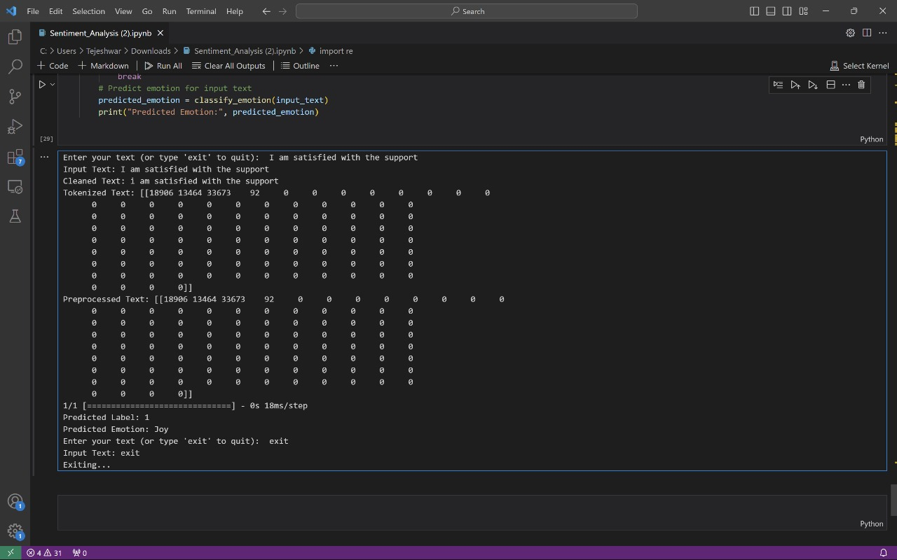
RESULTS
PROJECT LINK

