Slide 1
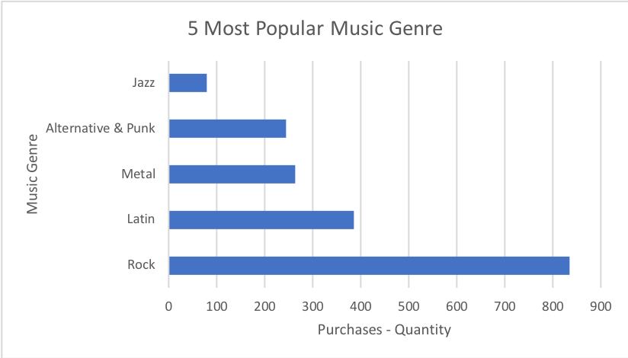
5 Most Popular Music Genre
We can see that Rock is the most popular music genre with the highest purchases, then Latin, Metal, Alternative & Punk and Jazz with less purchases.
Notes:
SELECT Genre.Name AS Type, SUM(InvoiceLine.Quantity) AS Purchases
FROM InvoiceLine
JOIN Invoice
ON InvoiceLine.InvoiceId = Invoice.InvoiceId
JOIN Track
ON InvoiceLine.TrackId = Track.TrackId
JOIN Genre
ON Track.GenreId = Genre.GenreId
GROUP BY Genre.Name
ORDER BY Purchases DESC
LIMIT 5

Slide 2
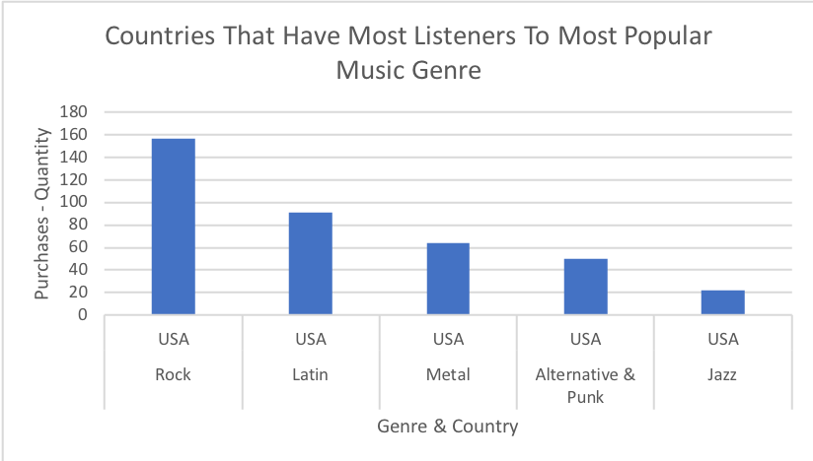
Countries That Have Most Listeners To Most Popular Music Genre
We can see that USA is the most country have the most number of listeners to the 5 most popular music genres.
Notes:
SELECT sub3.Type, sub3.Country, sub3.Purchases
FROM
(SELECT Country, Type, MAX(Purchases) AS No_Purchases
FROM
(SELECT Genre.Name AS Type, Invoice.BillingCountry AS Country, SUM(InvoiceLine.Quantity) AS Purchases
FROM Invoice
JOIN InvoiceLine
ON Invoice.InvoiceId = InvoiceLine.InvoiceId
JOIN Track
ON InvoiceLine.TrackId = Track.TrackId
JOIN Genre
ON Track.GenreId = Genre.GenreId
GROUP BY Type, Country) sub1
GROUP BY Type
ORDER BY Purchases DESC) sub2
JOIN (SELECT Genre.Name AS Type, Invoice.BillingCountry AS Country, SUM(InvoiceLine.Quantity) AS Purchases
FROM Invoice
JOIN InvoiceLine
ON Invoice.InvoiceId = InvoiceLine.InvoiceId
JOIN Track
ON InvoiceLine.TrackId = Track.TrackId
JOIN Genre
ON Track.GenreId = Genre.GenreId
GROUP BY Type, Country
ORDER BY Purchases DESC) sub3
ON sub3.Country = sub2.Country AND sub3.Type = sub2.Type AND sub3.Purchases = sub2.No_Purchases
LIMIT 5

Slide 3
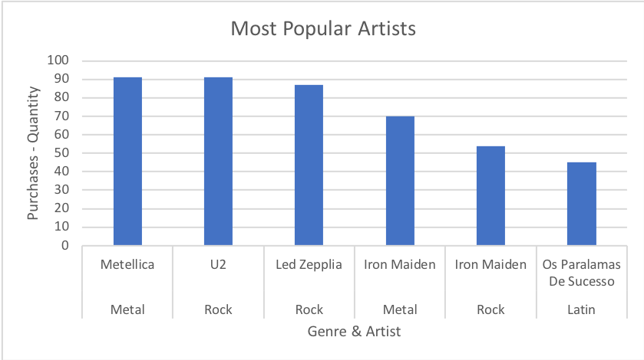
Most Popular Artists
We can see that Metellica and U2 are the most popular Artists with 91 purchases, followed by Led Zepplia, Iron Maiden and Os Paralamas De Sucesso with slight difference in number of purchases and they all surpass 45 purchases.
Notes:
SELECT Artist.Name, Genre.Name AS Type,SUM(InvoiceLine.Quantity) AS Purchases
FROM InvoiceLine
JOIN Invoice
ON InvoiceLine.InvoiceId = Invoice.InvoiceId
JOIN Track
ON InvoiceLine.TrackId = Track.TrackId
JOIN Genre
ON Track.GenreId = Genre.GenreId
JOIN Album
ON Track.AlbumId = Album.AlbumId
JOIN Artist
ON Album.ArtistId = Artist.ArtistId
GROUP BY Artist.Name, Type
HAVING SUM(InvoiceLine.Quantity) >= 45
ORDER BY Purchases DESC

Slide 4
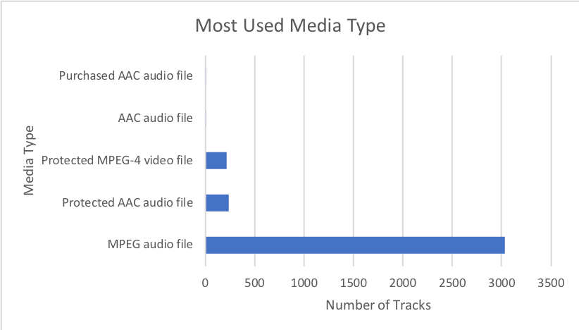
Most Used Media Type
We can see that MPEG audio file is the ost used media type and there is any other type that even close to it.
Notes:
SELECT MediaType.Name AS Media_Type, COUNT(Track.TrackId) AS No_Tracks
FROM MediaType
JOIN Track
ON MediaType.MediaTypeId = Track.MediaTypeId
GROUP BY Media_Type
ORDER BY No_Tracks DESC

