Slide 1
DATA SCIENCE INTERNSHIP
Internship Report & Project Summary
Thiranex – Skill Development & Future Tech
Nitin Karki
B.Tech CSE (AIML) – IILM University, Greater Noida
20 August – 19 September 2026

Slide 2
Internship Overview
A one-month, task-based Data Science internship focused on building practical skills across the full data science workflow — from raw data to actionable insight.
AT A GLANCE
Organization
Thiranex – Skill Development & Future Tech
4
1
100%
Domain
Data Science
Projects completed
Month duration
Tasks on track
Mode
Remote / Online, task-based
Duration
20 Aug – 19 Sept 2026
Certificate ID
THX-AUG2026-411
01
Thiranex – Data Science Internship

Slide 3
Objectives of the Internship
1
Data preprocessing
2
Predictive modeling
Clean, process, and visualize raw datasets.
Apply supervised ML algorithms to predict outcomes.
3
Exploratory analysis
4
Applied practice
Uncover patterns and trends through statistics & visuals.
Run the full workflow end-to-end on a real dataset.
02
Thiranex – Data Science Internship

Slide 4
PROJECT 01
KEY FEATURES
Data Cleaning & Visualization
Handled missing values, outliers & duplicates
Used Pandas, Matplotlib & Seaborn
Built dashboards & visual reports
Worked on a raw dataset to clean, process, and visualize insights.
EXPECTED OUTCOME
Learned data preprocessing, visualization, and storytelling with data.
COMPLETED SUCCESSFULLY
03
Thiranex – Data Science Internship

Slide 5
PROJECT 02
KEY FEATURES
Predictive Modeling Using ML
Applied Linear Regression, Decision Trees & Random Forest
Trained and tested models for accuracy
Visualized performance via confusion matrix & ROC curve
Built a model to predict outcomes based on given data.
EXPECTED OUTCOME
Gained experience in supervised learning and model evaluation.
COMPLETED SUCCESSFULLY
04
Thiranex – Data Science Internship

Slide 6
PROJECT 03
KEY FEATURES
Exploratory Data Analysis (EDA)
Used statistical summaries and visualizations
Identified correlations & key influencing factors
Presented insights in a structured report
Analyzed a dataset to uncover patterns and trends.
EXPECTED OUTCOME
Developed analytical thinking and data exploration skills.
COMPLETED SUCCESSFULLY
05
Thiranex – Data Science Internship

Slide 7
PROJECT 04
KEY FEATURES
Domain-Specific Applied Project
Chose a dataset (stock prices, patient records, sales data)
Performed end-to-end data analysis and prediction
Presented findings with visualizations & conclusions
Worked on a domain-specific dataset for applied, end-to-end learning.
EXPECTED OUTCOME
Applied data science skills in real-world contexts.
COMPLETED SUCCESSFULLY
06
Thiranex – Data Science Internship

Slide 8
Tools & Technologies
The technology stack used across all four projects.
Py
Python
Pd
Pandas & NumPy
Vz
Matplotlib & Seaborn
Core programming language
Data handling & preprocessing
Data visualization
ML
Scikit-learn
Jn
Jupyter Notebook
Ev
Train / Test & ROC
Machine learning models
Development environment
Model evaluation techniques
07
Thiranex – Data Science Internship

Slide 9
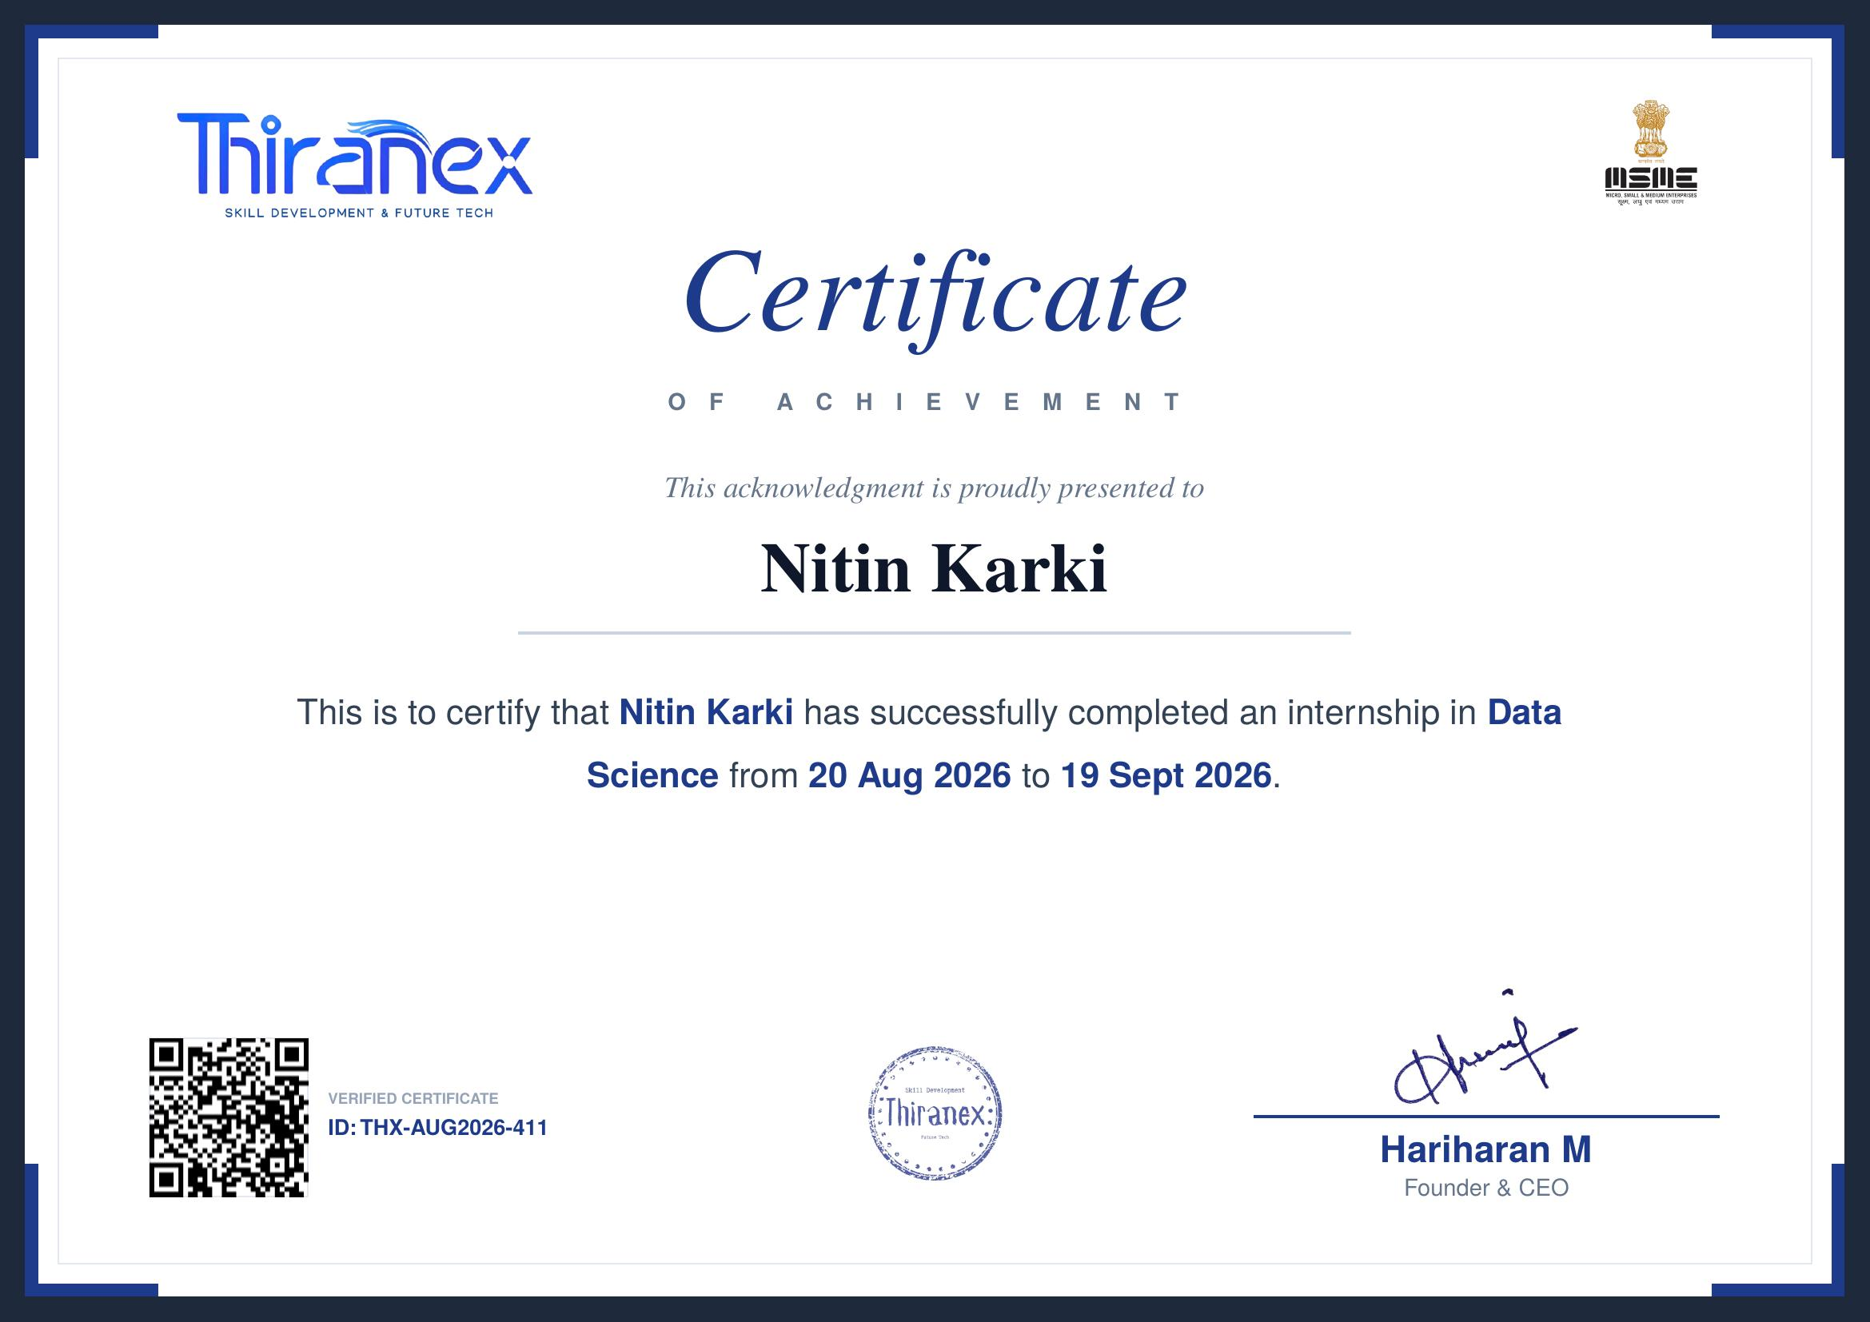
Outcomes & Certification
Proficiency in data preprocessing, cleaning & visualization
Practical experience in supervised machine learning
Strengthened analytical & data exploration skills
Ability to apply data science end-to-end on real problems
Verified certificate issued by Thiranex on successful completion of the internship.
Certificate ID: THX-AUG2026-411
Thank You
Nitin Karki • B.Tech CSE (AIML) • IILM University, Greater Noida

