Slide 1
SIH 2020
TEAM NAME: SHaKTiMaan
MENTOR NAME: Er. Saurabh Namdev
Problem Statement: AS121
College Name: IET Bundelkhand University
Organisation: Ministry of Women & Child
Development.
Name of Solution: CARE

Slide 2
Contents
1
2
3
4
Our Solution
Technology
Stack
Problem Explanation
Workflow
of Solution

Slide 3
01.
Problem Statement

Slide 4
Points from
Problem Statement (AS121)
Innovative online tool for protection of Child Rights.
Tracking and monitoring status of children that stay in government recognized Child
Card Institutions (CCI) and Specialized Adoption Agencies (SAA) and transferring them seamlessly.
Designing an effective biometric tool for daily attendance and in/out movement.
Provide login to District Child Protection Unit (DCPU) and Child Welfare
Committees (CWC) to enable them to access the tracking information.
Based on the recommendation, flagging children with higher eligibility of adoption based on attendance and guardian visits to be added to the legal adoption pool

Slide 5
Documents Studied
Juvenile Justice (Care and Protection of Children) Act 2015
Integrated Child Protection Scheme (ICPS)
UNICEF : Convention on the Rights of the Child

Slide 6
Information Sources
Probation Officer, Mr. Nandlal District Collectorate Office, Jhansi
Mr. Billal-Ul-Haq Project Co-ordinator, Railway Childline
CWC Officials Child Welfare Committe Office, Jhansi
Visited
Mother Teresa Orphanage.
NIC Officials.

Slide 7
Protection Of Child Rights
01
02
03
RIGHT TO
PROTECTION
RIGHT TO GOOD FAMILY
RIGHT TO HEALTHCARE
Every child has the right to be protected from expoitation, violence, abuse or neglect.
Every child has the right to have a good family life.
Every child has the right to the best health care possible, healthy food and a clean and safe environment to live in.

Slide 8
Goals
Cases of any exploitation, abuse, or neglect of a child can be directly reported to DCPU .
Any child in need of help can be identified and can receive help from DCPU.
Child Care Institutions may show false attendance of a child or slow down the process for transferring a child into adoption pool, so that they can get more financial grant.
District Probation Officer and CWC should have exact information of each child in CCIs who are eligible for Adoption Pool .
Every child in CCI should get best healthcare services.
.

Slide 9
02.
Our Solution

Slide 10




Our Solution
Child Welfare Committee
CCI
DCPU
CARE platform acts like a helping hand for the CCIs, CWCs and other higher officials. It also acts like a bridge between CWCs and SAAs.

Slide 11
Our Solution
CARE Web Portal
DCPU (District Child Protection Unit)Login..
Recommendation List for Highly Eligible child to be moved to Adoption Pool.
Notification of any report of exploitation or need of help of child in district.
CWC Login: Can track attendance and medical details of each child present in Child Care Institutions.
Creation of CSR(Child Study Report) and MER (Medical Examination Report) of a child.
State Officials Login : Details of every district is shown visually using Graphs.

Slide 12
Our Solution
2. CARE Desktop App
Can work offline and sync with the cloud database according to availability of network..
App can receive Circulars and Notices from CWC.
Tracking of Attendance daily of each child with Face Recogniton System.
Will track In/Out movements of child.
Will store all details of childen in CCIs in the local database.

Slide 13

1. Centralized CARE Database
Centralized Database for children in CCIs across the country.
CARE database is complementary of CARA database
KEY FEATURES
As CARA stores details of all children eligible for adoption. Our CARE stores details of all children living in CCI.
Details include Attendance, IN/OUT movement, Personal Details and Medical Health records.

Slide 14

2. Unique ID Generation
We are generating Unique IDs for children in CCI using uuid.
Probability of UUID v4 duplicates: Only after generating 1 billion UUIDs every second for the next 100 years, the probability of creating just one duplicate would be about 50%.
We are using UUID version 4.
When generated according to the standard methods, UUIDs are for practical purposes unique. Their uniqueness does not depend on a central registration authority or coordination between the parties generating them, unlike most other numbering schemes.

Slide 15

3. Face Recognition Attendance System
Eye- Blinking Attendance
Tensor-Flow Model is used for taking
attendance through blinking of eyes.
OpenCv is used for Face-Recognition.
Pickle is used for storing and getting the encoded datasets of images.
In-Out Movements are also stored with respective Child-IDs

Slide 16

4. Automating the process
Usually there is a lot of human intervention in tracking the child’s status & attendance taking process and amidst this maintaining transparency is also a challenge.
CARE is a platform which bring an Automation to this whole process at the same time brings transparency as well.
Customized Recommendation System

Slide 17
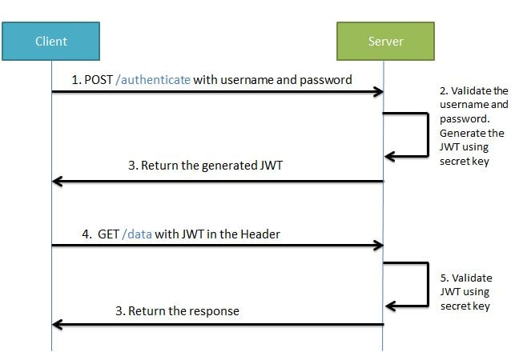
5.Authenticated APIs
Using JSON web tokens for creating secure data transfer.
Desktop App retreives and upload attendance data using secure JWT token based Http requests.

Slide 18


6. Sending E-Mail Alerts
Sending Email Alerts for taking action on Child after a certain fixed period
Twilio supports HTTP Basic and Digest Authentication. This allows you to password protect the TwiML URLs on your web server so that only you and Twilio can access them. One can provide a username and password via the following URL format.

Slide 19
03.
Working of CARE

Slide 20










Working of
CARE
Centralized
CARE Database
CWC Official
Child
Can view details.
Update Status.
Declare Legally Free
Syncing
Data
Biometric
Attendance
Higher Official
Can Track
Data of Children
In CCI.
Local
Database

Slide 21
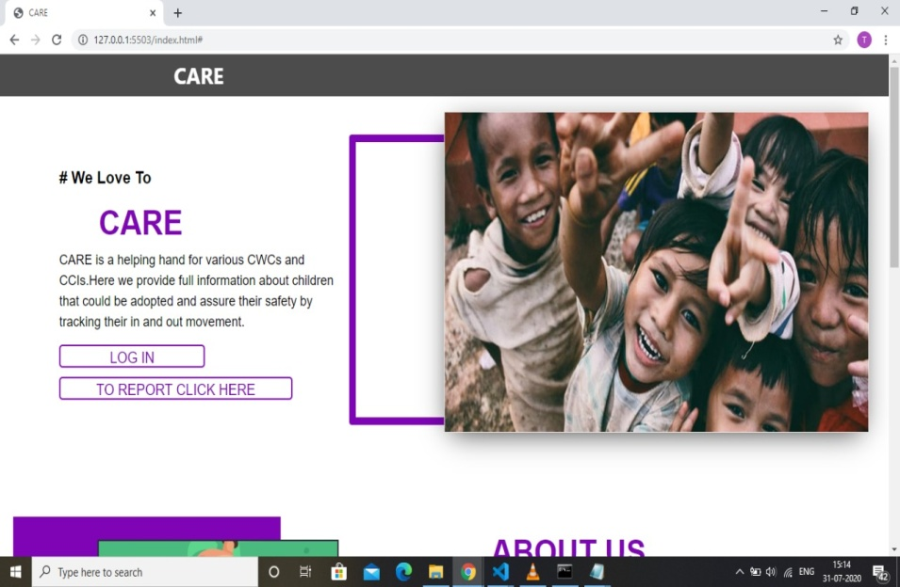
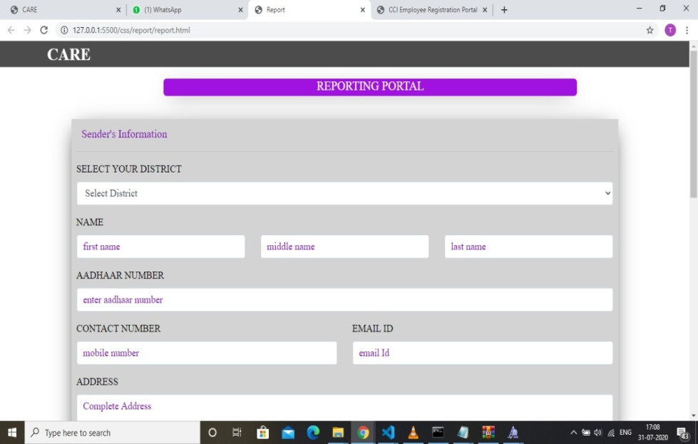

CARE Web Portal
CARE offers direct reporting
system to DCPU(District
Child Protection Unit) .
If any child is in need of help or
any case of child exploitation
can be addressed easily to
their district authorities. .

Slide 22
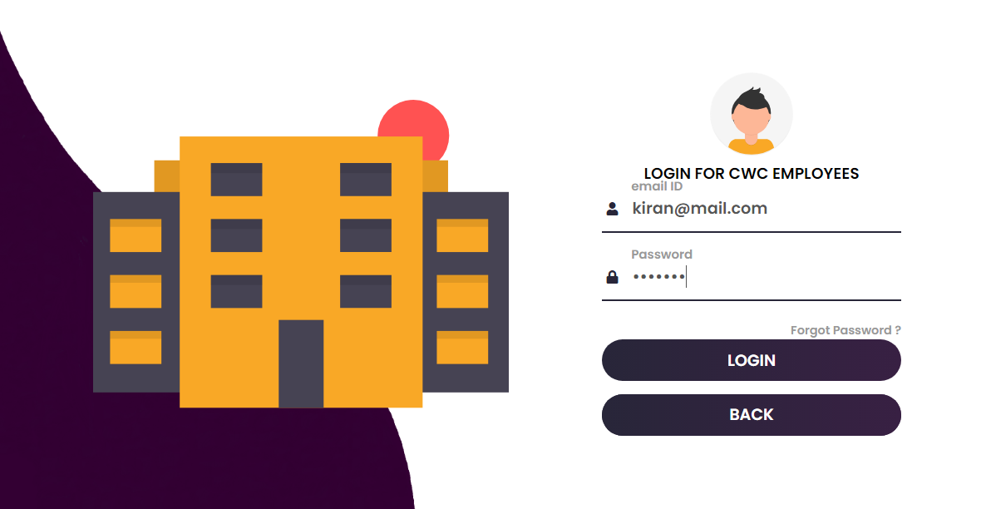
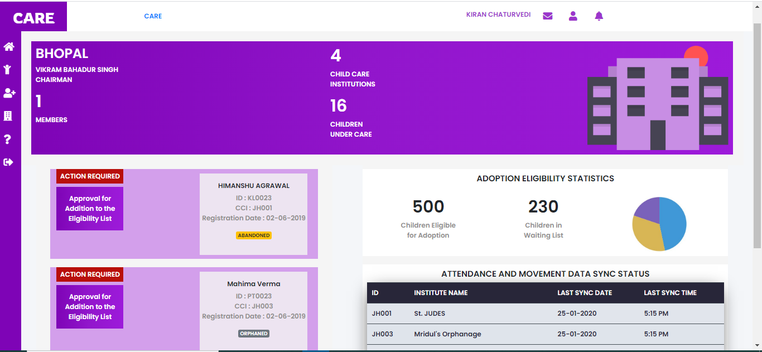
CARE Web Portal
CWC Dashboard shows details of
all CCIs and children under care.
Recommendation List of Higher
Eligible children for adoption.
Can send Notices and Circulars to
CCIs.
Can register new child, track attendance and view & update details of child.
Can declare legally free generating
CSR and MER report of child.

Slide 23
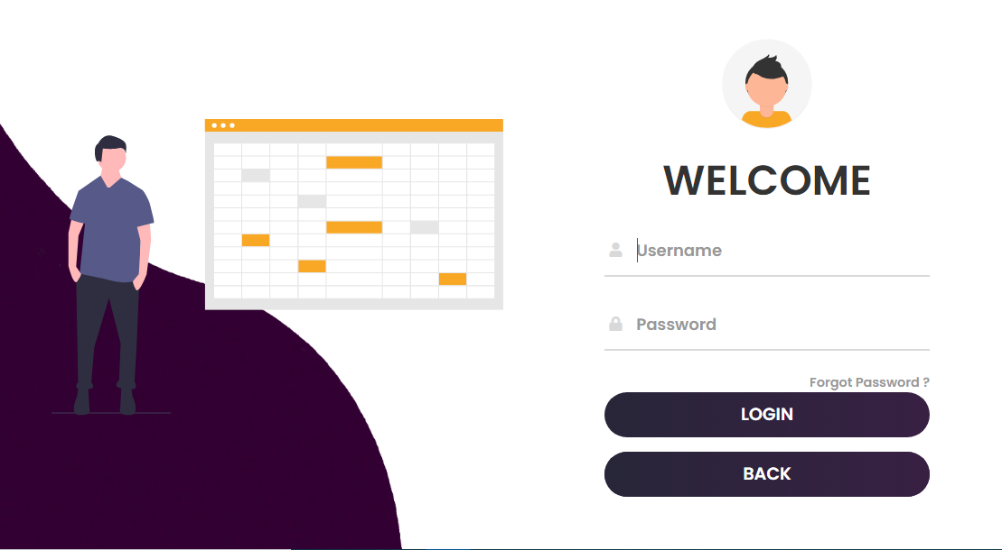
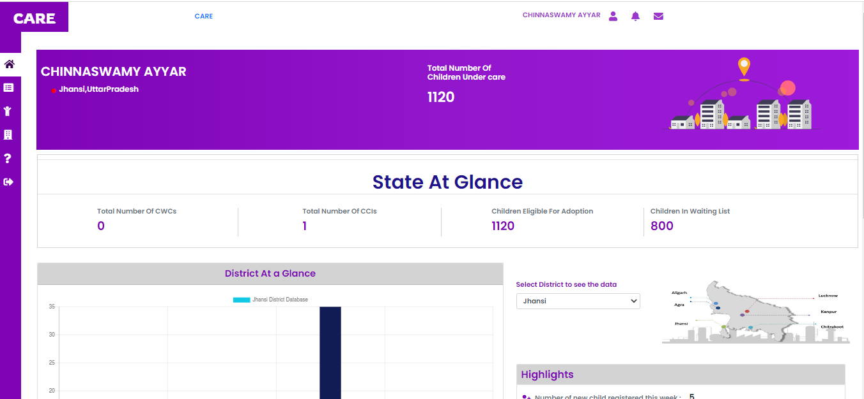
CARE Web Portal
State Officials Login :
State Officials can see details of CCIs and Attendance details of children in each district of the state.
Details and statistics are shown to
them using graphs.
This enables transparency in the
whole process .

Slide 24
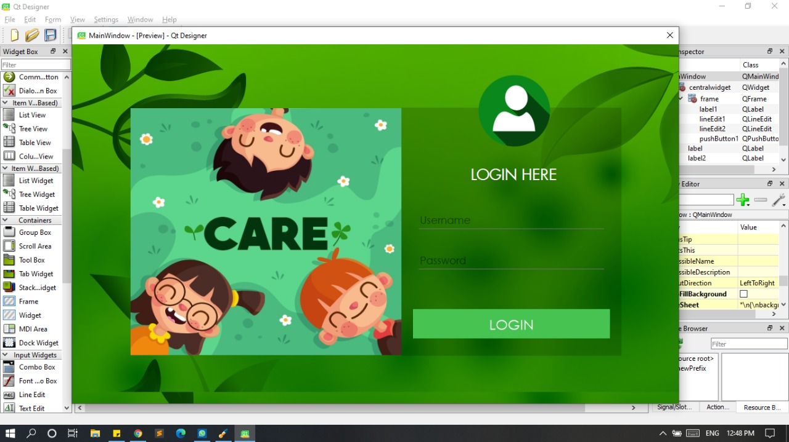
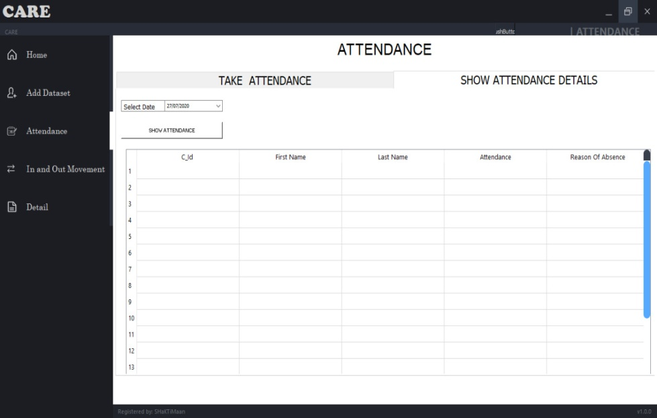
CARE Desktop App
CCI Login :
Child Care Institutions can take Attendance using Face Recognition System.
All details are stored in the local database and sync with the cloud database when network is available.
Desktop App shows all the Messages, and Notices sent by the Child Welfare Committee.

Slide 25
04.
Technology Stack

Slide 26

Centralized CARE Database
MongDB Atlas
as a
Cloud Database

Slide 27








CARE WEB APP

Slide 28

CARE Desktop App
PYQT
(For GUI)
TensorFlow
OpenCv

