Slide 1
General Frustrations with the (German) School System
Long commute times to school
Some People in poorer countries can't go to school
Not enough teachers
Teachers are not always knowledgable and/or competent in their field of excellence
Rigid curriculum which is not individually tailored to the strengths and weaknesses of the students
Low quality and quantity of (technical) equipment at schools
Conflicts between students and other students + students and teachers
Too much paper
Bad organization and information/unclear communication from the teachers
Healthy and good quality food at schools
Bad quality and maintenance of sometimes very old schools buildings
Womens education not at the same level as mens
Religious or ideaological influence on the curriculum (eg not teaching evolution)

Slide 2
Problem Tree Brainstorming
Ridgid curriculum which ignores individual needs and strengths + weaknesses
Bad organization and insufficient + unclear information and communication
Too much paper
Religious or ideological influence on curriculum
Teachers lacking skill and knowledge
Bullying and teachers having problem controlling the kids
Badly maintained and old school buildings
Bad equipment at schools
Not enough teachers
Not enough money
Bureaucratic barriers
Unattractive Job
Lack of govmnt support

Slide 3
Problem Tree
Bad student performance
Ridgid curriculum which ignores individual needs and strengths + weaknesses
Slower studying progress
Low student motivation
Bad organization and insufficient + unclear information and communication
Bad equipment at schools
Teachers lacking skill and knowledge
Too much workload for teachers
Not enough money
Not enough teachers

Slide 4

Making our Problem definition more specific
Bad student performance
Ridgid curriculum which ignores individual needs and strengths + weaknesses
Slower studying progress
Low student motivation
Bad organization
Unclear information
unclear communication
School Webportal is badly structured and missing features
Teachers lacking skill and knowledge
No standardization
Too much workload for teachers
Bad equipment at schools
Moodle lacking features
Not enough money
Not enough teachers

Slide 5
Feedback Given
Feedback Received
Group 19:
Beautiful Problem Tree, very good structure, a lot of thoughts went into the Problem Definition, very detailed problem definition, clear ideas for implementation
Group 8: The project under consideration is intriguing, as it tries to solve a challenge that can be addressed through the utilization of the Arduino kit. What sets this particular project apart is its real-world significance, resonating deeply within the sphere of practical, everyday existence, specifically as a potential resolution for individuals who are hearing impaired or deaf. This technical innovation is indeed very interesting and visionary, making it an great project to work on.
Group 8:
Problem: Bad organization + unclear information, very relatable problem. Very good analysis of root causes (bad equipment at schools, too much workload for teachers etc.). Solving this problem would create a lot of value. Problem tree had all important aspects. 10/10
Group 19:
The project is intriguing as it seeks to enhance the Moodle learning platform. What sets this project apart is its dedication to improving an essential educational tool that plays a significant role for students and teachers. This has real-world significance, resonating deeply within the field of online education and e-learning. Trying to finding alternatives and solutions for making Moodle more effective and user-friendly is commendable.

Slide 6
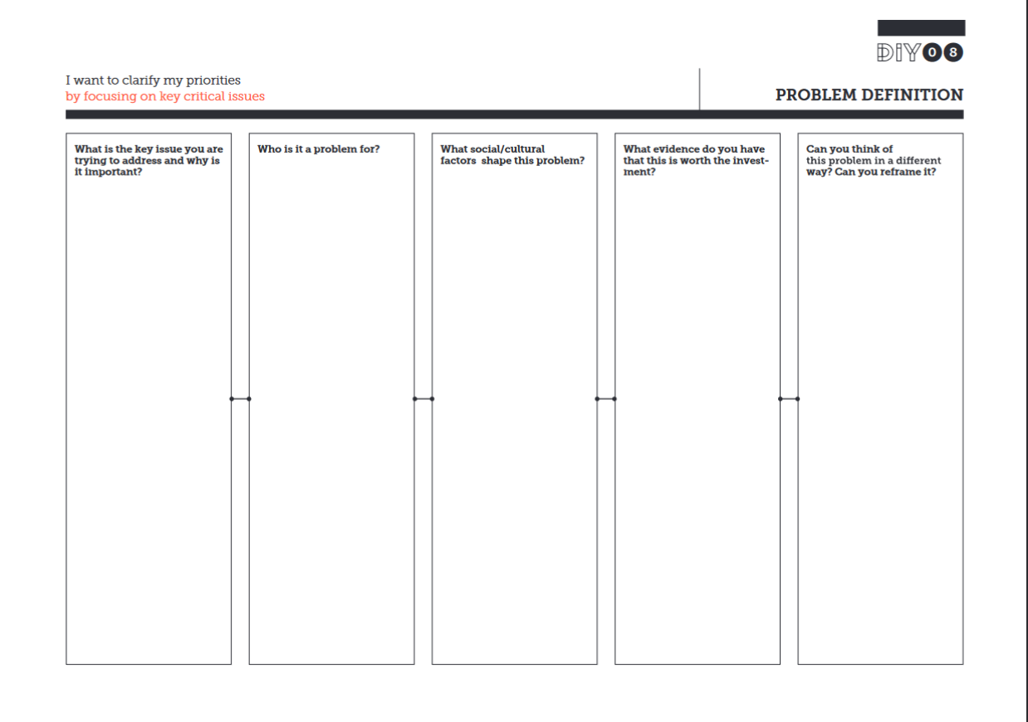
The Problem:
Bad organization and insufficient information and communication
Why its important:
Decreased learning efficiency and therefore slower studying progress
Dereased motivation because of increased frustration
Inability to adept the curriculum to individual needs of the students
The Students and Parents:
Decreased motivation to learn new thinga
Worse performance in school
Increased frustration and less fun
Makes working nad learning in school more difficult
The Teachers:
Makes their job more difficult
Makes it more difficult to present the curriculum to students in an efficient and engaging way
The Economy:
Decreased overall eduction of people decreases economic output and global competitiveness
Decreased individual economic output and thereby decreased wages and living standards
Qualitiy of organization and efficiency of communication not viewed as important as other things because they have no direct, only indirect, influence on the actually desired output
It is difficult to convince people of changing historically evolved legacy systems if those systems work (even though they might be highly inefficient and ineffective)
Regular complaints of other students that there is a general lack of good and efficient organization and communication
Teachers don‘t have enough time to organize better
Teachers don‘t have sufficient tools for good organization and communication

Slide 7

Persona 1/3
Motivations:
Improve organization in his school for teachers and students
Teach his students as best as possible
Improve the IT knowledge of his collegues
Modernize the schools IT systems and software
Personality:
Extroverted
Focused on Growth and Safety
Very intelligent and knowledgeable
Biography:
Herbert Lang is 42 years old and has a Masters Degree in IT. He is a teacher at a Gymnasium. After he suffered a stroke he was unable to teach for 3 consecutive months. Because other, non-IT teachers lacked the knowledge and skills and there are no other IT teachers at the school, the scope and depth of the IT curriculum was significantly reduced during his absence. Therefore the students are lacking important Information and Skills for their Informatics Abitur exam.
Frustrations:
Students are complain that the School platform „Moodle“ is outdated, slow and confusing.
Maintaining the schools IT systems is a lot of work
He has so much to do that there is no time to truly focuse on one task. His work effectiveness and efficiency is suffering because of this

Slide 8

Persona 2/3
Motivations:
Wants to work in the IT industry
Wants to specialize in network security and work for a leading tech company is this field
Loves solving complex problems
Personality:
Ambiverted
Focused on Growth
Visionary and Innovative
Biography:
Lena Müller has just started an Ausbildung as FIDV. She had a passion for technology from a young age and got inspired by her father who is a software developer. She has a natural inclination for innovation and has a visionary spirit.
Frustrations:
Has to deal with the obfuscated and complicated organizational systems in her school.
Has to work with team members in school who are not as quickly progressing as she is which is holding her back

Slide 9

Persona 3/3
Motivations:
Wants to learn as much about IT and Programming as possible
Wants to solve interesting Problems
Wants to work on interesting Projects in their field of interest
Wants to have a well scheduled and organized school week
Personality:
Introverted
Focused on Growth and Individuality
Motivated to work on things that interest them
Biography:
Chris Schmidt is attending 11th Grade in Highschool. They‘re interested in IT and want to start an Ausbildung as a FISI after their Abitur. Despite having Informatics as a course, the IT curriculum at their school is very poor and unorganized and there is no really competent teacher around. That‘s why Chris resorted to using ChatGPT and Google for learning new things in this field.
Frustrations:
Has to learn things that don‘t interest them
Has to deal with badly organized school weeks
Projects that need to be worked on are not well communicated and the projects generally don‘t fulfill the SMART criteria

Slide 10
Walt Disney Method
The Dreamer:
- Moodle with included "ChatGPT"
- Stuctured and easier to use Website (akin to Moodle)
All Infos and Documents in one place (standardised Methods)
General, from the Class Course seperate, Wiki in which Teachers and Students can add new information
In Moodle included Chat/Meeting app (instead of Webex)
In Moodle included Planner/Kanboard app
In Moodle included Timetable (instead of external Google Doc)
Only include Infos in Moodle which are relevant for the respective Student (no courses from chemistry for example)
In Moodle Integrated GitLab for every Student
Own Virtualization Platform for Students to deploy their VMs (like VCenter
The Realist:
ChatGPT:
- OpenAI ChatGPT subscription too expensive
- On-Prem ChatGPT
Moodle:
- Include Modules in Moodle using Iframes (for Chat/Meeting, Timetable, Gitlab, Wiki, ChatGPT app etc.)
The Critic:
ChatGPT:
- Needs too much power/too many hardware ressources
- High power usage = high CO2 exhaustions
Wiki:
- Teachers need to check content contributed by students

Slide 11
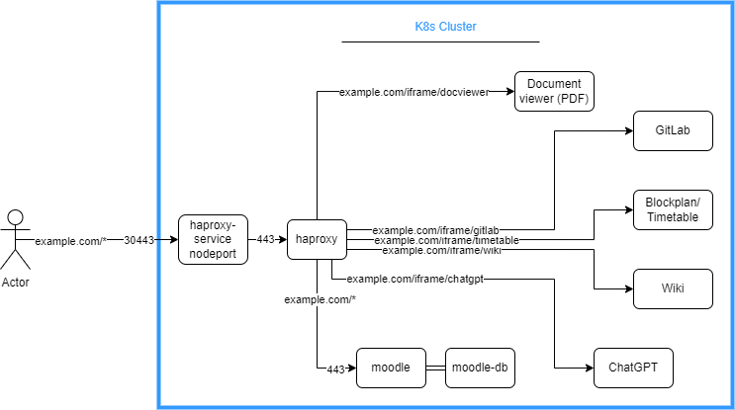
Infrastructure Architecture

Slide 12
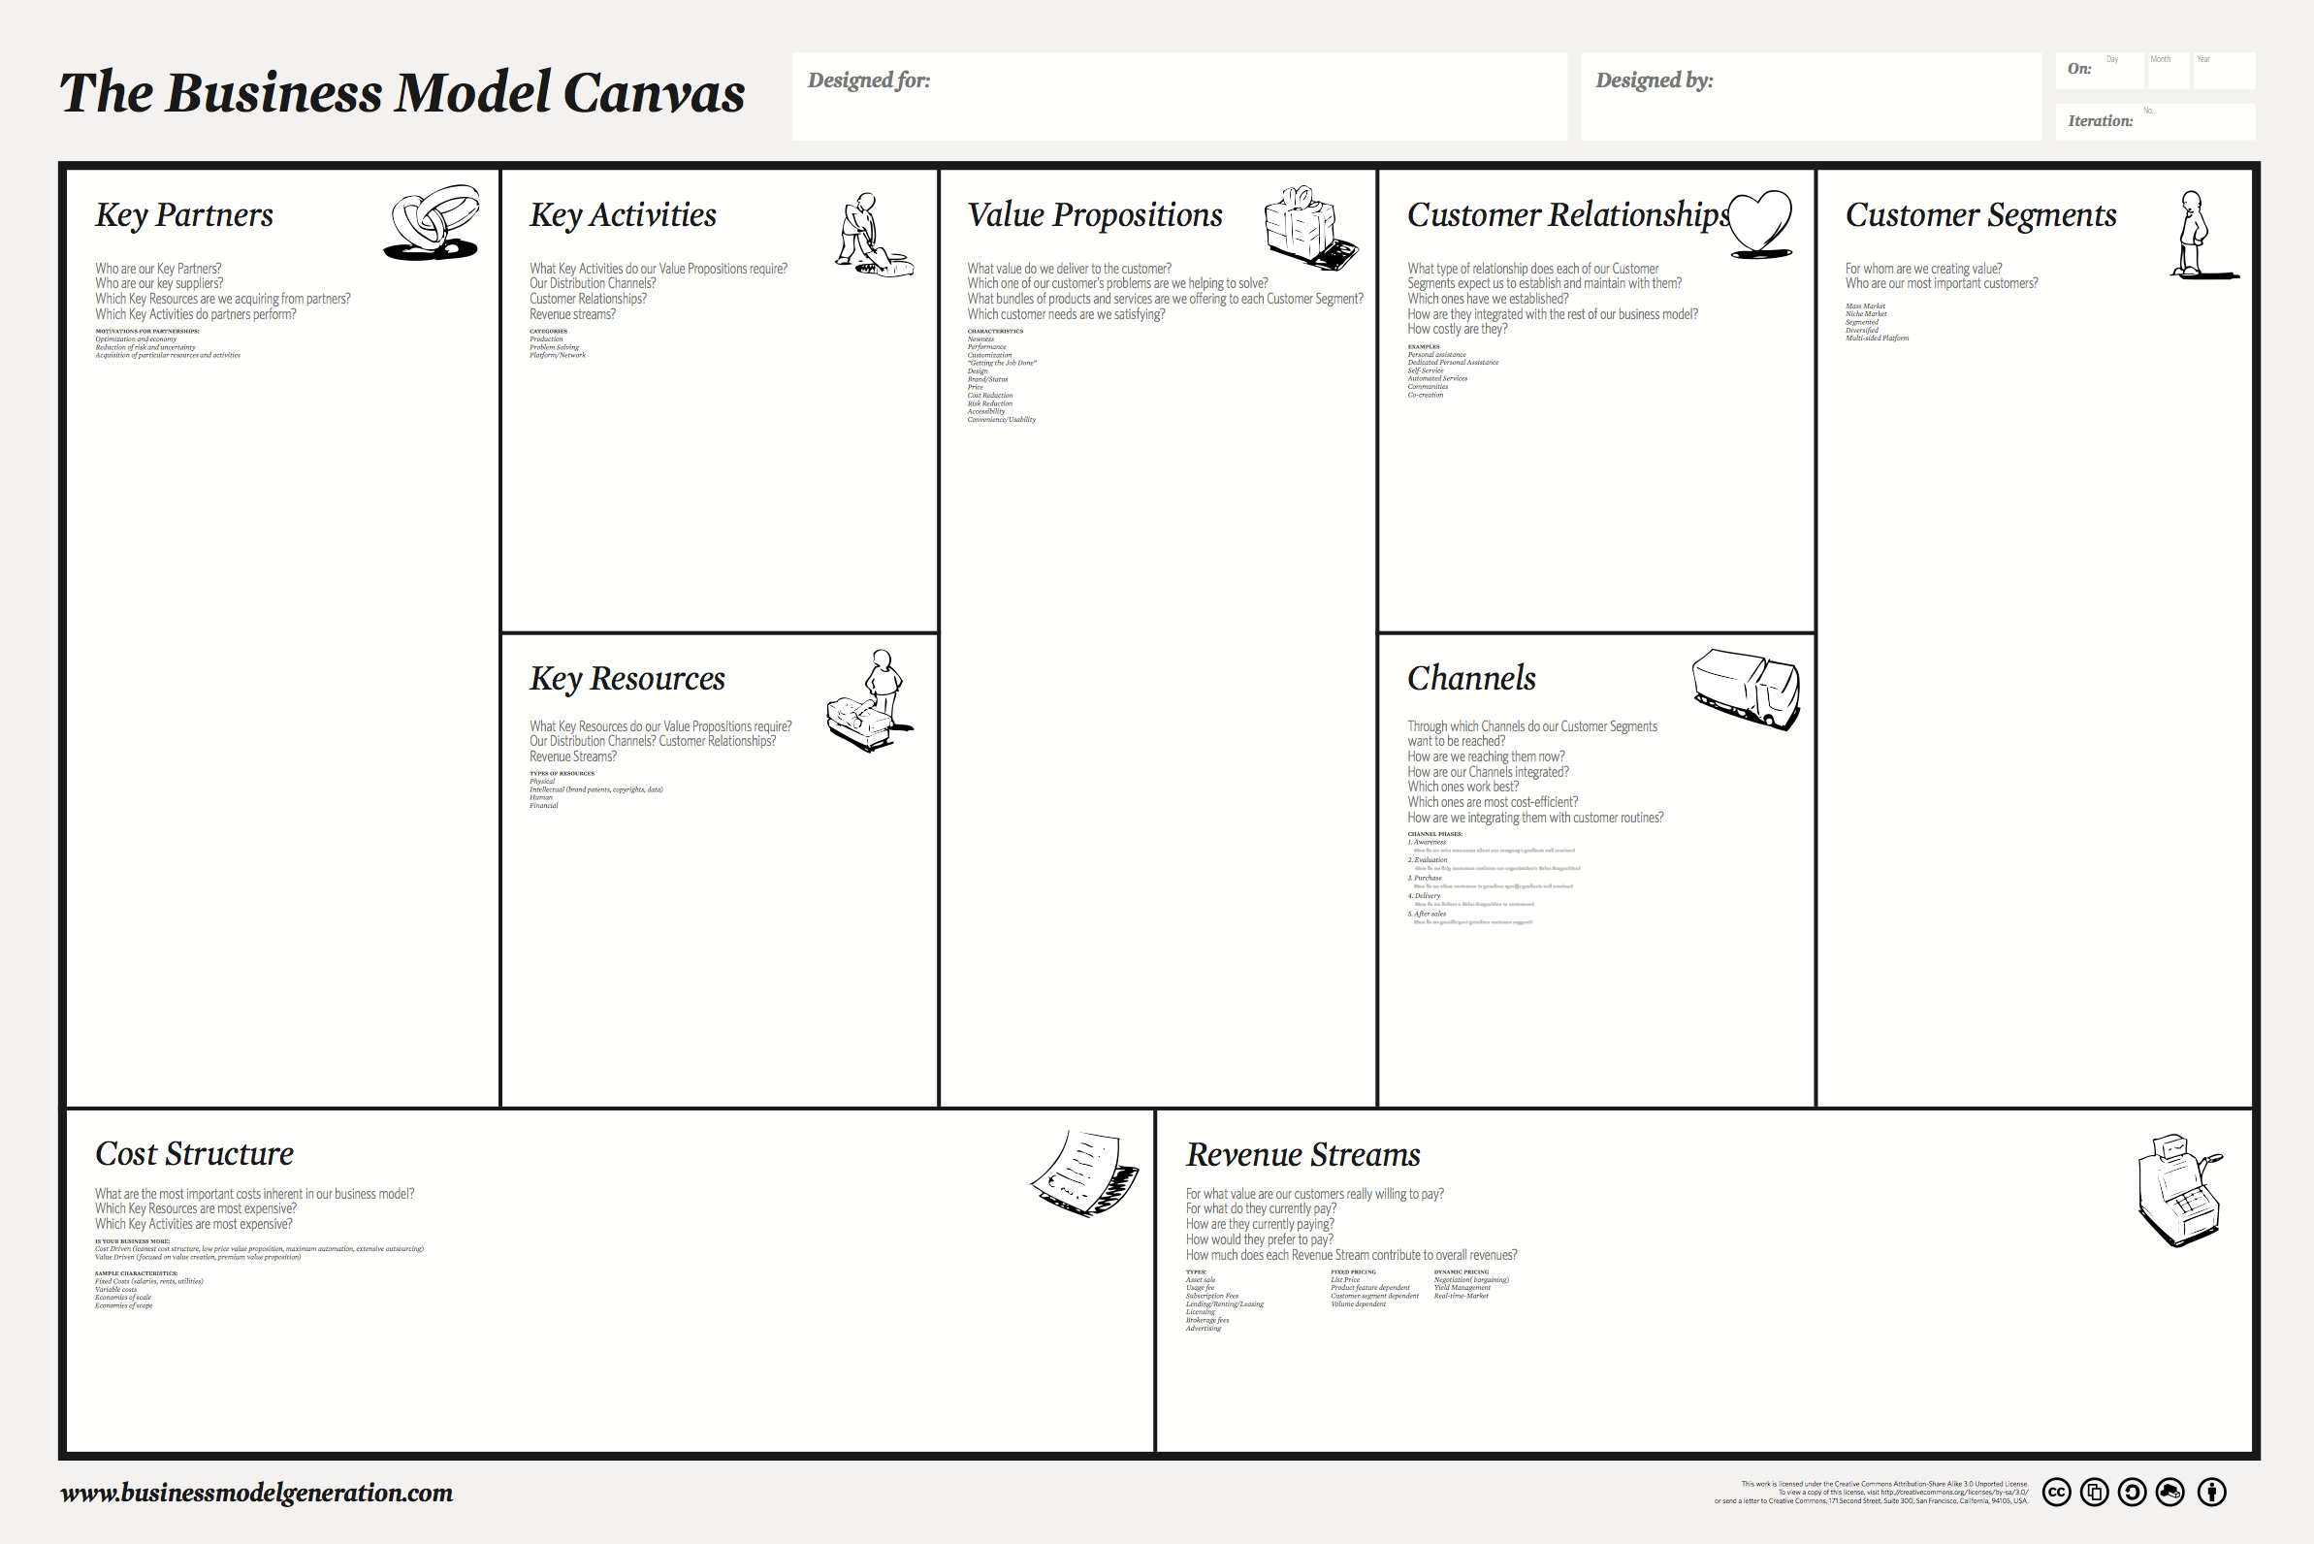
Key Partners:
The Moodle company (moodle-as-a-service
The teachers
Key Suppliers:
Moodle (the base platform)
Software developers (the Iframe Modules
Hosting company/cloud (to run the iframes on webservers)
Developing (iframe) modules
Talking with teachers and students what is needed/required
Teachers
Students
Iframe Modules for Moodle extend its functionality and allow for a better and more customizable moodle experience
Servers/Cloud to run the Iframe modules on
Moodle
Developing new software modules costs money
Costs for hosting/cloud

