Slide 1
Generalization
Syed Hamza Afzal Ashraf
Abdul Muqsit Farooqui

Slide 2
Research questions
How do design methodologies and strategic techniques contribute to Generalization.
Research Paper “Assessing methods for generalizing experimental impact estimates to target populations”

Slide 3
Research Paper
School Dropout Demonstration Assistance Program (SDDAP data)
N=2118, 35 covariates
Treatment variable that contains information of which student received counselling etc.
ATE (Average Treatment Effect) so that we can generalize on larger populations.

Slide 4
Statistical Approaches of Generalization
Our Design Selection
Treatments effect using different settings
Propensity-score-based
Accuracy of Various Method
Compare the Relative Bias and Efficiency

Slide 5
Fifa Players Performance
We have data of two FIFA rankings, 18 and 19.
Generalization on Overall being influenced by Wage.
We selected Overall and wage of FIFA 18, and checked in with FIFA 19.
If there’s a difference in Wage and Overall in current ranking, we include that in Treatment = 1 Else Treatment = 0.

Slide 6
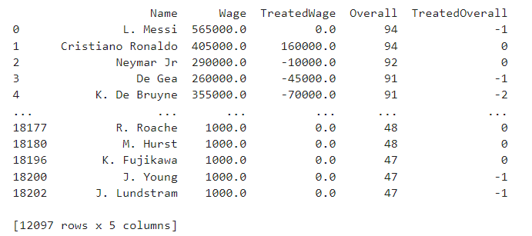
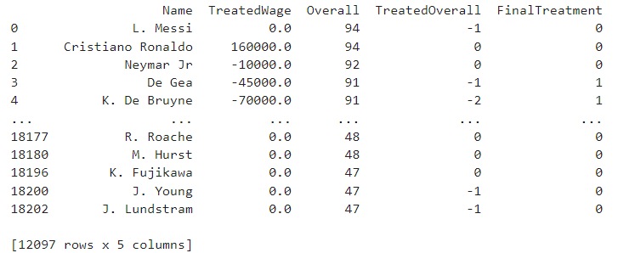
Fifa Players Performance
Calculations on Wage and Overall (18 and 19)
Final Treatment is Treatment column

Slide 7
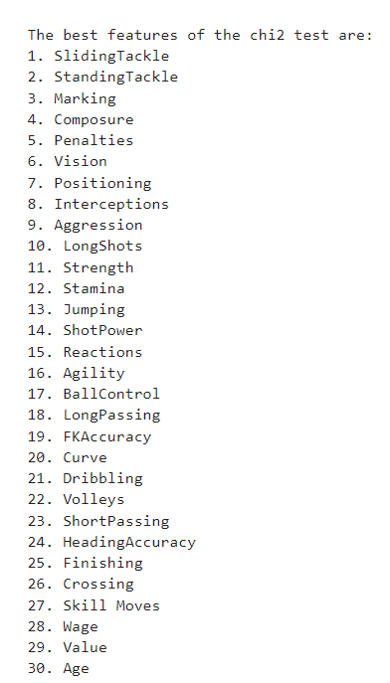
Feature Selection

Slide 8
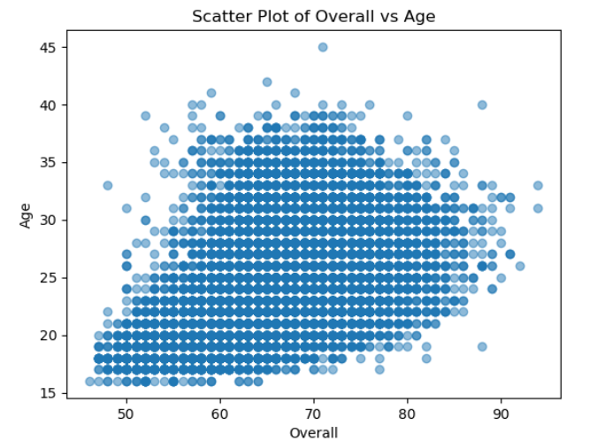
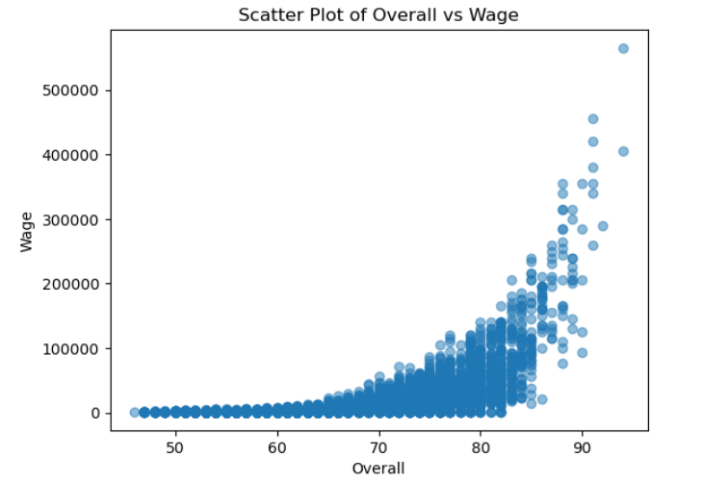
Scatter Plot
Descriptive Analysis
Scatter Pot

Slide 9
Generalization Strategies
Linear Regression
Doubly Robust (DR) with Logistic Regression (LR)
Doubly Robust Random Forest
Gaussian Naive Bayes

Slide 10
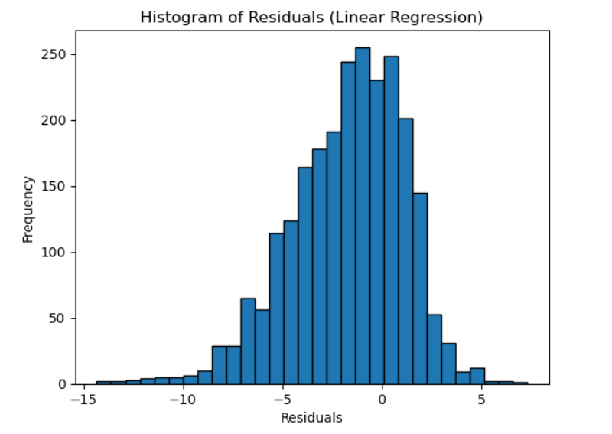
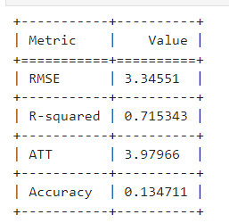
Linear Regression
Results:

Slide 11
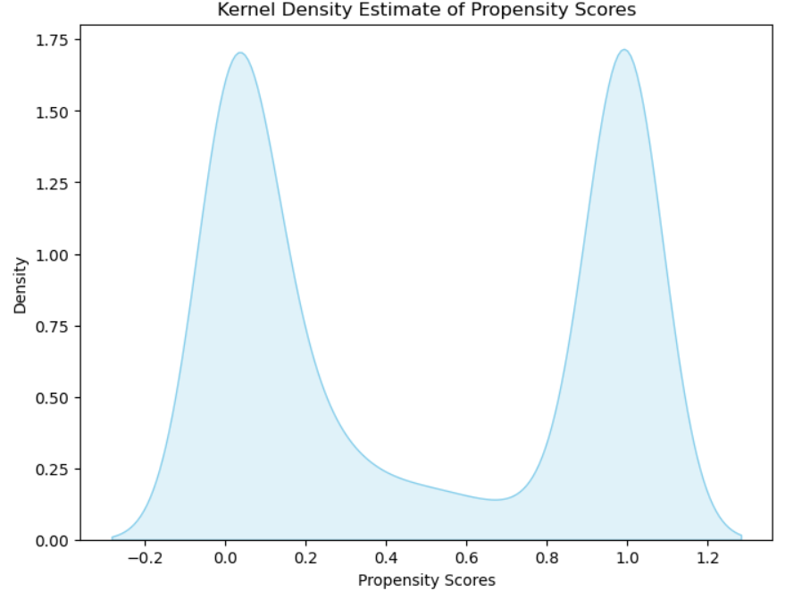
Linear Regression
Results:

Slide 12
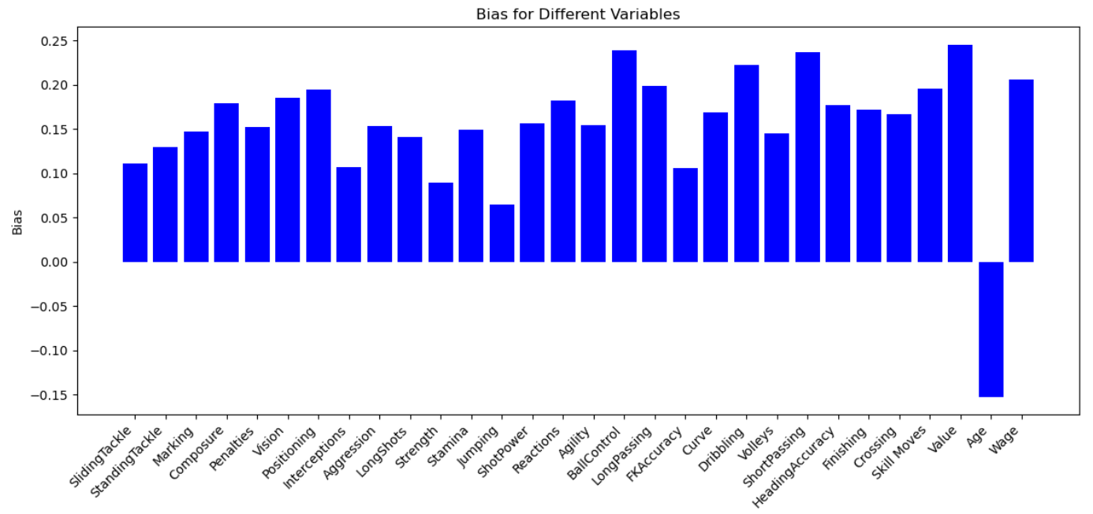
Linear Regression
Results:

Slide 13
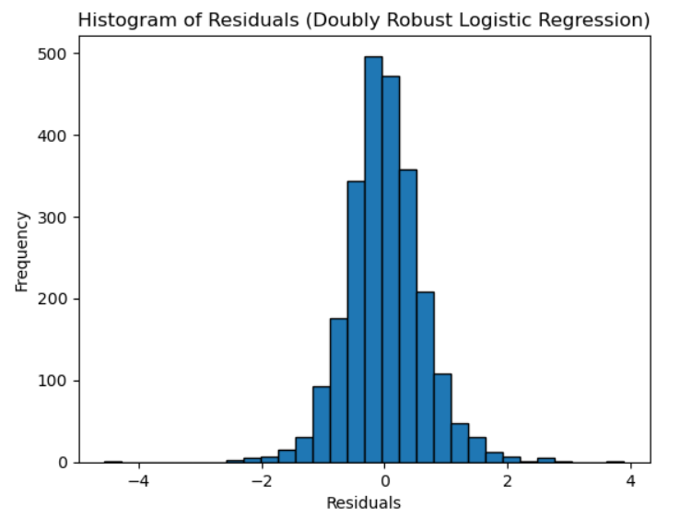
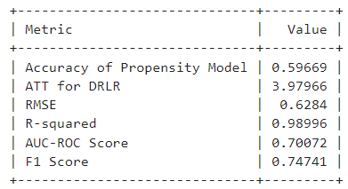
Doubly Robust with Logistic Regression
Results:

Slide 14
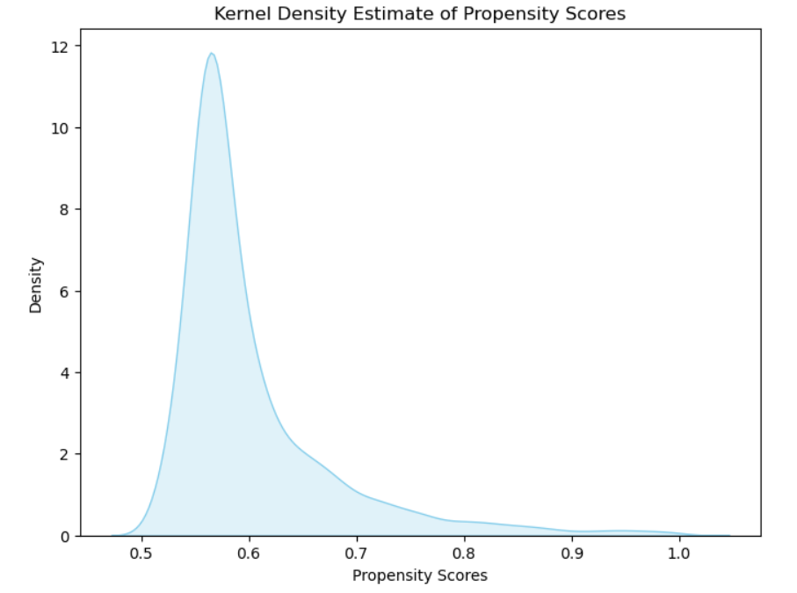
Doubly Robust with Logistic Regression
Results:

Slide 15
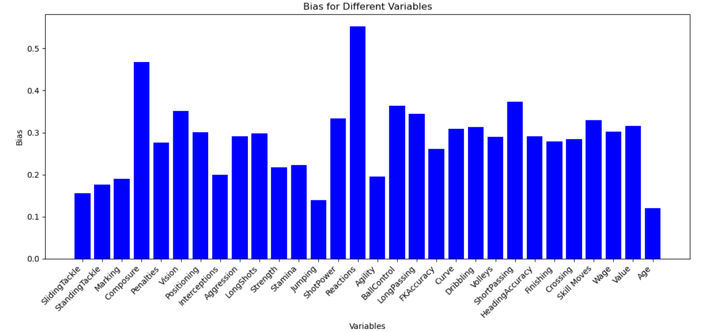
Doubly Robust with Logistic Regression

Slide 16
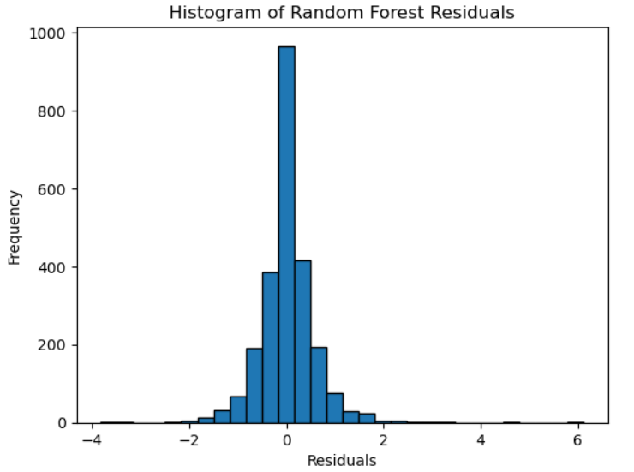
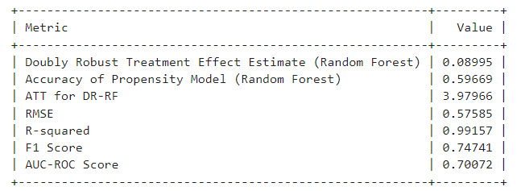
Doubly Robust Random Forest
Results:

Slide 17
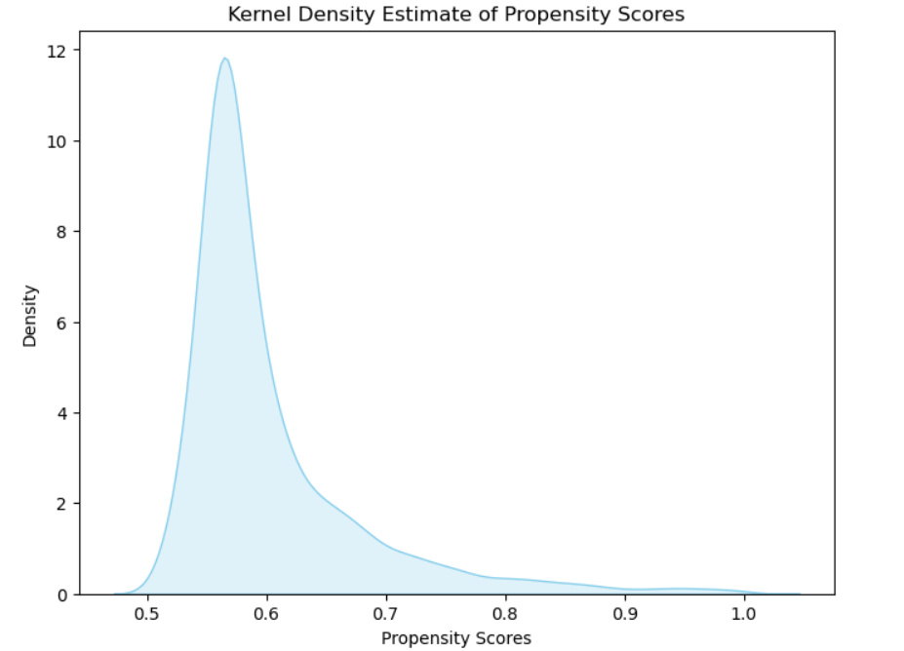
Doubly Robust Random Forest
Results:

Slide 18
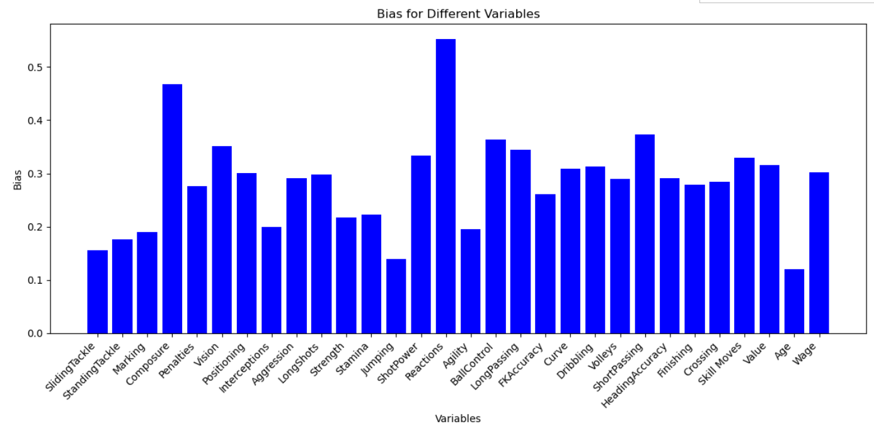
Doubly Robust Random Forest

Slide 19
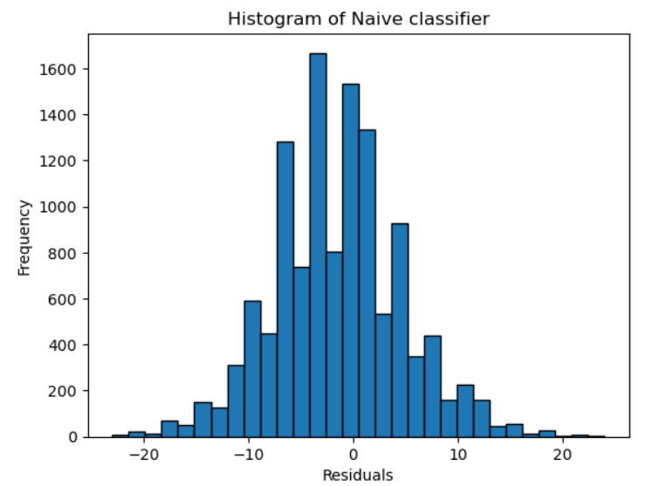
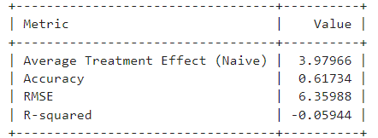
Gaussian Naive Bayes
Results:

Slide 20
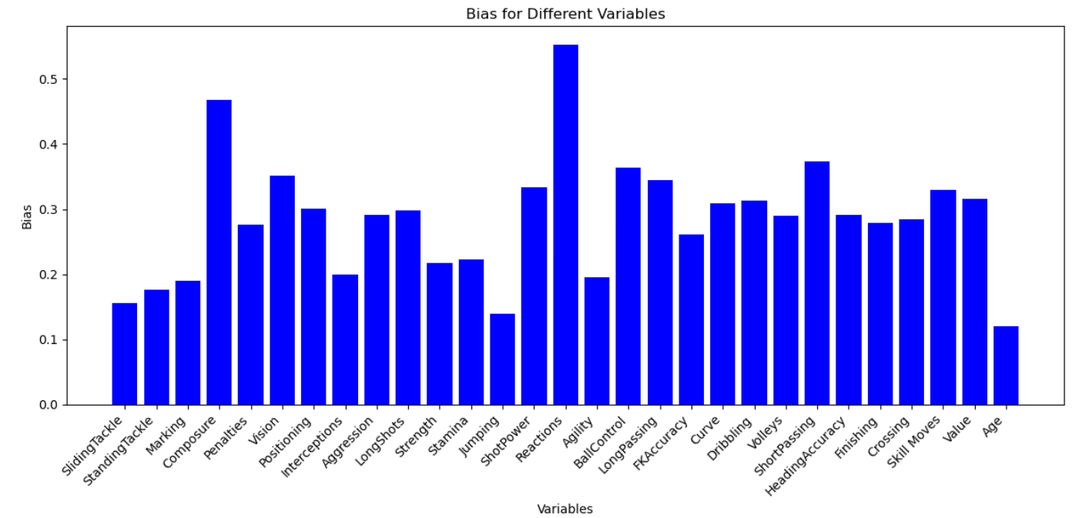
Gaussian Naive Bayes

Slide 21
Conclusion
Machine learning based algorithm (DR RF) performs better than Linear Regression.
Naïve Bayes performs the worst.

