Slide 1


Slide 2
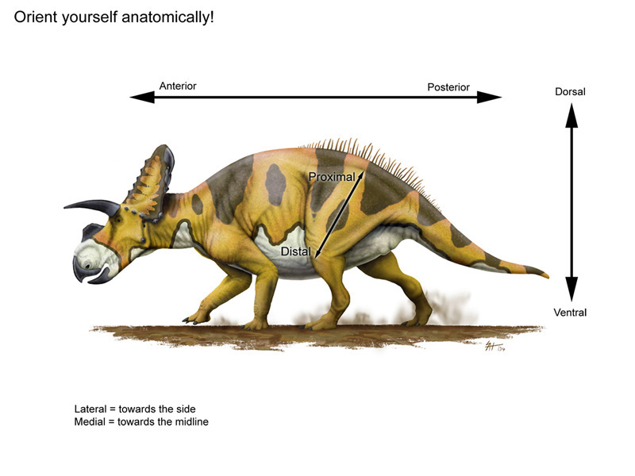

Slide 3
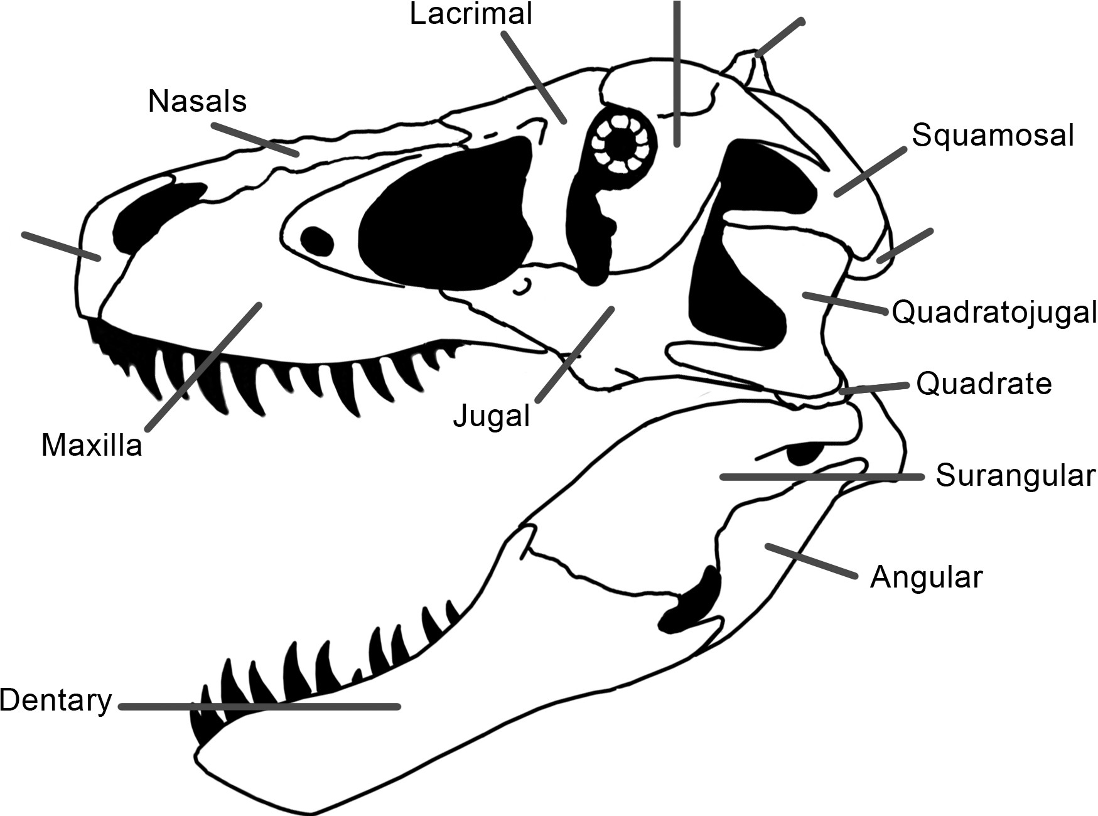
External Bones of the Skull
Like other vertebrates, dinosaur skulls are made up of many bones joined together. Here are the ones that are visible in side view.
Postorbital
Parietal
Premaxilla
Occipital
Copyright Scott Hartman, 2012.

Slide 4
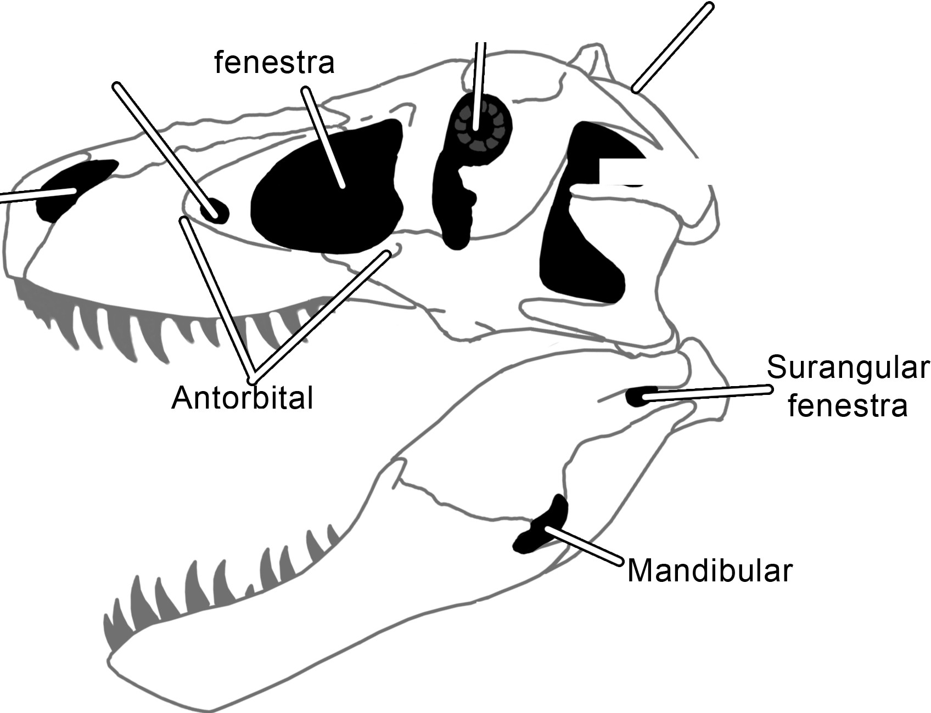
Holes of the Skull
Dinosaur skulls had a variety of holes and depressions in them. In anatomical terms a "major" hole (a big one) is called a fenestra, while a depression is called a
Superior temporal fenestra (not visible from the side)
fossa.
Orbit (eye hole)
Antorbital
Promaxillary fenestra
Inferior
=::===;::�temporal
fenestra
Nares (nose hole)
fossa
fenestra
Copyright Scott Hartman, 2012.

Slide 5
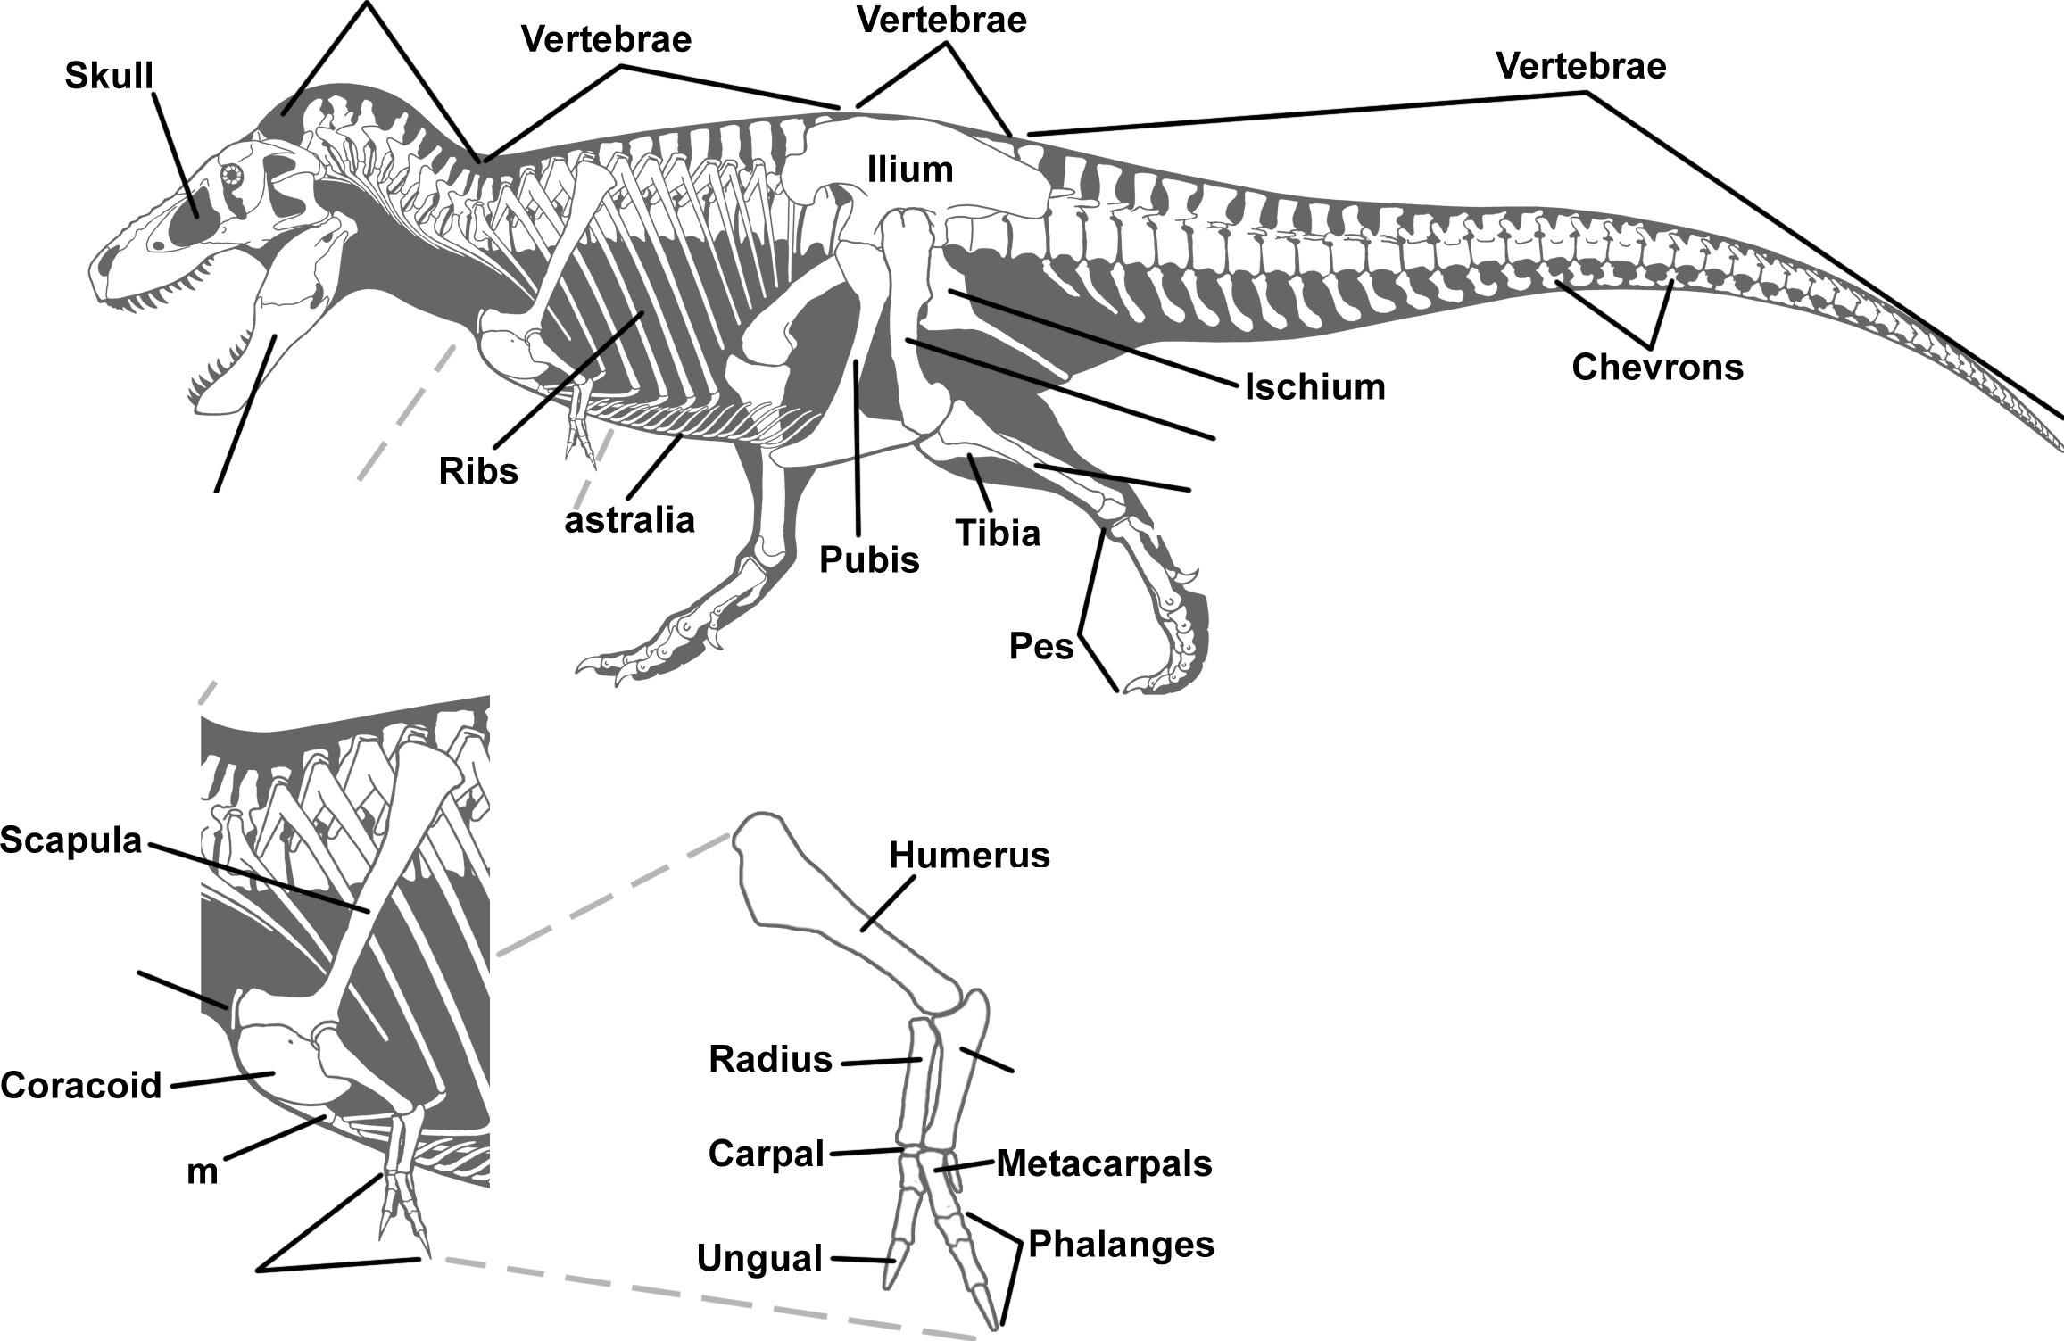
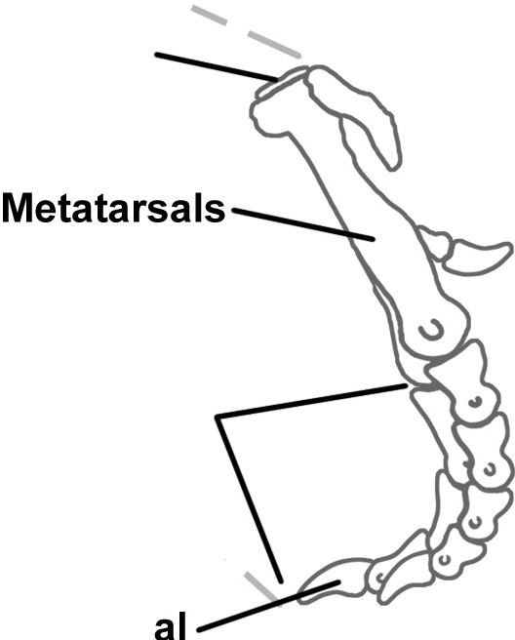
Dinosaur osteology primer (learn the bones!)
Cervical
Vertebrae
Dorsal
Sacral
Caudal
Femur
......Fibula
Mandible /
I
I
I
G
........ ........ ......
I
I
.......
I
''
....... ...... ......
...... .....
' '
Tarsals
' ' '
Furcula
'
Ulna
' 'Pha anges
' '
Sternu
'
Manus
Ungu
Copyright Scott Hartman, 2013.

Slide 6
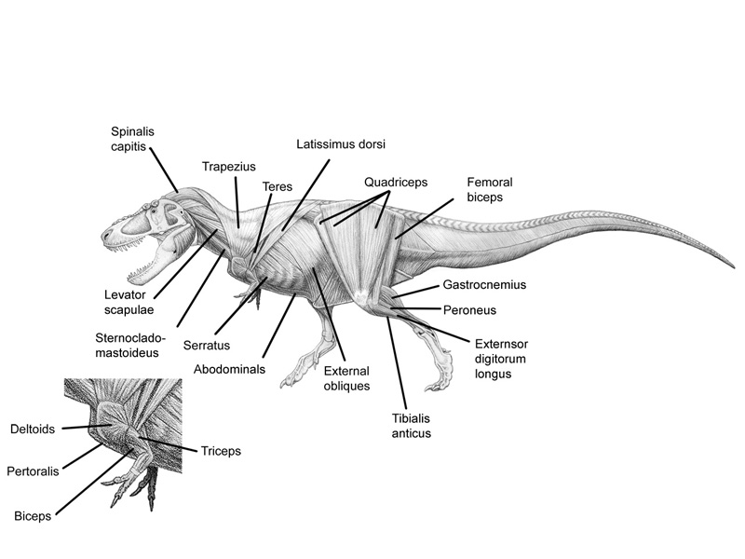

Slide 7
