Slide 1
01_Intro
Quiz

Slide 2
1. What is RStudio?
A programming language
A package in the R programming language
An integrated development environment (IDE)
A library in the R programming language

Slide 3
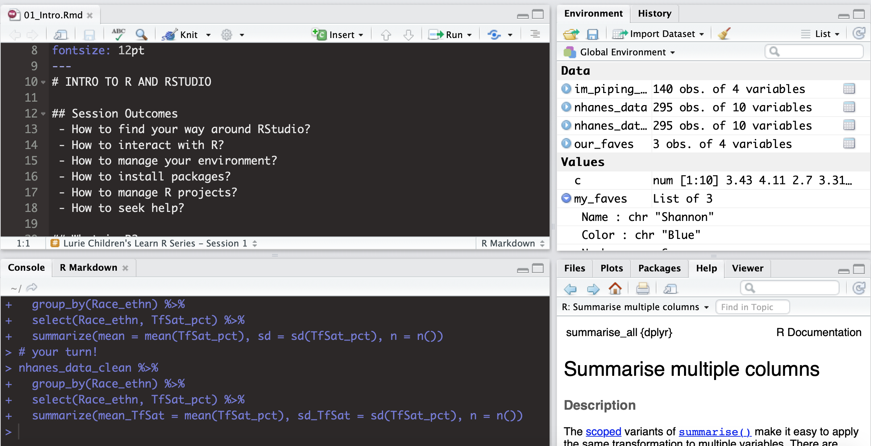
2. Which is the Console pane?
A
C
A
B
C
D
B
D

Slide 4
3. What symbol is used to comment code in R?
!
$
%>%
#

Slide 5
4. Which is a valid object name in R?
%deviation
4th_floor_data
lab.data
my data

Slide 6
5. How can you access help in R?
Type help()
Type ?
The Help tab
All of the above

