Slide 1
03_RMarkdown
Shannon Haymond, PhD

Slide 2
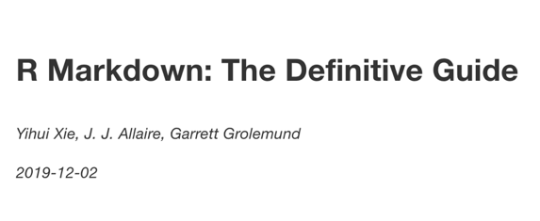
https://bookdown.org/yihui/rmarkdown/
Great resource!

Slide 3
What is R Markdown?
R Markdown is an R package and a set of tools that are deeply embedded in RStudio
Specific authoring format that enables documents that combine text, R code, and the output from that code (tables, graphics, etc) in a way that is best for human understanding – facilitates literate programming
Any R Markdown document can be used as a Notebook
Notes:
R Notebooks are an implementation of Literate Programming that allows for direct interaction with R while producing a reproducible document with publication-quality output.
Any R Markdown document can be used as a notebook, and all R Notebooks can be rendered to other R Markdown document types. A notebook can therefore be thought of as a special execution mode for R Markdown documents. The immediacy of notebook mode makes it a good choice while authoring the R Markdown document and iterating on code. When you are ready to publish the document, you can share the notebook directly, or render it to a publication format with the Knit button.

Slide 4
What is an R Notebook?
Notebooks are R Markdown documents with chunks that can be executed independently and interactively, with output visible immediately beneath the input and Viewer tab – great for iterating code.
All R Notebooks can be rendered to other R Markdown document types
Notes:
R Notebooks are an implementation of Literate Programming that allows for direct interaction with R while producing a reproducible document with publication-quality output.
Any R Markdown document can be used as a notebook, and all R Notebooks can be rendered to other R Markdown document types. A notebook can therefore be thought of as a special execution mode for R Markdown documents. The immediacy of notebook mode makes it a good choice while authoring the R Markdown document and iterating on code. When you are ready to publish the document, you can share the notebook directly, or render it to a publication format with the Knit button.

Slide 5
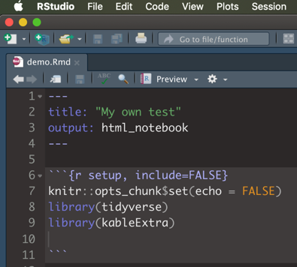
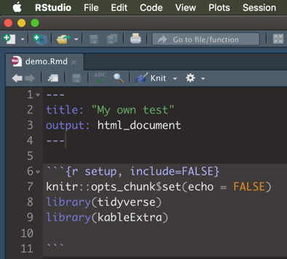
R Notebook
R Markdown

Slide 6
We’ll use 3 steps
Organize
Analyze
Render
R Project
R Markdown
R Markdown

Slide 7
2.
Analyze/Summarize
We’ll use R Notebook to analyze/summarize data

Slide 8
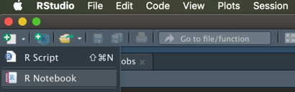
1. Use New File >> R Notebook button on toolbar 2. Use New File >> R Notebook command from File tab
Create new R Notebook

Slide 9
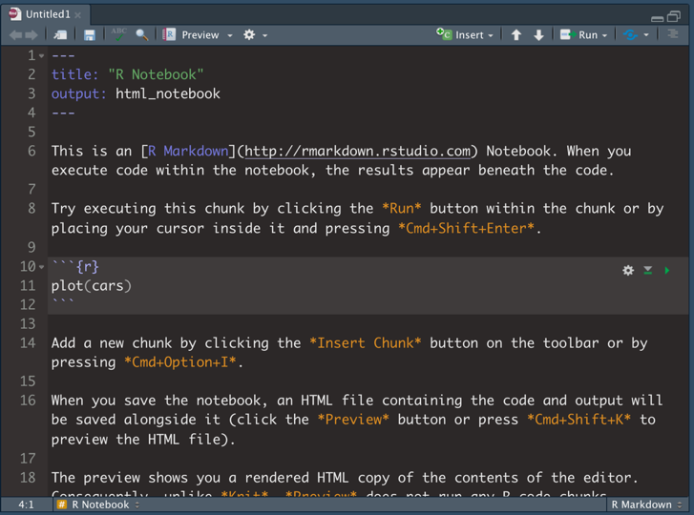
Text with formatting and hyperlinks
YAML
R code chunk
Notes:
Note R code chunk syntax and shortcut

Slide 10

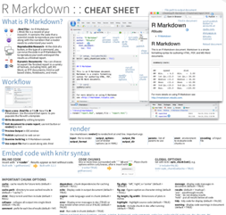
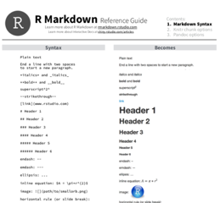
More great resources!

Slide 11
Customize the YAML options.
Change the YAML title to your own title
Add a YAML option for author

Slide 12
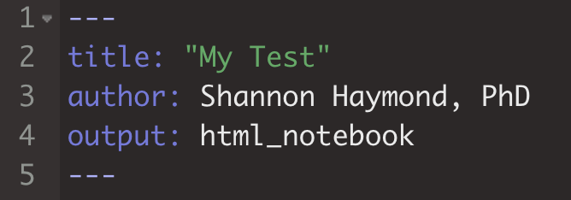

Slide 13
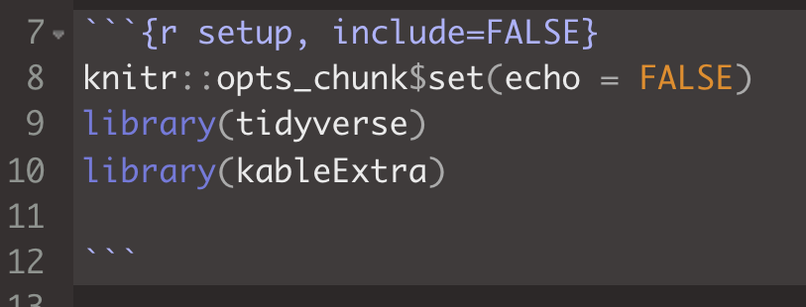
Prevents code and results from appearing in the finished file (default = TRUE)
Display code in output document (default = TRUE)

Slide 14
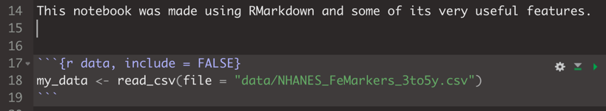
Note syntax for R chunk
New chunk:
*Insert Chunk* button on the toolbar or by pressing Cmd+Option+I or Ctrl+Alt+I
Execute code:
Press *play* button to run entire chunk or select and press Cmd+Enter or Ctrl+Enter

Slide 15
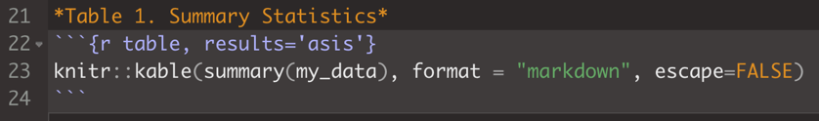
*words* = words
Function call for styling HTML table
Function call to make the summary stats table

Slide 16
Inline code syntax:
`r code here`
Use backtick, not single quote!

Slide 17
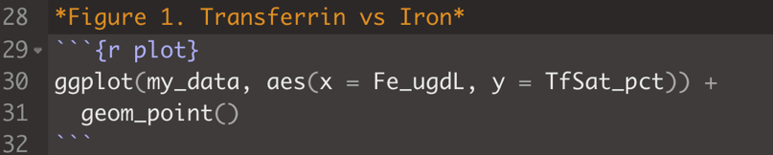
*words* = words
ggplot(data = <DATA>, aes(x = <X_DATA>, y = <Y_DATA>)) +
<GEOM_FUNCTION>

Slide 18
3.
Render
Now, we’ll format our report and export it

Slide 19
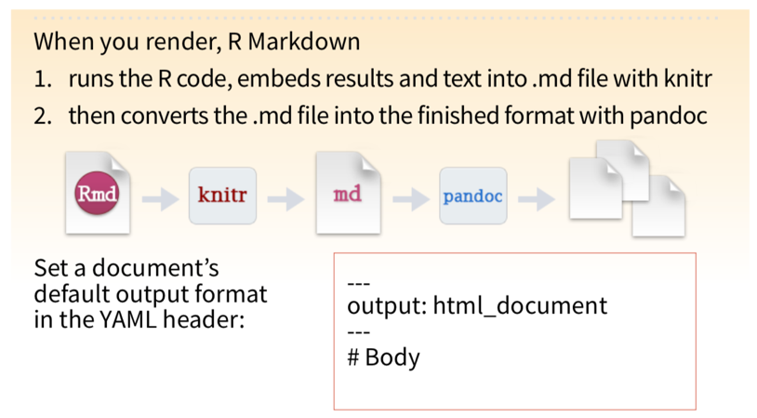

Slide 20
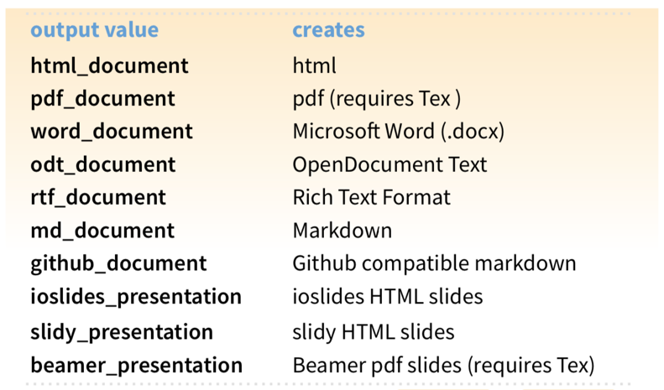

Slide 21
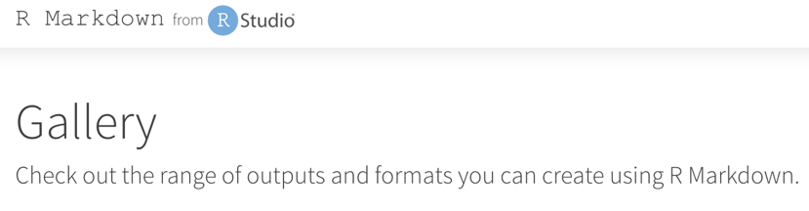
https://rmarkdown.rstudio.com/gallery.html

Slide 22
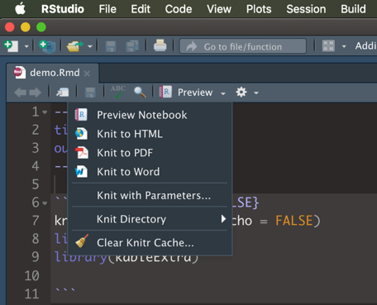
Export our Report

Slide 23
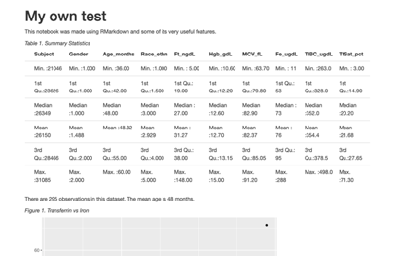
HTML Reports
Place your screenshot here
Customization
Distribution
Interactivity

Slide 24
BONUS!
Add customization and interactivity

Slide 25
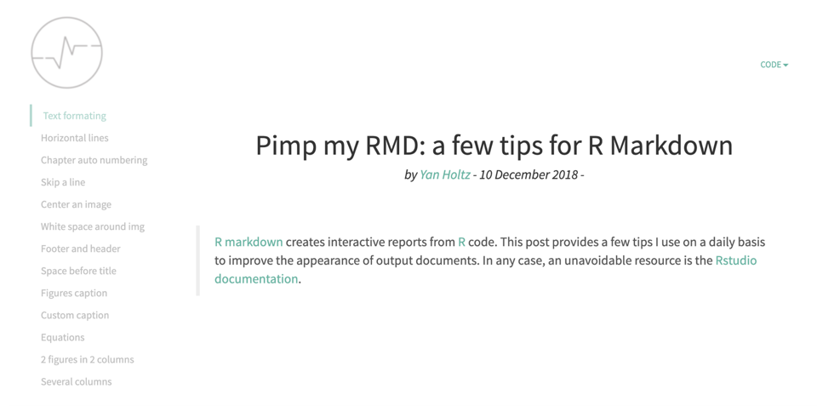
https://holtzy.github.io/Pimp-my-rmd/

Slide 26
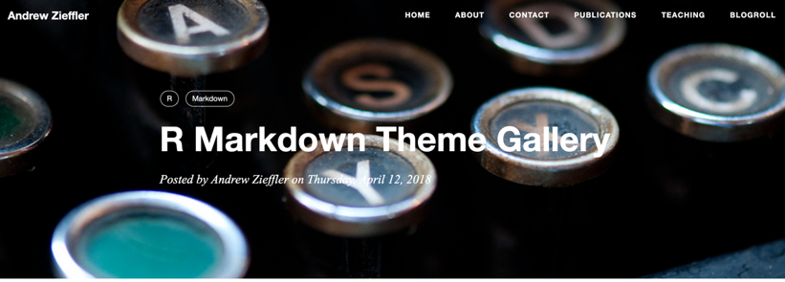
https://www.datadreaming.org/post/r-markdown-theme-gallery/

Slide 27
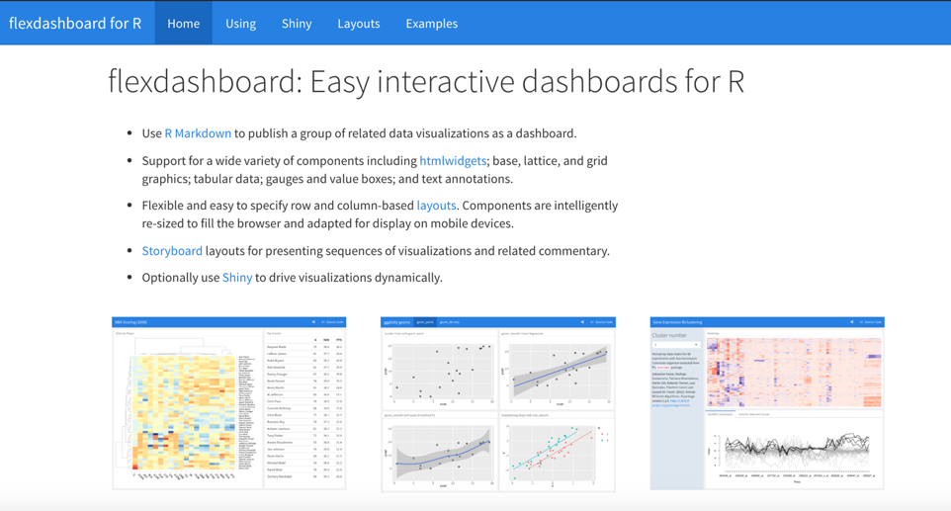
https://rmarkdown.rstudio.com/flexdashboard/

Slide 28
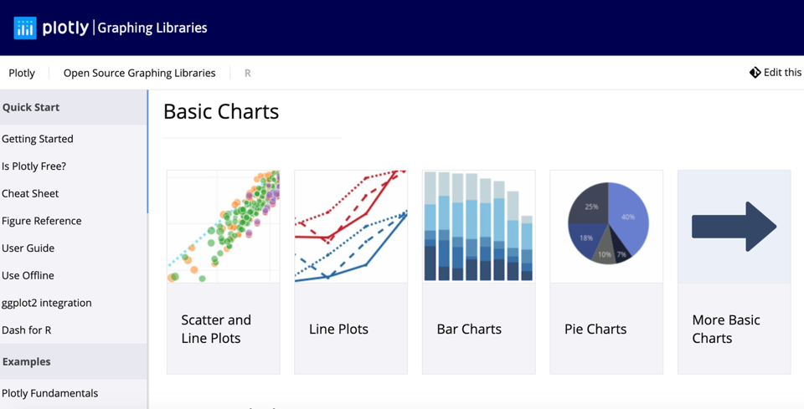
https://plot.ly/r/

Slide 29
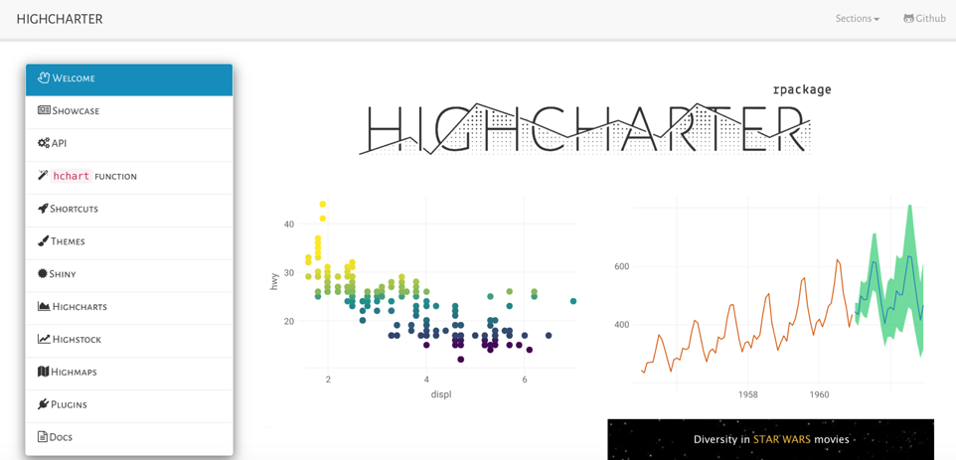
http://jkunst.com/highcharter/

Slide 30

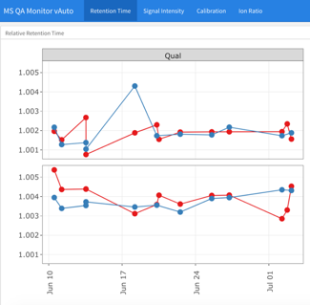
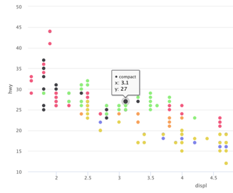
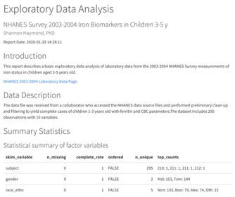
flexdashboard w/
ggplotly
highcharter
cosmos theme

