Slide 1
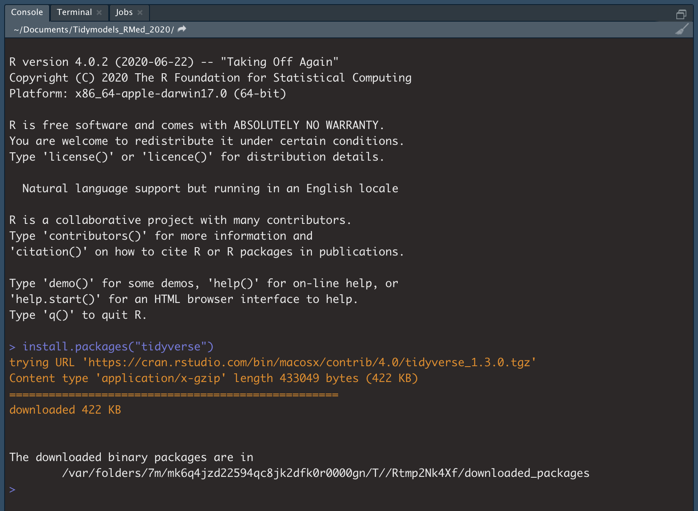
Check your R version here
Enter provided code here, press Enter.
Confirm install worked.

