Slide 1

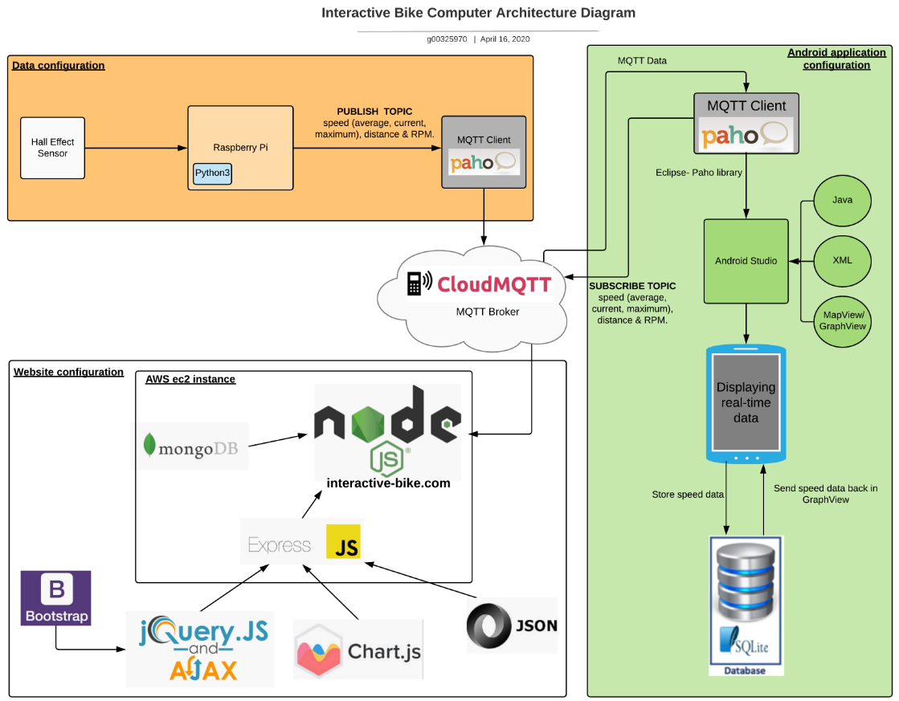
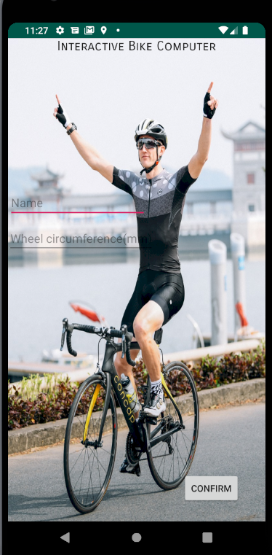
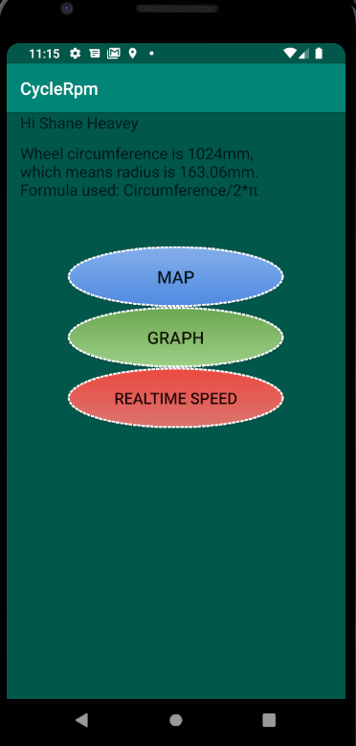
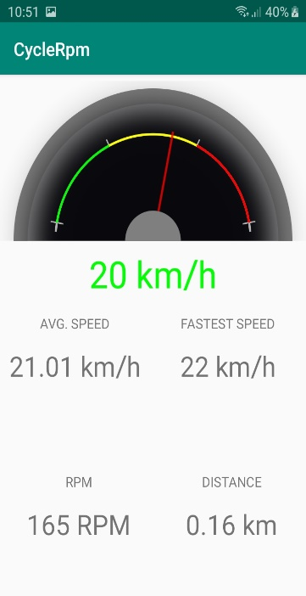
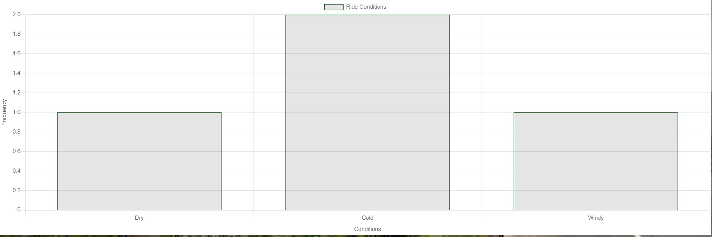
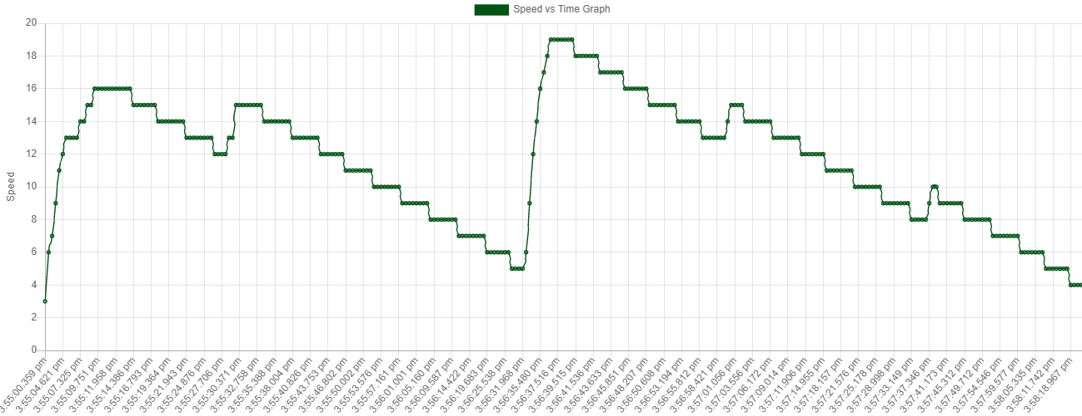
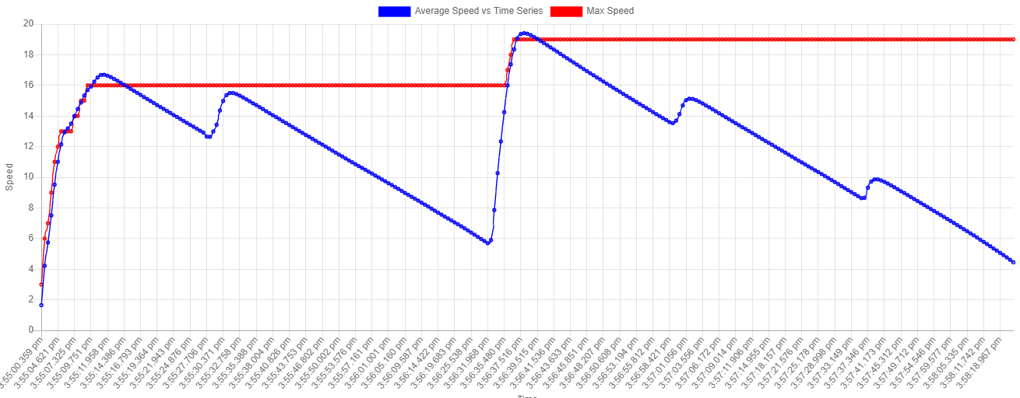
Interactive Bike Computer
Shane Heavey
Hardware & Software
Raspberry Pi 4
Hall Effect sensor
10,000mAh power bank
Python
MQTT
Android Studio
Amazon Web Services
Java/JavaScript
Node.js & Express
jQuery
Bootstrap
Chart.js
BEng (H) Software & Electronic Engineering
Project Description
This project is the perfect accessory for cyclists and people who take cycling seriously. It provides all your cycling data & statistics, both real time on your mobile device, and also available on interactive-bike.com
A Python script running on a Raspberry Pi calculates data (current/ average/ maximum speed, distance & RPM) from a Hall Effect Sensor. This data is displayed using Android Studio on your mobile device.
A Node.js web server hosts a MongoDB database that stores the data. Express, jQuery, Bootstrap, JSON & AJAX are used to display the data for each cycling session, with the option to describe the ride conditions. Chart.js outputs this data into responsive graphs. The website is deployed on an Amazon EC2 instance.
Interactive-bike.com
Interactive-bike.com
Android Studio Activities
Chart.js Graphs
Results
Python script sends data to MQTT broker as designed.
Fully functional Android application & website.
Bike is fully remote - 10,000mAh power bank.

