Slide 1
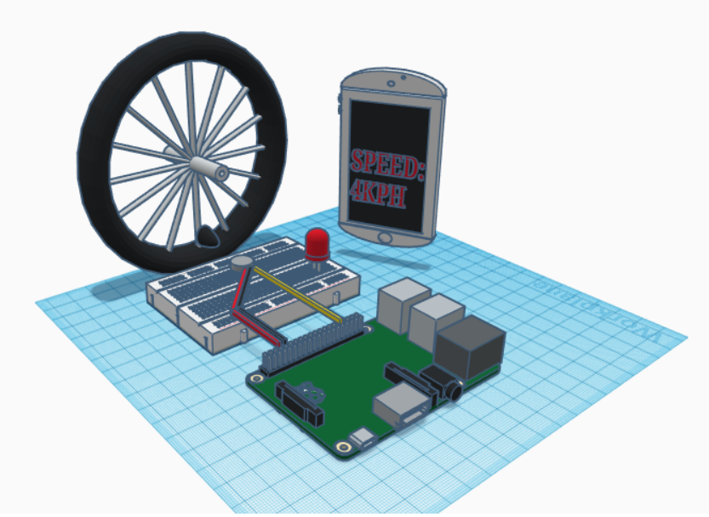
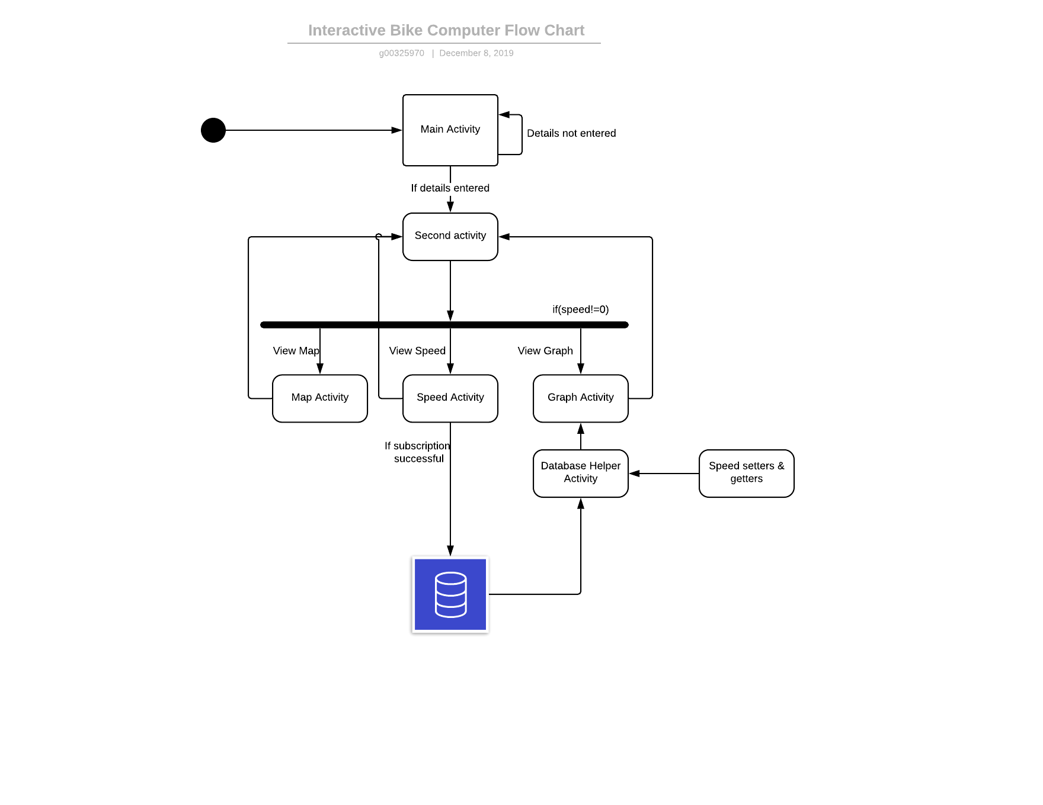
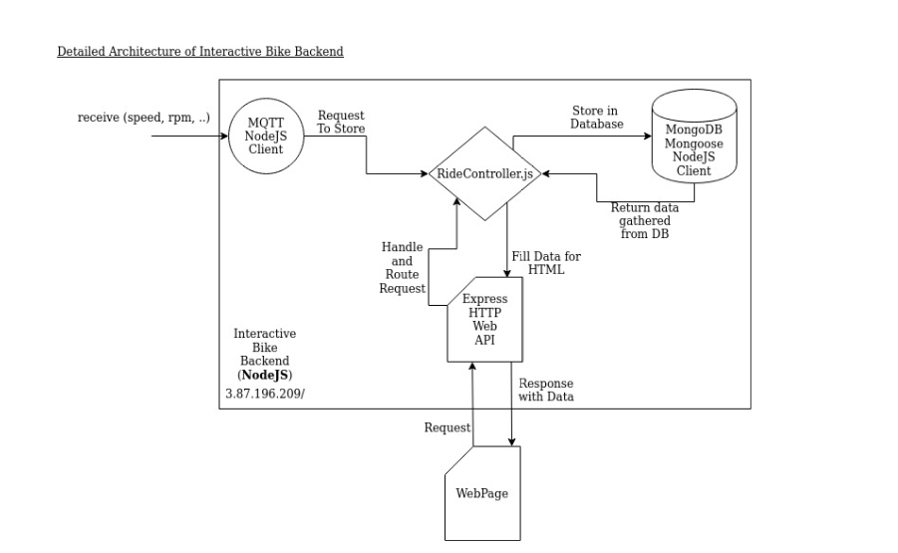

Interactive Bike Computer Shane Heavey
Project Description
This Raspberry Pi based project is the perfect accessory for cyclists and people who take cycling seriously.
A python script calculates data(current/ average/ maximum speed, distance, RPM) from the Hall Effect Sensor. This data is displayed real-time on an Android Studio application.
An Amazon Web Server hosts a MongoDB database that stores the data.
A Node.js website using Express, jQuery, Bootstrap, JSON, AJAX is displaying each cycling session, categorised by date. Chart.js outputs this data into graphs
A 3D CAD image was designed with Tinkercad.
Hardware and Software
Raspberry Pi 4
Hall Effect sensor & magnet
Python(algorithms)
MQTT
Java
JavaScript
Node.js
Express & Bootstrap
Android Studio
Amazon Web Services
Chart.js
BEng Computer & Electronic Engineering

