Slide 1
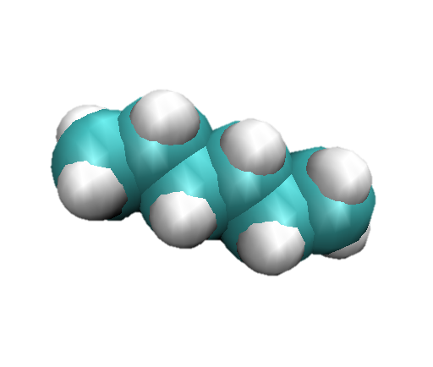



Vacuum
Neat Water
Salt solution
Anions
F⁻ Cl⁻ I⁻
Cations
Na⁺ K⁺ Rb⁺ Cs⁺

