Slide 1

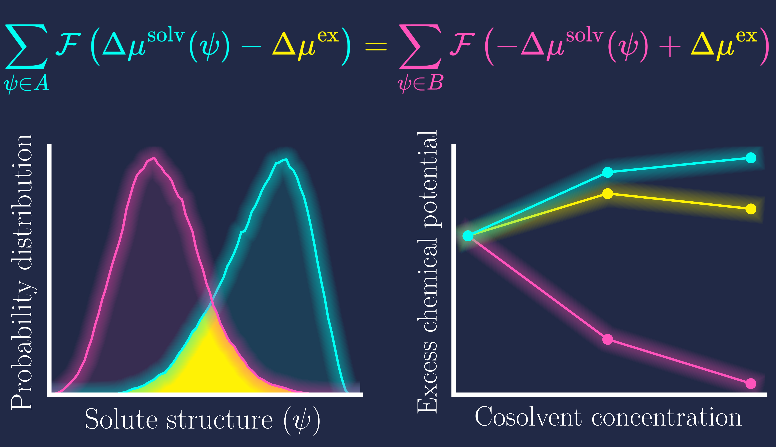
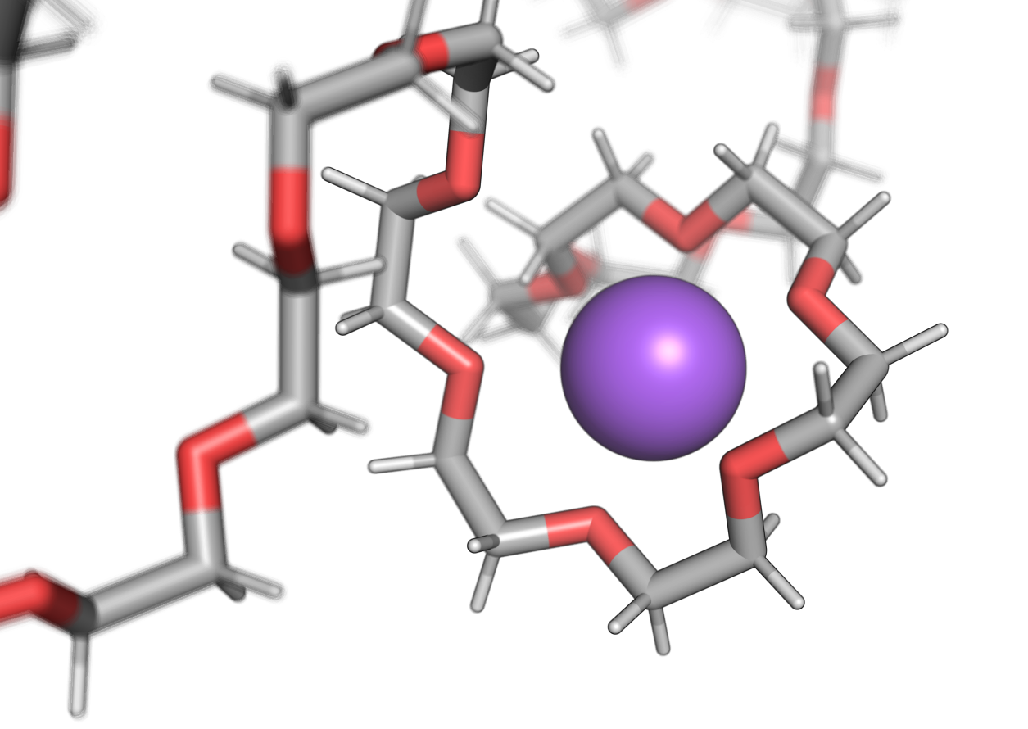
Advancing Chemical Potential Calculations of Large Polymers: Introducing the Effect of Conformational Change
Stefan Hervø-Hansen & Nobuyuki Matubayasi
Osaka University
Background
Structural changes in soft matter like polymers affect their thermodynamics.
Results & Methodology
Development of new BAR-like method to account for changes in conformational ensemble due to co-solvent
Conclusions
Our method correctly captures the physics of PEG solvation in water, Urea, and NaCl can capture

