Slide 1
Solutions

Slide 2

black_hole.jpg
Aztec code of pixels value (1,1,1) in the center
Use photoshop
or gimp
or similar

Slide 3
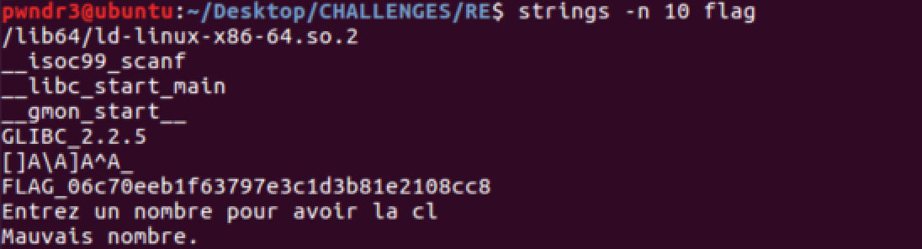
flag
Simply extract strings from file

Slide 4
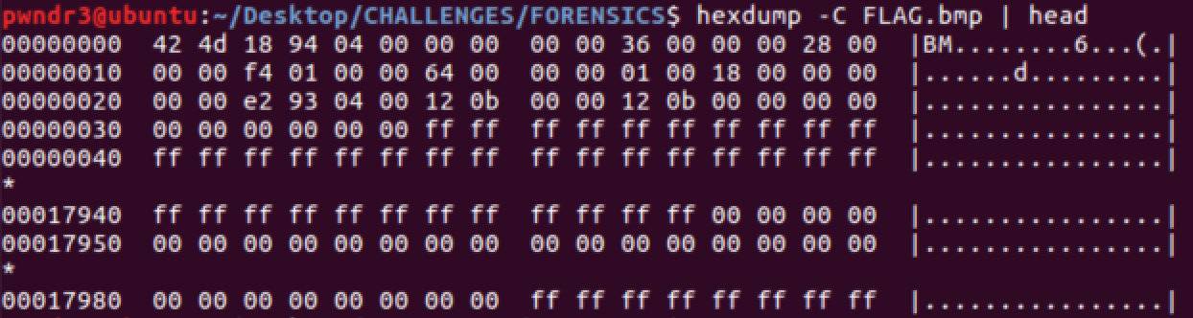
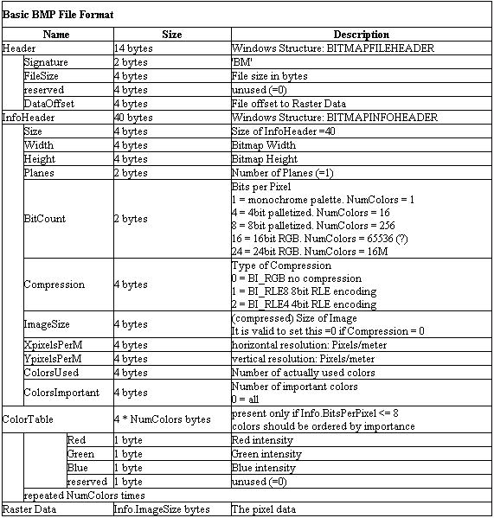
flag.bmp
Width : 0x000001F4 = 500
Height : 0x00000064 = 100
Filesize : 0x000493E2 = 300002 (with padding)

Slide 5
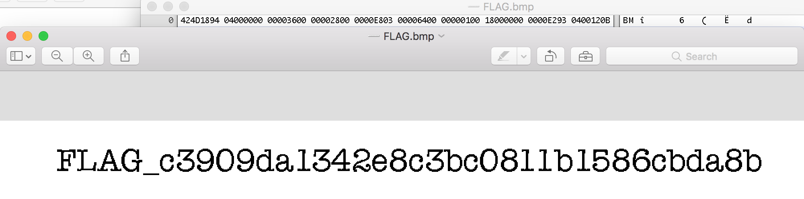
flag.bmp
Looking at the header we find data after width x height (as offset – i.e. after 0x64 x 0x1f4 = 0xC350 = 50000)
By trial and error we can find that putting 0x3e8 (1000) as width gives us a valid image :

Slide 6
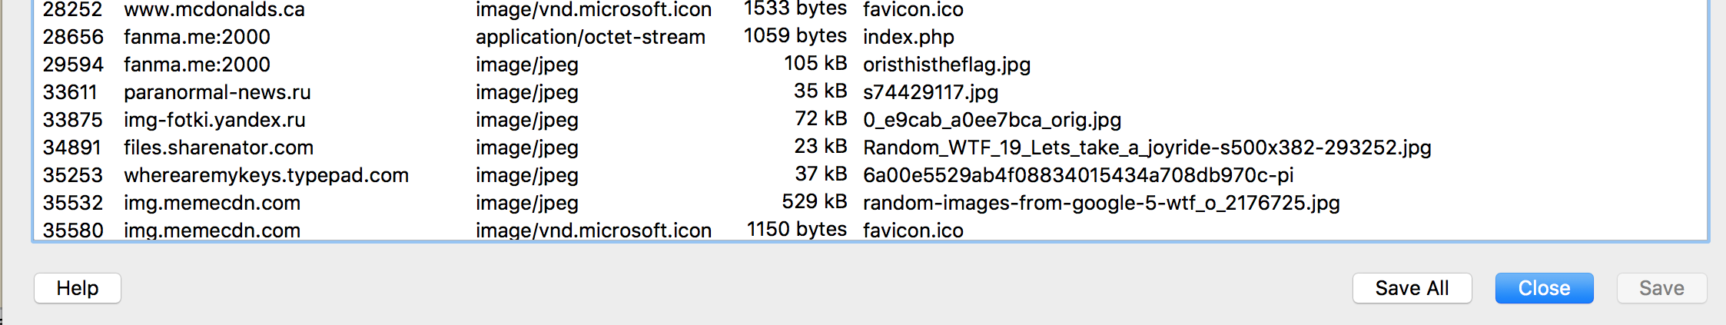
secretwebsite.pcap
Open in wireshark then File->Export Objects->Http…

Slide 7
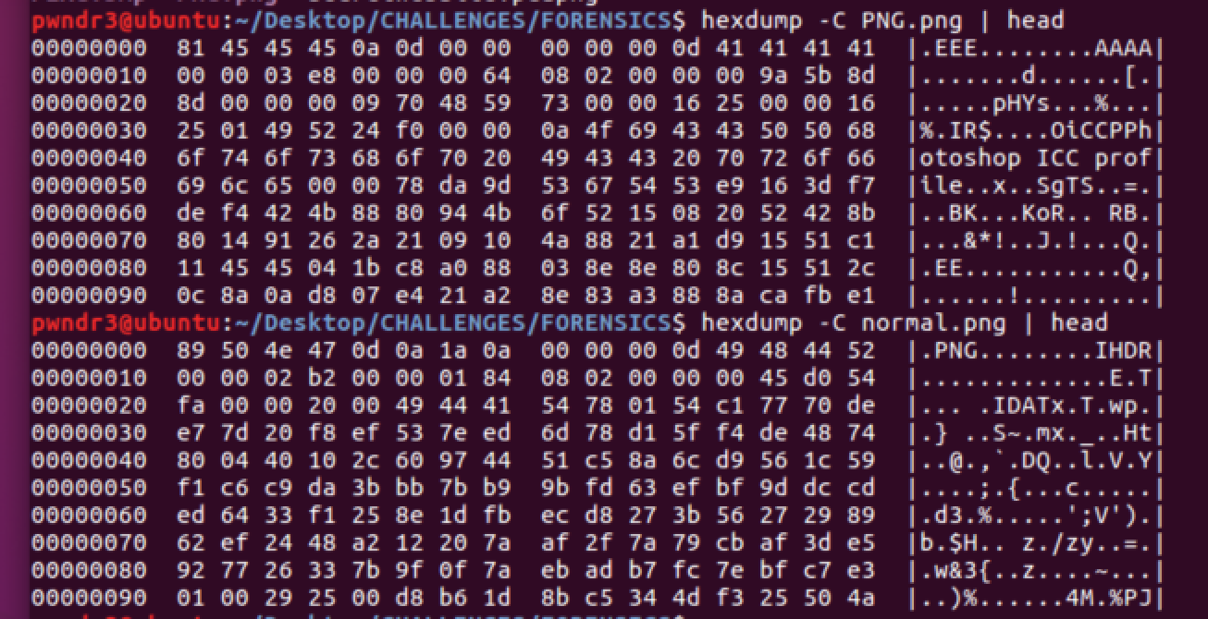
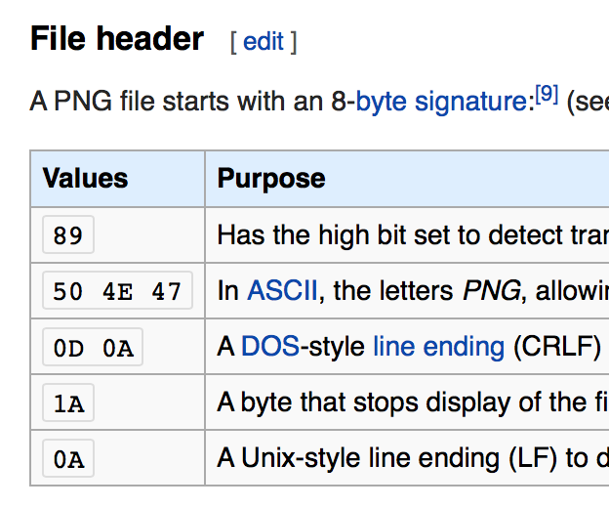
PNG.PNG
SIMILAR TO FLAG.BMP (EVEN EASIER)
Only the first lines need to match
(look at png file header)
+ first chunk (i.e. IHDR)

Slide 8
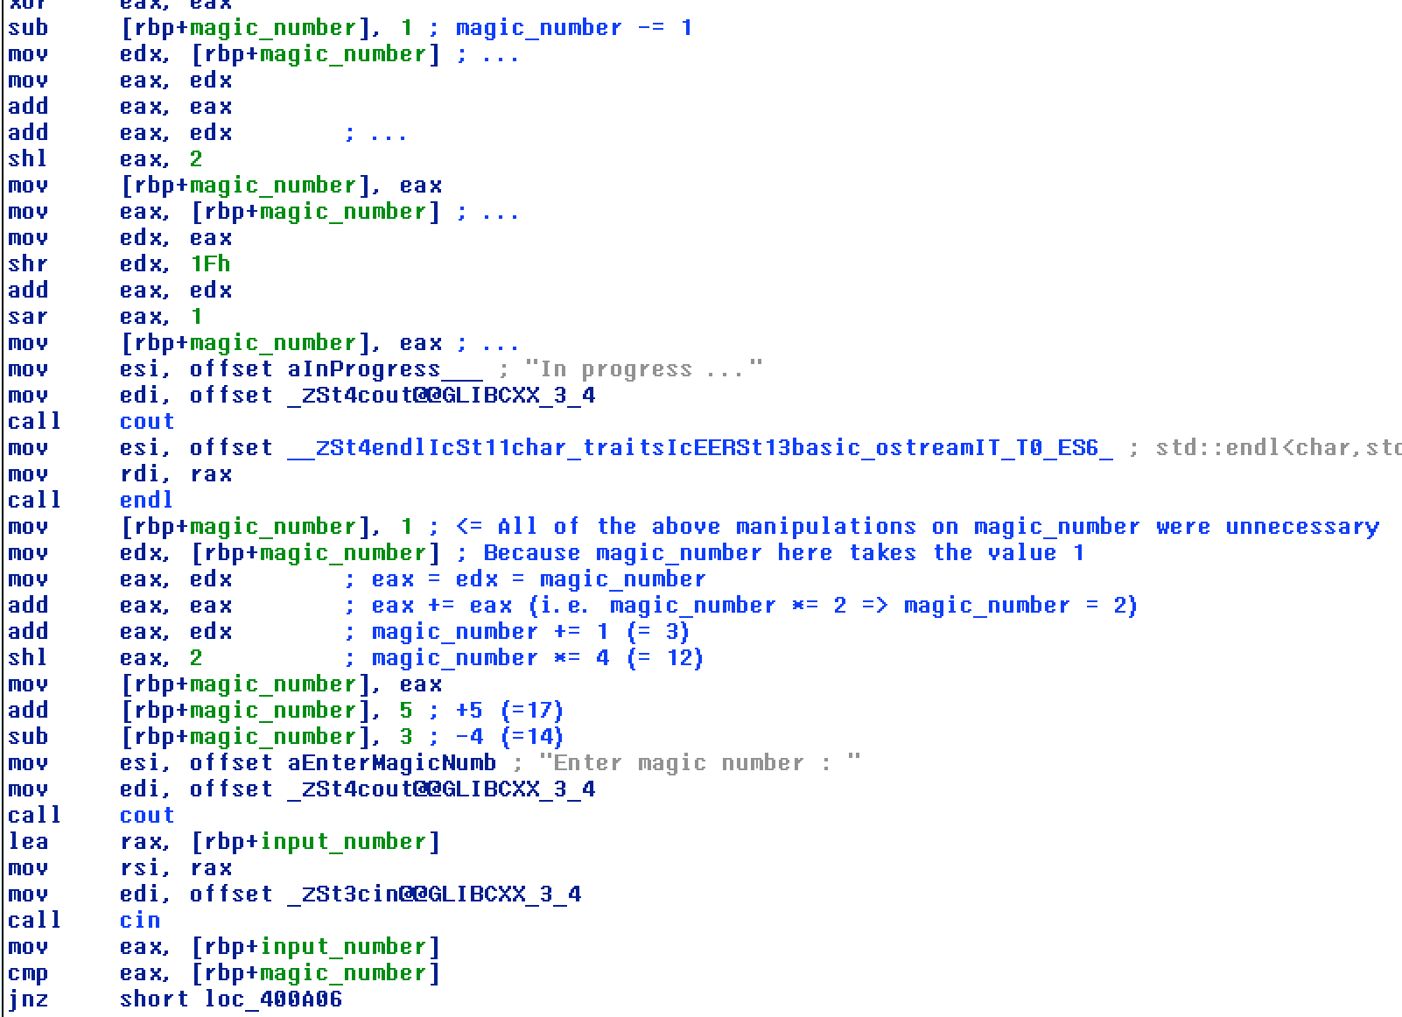
magic_number
}
UNNECESSARY

Slide 9
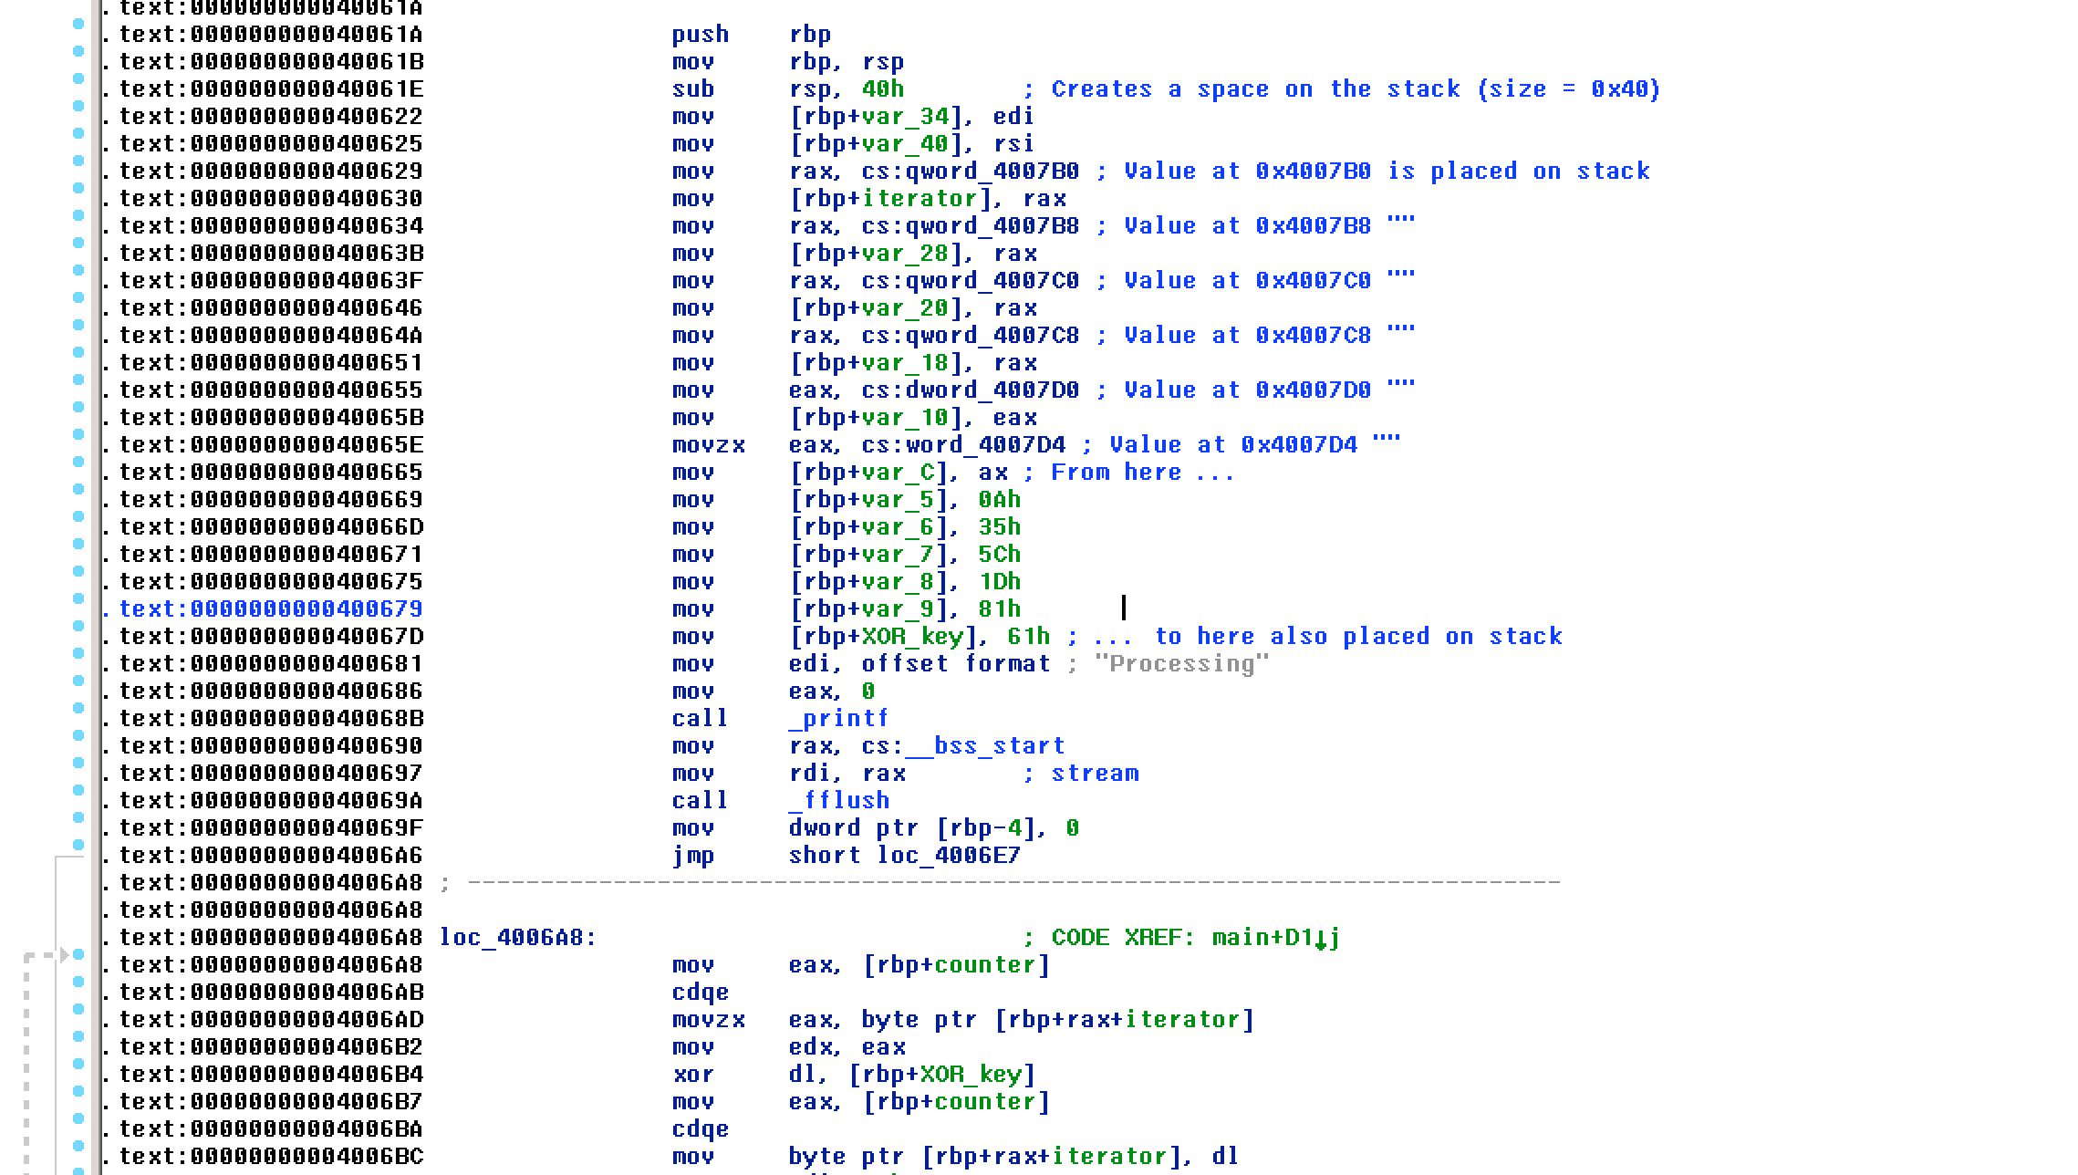
ILOVEC++
Push values on the stack then xor one after another with value 0x61

Slide 10
Others …
Other solutions were either
too complicated to be put in the powerpoint (tell me if you are still interested)
cannot be posted because they are live challenges on websites
OR
Note : I no longer have access to SQLi challenges so I cannot post any solution
☹

