Slide 1



User
Cloudflare
Server certificate
Origin server
Web content
① Client hello
② Server certificate
③ Premaster secret
(Encrypted with public key)
④ Premaster secret
(Encrypted with public key)
⑤ Premaster secret
Key server
Private key
Session key
Session key

Slide 2
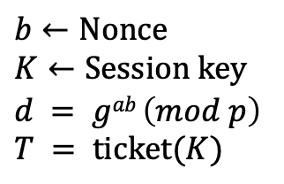

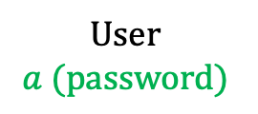



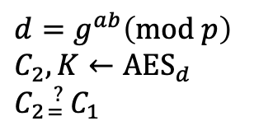

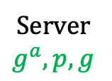

User
$$a (password)$$
Cloudflare
Server
$$g^{a},p,g$$
$$C_{1}←Challenge$$
$$① C1, userID$$
$b←Nonce$
$K←Session key$
$d = gab \left(mod p\right)$
$T = ticket(K)$
$d=g^{ab}\left(mod p\right)$
$C_{2}, K←{AES}_{d}$
$C_{2}{}_{=}^{?} C_{1}$
$$② AESd(C1,K), gb, p, T$$
$Session key:K$
③ ${AES}_{K}\left(data, requestID, timestamp\right), T$
$Session key:K$
…

