Slide 1
分布式系统期末PJ报告
--Wikipedia 索引建立
林士翰 15307130120

Slide 2





系统架构
MySQL: InvertedIndex,
PageIndex
offset
length
count
4
TF File: TF, pageid, title
8
pageid
2
keyword
5
TF, pageid, title
offset, length
9
offset
length
count
3
10
offset, length
TF
pageid
title
6
1
keyword
pageid
page(xml)
wikidumps
7
11
12
page(html)
Python+Flask

Slide 3
Hadoop
PageIndex (49.4M) 每个page在XML中的起始位置(offset)和长度(length)
TF File (19.81G) 每个word在每个page中的TF值，以及对应的title
InvertedIndex (73.1M) 每个word在TF File中的起始位置(offset)和长度(length)

Slide 4
Hadoop
PageIndex 每个page在XML中的起始位置(offset)和长度(length)
Hadoop InputFormat, XmlInputFormat
Mapper input: key=offset, value=pageXML output: key=offset, value=length
无需reducer

Slide 5
系统架构
MySQL: PageIndex
8
pageid
offset, length
9
10
offset, length
page(xml)
wikidumps
11
Python+Flask

Slide 6
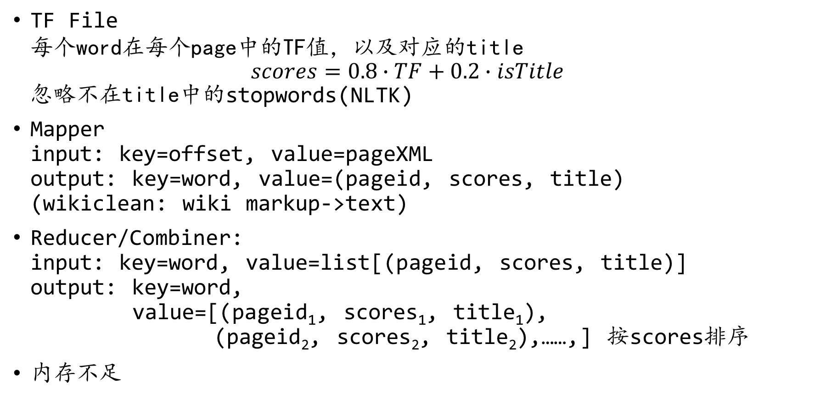
Hadoop
TF File 每个word在每个page中的TF值，以及对应的title $scores=0.8∙TF+0.2∙isTitle$ 忽略不在title中的stopwords(NLTK)
Mapper input: key=offset, value=pageXML output: key=word, value=(pageid, scores, title) (wikiclean: wiki markup->text)
Reducer/Combiner: input: key=word, value=list[(pageid, scores, title)] output: key=word, value=[(pageid₁, scores₁, title₁), (pageid₂, scores₂, title₂),……,] 按scores排序
内存不足

Slide 7
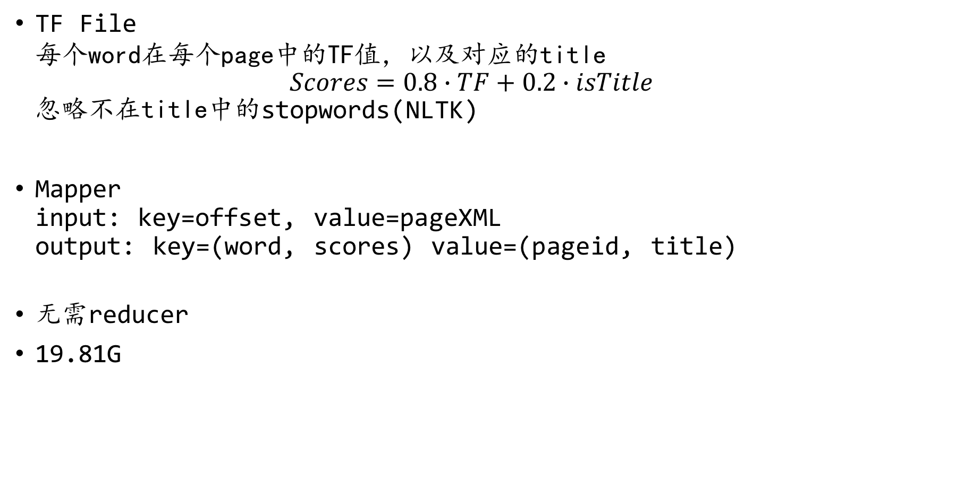
Hadoop
TF File 每个word在每个page中的TF值，以及对应的title $Scores=0.8∙TF+0.2∙isTitle$ 忽略不在title中的stopwords(NLTK)
Mapper input: key=offset, value=pageXML output: key=(word, scores) value=(pageid, title)
无需reducer
19.81G

Slide 8
系统架构
MySQL: PageIndex
TF File: TF, pageid, title
8
pageid
5
TF, pageid, title
offset, length
9
10
offset, length
page(xml)
wikidumps
11
Python+Flask

Slide 9
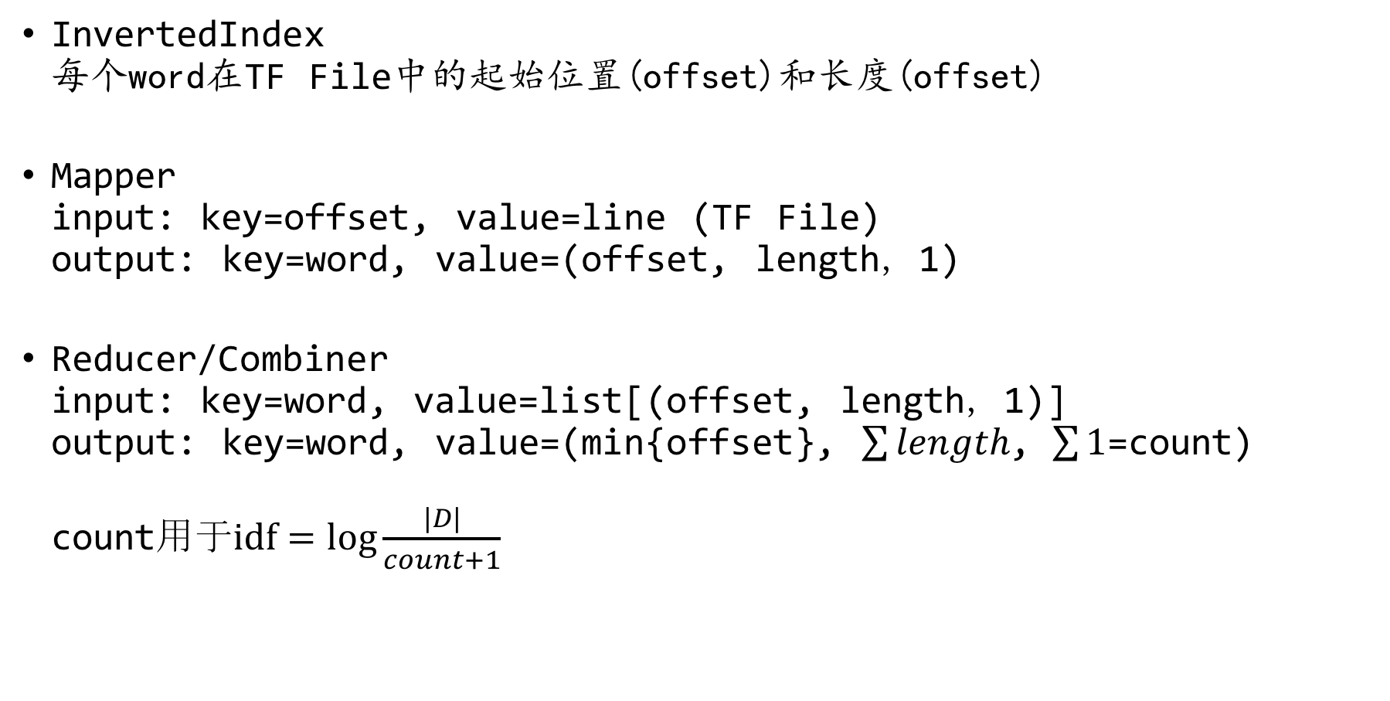
Hadoop
InvertedIndex 每个word在TF File中的起始位置(offset)和长度(offset)
Mapper input: key=offset, value=line (TF File) output: key=word, value=(offset, length，1)
Reducer/Combiner input: key=word, value=list[(offset, length，1)] output: key=word, value=(min{offset}, $\sum{length}$, $\sum{1}$=count) count用于$idf=\log{\frac{|D|}{count+1}}$

Slide 10
系统架构
MySQL: InvertedIndex,
PageIndex
offset
length
count
4
TF File: TF, pageid, title
8
pageid
2
keyword
5
TF, pageid, title
offset, length
9
offset
length
count
3
10
offset, length
page(xml)
wikidumps
11
Python+Flask

Slide 11
系统架构
MySQL: InvertedIndex,
PageIndex
offset
length
count
4
TF File: TF, pageid, title
8
pageid
2
keyword
5
TF, pageid, title
offset, length
9
offset
length
count
3
10
offset, length
TF
pageid
title
6
1
keyword
pageid
page(xml)
wikidumps
7
11
12
page(html)
(smx: wiki markup -> html)
(redirect page)
Python+Flask

Slide 12
Thank you!
Q&A

