Slide 1
Personalized medicine : Redefining Cancer Treatment
By
Shivam Shukla (18bec102)
Shubham Soni (18bec110)

Slide 2
Contents
Problem Statement
Concepts used
Results
Conclusion
Future Scope

Slide 3
Problem Statement
A lot has been said during the past several years about how precise the medicine is and, more concretely, how genetic testing is going to disrupt the way diseases like cancer are treated.
But this is only partially happening due to the huge amount of manual work still required. Once sequenced, a cancer tumor can have thousands of genetic mutations. But the challenge is distinguishing the mutations that contribute to tumor growth (drivers) from the neutral mutations (passengers).
We need to develop a Machine Learning algorithm that, using this knowledge base as a baseline, automatically classifies genetic variations

Slide 4
Concepts used
Log loss
Confusion matrix
Precision matrix
Recall matrix
One hot encoding
Response encoding
Laplace smoothing
SGD Classifier
Calibrated classifier

Slide 5
Log Loss
Log Loss is the most important classification metric based on probabilities. It’s hard to interpret raw log-loss values, but log-loss is still a good metric for comparing models. For any given problem, a lower log loss value means better predictions.
Mathematical interpretation:
Log Loss is the negative average of the log of corrected predicted probabilities for each instance.
X | Y | Y’ = Probability
x1 | 1 | 0.9
x2 | 1 | 0.6
x3 | 0 | 0.1
x4 | 0 | 0.4

Slide 6
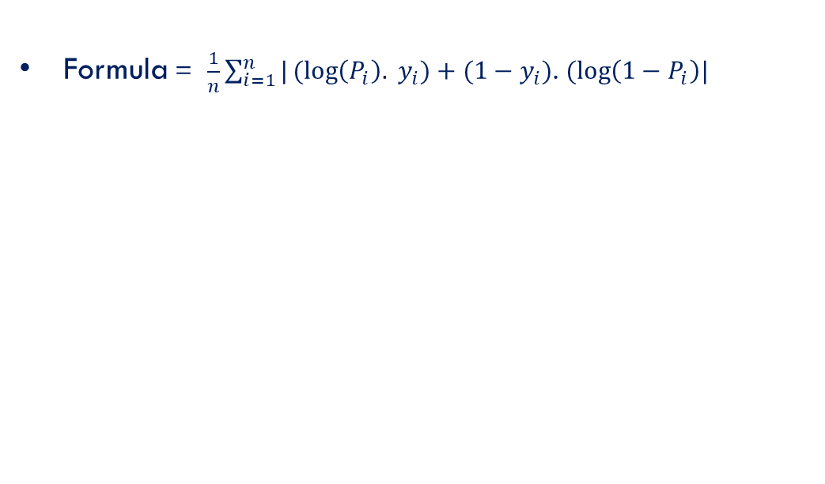
contd.
Formula = $\frac{1}{n}\sum_{i=1}^{n}{|(log\left(P_{i}\right). }y_{i})+(1−y_{i})$. $(log\left(1−P_{i}\right)|$
X | Y | Y’ = Probability | Log loss
x1 | 1 | 0.9 | 0.0475
x2 | 1 | 0.6 | 0.22
x3 | 0 | 0.1 | 0.0475
x4 | 0 | 0.4 | 0.22

Slide 7
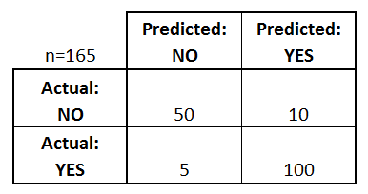
Confusion Matrix
A confusion matrix is a table that is often used to describe the performance of a classification model (or "classifier") on a set of test data for which the true values are known.

Slide 8


Precision Matrix and Recall Matrix
Precision tells us how many of the correctly predicted cases actually turned out to be positive.
Recall tells us how many of the actual positive cases we were able to predict correctly with our model

Slide 9
One hot encoding
The input to this transformer should be a matrix of integers, denoting the values taken on by categorical (discrete) features. The output will be a sparse matrix where each column corresponds to one possible value of one feature
COUNTRY | DATA
USA | A
INDIA | B
ENGLAND | C
DATA | USA | INDIA | ENG
A | 1 | 0 | 0
B | 0 | 1 | 0
C | 0 | 0 | 1

Slide 10
Response Encoding
When the dataset is too large, using one hot encoding will create huge number of columns and hence increases computational time.
In such cases, we use response encoding where we get the probability of occurrence as the number of times a feature corresponds to a class.
The higher the occurrence of the data point having the same class, the higher the probability and hence that class will be predicted.

Slide 11
 |  |  | OCCURRENCE VECTOR (1*9)
ID | GENE | CLASS | CLASS 1 | CLASS 2 | CLASS 3 | CLASS 4 | CLASS 5 | CLASS 6 | CLASS 7 | CLASS 8 | CLASS 9
1 | ABR | 1 | 1/10=0.1 | 1/10=0.1 | 0 | 0 | 0 | 0 | 0 | 0 | 0
2 | GHI | 6 | 0 | 0 | 0 | 0 | 0 | 1/10=0.1 | 0 | 0 | 0
3 | TYI | 4 | 1/10=0.1 | 0 | 0 | 2/10=0.2 | 0 | 0 | 0 | 0 | 0
4 | KIO | 7 | 0 | 0 | 0 | 0 | 0 | 0 | 2/10=0.2 | 0 | 0
5 | QWR | 8 | 0 | 0 | 0 | 0 | 0 | 0 | 0 | 1/10=0.1 | 0
6 | LKI | 4 | 0 | 0 | 0 | 1/10=0.1 | 0 | 0 | 0 | 0 | 0
7 | TYI | 4 | 1/10=0.1 | 0 | 0 | 2/10=0.2 | 0 | 0 | 0 | 0 | 0
8 | ABR | 2 | 1/10=0.1 | 1/10=0.1 | 0 | 0 | 0 | 0 | 0 | 0 | 0
9 | KIO | 7 | 0 | 0 | 0 | 0 | 0 | 0 | 2/10=0.2 | 0 | 0
10 | TYI | 1 | 1/10=0.1 | 0 | 0 | 2/10=0.2 | 0 | 0 | 0 | 0 | 0

Slide 12

Laplace smoothing
Laplace smoothing is a smoothing technique that helps tackle the problem of zero probability in the Naïve Bayes machine learning algorithm

Slide 13
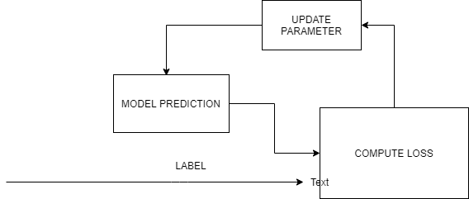
Stochastic Gradient Descent Classifier
SGDClassifier is a linear classifier

Slide 14
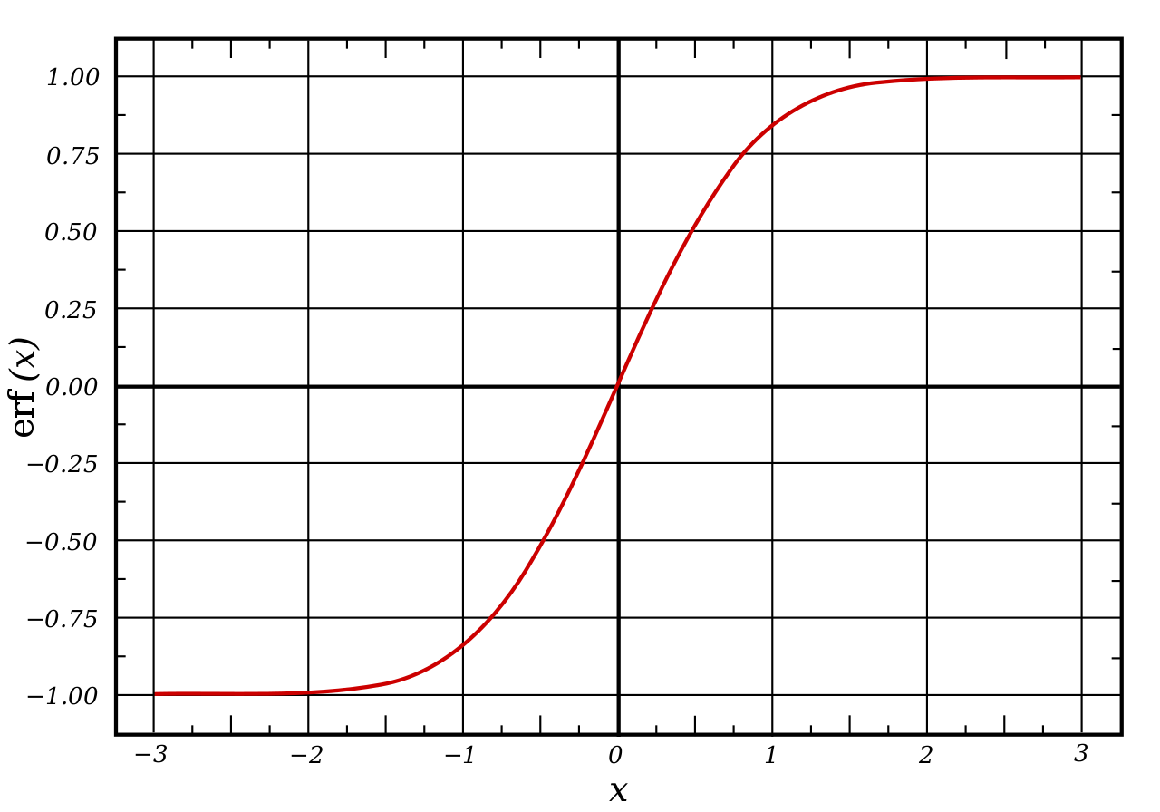
Calibrated classifier (Sigmoid function)
A sigmoid function is a mathematical function having a characteristic "S"-shaped curve or sigmoid curve. A common example of a sigmoid function is the logistic function

Slide 15
Results
 |  | LOG LOSS
 | Algorithms for models | Train | CV | Test | Accuracy
1 | Random Model | 2.468 | 2.531 | 2.49 | --
2 | Naïve Bayes | 0.837 | 1.22 | 1.311 | 60.8
3 | kNN | 0.473 | 1.034 | 1.033 | 63
4 | Logistic Regression | 0.537 | 1.067 | 1.098 | 67.2
5 | Linear SVM | 0.558 | 1.109 | 1.652 | 66.4

Slide 16
Conclusion
This classification system is simple enough to be quickly implemented, and hence can specifically guide reporting decisions at the important boundary of limited and moderate evidence, determining whether a gene is characterized.
The minimal value for the Log-Loss is obtained on implementing K Nearest Neighbors algorithm on the gene, variation, and text data value points. Although the Log-Loss for K Nearest Neighbors algorithm is less, we choose Logistic Regression because the accuracy is high.

Slide 17
Future Scope
As a future scope, the similar gene mutation and classification techniques can be extended to find a cure to diseases other than Cancer and can be a breakthrough technology in the field of medical science.

Slide 18
THANK YOU!

