Slide 1














$v_{1}$
$v_{6}$
$v_{1}$
$v_{6}$
$v_{5}$
$v_{5}$
$v_{2}$
$v_{2}$
$v_{4}$
$v_{4}$
$v_{3}$
$v_{3}$
$v_{4}$
$v_{4}$

Slide 2
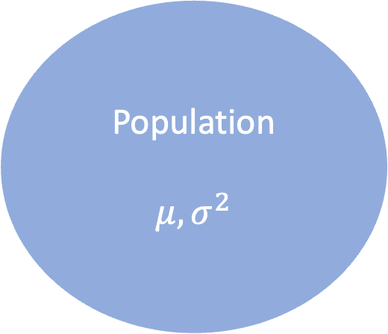
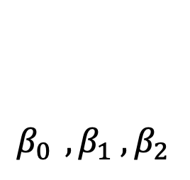

Population
$$μ, σ^{2}$$
Sample
Sampling
Inference
Sample
Manifold
$β_{0 } ,β_{1} ,β_{2}$
Sampling
Inference

