Slide 1
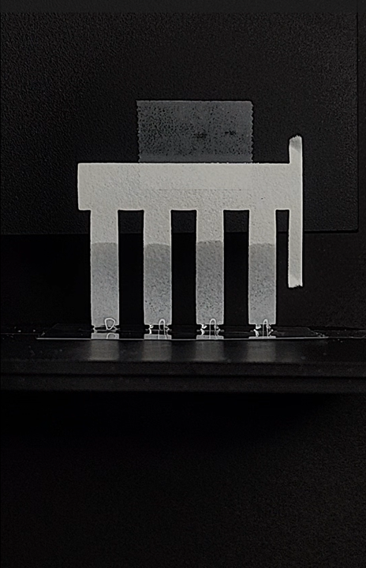
Paper Microfluidic Detection of Heavy Metal Using Biopolymers
Wimonmas Areekul
Laboratory of Biological, Biomimetic, Eco-friendly Materials
Division of Environmental Science and Engineering
Notes:
Visual image

Slide 2
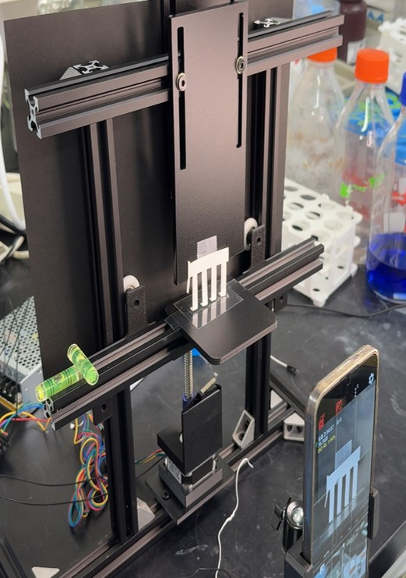
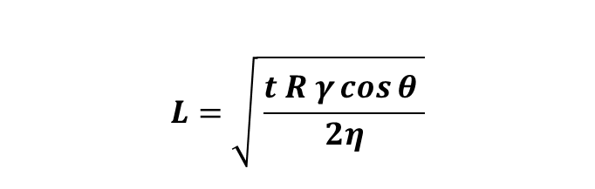
Introduction: SALSA
System Automated Loading for Sample Analysis
Lucas-Washburn Equation
$$L=\sqrt{ \frac{t R γ\cos{θ} }{2η}}$$
Where L = Flow distance
t = Time
R = Capillary radius
γ = Surface tension
θ = Water contact angle
η = Dynamic viscosity
2/23

Slide 3
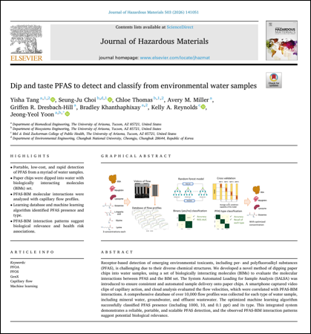
Introduction: Literature review
Paper microfluidic detection
of PFAS* using biopolymers
Three PFAS types – PFOA, PFOS, GenX
Three machine learning models – XGBoost, Random Forest, SVMs (Support Vector Machine)
Reagents – Bovine serum albumin (BSA), Lysozome, Myoglobin, L-lysine, Glycine, Glutamine, L-aspartic acid
Accuracies for PFAS type classification
However, PFAS pollution is still not
a significant problem in Thailand
Model | Accuracy (%)
XGBoost | 91.7
Random Forest | 94.7
SVM | 93.7
*Per- and polyfluoroalkyl substances
3/23

Slide 4
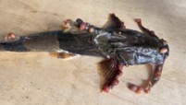
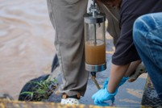


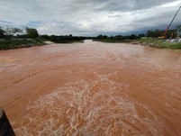
Introduction: Motivation
Emerging Heavy Metal Contamination in Northern Thailand
Apr 2025
Nov 2025
Present
Infected, mutant fish
(Source: ThaiPBS)
Arsenic detected
in Kok river
Arsenic + Chromium detected
in Salawin river
(Pollution Control Department, 2025)
Bad water quality
(Source: Mongabay)
4/23

Slide 5




Introduction: Motivation
Problems of conventional methods for heavy metal detection
High
cost
Centralized
laboratory
Intensive
resources
Reverse
contamination
“The use of biopolymers provides sustainable solutions”
5/23

Slide 6
Experiment I
Classification of arsenic (As), chromium (Cr) and cadmium (Cd)
using chitosan and poly-L-lysine

Slide 7


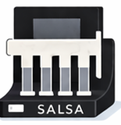
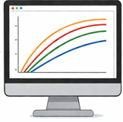
Methodology
Factor | Levels
Heavy metal | As, Cr, Cd
Heavy metal concentration (ppb) | 0, 1, 10, 100 (As) 0, 5, 50, 500 (Cr, Cd)
Reagent | Chitosan, Poly-L-lysine
Reagent concentration (ppb) | 0, 1, 100, 10000
Conditions | Chitosan: 300 µM CH₃COOH Poly-L-lysine: DI
Surface water quality standard for heavy metals
Heavy metal | Concentration (ppb)
Arsenic (As) | 10
Chromium (Cr) | 50
Cadmium (Cd) | 50
Dilution
preparation
Vortex
Mixing
Paper chip loading
and SALSA operation
Flow profile analysis
+ Machine learning
7/23

Slide 8
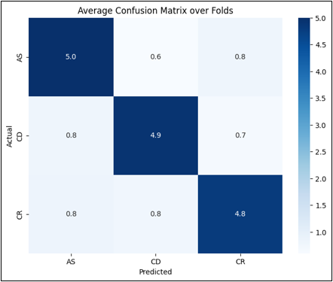
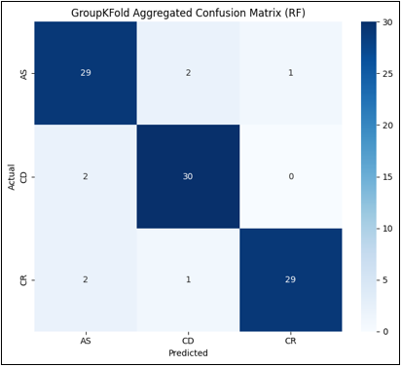

Results: Overall accuracy
Model | Reagent | Mean Score | Std Dev
XGBoost | all | 0.7665 | 0.0938
 | Chi | 0.6251 | 0.0891
 | Lys | 0.7624 | 0.1057
Random Forest | all | 0.9333 | 0.0757
 | Chi | 0.6917 | 0.0864
 | Lys | 0.8750 | 0.1179
SVM | all | 0.9583 | 0.0417
 | Chi | 0.8750 | 0.0780
 | Lys | 0.8750 | 0.0977
XGBoost
The results from Random Forest and SVM models show high accuracy (> 90%), however, the result from XGBoost model still shows the accuracy less than 80%
Random Forest
SVM
8/23

Slide 9
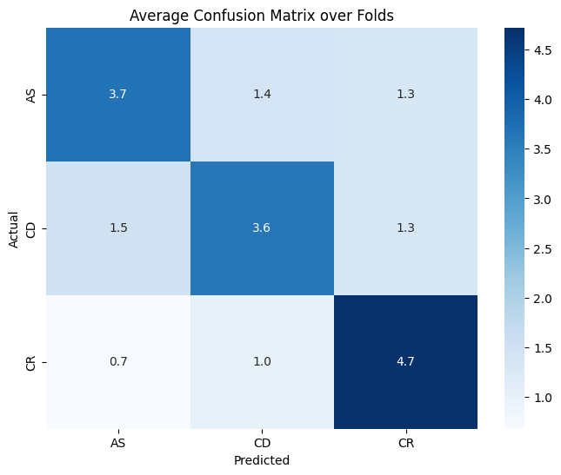
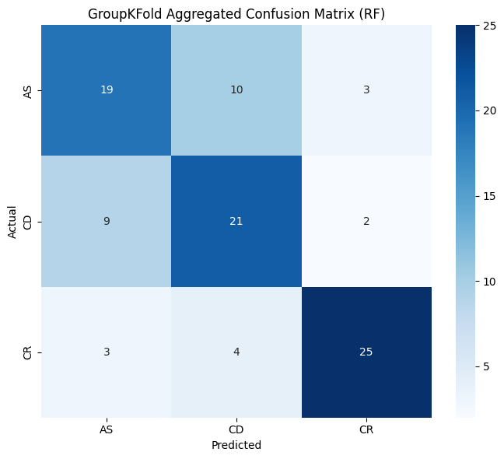
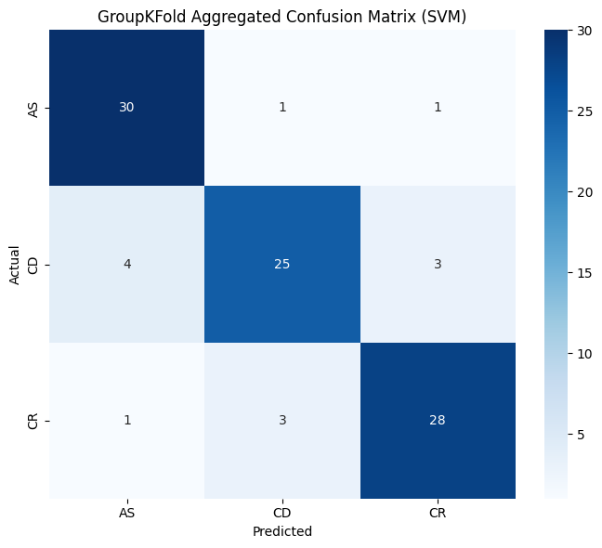
Results: Chitosan accuracy
Model | Reagent | Mean Score | Std Dev
XGBoost | all | 0.7665 | 0.0938
 | Chi | 0.6251 | 0.0891
 | Lys | 0.7624 | 0.1057
Random Forest | all | 0.9333 | 0.0757
 | Chi | 0.6917 | 0.0864
 | Lys | 0.8750 | 0.1179
SVM | all | 0.9583 | 0.0417
 | Chi | 0.8750 | 0.0780
 | Lys | 0.8750 | 0.0977
XGBoost
Although the result from SVM model shows high accuracy (> 80%), the results from XGBoost and Random Forest models show low accuracy (< 70%)
Future work - Conduct the experiment using other biopolymers
Random Forest
SVM
9/23

Slide 10
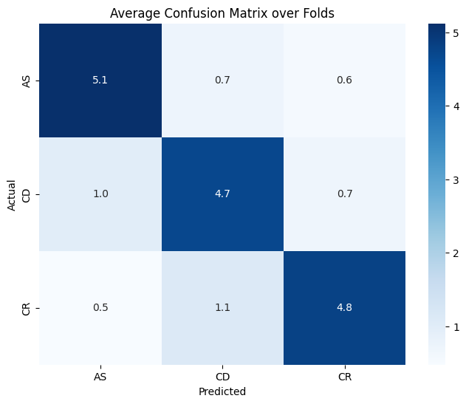
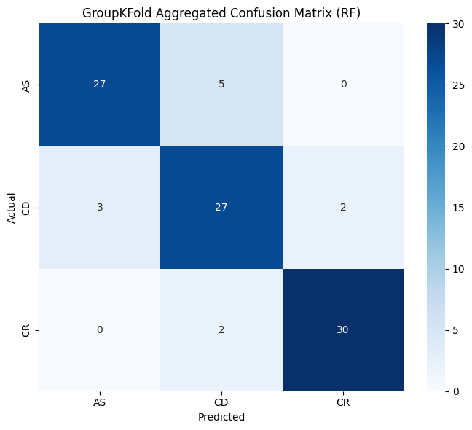
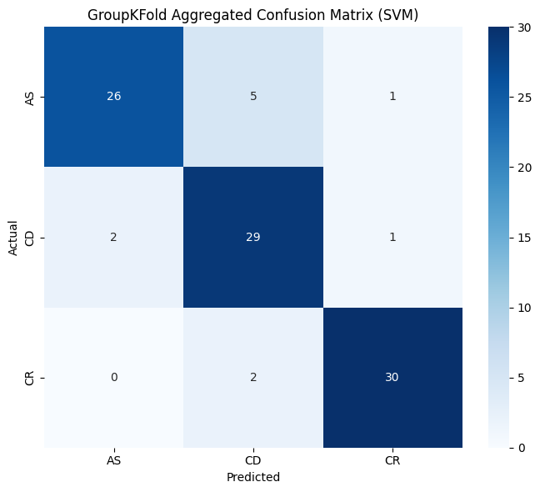
Results: Poly-L-lysine accuracy
Model | Reagent | Mean Score | Std Dev
XGBoost | all | 0.7665 | 0.0938
 | Chi | 0.6251 | 0.0891
 | Lys | 0.7624 | 0.1057
Random Forest | all | 0.9333 | 0.0757
 | Chi | 0.6917 | 0.0864
 | Lys | 0.8750 | 0.1179
SVM | all | 0.9583 | 0.0417
 | Chi | 0.8750 | 0.0780
 | Lys | 0.8750 | 0.0977
XGBoost
The results from Random Forest and SVM models show high accuracy (> 80%), however, the result from XGBoost still shows the accuracy less than 80%
Future work - Conduct the experiment in other conditions than DI water and blend poly-L-lysine with other biopolymers to improve the accuracy
Random Forest
SVM
10/23

Slide 11
Experiment II
Classification of arsenic (As), cadmium (Cd) and cobalt (Co)
using alginate, tannin and gallic acid

Slide 12
Methodology
Factor | Levels
Heavy metal | As, Cd, Co
Heavy metal concentration (ppb) | 0, 1, 10, 100 (As, Co) 0, 5, 50, 500 (Cd)
Reagent | Alginate, Tannin, Gallic acid
Reagent concentration (ppb) | 0, 1, 100, 10000
Conditions | DI, 0.1 M PBS, 0.7 M NaCl, RSW
Surface water quality standard for heavy metals
Heavy metal | Concentration (ppb)
Arsenic (As) | 10
Cadmium (Cd) | 50
Cobalt (Co) | -
Dilution
preparation
Vortex
Mixing
Paper chip loading
and SALSA operation
Flow profile analysis
+ Machine learning
12/23
7/13

Slide 13
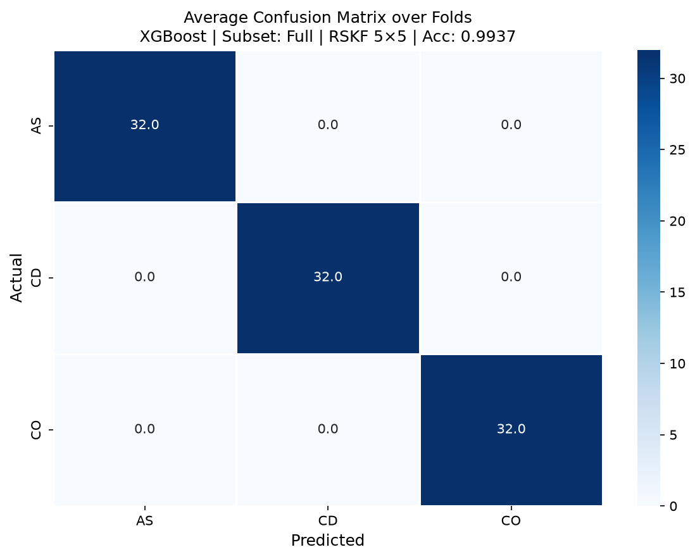


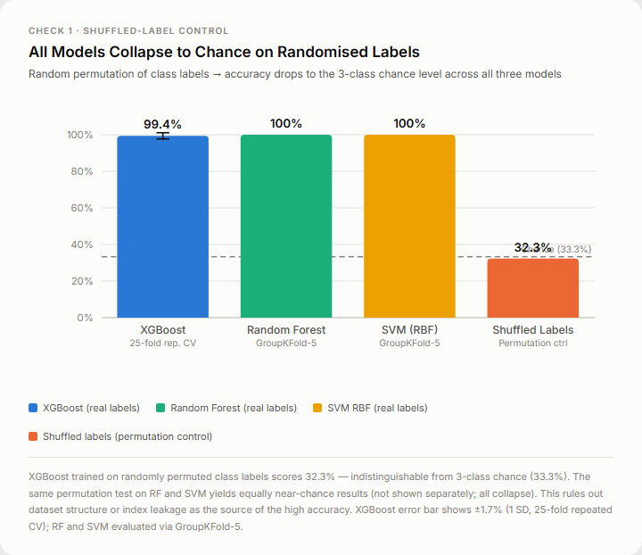
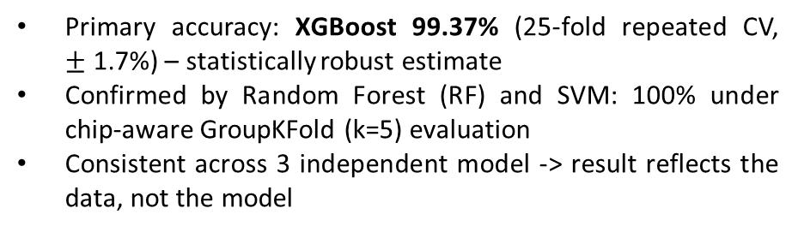
Results: Overall accuracy
Model | Mean Score | Std Dev
XGBoost | 0.9937 | 0.017
Random Forest | 1.0000 | 0.000
SVM | 1.0000 | 0.000
Primary accuracy: XGBoost 99.37% (25-fold repeated CV,
$±$ 1.7%) – statistically robust estimate
Confirmed by Random Forest (RF) and SVM: 100% under chip-aware GroupKFold (k=5) evaluation
Consistent across 3 independent model -> result reflects the data, not the model
XGBoost
Shuffled-label control: 32.3%
-> signal is genuine, not artefact
Random Forest
SVM
13/23

Slide 14
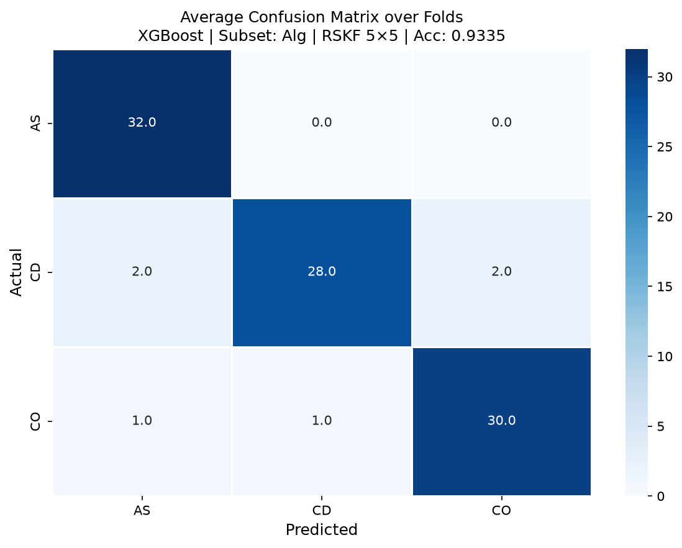


Results: Accuracy by reagent
Model | Reagent | Mean Score | Std Dev
XGBoost | all | 0.9937 | 0.017
 | Alg | 0.9335 | 0.056
 | Tan | 0.9376 | 0.054
 | Gal | 0.9520 | 0.054
Random Forest | all | 1.0000 | 0.000
 | Alg | 1.0000 | 0.000
 | Tan | 0.9917 | 0.019
 | Gal | 1.0000 | 0.000
SVM | all | 1.0000 | 0.000
 | Alg | 1.0000 | 0.000
 | Tan | 0.9917 | 0.019
 | Gal | 1.0000 | 0.000
XGBoost
High accuracy confirmed across all models
Largest XGBoost variance among reagents
-> signal slightly condition-sensitive
Random Forest
SVM
14/23

Slide 15
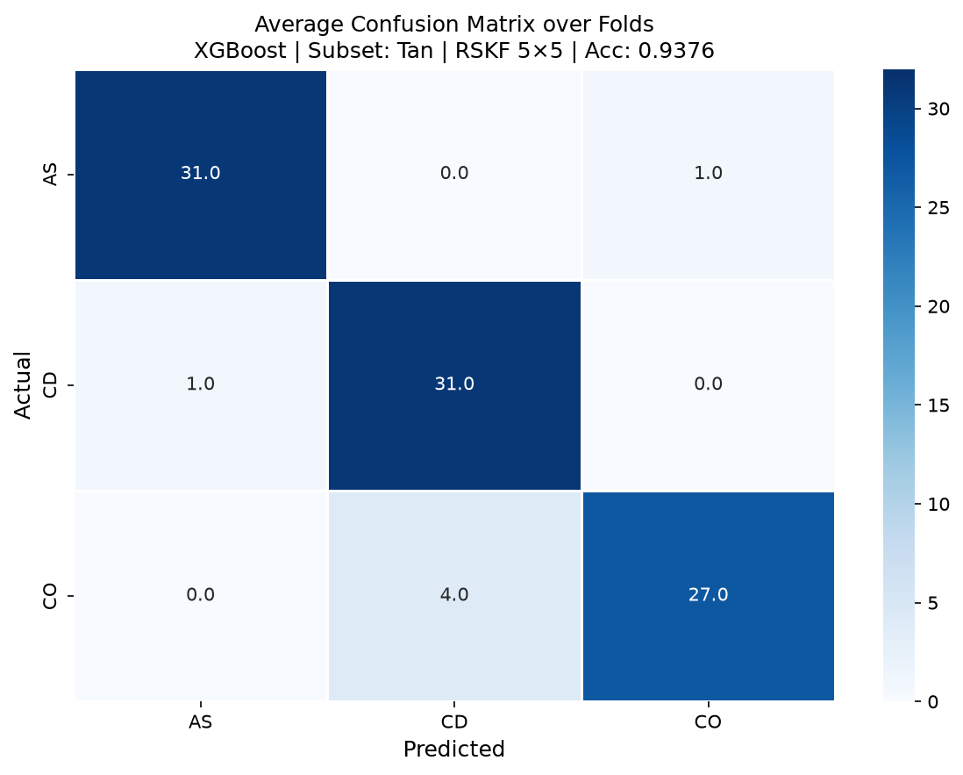
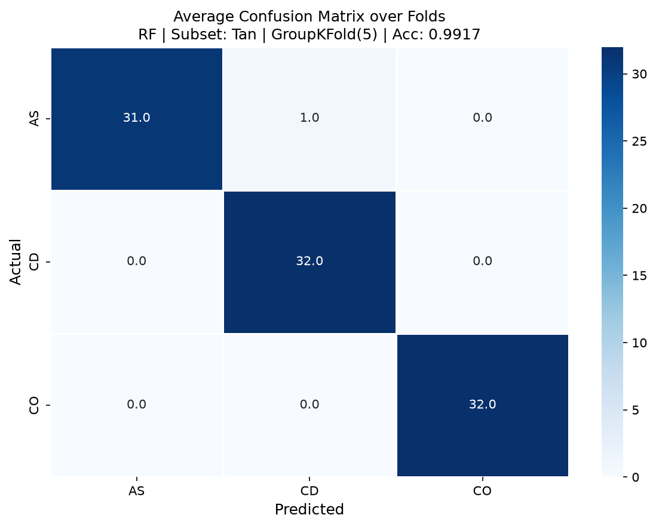
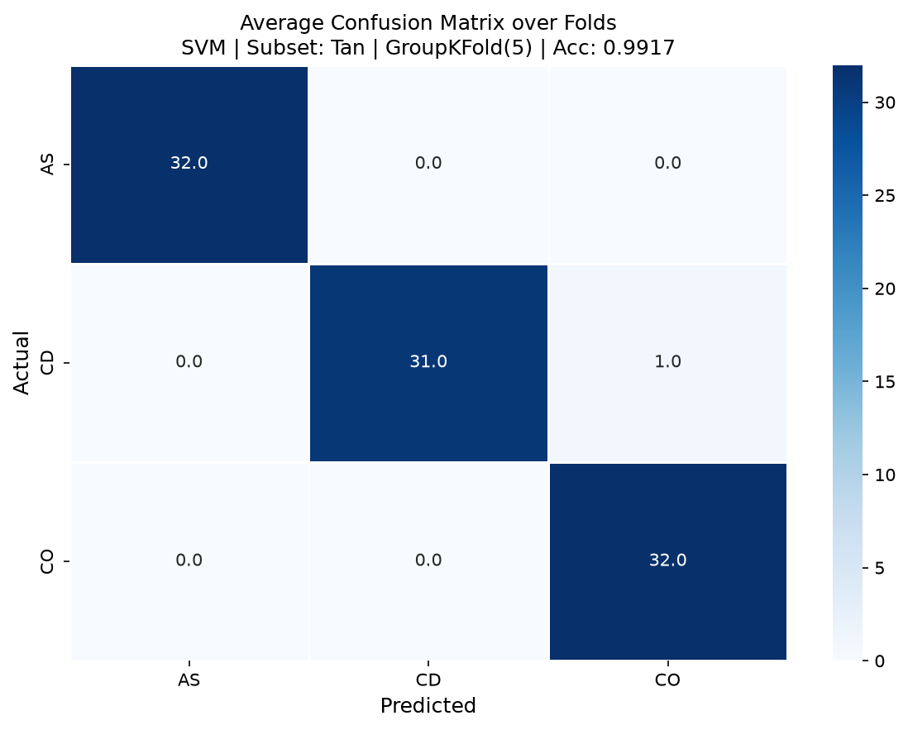
Results: Accuracy by reagent
Model | Reagent | Mean Score | Std Dev
XGBoost | all | 0.9937 | 0.017
 | Alg | 0.9335 | 0.056
 | Tan | 0.9376 | 0.054
 | Gal | 0.9520 | 0.054
Random Forest | all | 1.0000 | 0.000
 | Alg | 1.0000 | 0.000
 | Tan | 0.9917 | 0.019
 | Gal | 1.0000 | 0.000
SVM | all | 1.0000 | 0.000
 | Alg | 1.0000 | 0.000
 | Tan | 0.9917 | 0.019
 | Gal | 1.0000 | 0.000
XGBoost
Lowest accuracy of three reagents across all models
Tannin’s polyphenolic structure may produce overlapping electrochemical signal signatures between certain metal species under some buffer conditions, making the classification boundary less sharp compared to other two reagents
Random Forest
SVM
15/23

Slide 16
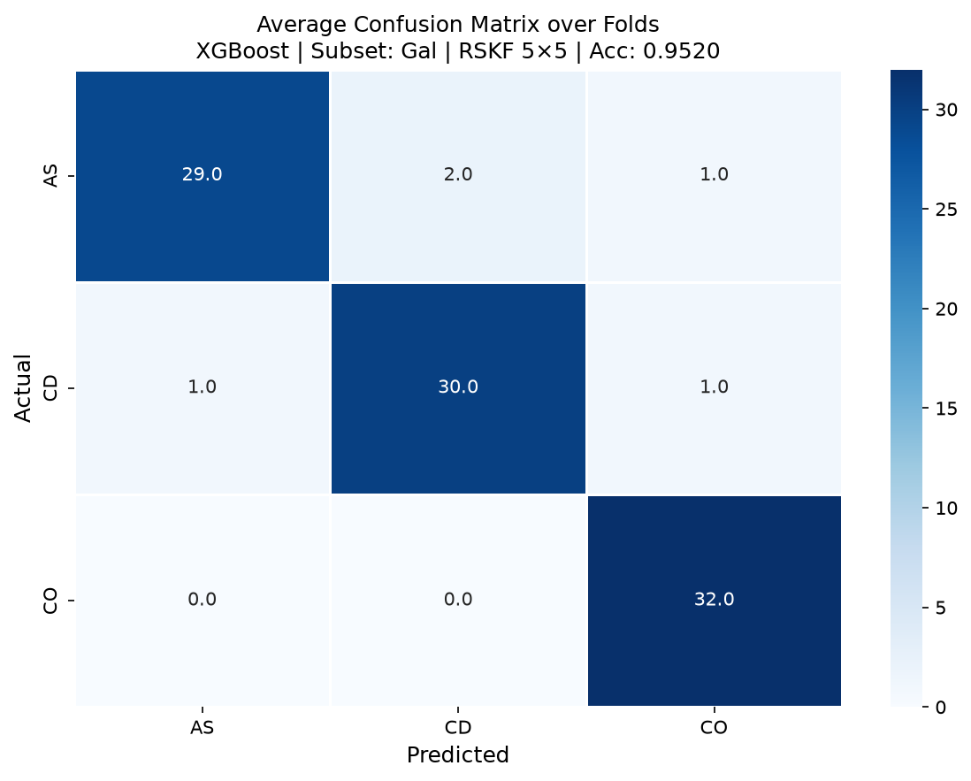


Results: Accuracy by reagent
Model | Reagent | Mean Score | Std Dev
XGBoost | all | 0.9937 | 0.017
 | Alg | 0.9335 | 0.056
 | Tan | 0.9376 | 0.054
 | Gal | 0.9520 | 0.054
Random Forest | all | 1.0000 | 0.000
 | Alg | 1.0000 | 0.000
 | Tan | 0.9917 | 0.019
 | Gal | 1.0000 | 0.000
SVM | all | 1.0000 | 0.000
 | Alg | 1.0000 | 0.000
 | Tan | 0.9917 | 0.019
 | Gal | 1.0000 | 0.000
XGBoost
Best-performing reagent across all models
Random Forest
SVM
16/23

Slide 17



Results: Accuracy by condition
Model | Condition | Mean Score | Std Dev
XGBoost | all | 0.9937 | 0.017
 | DI | 0.8958 | 0.080
 | PBS | 0.9088 | 0.067
 | NaCl | 0.9645 | 0.029
 | RSW | 0.9540 | 0.053
Random Forest | all | 1.0000 | 0.000
 | DI | 0.9917 | 0.019
 | PBS | 0.9583 | 0.042
 | NaCl | 1.0000 | 0.000
 | RSW | 1.0000 | 0.000
SVM | all | 1.0000 | 0.000
 | DI | 0.9917 | 0.019
 | PBS | 1.0000 | 0.000
 | NaCl | 1.0000 | 0.000
 | RSW | 1.0000 | 0.000
XGBoost
XGBoost shows lowest accuracy and highest variance of all conditions
RF and SVM each misclassified one sample
Random Forest
SVM
17/23

Slide 18
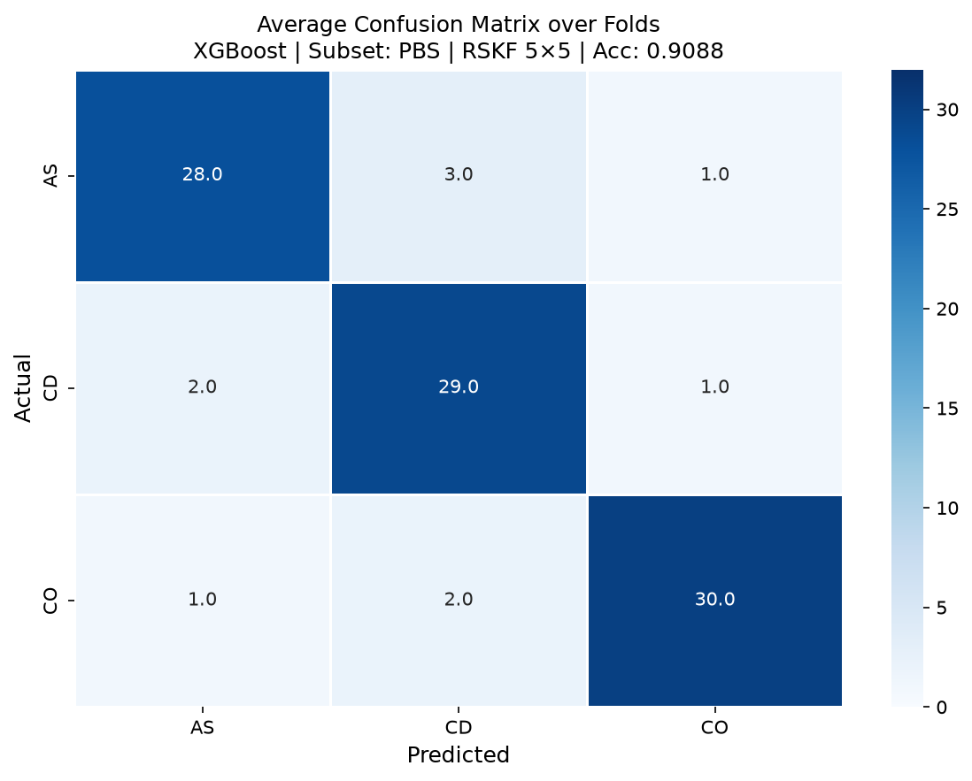
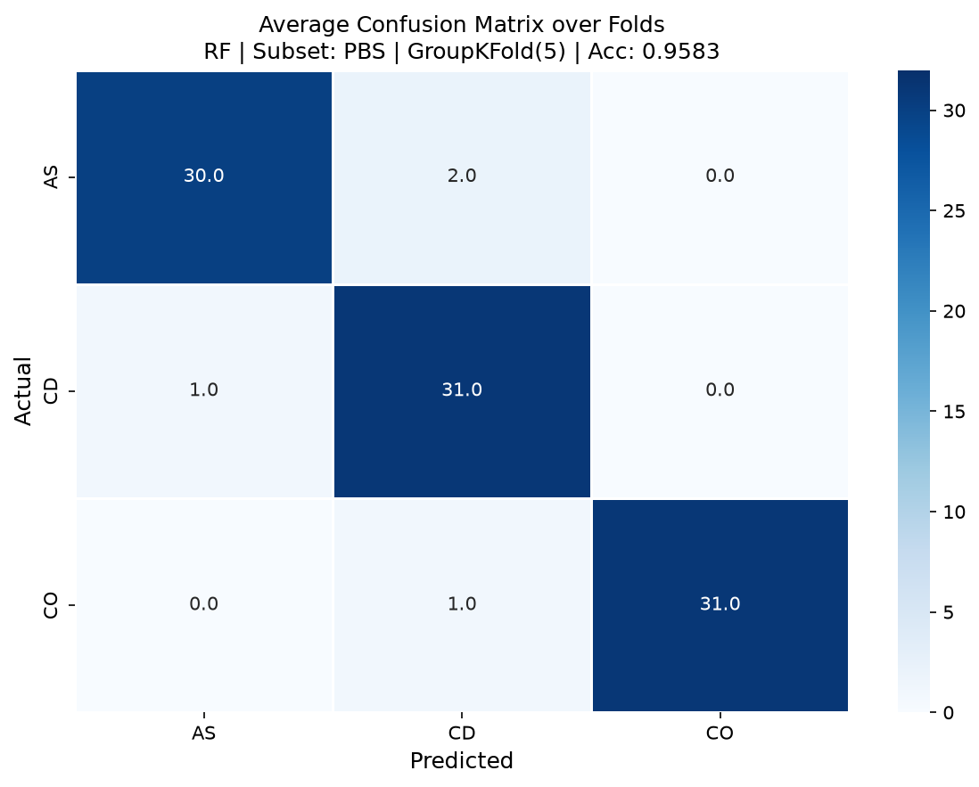

Results: Accuracy by condition
Model | Condition | Mean Score | Std Dev
XGBoost | all | 0.9937 | 0.017
 | DI | 0.8958 | 0.080
 | PBS | 0.9088 | 0.067
 | NaCl | 0.9645 | 0.029
 | RSW | 0.9540 | 0.053
Random Forest | all | 1.0000 | 0.000
 | DI | 0.9917 | 0.019
 | PBS | 0.9583 | 0.042
 | NaCl | 1.0000 | 0.000
 | RSW | 1.0000 | 0.000
SVM | all | 1.0000 | 0.000
 | DI | 0.9917 | 0.019
 | PBS | 1.0000 | 0.000
 | NaCl | 1.0000 | 0.000
 | RSW | 1.0000 | 0.000
XGBoost
Only condition where RF drops below 99%
Phosphate and saline components may interact with metal species or reagents, causing signal overlap
-> priority target for measurement optimization
Random Forest
SVM
18/23

Slide 19
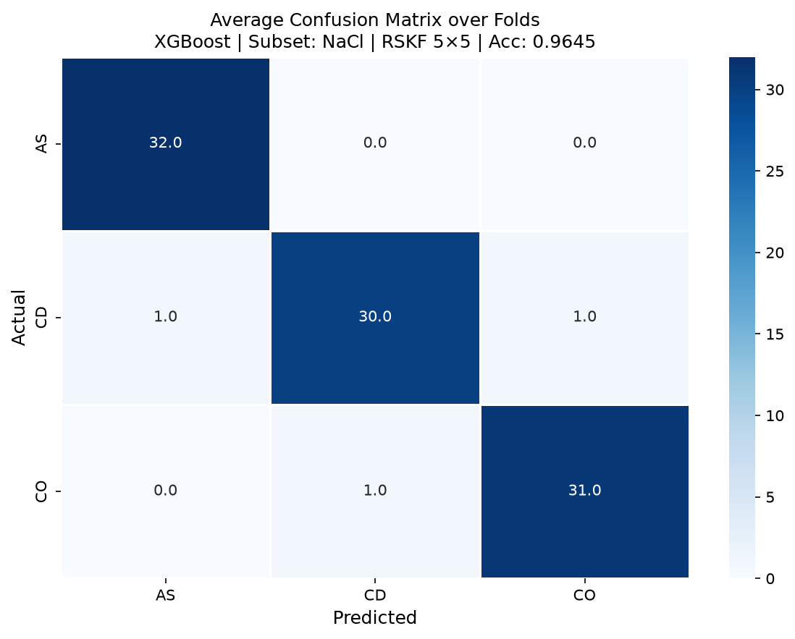


Results: Accuracy by condition
Model | Condition | Mean Score | Std Dev
XGBoost | all | 0.9937 | 0.017
 | DI | 0.8958 | 0.080
 | PBS | 0.9088 | 0.067
 | NaCl | 0.9645 | 0.029
 | RSW | 0.9540 | 0.053
Random Forest | all | 1.0000 | 0.000
 | DI | 0.9917 | 0.019
 | PBS | 0.9583 | 0.042
 | NaCl | 1.0000 | 0.000
 | RSW | 1.0000 | 0.000
SVM | all | 1.0000 | 0.000
 | DI | 0.9917 | 0.019
 | PBS | 1.0000 | 0.000
 | NaCl | 1.0000 | 0.000
 | RSW | 1.0000 | 0.000
XGBoost
Best-performing condition across all models
Random Forest
SVM
19/23

Slide 20



Results: Accuracy by condition
Model | Condition | Mean Score | Std Dev
XGBoost | all | 0.9937 | 0.017
 | DI | 0.8958 | 0.080
 | PBS | 0.9088 | 0.067
 | NaCl | 0.9645 | 0.029
 | RSW | 0.9540 | 0.053
Random Forest | all | 1.0000 | 0.000
 | DI | 0.9917 | 0.019
 | PBS | 0.9583 | 0.042
 | NaCl | 1.0000 | 0.000
 | RSW | 1.0000 | 0.000
SVM | all | 1.0000 | 0.000
 | DI | 0.9917 | 0.019
 | PBS | 1.0000 | 0.000
 | NaCl | 1.0000 | 0.000
 | RSW | 1.0000 | 0.000
XGBoost
Achieved strong classification performance
Demonstrates applicability to real environmental water sample conditions
Random Forest
SVM
20/23

Slide 21
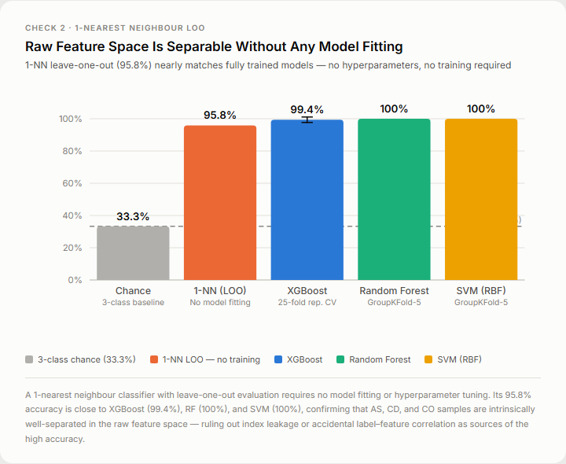
Overfitting analysis
1-nearest neighbour classifier
with leave-one-out evaluation
Shuffled labels (permutation control)
Shuffled-label control (32.3%) is near 3-class chance (33.3%)
-> confirms real signal
1-NN leave-one-out (95.8%) is close to XGBoost (99.4%), RF (100%) and SVM (100%)
-> confirms that raw feature space is separable without any model fitting
21/23
7/13

Slide 22
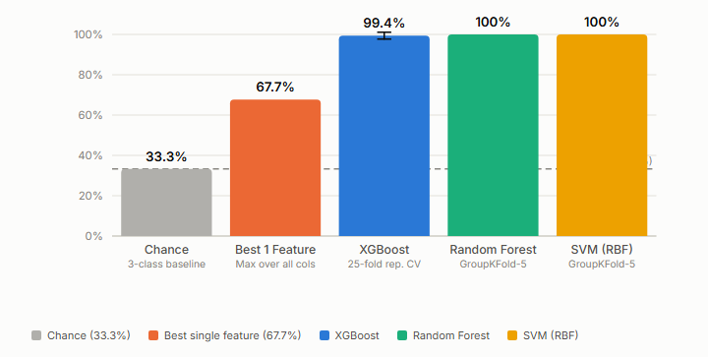
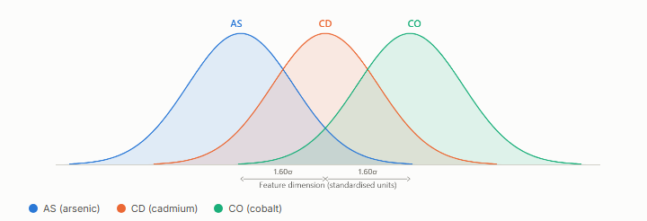
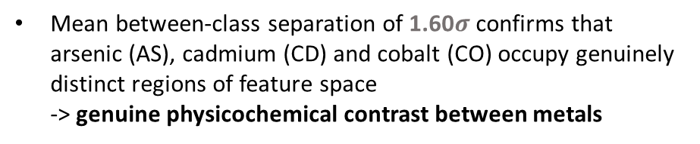
Overfitting analysis
Best single feature accuracy
Between-class feature separation
Mean between-class separation of 1.60$σ$ confirms that arsenic (AS), cadmium (CD) and cobalt (CO) occupy genuinely distinct regions of feature space
-> genuine physicochemical contrast between metals
Best single feature accuracy (67.7%) is far below XGBoost (99.4%), RF (100%) and SVM (100%)
-> none of the three independent models is reducible to one trivially separating column; each genuinely integrates information
22/23
7/13

Slide 23
Next step: thesis
Factor | Levels
Heavy metal | As, Cr(3+ and 6+), Cd, Co
Heavy metal concentration (ppb) | 0, 1, 10, 100 (As, Co) 0, 5, 50, 500 (Cr, Cd)
Reagent | Chitosan, Alginate, Tannin
Reagent concentration (ppb) | 0, 1, 100, 10000
Conditions | DI, 0.1 M PBS, Chaopraya river sample, Hyeongsan river sample
 | As | Cr3+ | Cr6+ | Cd | Co
Chitosan (4 conditions) | 960 combinations 8 measurement per combination 7,680 measurements in total
Alginate (4 conditions)
Tannin (4 conditions)
Current available salsa data from previous experiment
=> 224 combinations (23.33%)
Complete all salsa data collection within December
23/23
7/13

Slide 24
Thank you

