Slide 1
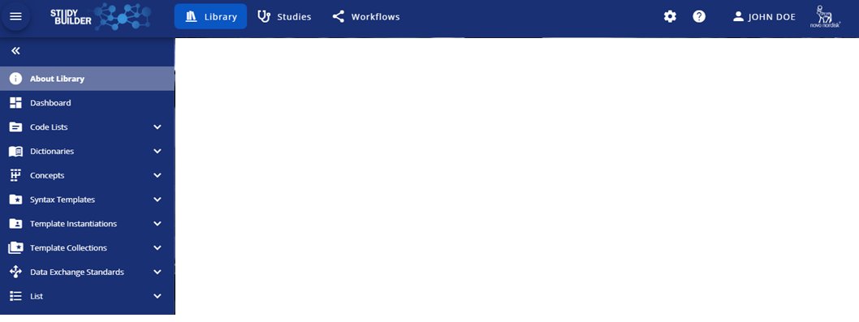
Show/Hide
Secondary Navigation
Display settings
Primary Navigation
Help
Log out
Secondary Navigation

