Slide 1
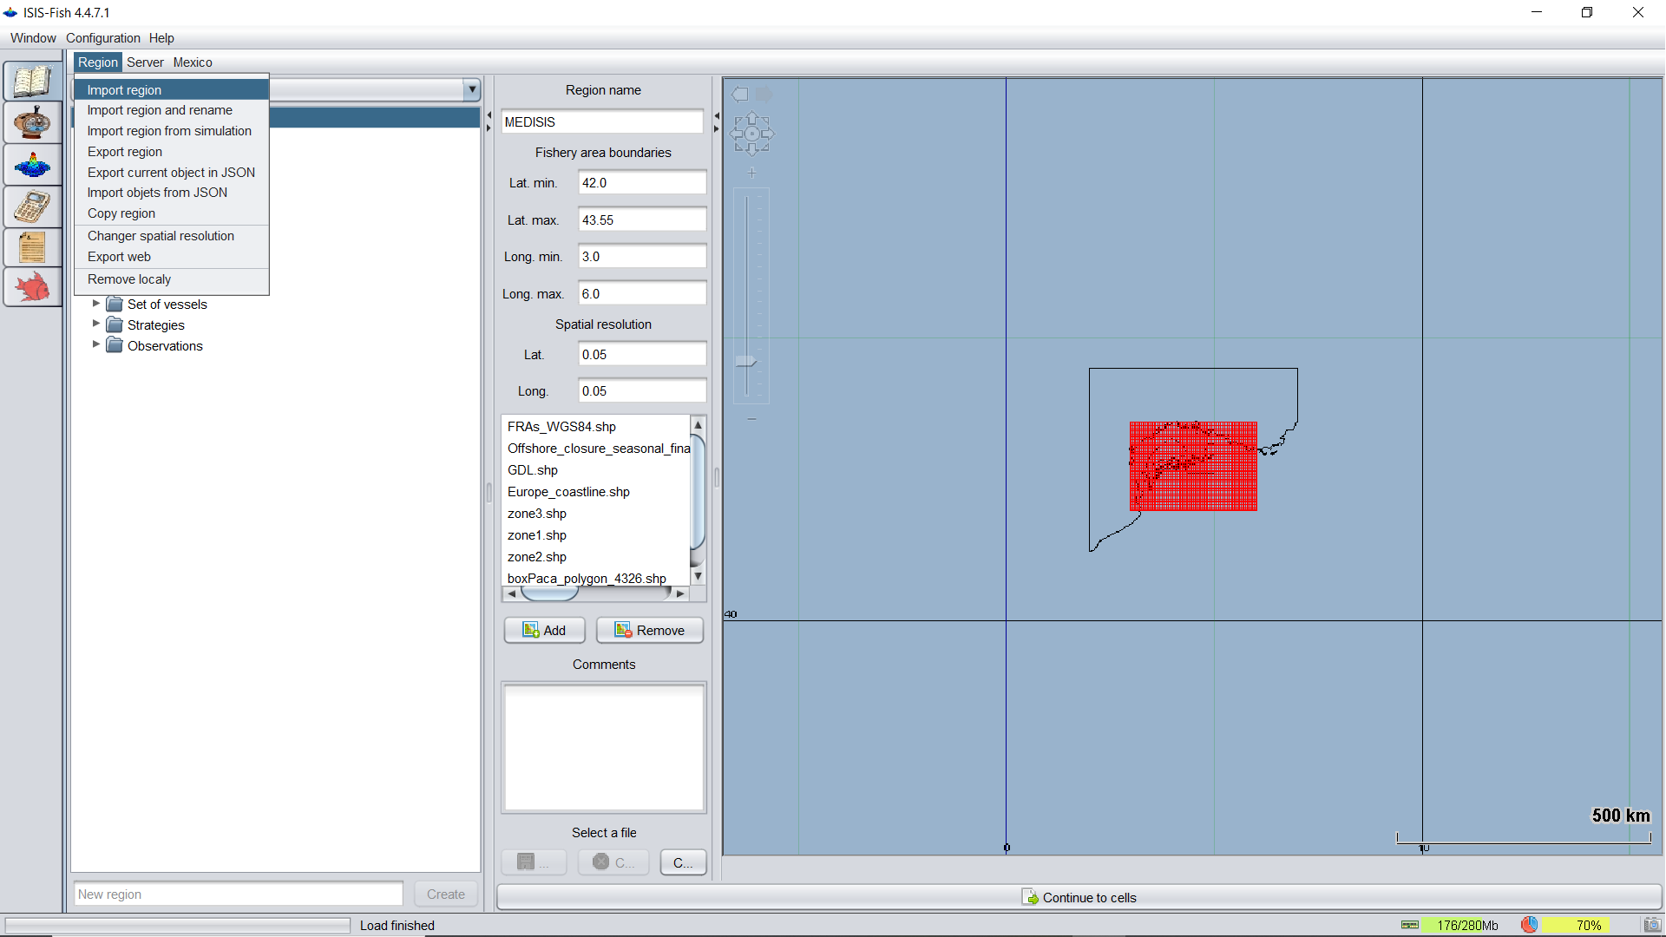
1) Select the Region tab, and then click on the import region tab.
2)Click on the « ISIS.Fish.Region.definitions.zip » file
3) You can explore the different settings and defintions through selecting the various folders and tabs on the left-hand side.

Slide 2
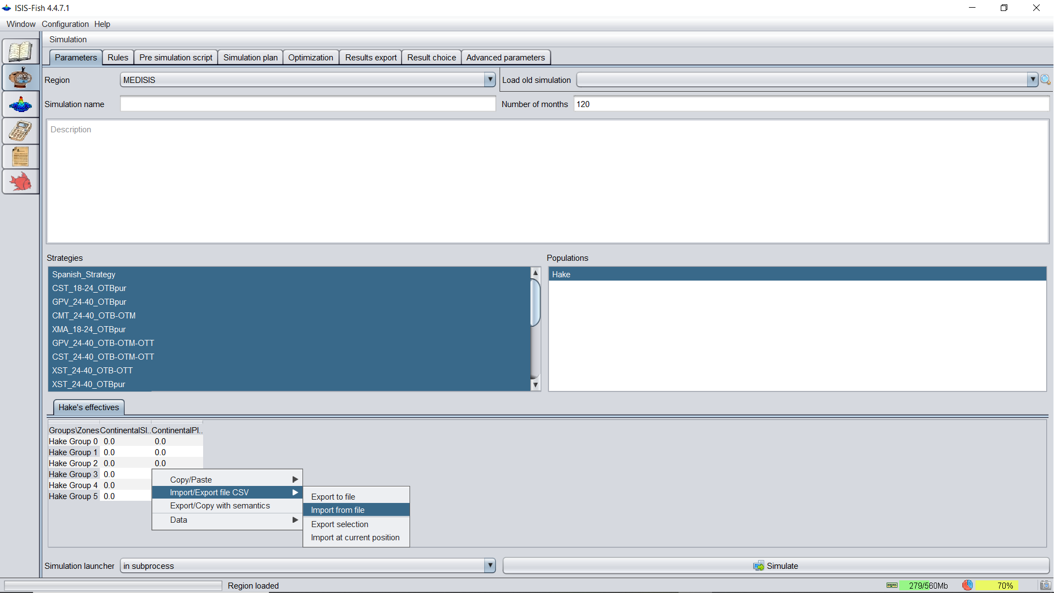
1) Select the Region MEDISIS
2) Set the number of of Months
to 120
3) Select all Strategies
4) Select Hake
5) Right click on the empty table, then import file CSV, import from file, and select « InitialStockLevels.csv » in the the folder « ISIS.Fish.Input.Tables »

Slide 3
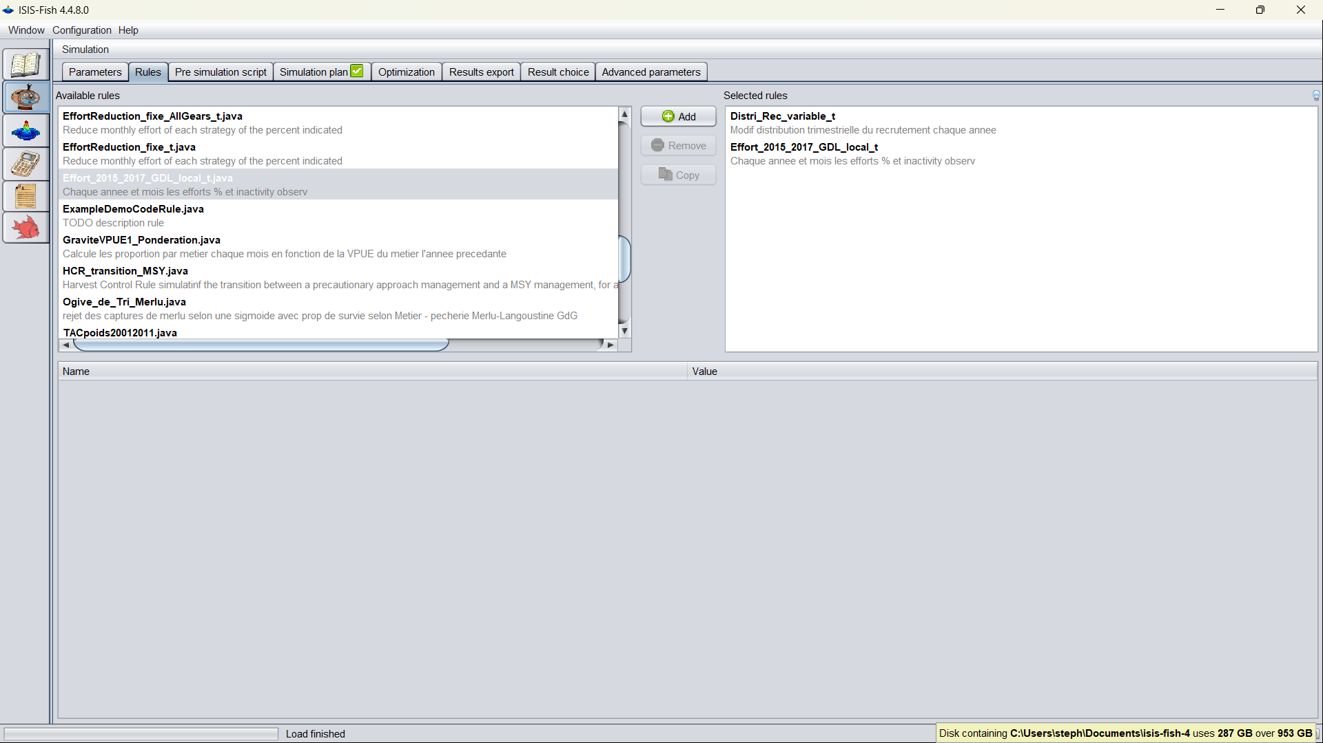
1) When installing the software for ISIS-Fish, you will find an « isis-fishisis-fish-4 » folder. Copy the rules provided in the ISIS.Fish.Rules into the « isis-fish-4\isis-community-database\rules » folder
2) Select ONLY Effort_2015_2017_GDL_local_t.java and Distri_Rec_variable_t.java under the Rules tab of the simulation pane.
3) You will be asked to verify the file locations and setttings. Accept the settings and correct the paths as needed.

Slide 4
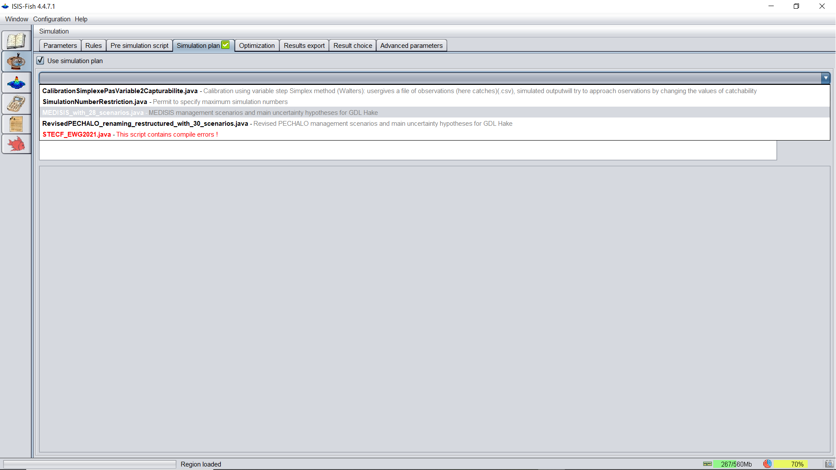
1) Similiar with the rules, copy the simulation plan into the « isis-fish-4\isis-community-database\simulationplans » folder.
2) Select the simulation plan « MEDIS_with28_scenarios.java » and click add.
3) Again you will be asked to verify settings and file locations, accept these settings and change the file location as needed.

Slide 5
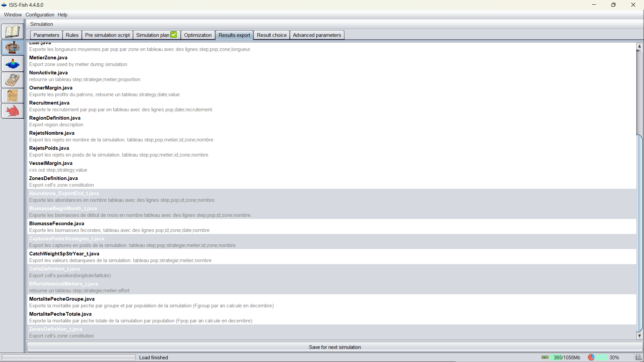
1) Copy the export files to found in the folder «ISIS.Fish.Exports » into the « isis-fish-4\isis-community-database\exports » folder
2) Select all of the export you have copied under the Results export tab of the simulation pane.
3) Feel free to check out the other result types. But these are not used in the analyses.

Slide 6
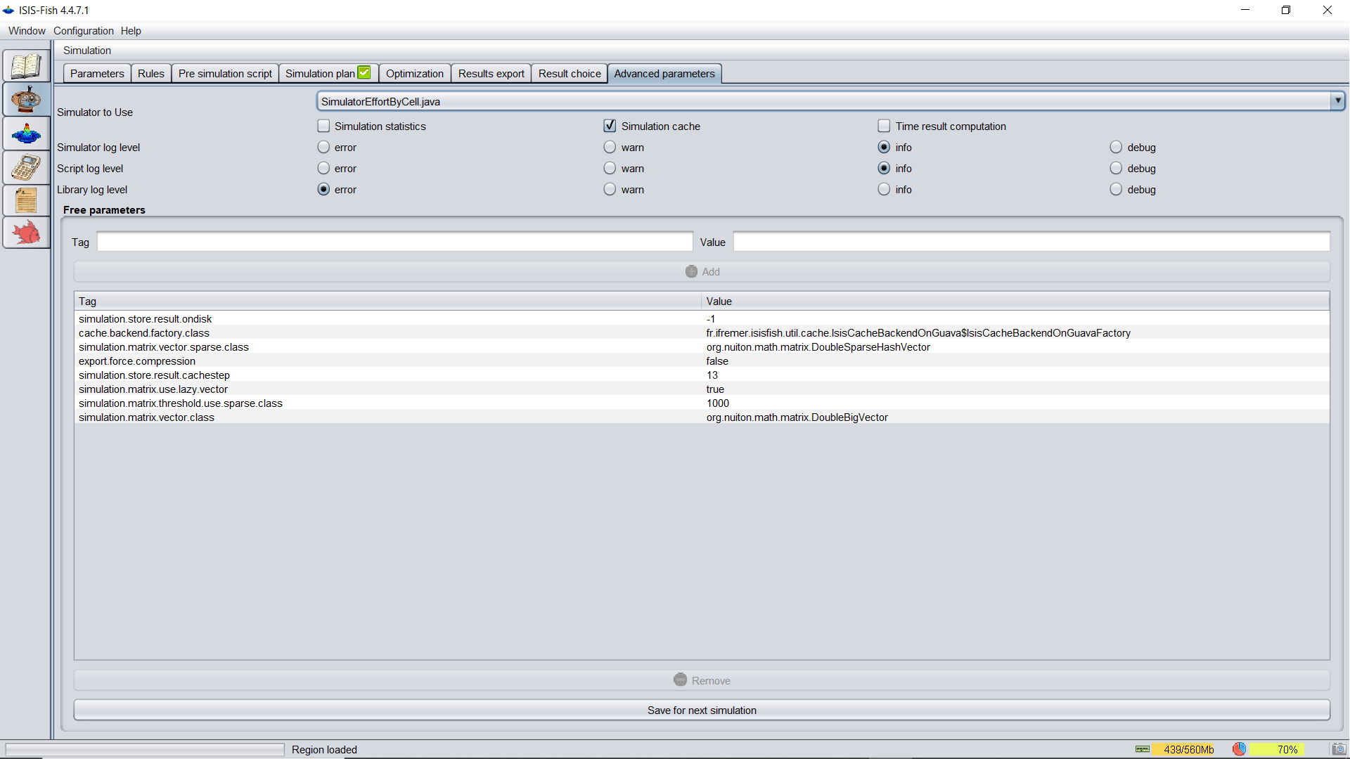
1) Lastly, under the advanced parameters settings, slect simulatorEffortCell.java.
2) Check error and simulation catch for debugging.

Slide 7
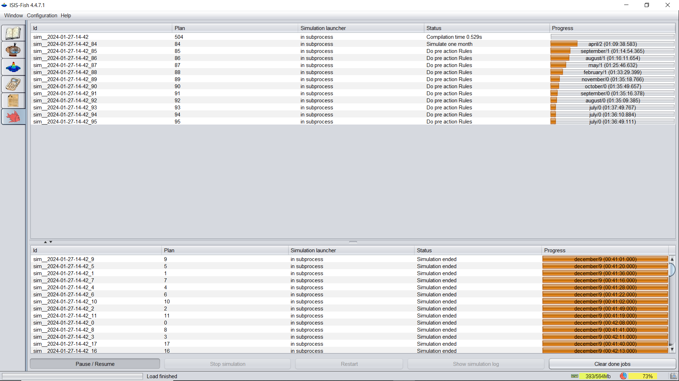
1) To view the status of the simulations or to stop, pause resume, click the fish icon on the left mean bar.

Slide 8
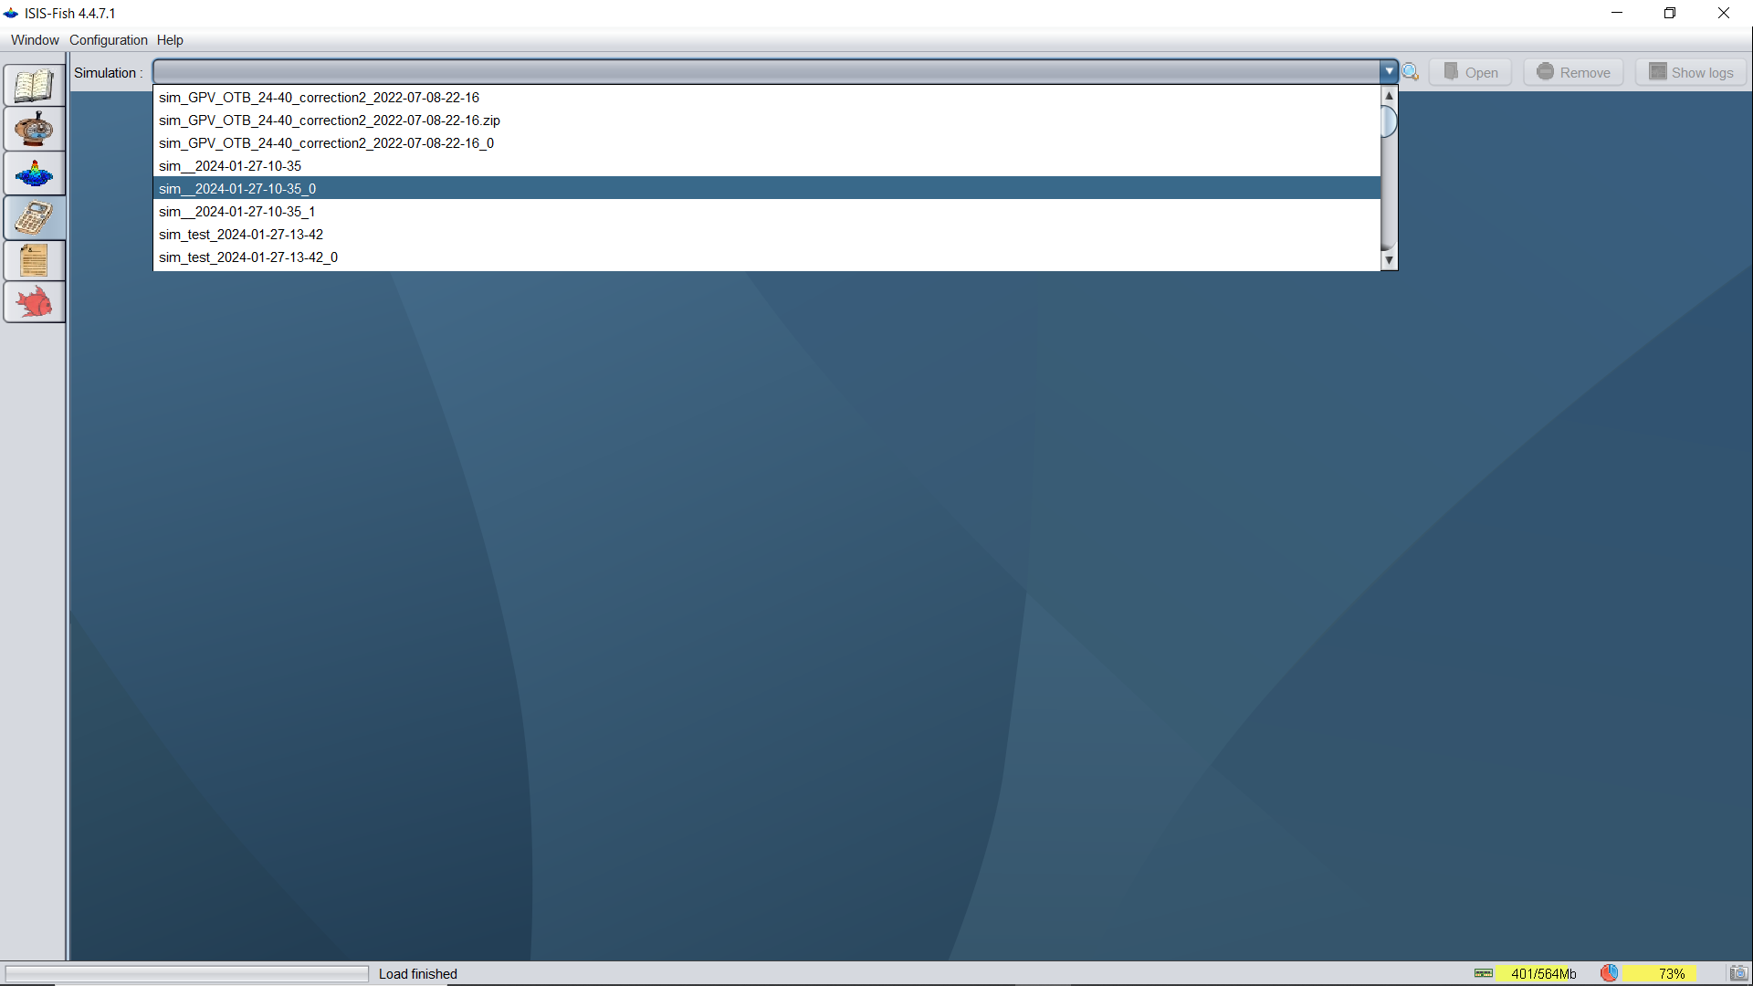
1) To open a given simulation, you can click the calculator icon in the left menu bar.
2) Select the simulation of interest...note the name will be in the format : “name you chose_year-month-day-hour-minute
3) Once, selected the open icon on the upper right will appear, click open.

Slide 9
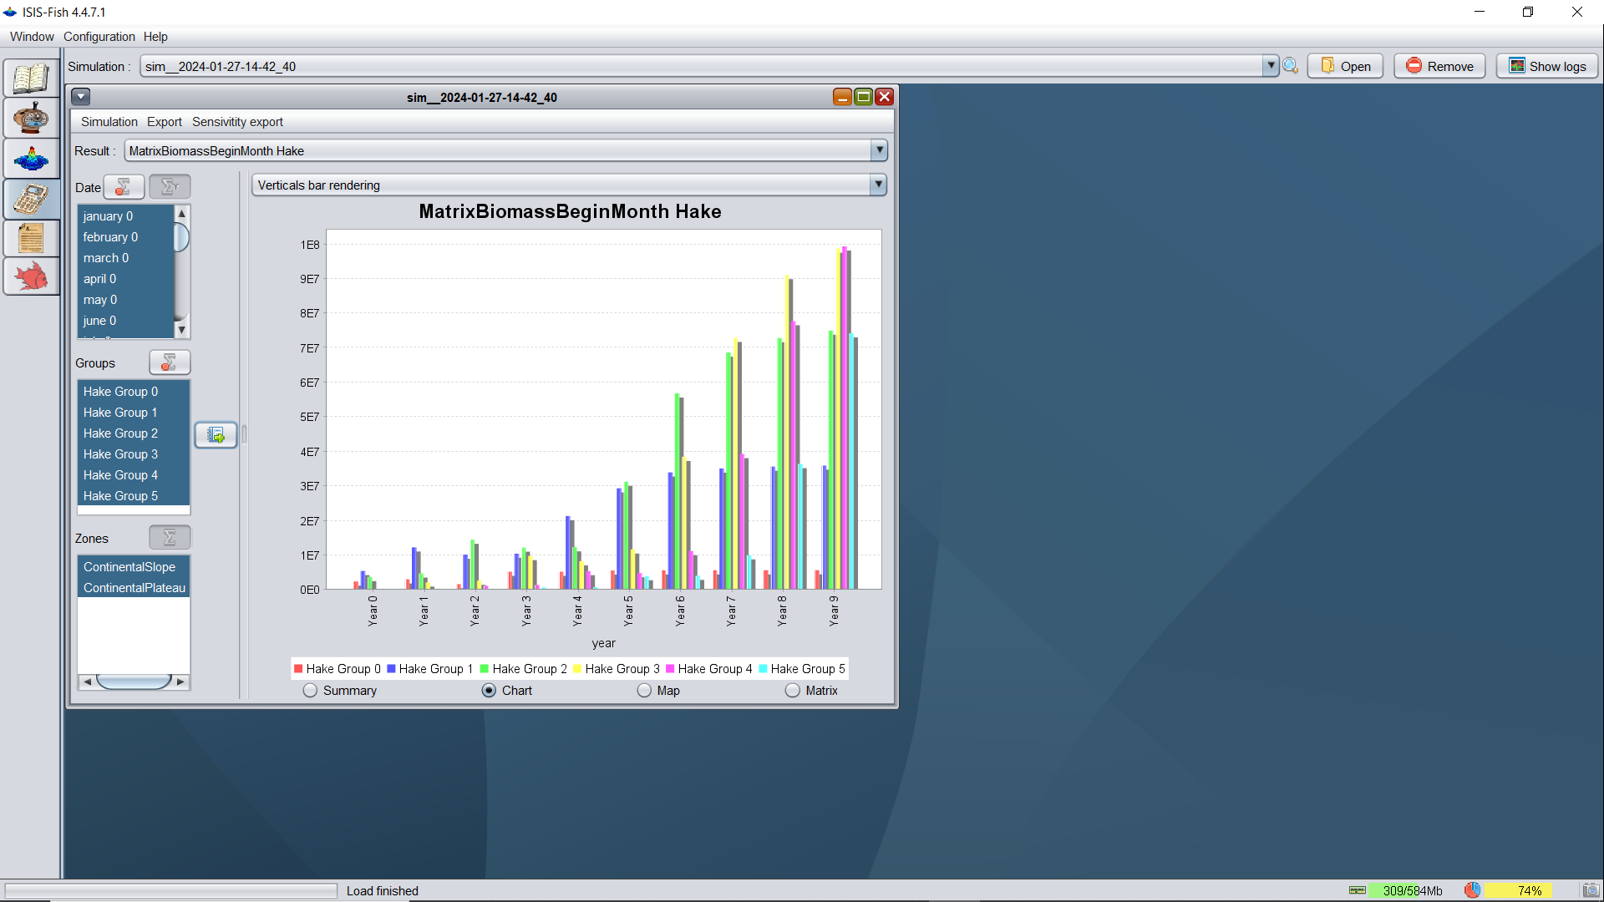
5) You will find a new window opened, which will allow you to visualize the simulation results in a multitude of ways.
6) Note that you will only be able to visual two aspects at-once with the graphing feature.
7) You need to sum over the remaining variables. In this case we have summed the Zones corresponding to our two population zones (the continental plateau and interface between the continental shelf and submarien canyon heads

Slide 10
After simulating the results, it is time to move to analysing the data in R.
instructions and the code are presented together as Rmarkdown files, which can be found in the “Part2.Analysing.the.simulation.output” folder.

