Slide 1
Volunteer / dating app
Ariana, Jason, Shibo, yicheng

Slide 2
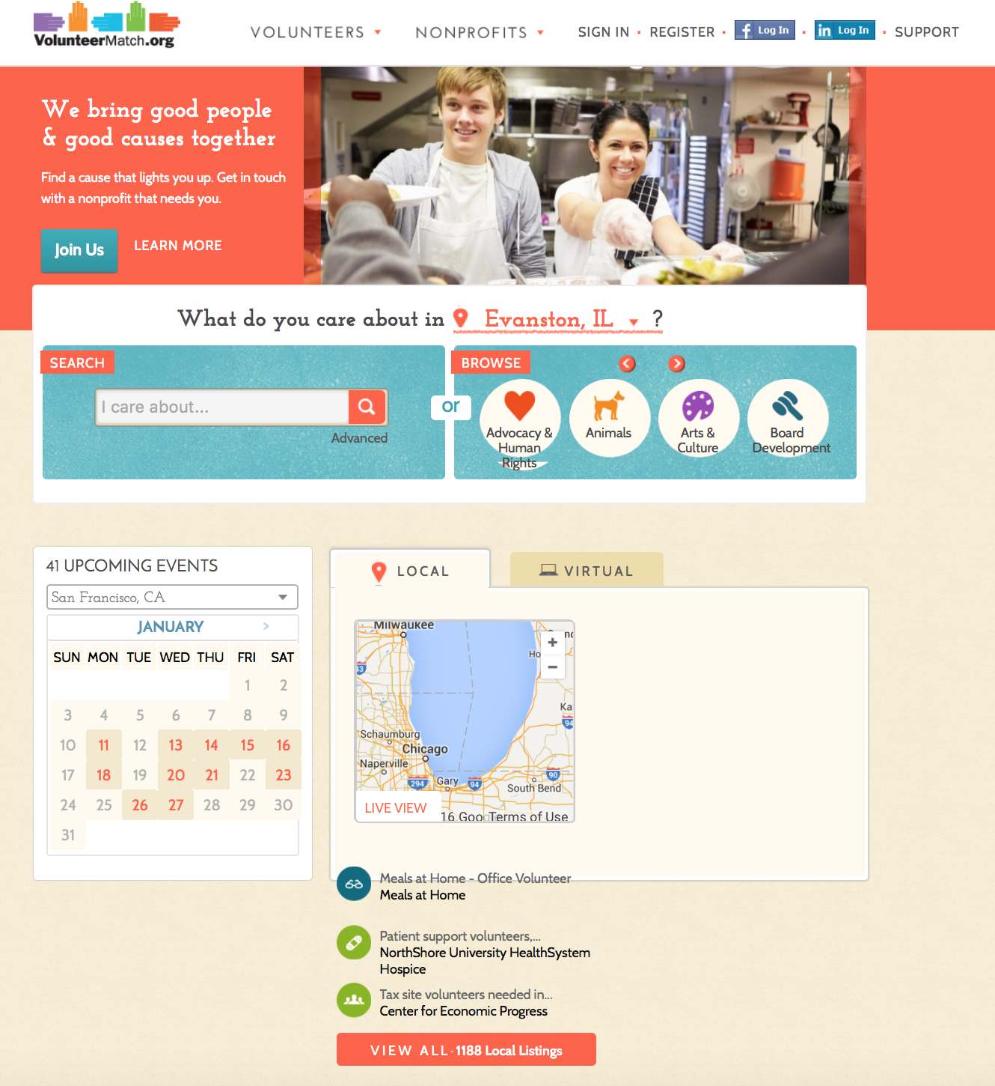
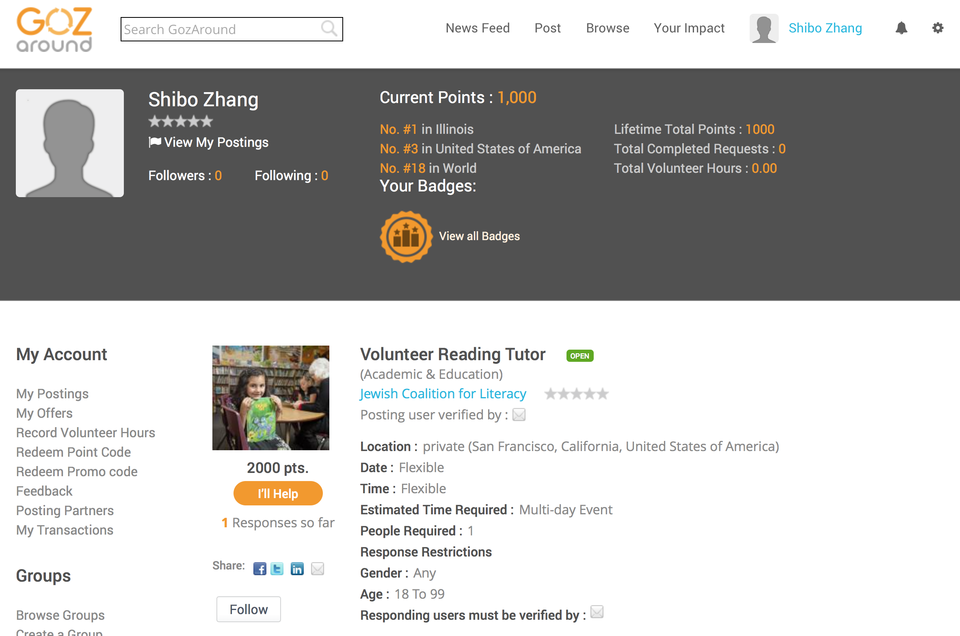
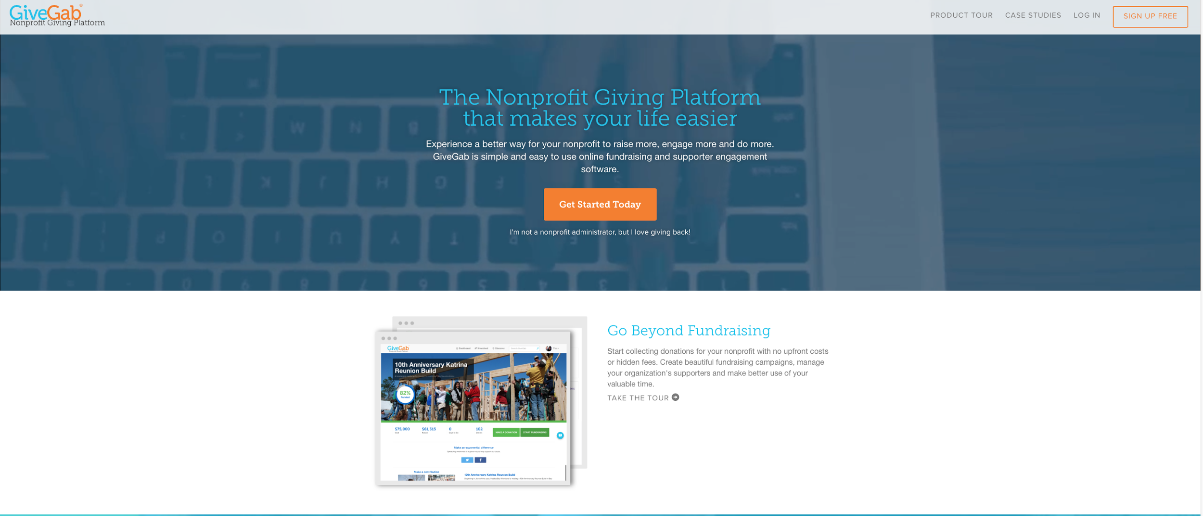
Problem statement & related work
Most people want to volunteer, but few do. Possible reasons:
Lack of volunteering activity of interest
Lack of time
Would rather date instead.
App addresses
all three
Competitors

Slide 3
interviews
Users Preferred
Icons (icons > text)
Maps (how close is the volunteer site)
Filters
Text-based account confirmation
Pre-filled forms
Users misunderstood
Search bar - not where to type location
“I want to volunteer” (not binding)

Slide 4
Representative tasks
Single female college student SIGNS UP for a volunteering event that suits her interest and short-term availability, where she can find another male participant to volunteer with
Full-time paid organizer POSTS volunteer opportunity to work at the local food bank for a short period on Friday night, 6pm-8pm.
Single male 25-yr old DEVELOPS PROFILE so that when he signs up for volunteer event, his profile is available for single females to view.

Slide 5
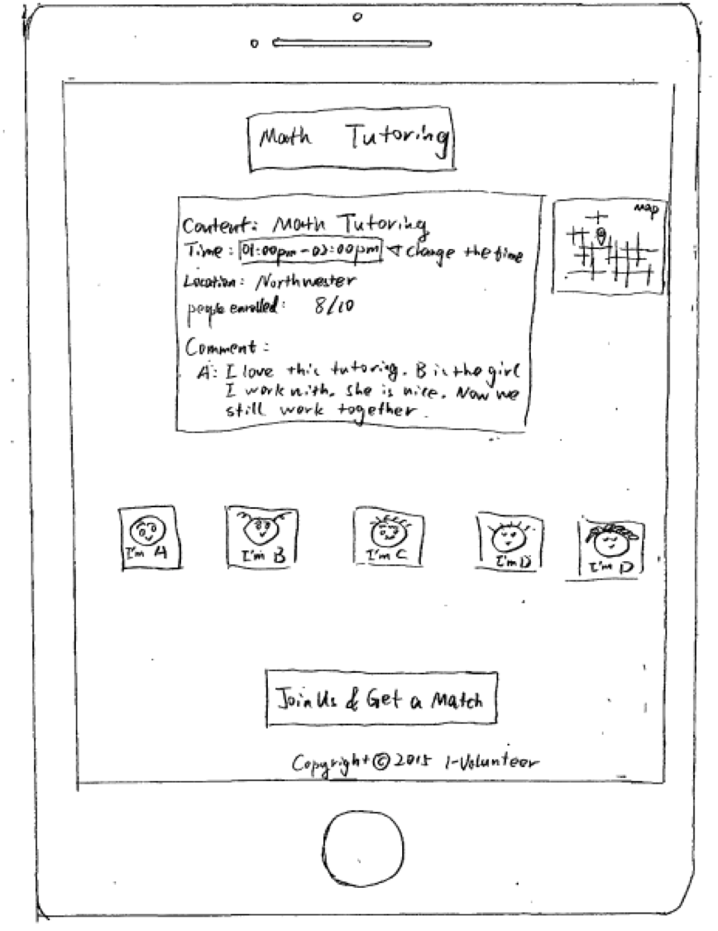
Paper prototype
3 interviews led to the following fixes made:
Make it easier to find Organizer mode
Add back buttons
Address incompletely filled-in forms
Future features:
swiping

Slide 6
Demo
Prototype led to a very similar HTML implementation
http://shvsmk.github.io/VolunteerMatch/

