Slide 1
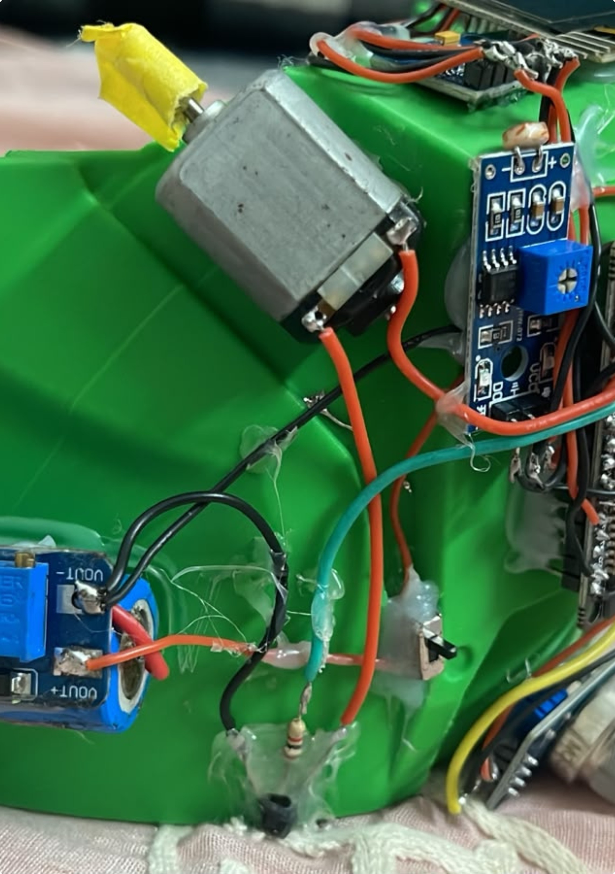
WORKING PROTOTYPE · SAFETY SYSTEM
Smart Helmet, Safer Ride
An integrated rider-safety prototype that verifies, monitors, and responds.
VERIFY — RC522 RFID authenticates the rider and moves the system from LOCKED to ARMED.
MONITOR — ESP32-CAM + VLM assess helmet use and visible drowsiness while sensors keep watch.
RESPOND — A probable crash starts a cancellation window before Telegram escalation.
Built as a working prototype: ESP32 DevKit + ESP32-CAM on a 3D-printed helmet body, with OLED status, buzzer feedback and live monitoring.

Slide 2





Helmet non-compliance
Drowsiness
THE RISK WINDOW
Motorcycle safety breaks down in moments
Alcohol
Impact
Several small failures can compound before help is even requested.
Delayed help
The project brings these checks into one wearable system instead of separate devices.

Slide 3
ONE WEARABLE SYSTEM
One helmet. Four safety layers.
Authenticate
Assess
the rider with RC522 RFID.
helmet use and visible drowsiness with ESP32-CAM + VLM.
Monitor
Escalate
alcohol, light, motion, vibration, GPS, and system state.
a probable crash through cancellation logic and Telegram.

Slide 4

SYSTEM ARCHITECTURE
The system architecture is built around two ESP32 nodes
One node fuses safety state and sensor input. The other sees the rider.
NODE 01
NODE 02
Network layer
ESP32 DevKit
ESP32-CAM
Wi-Fi connects camera analysis and remote Telegram alerts.
Sensor fusion, safety state, OLED, buzzer, RFID, GPS, dashboard.
Rider image capture and helmet/drowsiness analysis.

Slide 5
Safety starts before the ride
Authorized RFID tag changes the system from LOCKED to ARMED.
Camera check reports helmet and visible drowsiness status.
MQ-3, light, GPS, and motion inputs remain available to the controller.

Slide 6



LIVE MONITORING
During the ride, the helmet keeps watching
The system combines physical signals, local feedback, and a live view of safety state.
Motion + impact
Local feedback
Live dashboard
MPU6050 tracks acceleration and tilt; vibration input supports impact detection.
LDR reports ambient light; OLED and buzzer provide local feedback.
The live dashboard exposes motion, gas, GPS, safety state, and rider-check results.

Slide 7
ACCIDENT RESPONSE
A probable crash gets a chance to be cancelled
PENDING
Cancel window
ALERTED
Impact spike or sustained large tilt starts a PENDING countdown.
The rider can cancel through touch input, RFID, or the dashboard.
If the window expires, the system enters ALERTED and sends Telegram the latest GPS location, trigger reason, speed, and tilt.

Slide 8




HARDWARE CONSTELLATION
The hardware is compact, but the sensing is broad
Core nodes
Position + motion
ESP32 DevKit + ESP32-CAM + OV2640
RC522 RFID, MPU6050, vibration sensor, NEO-6M GPS
Rider + environment
Physical integration
MQ-3 alcohol sensor, LDR, touch sensor, OLED, buzzer
3D-printed helmet body for physical integration

Slide 9
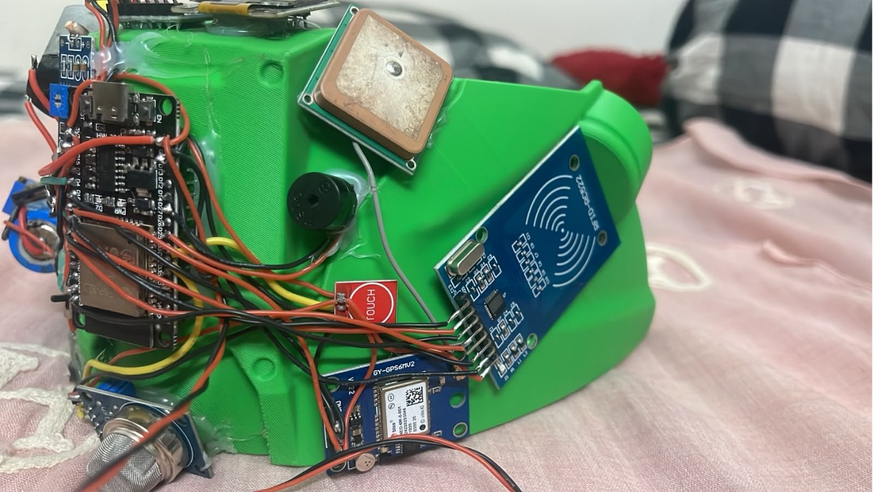
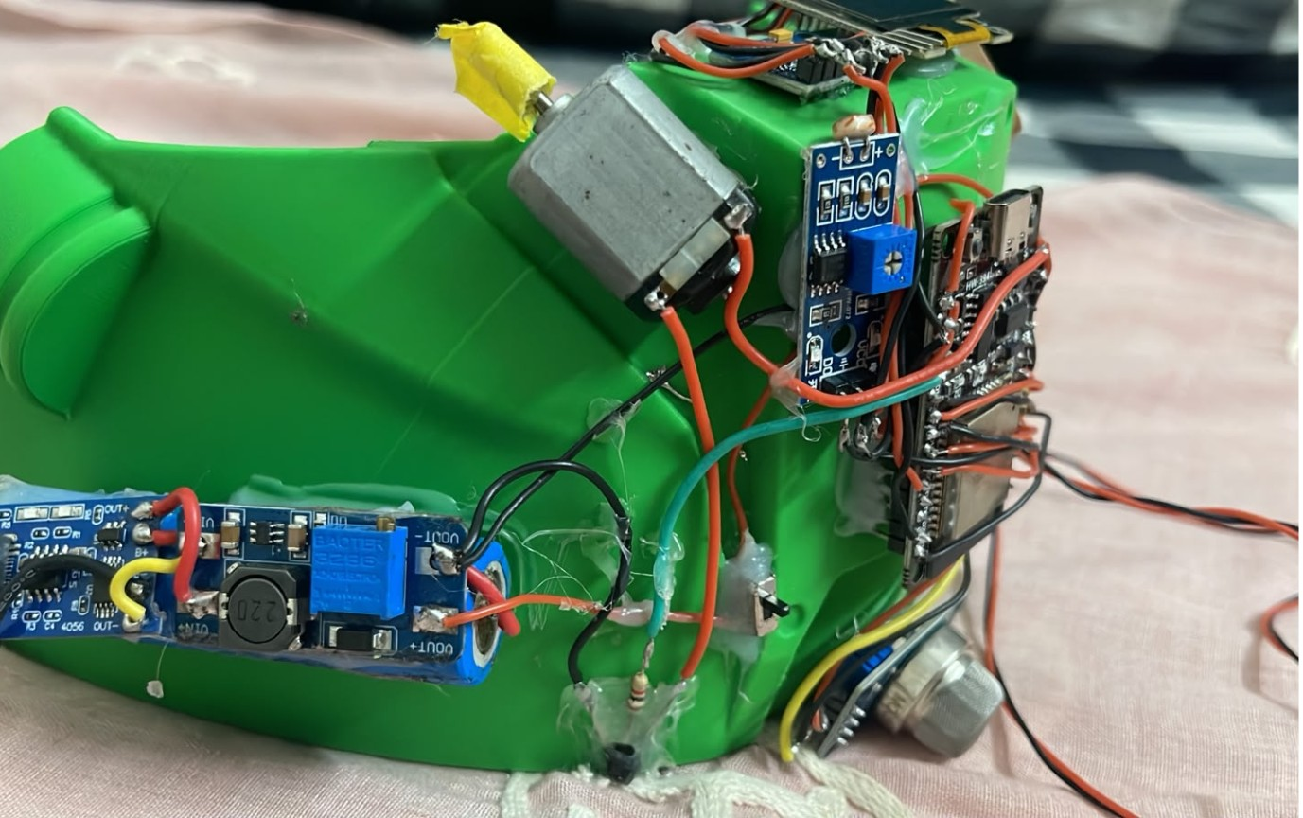

PHYSICAL PROTOTYPE
The prototype is physically assembled and testable
Integrated electronics around the helmet shell.
Rider-facing camera and sensing hardware.
The completed build mounts the electronics around a 3D-printed helmet body, with the camera positioned for rider-facing capture and the controller, RFID, OLED, buzzer, GPS, gas sensor, LDR, and wiring integrated around the shell.
ASSEMBLED BUILD

Slide 10

FROM PROTOTYPE TO VALIDATION
PROVES
NEXT
What this prototype proves — and what comes next
One connected safety path
Validate the edge cases
Validate thresholds across real riding conditions.
Add the final wiring/dashboard evidence.
Replace prototype-level sensing with calibrated safety hardware where required.
Integrated sensing
Rider arming
Camera analysis
Accident cancellation
GPS context
Remote notification

